Slide 1
Chapter 1: Introduction to Statistics
LEARNING OBJECTIVES
1. Big picture of Statistics
2. Data
3. Collecting data
4. Mechanistic and Empirical models

Slide 2
Why is Statistics?
Statistics allows you to understand a subject much more deeply.
Statistics helps us to make discoveries in science, make decisions based on data, and make predictions.
Statisticians and statistical methods are important part of pharmaceutical industry, social scientists, business practice,…

Slide 3
What is Statistics?
Statistics is the science of collecting, organizing, analyzing, and interpreting DATA in order to make decisions
Descriptive Statistics:
Involves organizing, summarizing, and displaying data.
e.g. Tables, charts, averages
Inferential Statistics:
Involves using sample data to draw conclusions about a population.

Slide 4
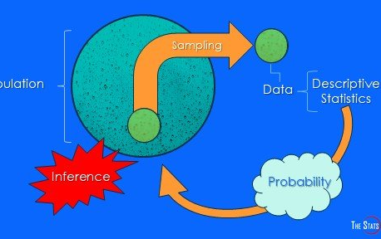
Big picture of Statistics

Slide 5
Statistical concepts
Population(quần thể): the complete collection of all individuals to be studied.
Sample(mẫu): Sub-collection of members selected from a population.
Data: consist of information coming from observations, counts, measurements, or responses.
Parameter(tham số): a numerical measurement describing some characteristic of a population.
Statistic(thống kê): a numerical measurement describing some characteristic of a sample.

Slide 6
Type of data
Qualitative data ( định tính)
Quantitative data ( định lượng)
Major
Place of birth
Age
Temperature
Discrete
Continuous

Slide 7
Collecting data
Retrospective study (nghiên cứu hồi cứu): using historical data.
Observational study(nghiên cứu quan sát): A researcher observes and measures characteristics of interest of part of a population.
Designed experiment: A treatment is applied to part of a population and responses are observed

Slide 8
Statistical model (explaining the relationship between variables)
Mechanistic model(mô hình cơ học): built from our underlying knowledge.
Example: Current = Voltage/Resistance, or I = U / R
Empirical model (mô hình thực nghiệm): uses our engineering and scientific knowledge of the phenomenon:
Response = deterministic function + random error
Example: I = U / R + ε
Remark: ε is a term added to the model to account for the fact that the observed values of current flow do not perfectly conform to the mechanistic model.

