Slide 1
Problems for sovling
Source: from Hackkerank, LeetCode,...

Slide 2
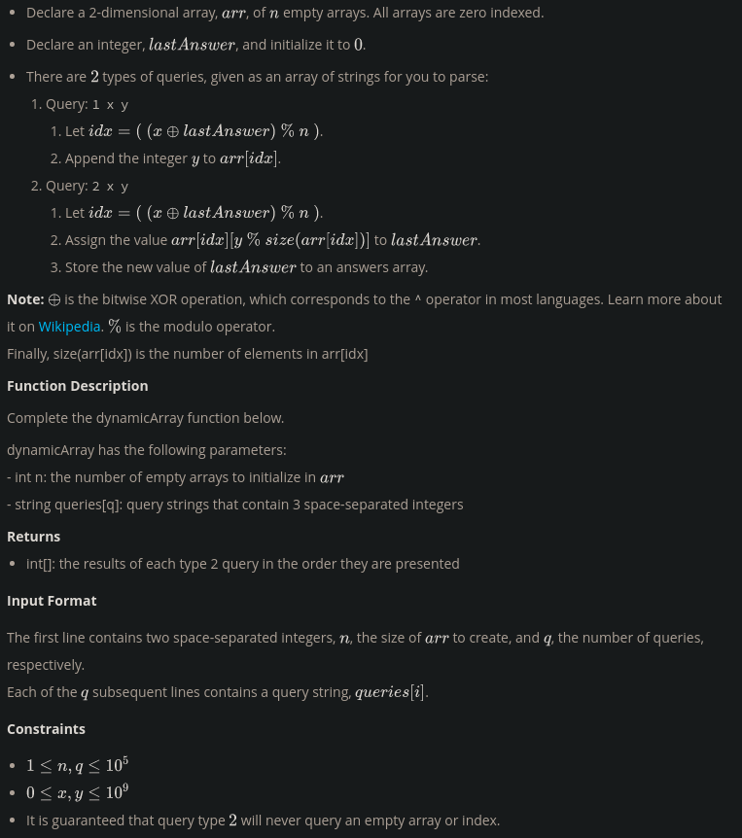
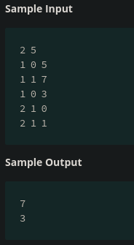
1. Dynamic Array <easy>
Too hard for understanding

Slide 3
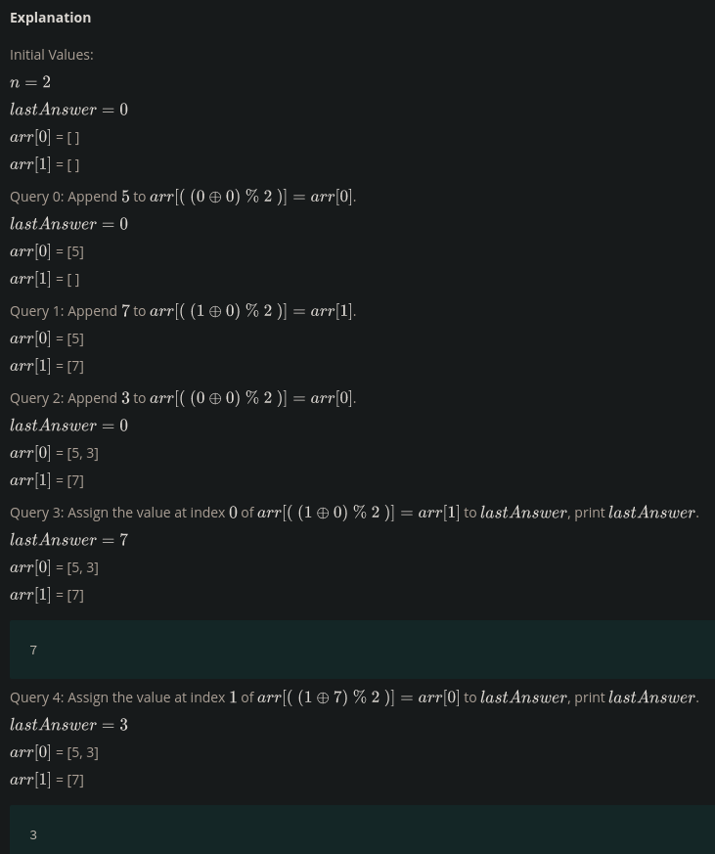
1. Dynamic Array <easy>

Slide 4
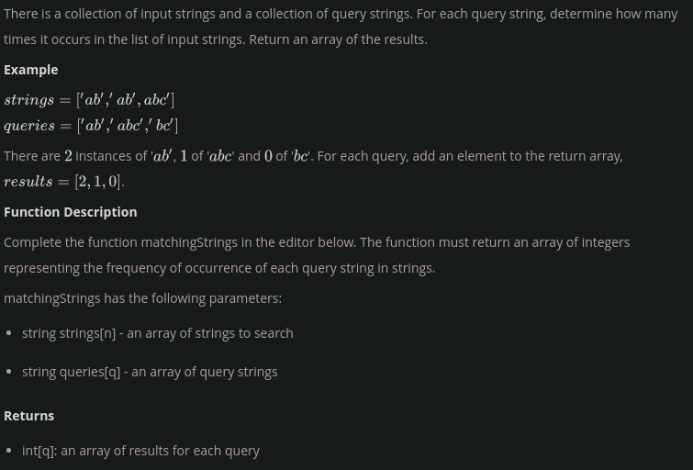
2. Sparse Arrays <Medium>

Slide 5
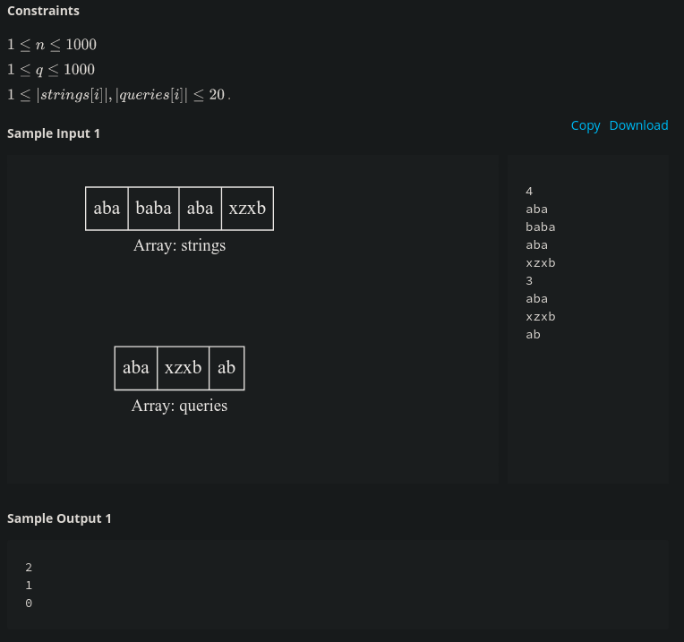
2. Sparse Arrays <Medium>

Slide 6
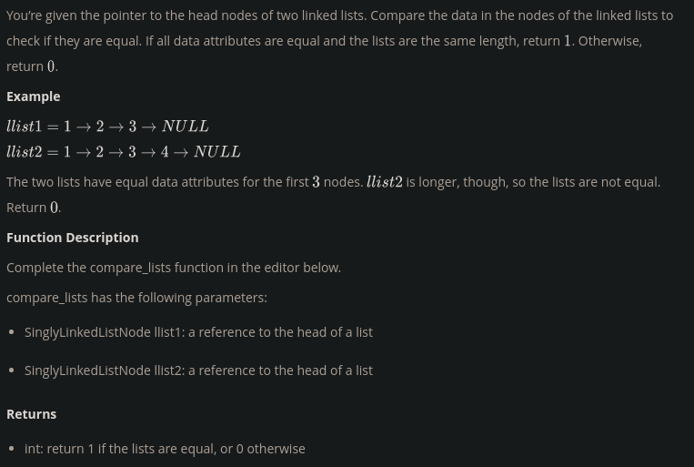
3. comparing LinkedList <Easy>

Slide 7
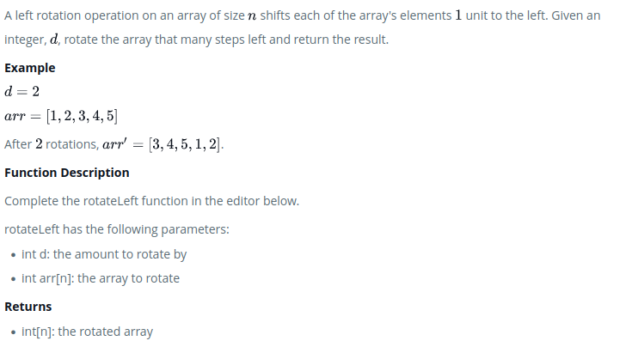
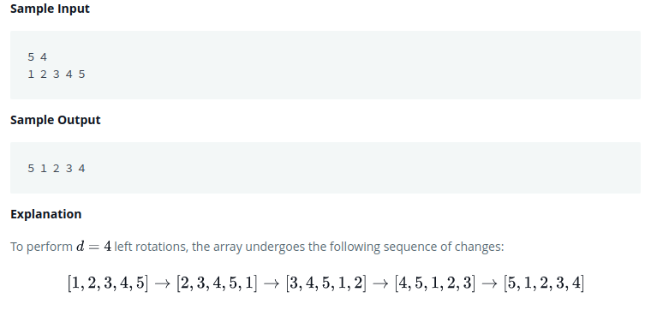
4. rotating Left <Easy>
Problems:
Example:

Slide 8
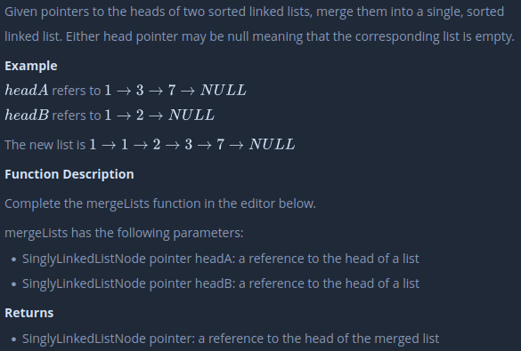
5. merge lists <Easy>
Problems:

