Slide 1
Worship
Trieu john

Slide 2
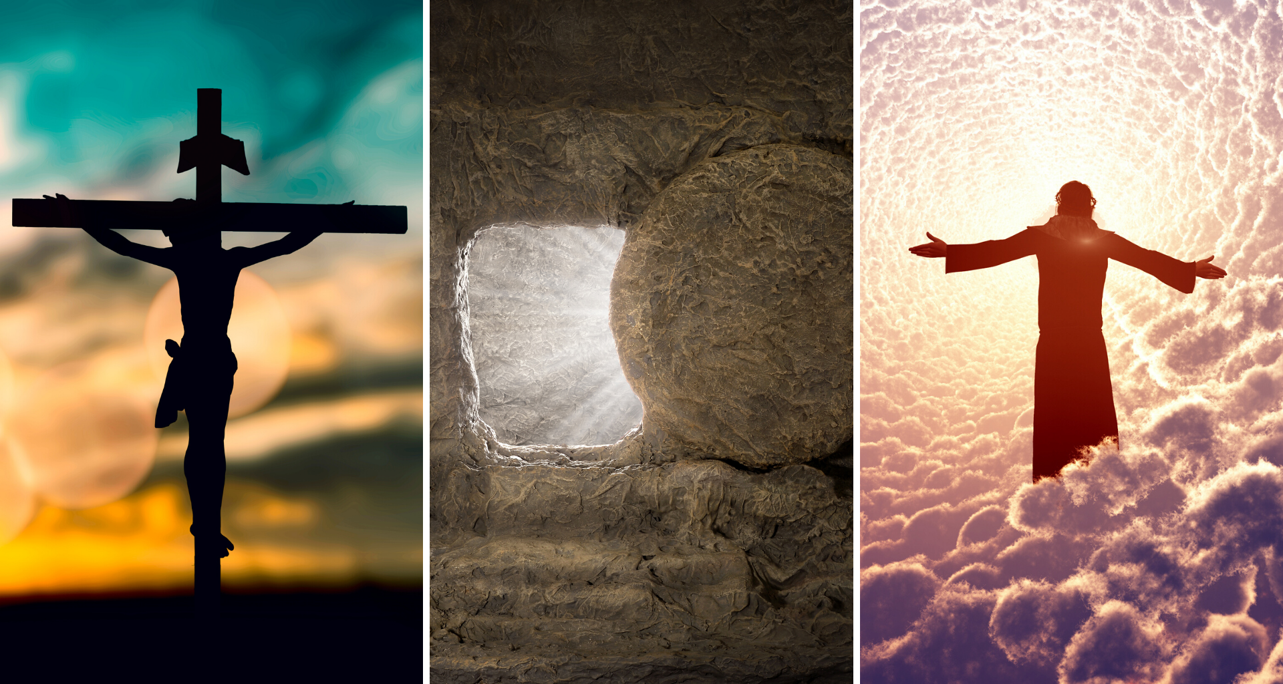
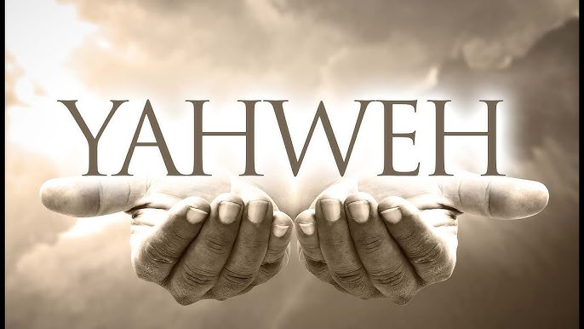
Structure
Worship
The fact of worship nowadays
Understanding about worship
Worship Leader
Who am I?
What should I do?
Practice Time

Slide 3
The fact of the Church nowadays
Worship
It certainly is true that hardly anything is missing from our churches these days— except the most important thing. We are missing the genuine and sacred offering of ourselves and our worship to the God and Father of our Lord Jesus Christ
Worship - A.W Tozer

