Slide 1
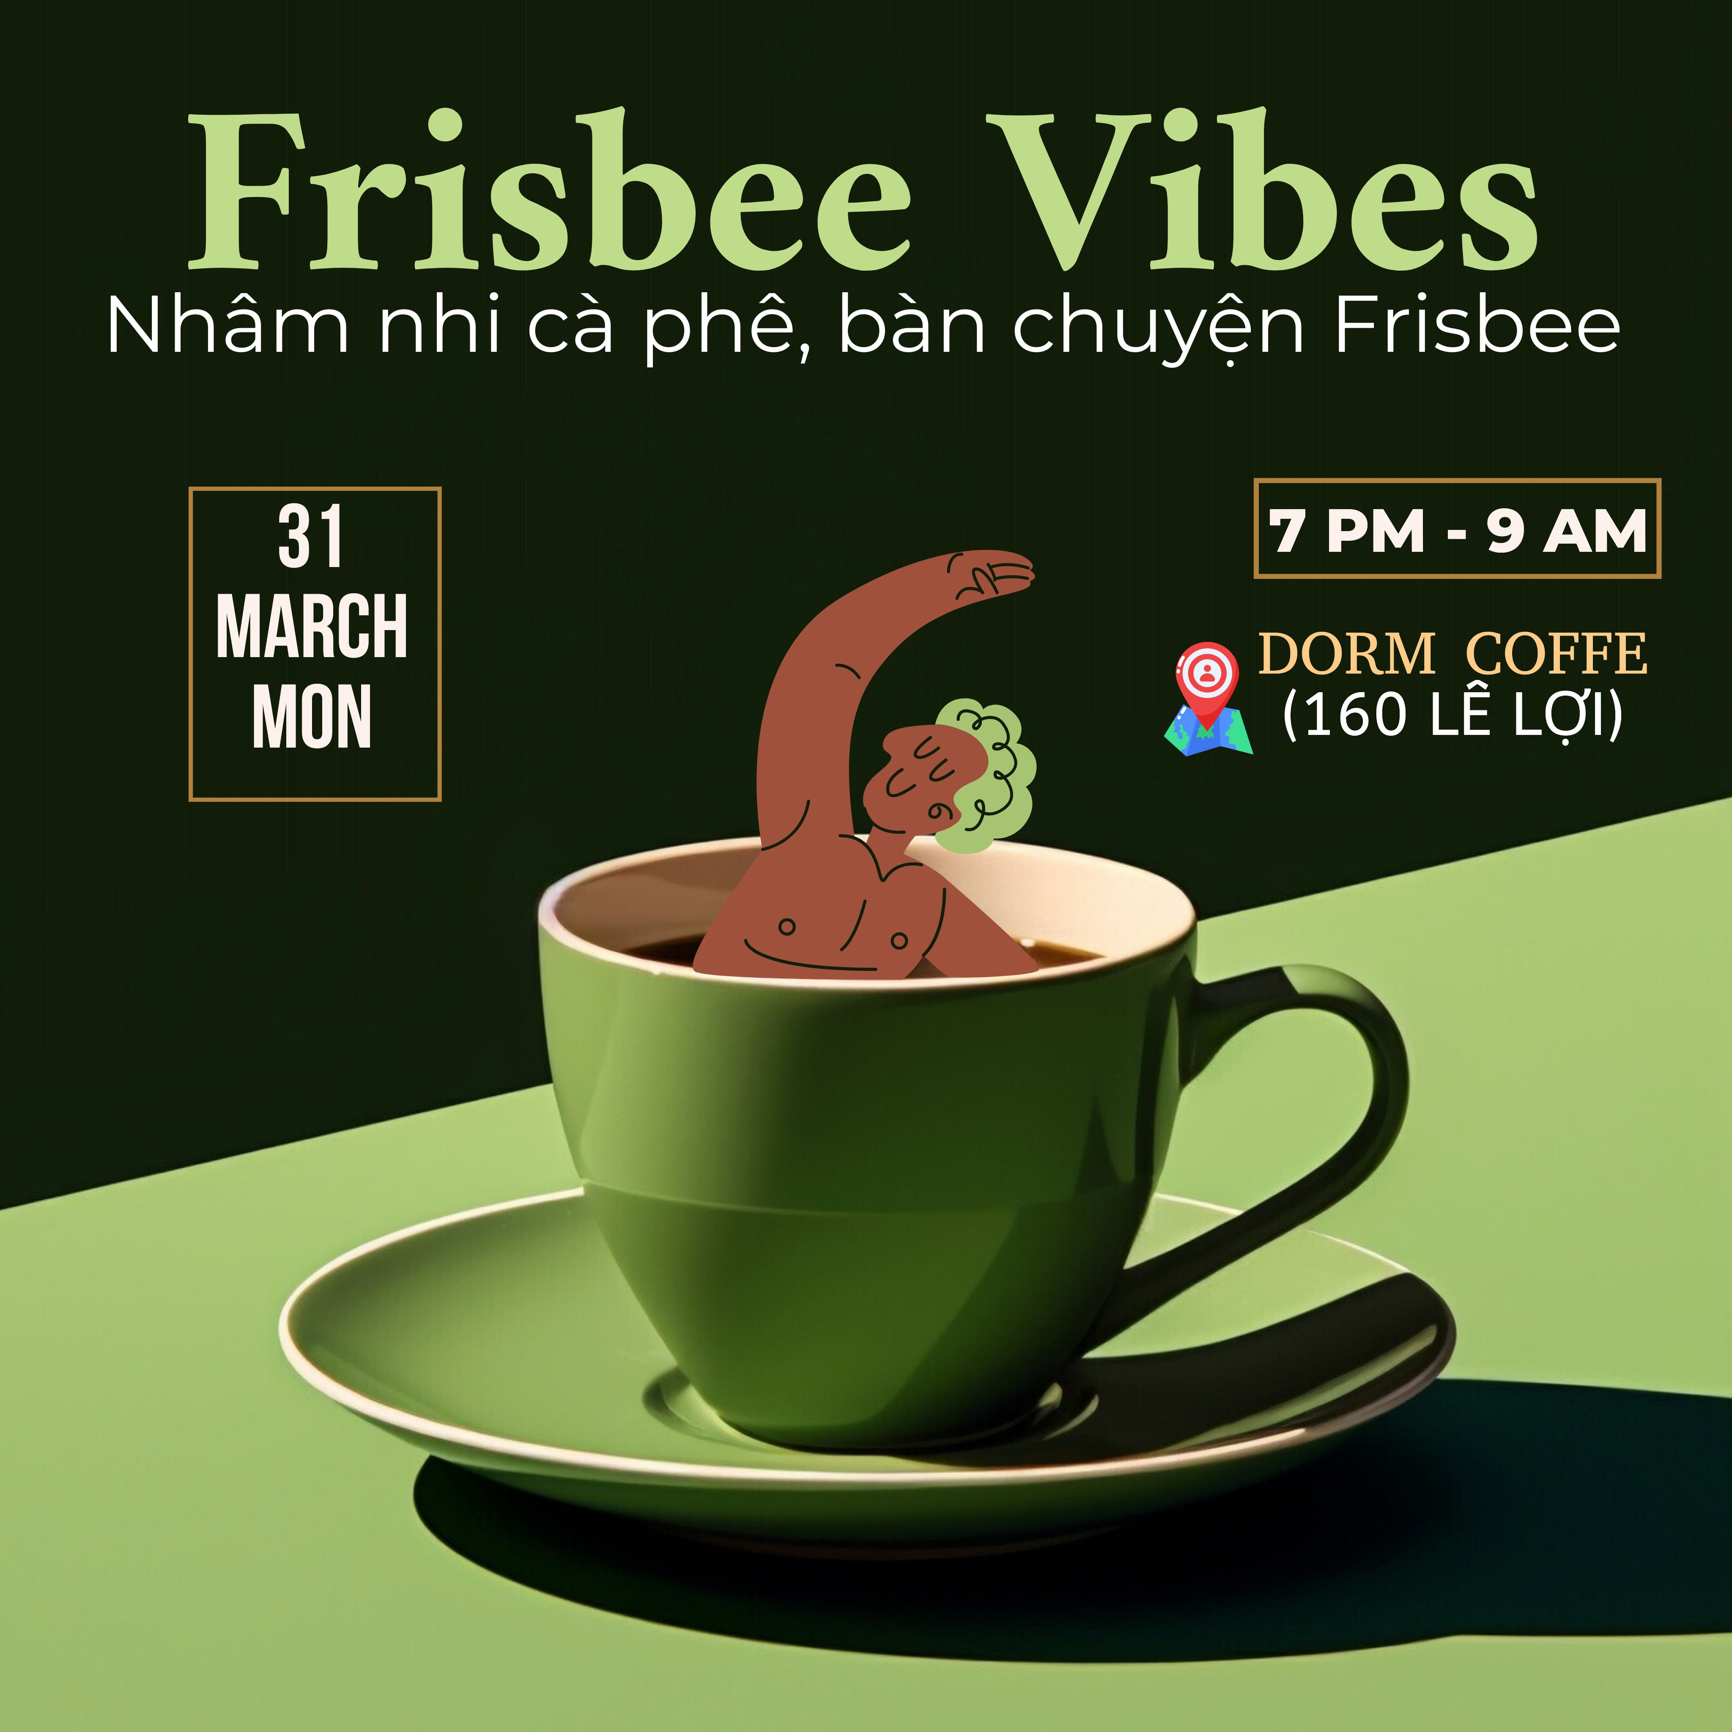

Slide 3


Slide 4
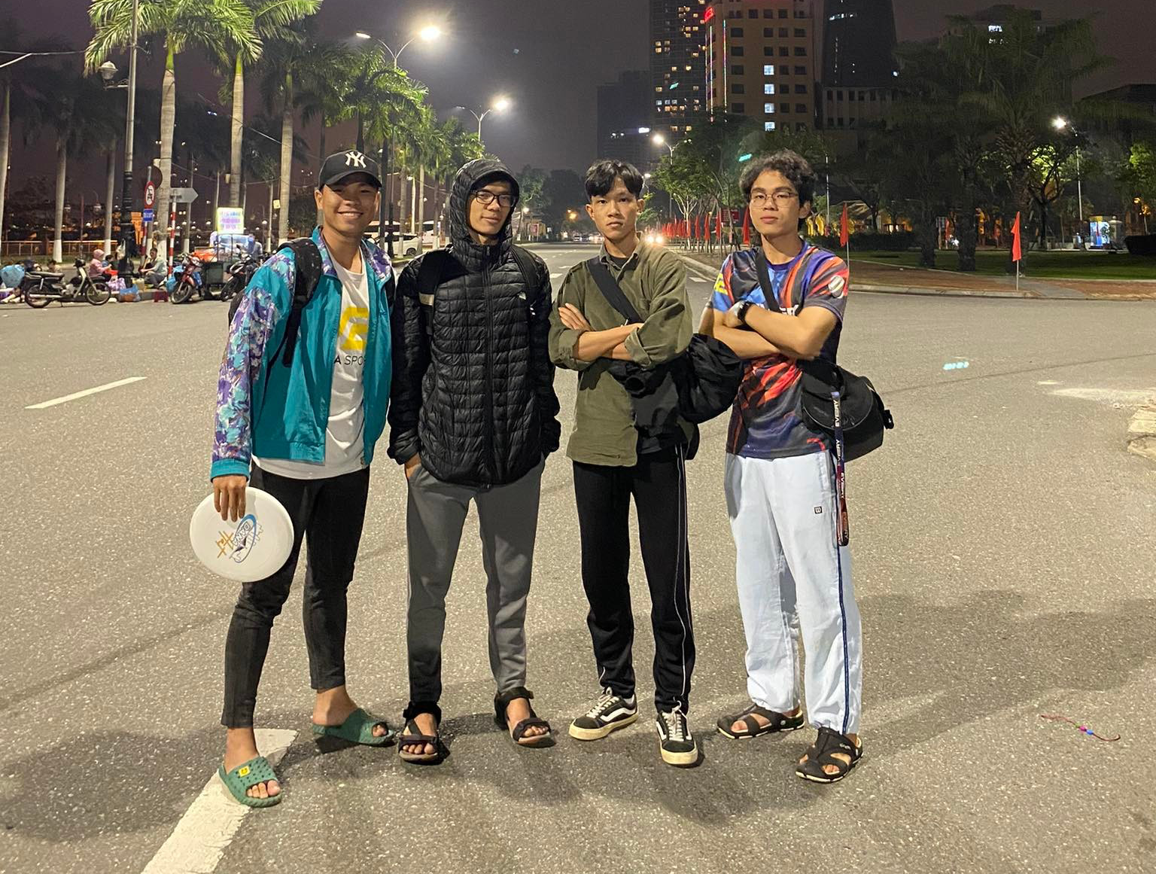
Core Members: 4T
Captain: Ngoc Trieu
Coach: Xuan Trang
Media: Anh Tuan
Huddle: Viet Tan
Notes:
Beach – Park practicings

Slide 5
Progress
NTC
Every
Camp
NTC
4T
Spirit

Slide 6
Why Spirit?
‘Spirit’ relates to the Christianity Community, we are Christians who believe in Jesus Christ and is led by the Holy Spirit so the fundamental values from us based on the teaching of Jesus Christ
‘Spirit’ means for the spirit of the game – most priority while participating in the game – fairness, integrity, peace and friendly.

Slide 7



Slide 8


Slide 9
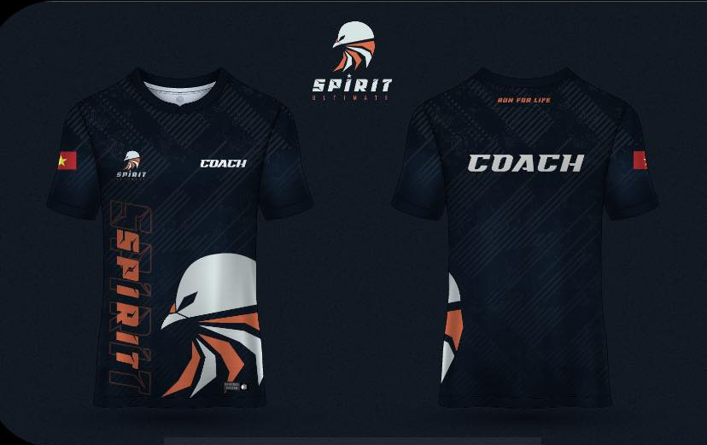
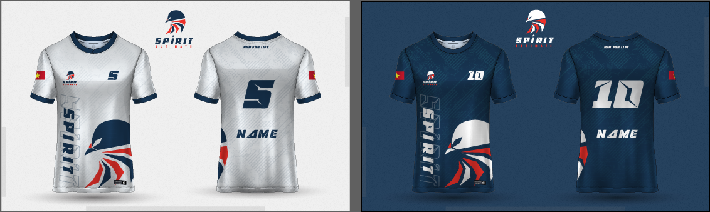

Slide 10
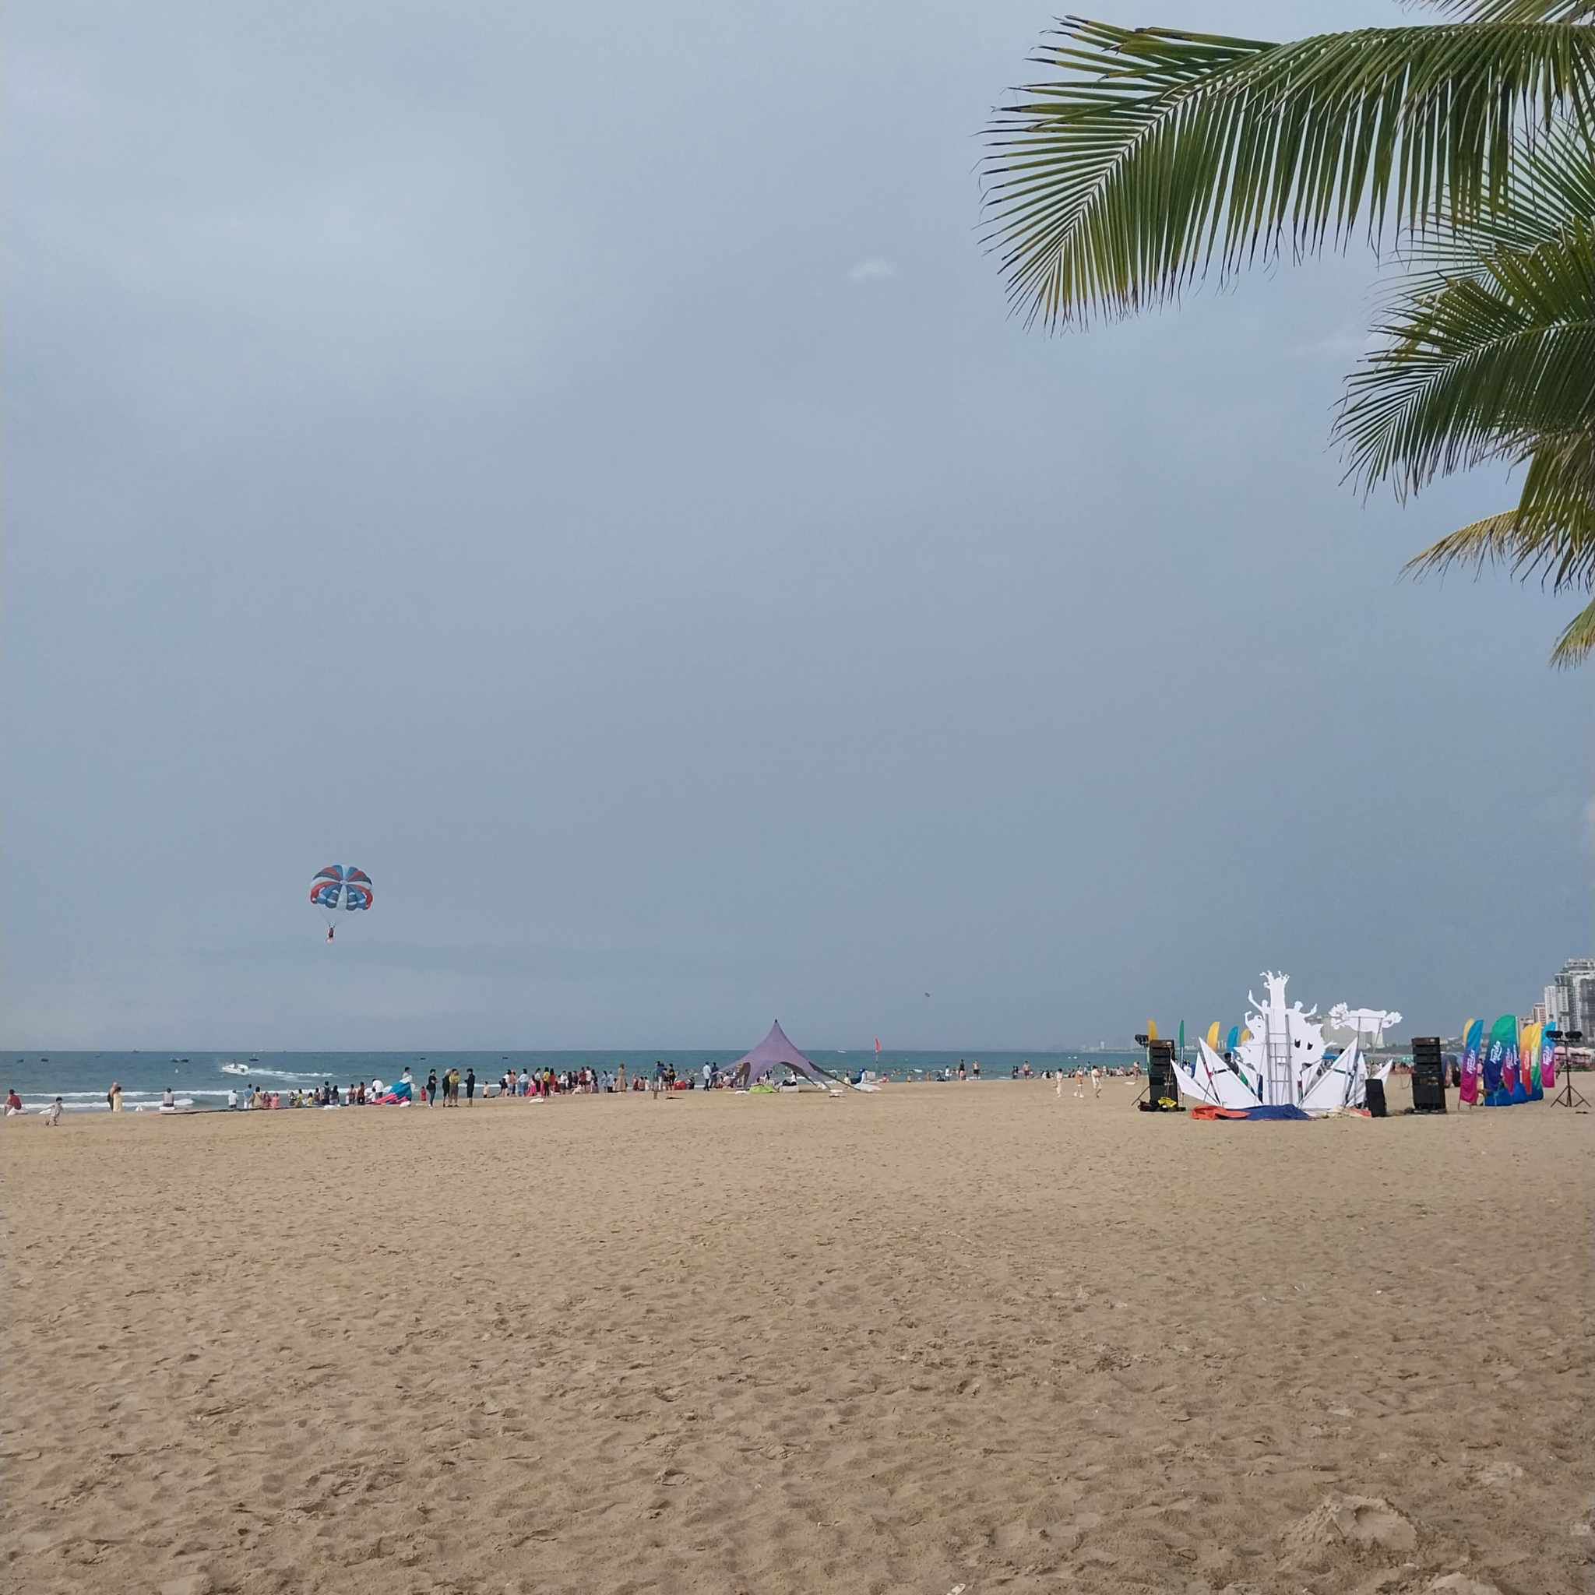
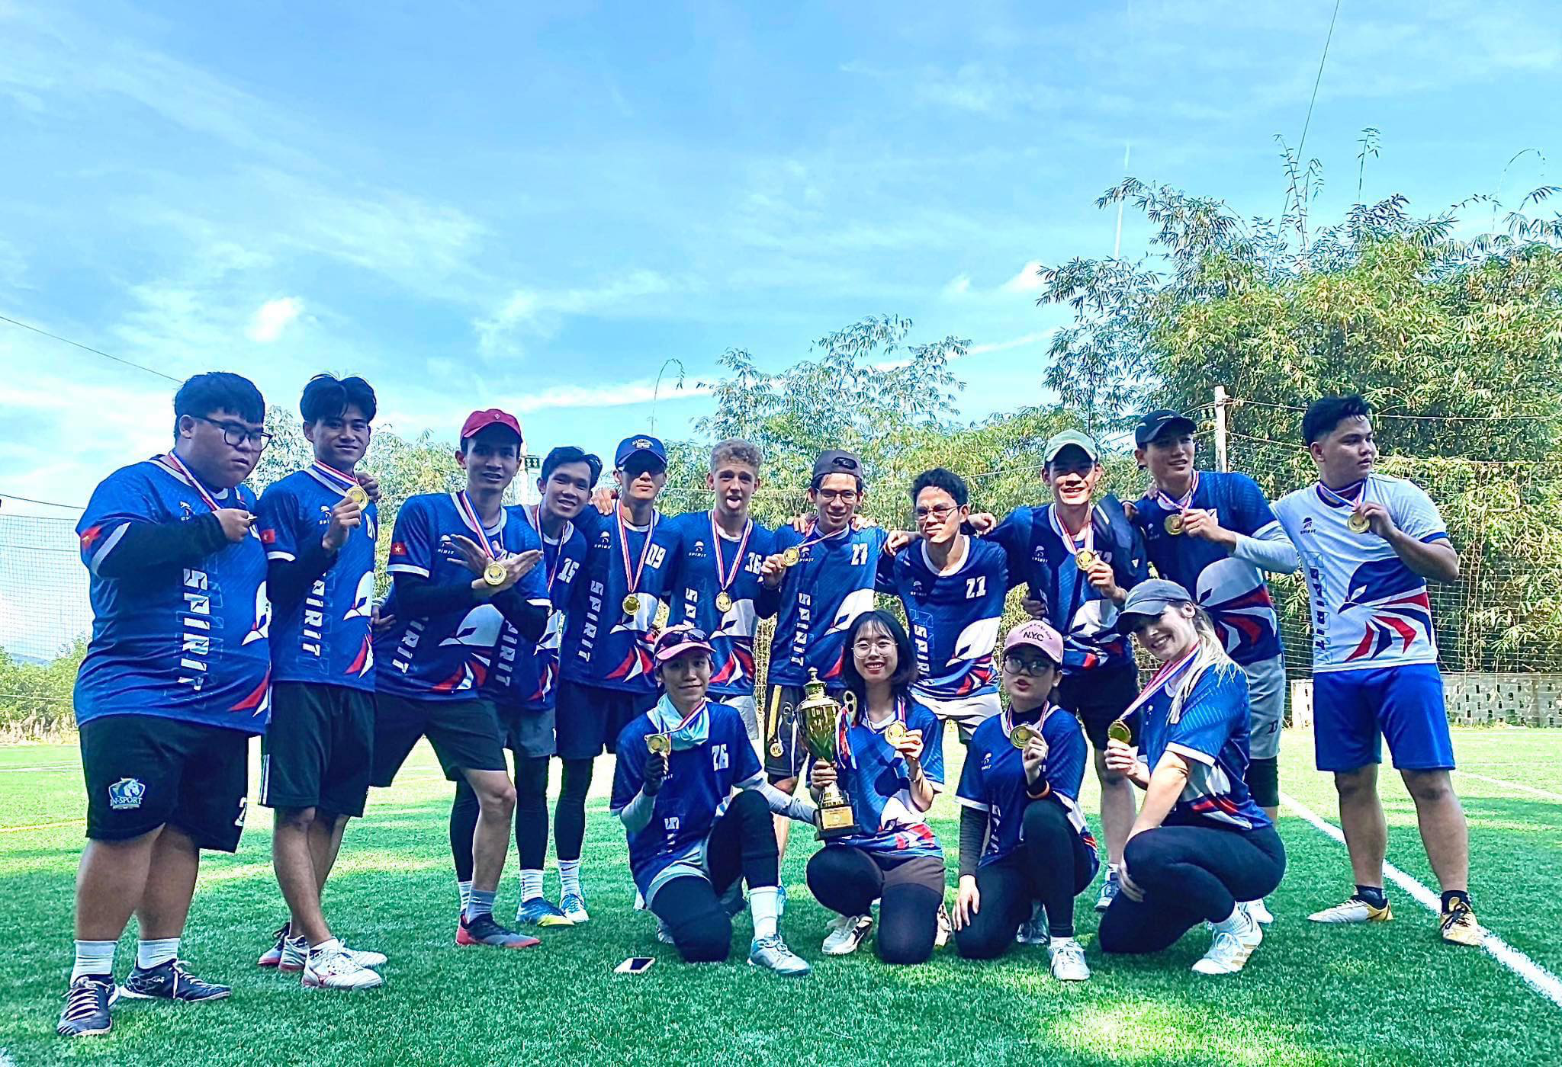
Notes:
Beach – Park practicings

Slide 11
Timeline
January
Frist commitments
NTC Hue Pickup
August– September
SeaCup 3
MekongCup - Tuan
11/2022
Founded
FCA Member
February
Support NTC
2023
2024
2025
NTC QN Training
3in1 HAT
January
DaNa HAT 1
December
Christmas
December
Christmas
May
Spirit

Slide 12
Participants
11-12/2023 | 2024 | 2025
[5-10] people | [13-19] people | [16-26] people

Slide 13
SUC - Changes in 2025

Slide 14
Staffs in SUC

Slide 15
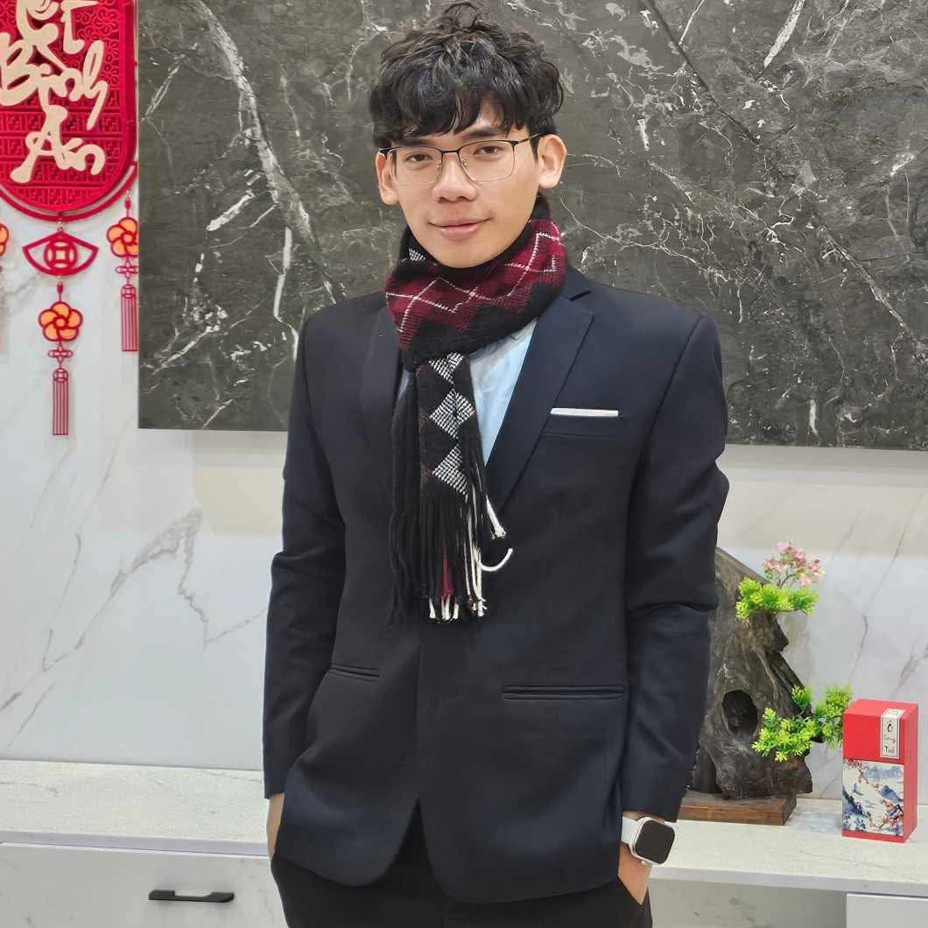
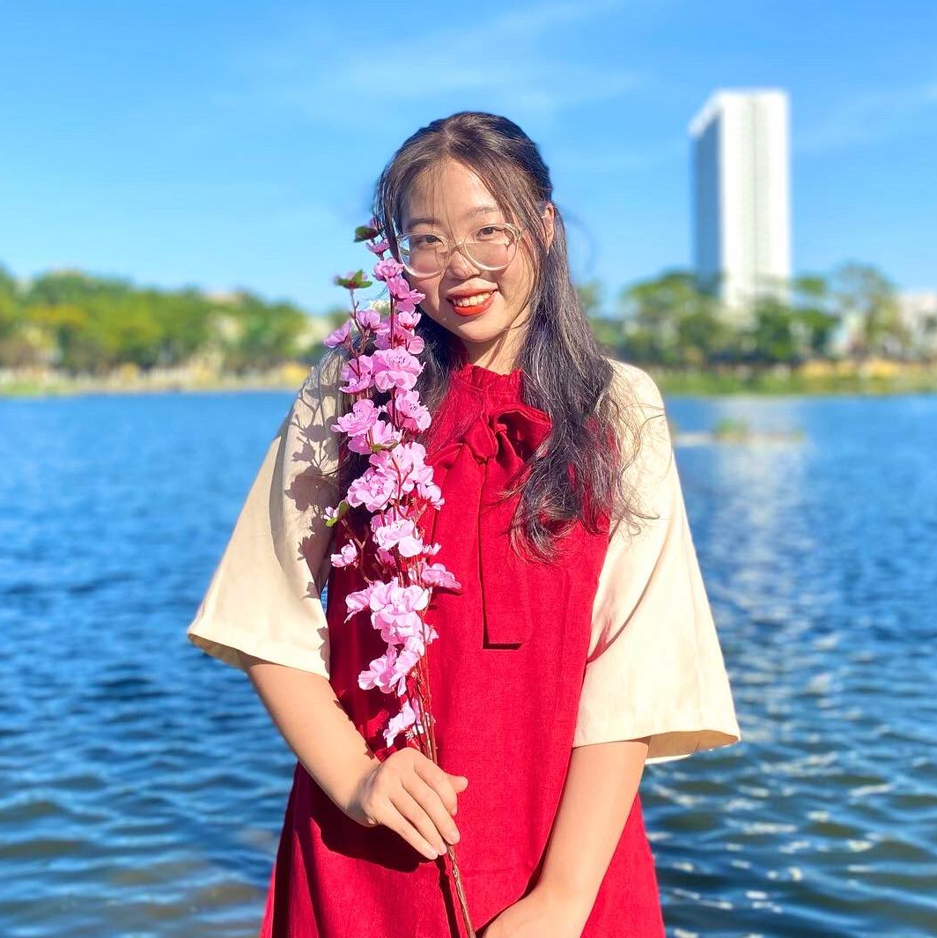
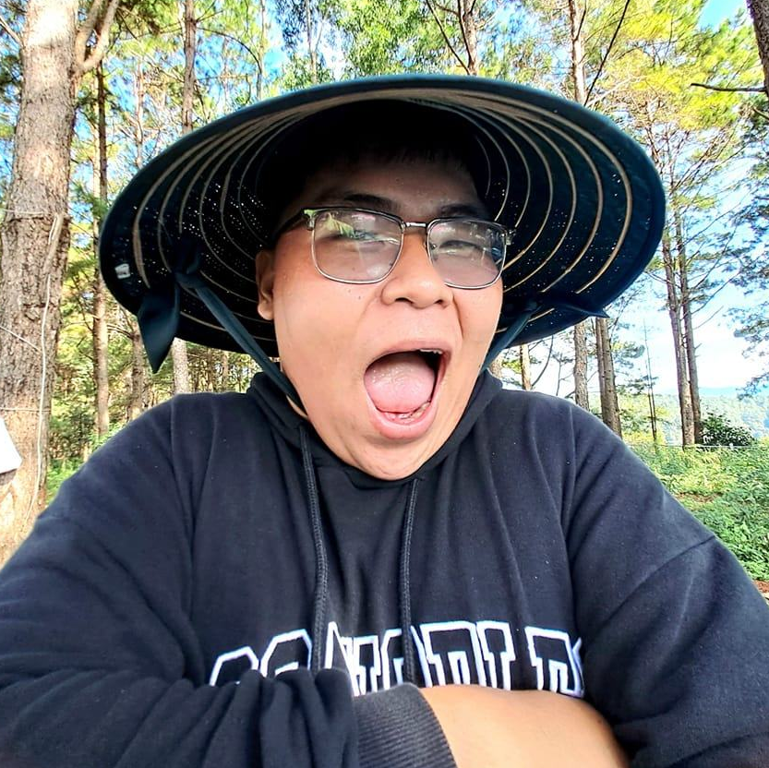
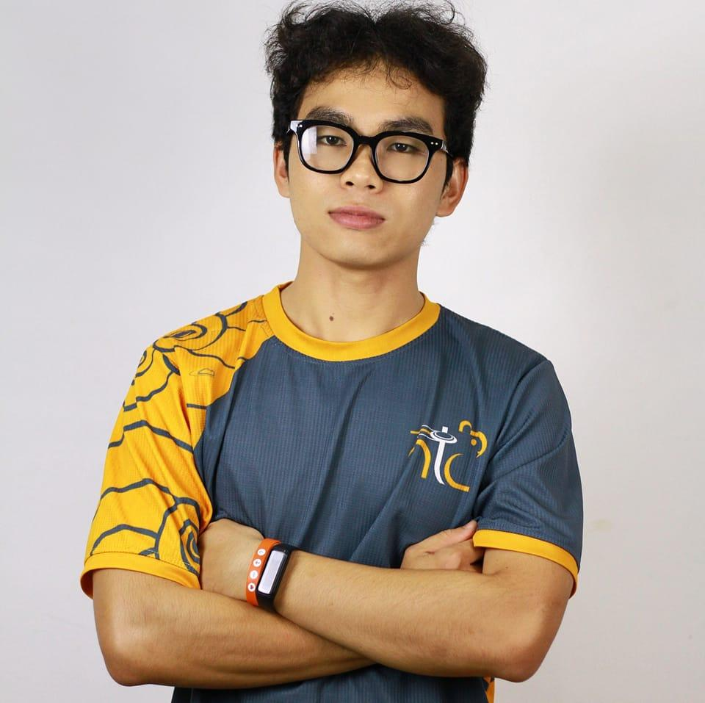
Staffs in SUC
Captain
Coach
Treasurer
Media

Slide 16

Phan Ngọc Triều
Role:
- Be responsible for any things which relate to SUC
- Helping new nembers to know about SUC and frisbee community
- Collecting responses from members and giving the corresponding ways for SUC
Captain

Slide 17
Nguyễn Xuân Trang
Role:
- Researching frisbee’s skills
- Training frisbee skills
- Training fitness
- Tracking the practicing progress of member and giving improvement steps to help member to build up
- Build up the new generation coaches
Coach

Slide 18
Đoàn Cao Diệu Quỳnh
Role:
- Manage the finance of SUC team
- Support as a logistics in buying some furniture or fruits to the practice time
- Raising fund plans
- Receiving fee payment for field after each practicing
- Do summarize the finance and report
Treasurer
Notes:
Logistics: hậu cần

Slide 19
Nguyễn Vĩnh Tường
Role:
- Make up ideas for weekly posters and do post the poster for the training time, events,…
- Making plan for SUC to attractive people’s concerning
- Page Management
- Make uniform designs up
Media
Notes:
Logistics: hậu cần

Slide 20
Role Needed
Coach
At least 1 person
Requirement
Logistic
At least 1 person
Be an official member
Be with team at least 2 months
Media
At least 2 person
Notes:
Logistics: hậu cần

Slide 21
Vision - Goal

Slide 22
Vision - Goal
To frisbee:
Mastering the basic skills of frisbee
Mastering the stategies for doing offense and defense
Participating an Asia Tournament - FCA
To us:
Members would be closer to each other
Notes:
Friendship would be the on top one

Slide 23
Activities

Slide 24
Activities
The training time would come up to be 2 hours
Frame of training time: Opening prayer -> Warming up -> Fitness and Disc Thrill -> Pick up -> Huddle -> Close Prayer
PickupMonthly – Friendly Match to NTC in every first week of month
More team activities (coffee, workshop, training,…)
Archivement Gifts in milestones (1 year, 2 year, 3 year, …)
Tracking the attendance of member and skill improvement every week
Fitness Together (Jogging, Walking, Running,…)
Notes:
Friendship would be the on top one

Slide 25
Fee

Slide 26
Membership & Visitor
 | Worker | Students | PUS
Membership (Offical member) | 180k/Month | 120/Month | 100k/month
Visitor | 40k/Time | 25k/Time | 20k/Time
First Visiting | Free | Free | Free
All of those who participate membership would receive
all the benefits for member from SUC
The Match | Worker | Students | PUS
Membership | Paid | Paid | Paid
Non-membership | 30k/House | 15k/House | 10k/House
Notes:
PUS: pre-university student

Slide 27
Benefits

Slide 28
Benefits
Just be only applied for offical member
(determined by membership)
As a member:
Receiving the gifts from SUC as every milestone
Be tracked in attendance and skill improvement progress
Got the voucher of 50% of drinking in the coffee sections
As any role in SUC:
* Be reduced 80% membership of a month in each 6 months
Notes:
Friendship would be the on top one

