Slide 1

LUNA SURFACE MANAGER
CONTENT
Overview
Introduction to LSM
Compare LSM and Display Manager, Window Manager, Weston
Wayland Protocol, Wayland EGL, Wayland Adaptation
QPA – Qt Platform Abstraction
Main Content
Functionality in details of LSM, starfish LSM and component diagram
Internal sequence
External API - sequence
LGEDV DANANG
2024.10

Slide 2
I. 1 Introduction to LSM
Luna Surface Manager
A Wayland Compositor and Window Manager in WebOS
A Wayland Compositor
Composition of Wayland surfaces without copying
Delivering input events to clients
Compliant with standard Wayland Protocol
Based on QtWayland
Window Manager
Window manager as per business logic
Highly reusable and customize architecture
LGEDV DANANG
2024.10

Slide 3
I. 1 Introduction to LSM
Features
Graphic UI
Built-in system UI
Composition of surfaces from applications as well as Built-in system UI
QML-based system UI within LSM that is seamlessly composited with Wayland surfaces
QML-based window layout with fluent animations
Multi-display supports
Virtual Keyboard
Configurability per screen – resolution, orientation layout
Wayland protocol based architecture – applicable to any kind of applications
Mirroring between screens
Customizable keyboard UI based on plugin architecture
High DPI rendering and device independent rendering
Input event handling
Touchscreen, keyboard, pointing and tablet inputs
Focus management with customization as per business logic
LGEDV DANANG
2024.10

Slide 4
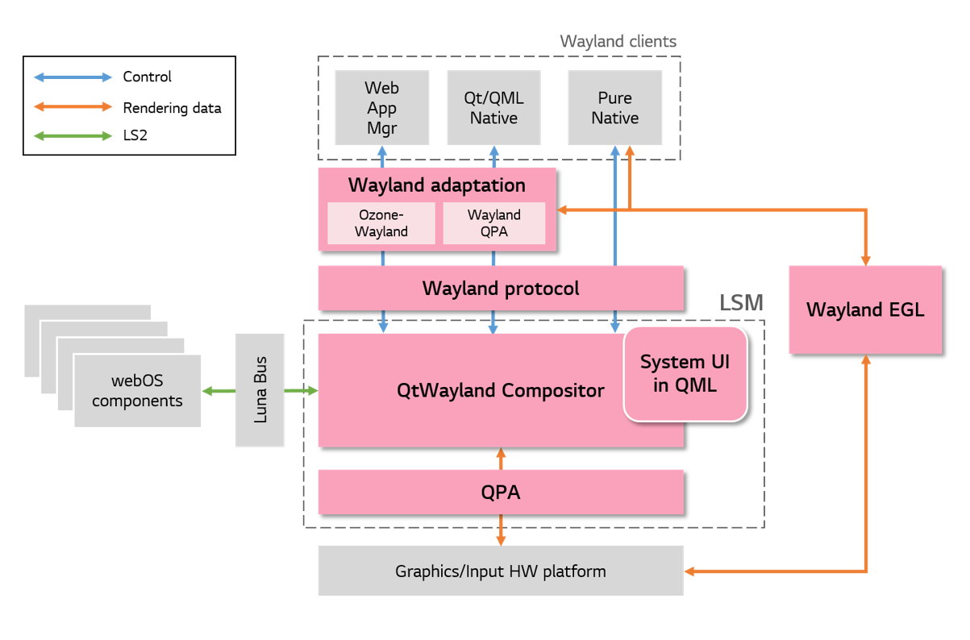
I. 1 Introduction to LSM: Architecture
LGEDV DANANG
2024.10

Slide 5
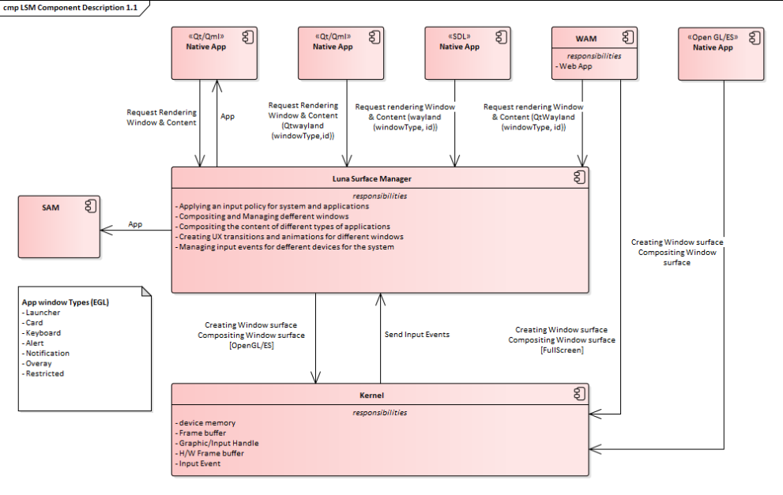
I. 1 Introduction to LSM: Context Diagram
LGEDV DANANG
2024.10

Slide 6
I. 2 Compare LSM and Display Manage, Window Manager, Weston
1. Summary Context Graphics

Slide 7
I. 2 Compare LSM and Display Manage, Window Manager, Weston
2. Compare LSM and Display Manage, Window Manager, Weston
 | Feature | LSM | Window Mng | Display Mgr | Input mgr | Weston
Compositor | Compose windows, rendering | X |  |  |  | X
 | Input event | X |  |  |  | X
HMI control | Create scene | X | X | X
 | Communicate with others | X | X | X | X
 | Handle request show/hide | X | X | X
 | Check app is ready |  | X
 | Noti foreground application | X | X
 | Windows effect | X | X
 | Input manager | X |  |  | X
LGEDV DANANG
2024.10

Slide 8
I. 2 Compare LSM and Display Manage, Window Manager, Weston
2. Compare LSM and Display Manage, Window Manager, Weston
Others | LSM | Window Mng | Display Mgr | Weston
Language | CPP, Qt, JS | CPP | CPP | C
Based on | Qtframework | Wayland client Ilmclient Ivi controller | Wayland client Ilmclient Ivi controller | Wayland server
Designer patent | Observe MVC Composite | Composite | Composite
Core and Custom | Yes | HKMC: No ULC: Yes | No | No
Repo | LSM, starfirsh LSM, libim, qpa-starfish-input, aps-starfish-service | Windows Manager | Displaymgr, hmi graphics, multidisplay | Weston, wayland, Wayland ivi extension
LGEDV DANANG
2024.10

Slide 9
I. 3 Wayland protocol, Wayland EGL, Wayland Adaptation
1. Wayland protocol
Wayland protocol is a protocol for a compositor to talk to its clients
2. The compositor can a standalone display server running on Linux Kernel mode Setting and evdev input devices, an X application, or a Wayland client itself
3. The clients can be traditional applications, X servers or other display servers. Document: https://wayland.freedesktop.org/docs/html/
2. Wayland EGL
Wayland EGL is an extension of EGL - an interface protable layer for graphics resource management and is divided into two parts:
- Where a client allocates GPU memory to perform rendering
- Where server fetches GPU memory (allocated by the client) to perform composition
3. Wayland adaptation Layer
Wayland adaptation layer includes adaptation layers for each client type: Ozone-Wayland for WAM, and Wayland QPA for Qt/QML applications.
Wayland adaptation layer connects an application framework owned by an application with the Wayland protocol API
LGEDV DANANG
2024.10

Slide 10
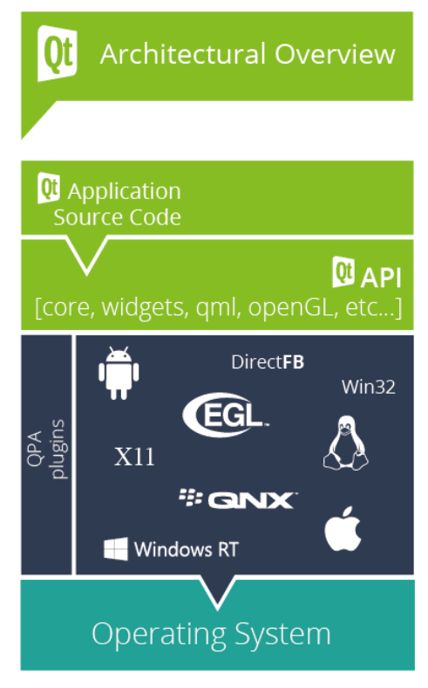
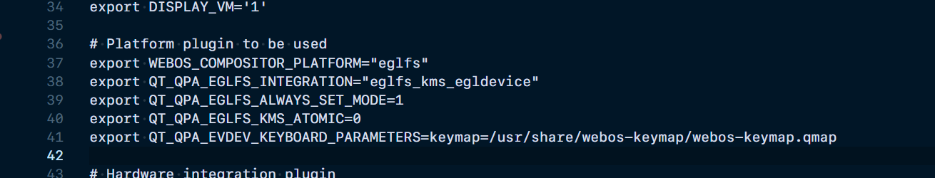
I. 4 QPA – Qt Platform Abstraction
1. QPA
The Qt Platform Abstraction (QPA) is the main platform abstraction layer in Qt.
This is the layer that promotes the integration between Qt and the underlying platform.
Each platform abstraction is then implemented in the form of a QPA plugin, that is loaded at run-time
Product.env
It is composed of a plugin as an absraction layer to support cross-platform, and it is possible to run an application with one code on various platforms by changing QPA.
QPA supports a graphics/input hardware abstraction layer for Qt applications.
The documents of QPA are just a few
Refer:
https://doc.qt.io/qt-6/qpa.html
https://www.kdab.com/wp-content/uploads/stories/EmbeddedsGoneCute.pdf
https://code.qt.io/cgit/qt/qtbase.git/tree/src/plugins/platforms
https://doc.qt.io/qt-6/embedded-linux.html
LGEDV DANANG
2024.10
Notes:
Qt will select a default QPA plugin, depending on the platform. The QT_QPA_PLATFORM environment variable and the -platform command line argument allow you to override this default.
QGuiApplication::platformName
Calling this function without a QGuiApplication will return the default platform name, if available. The default platform name is not affected by the -platform command line option, or the QT_QPA_PLATFORM environment variable.
android, cocoa (for macOS), directfb, eglfs, ios, linuxfb, qnx, offscreen, windows, wayland, xcb
Currently, we are using eglfs is a platform – because LSM as role of wayland display server protocol – used on Linux desktops and Embedded Systems

Slide 11
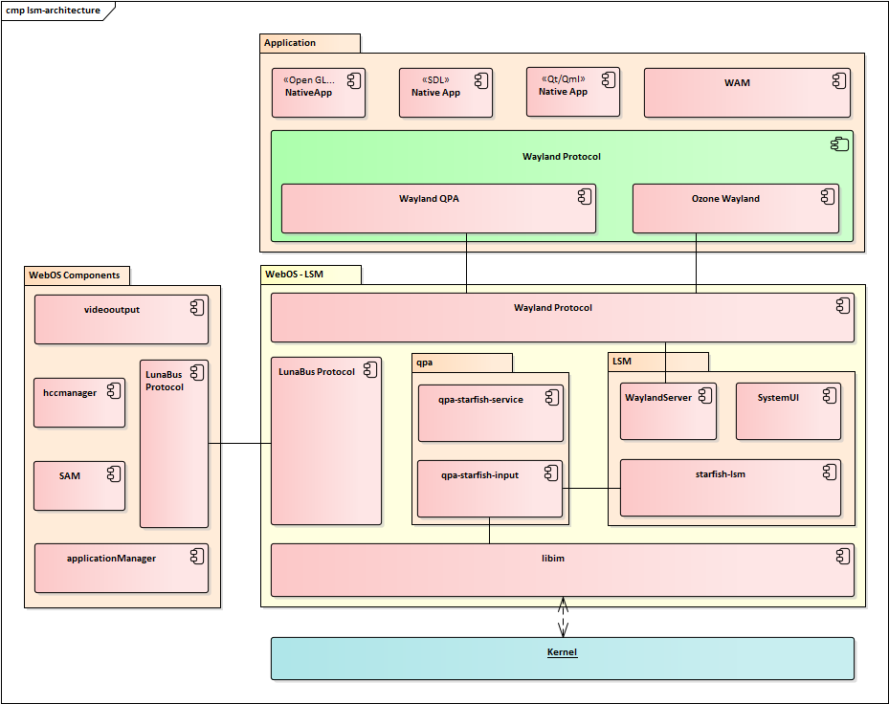
I. 4 QPA – Qt Platform Abstraction
2. Diagram
Refer:
https://github.com/intel/ozone-wayland
LGEDV DANANG
2024.10

Slide 12
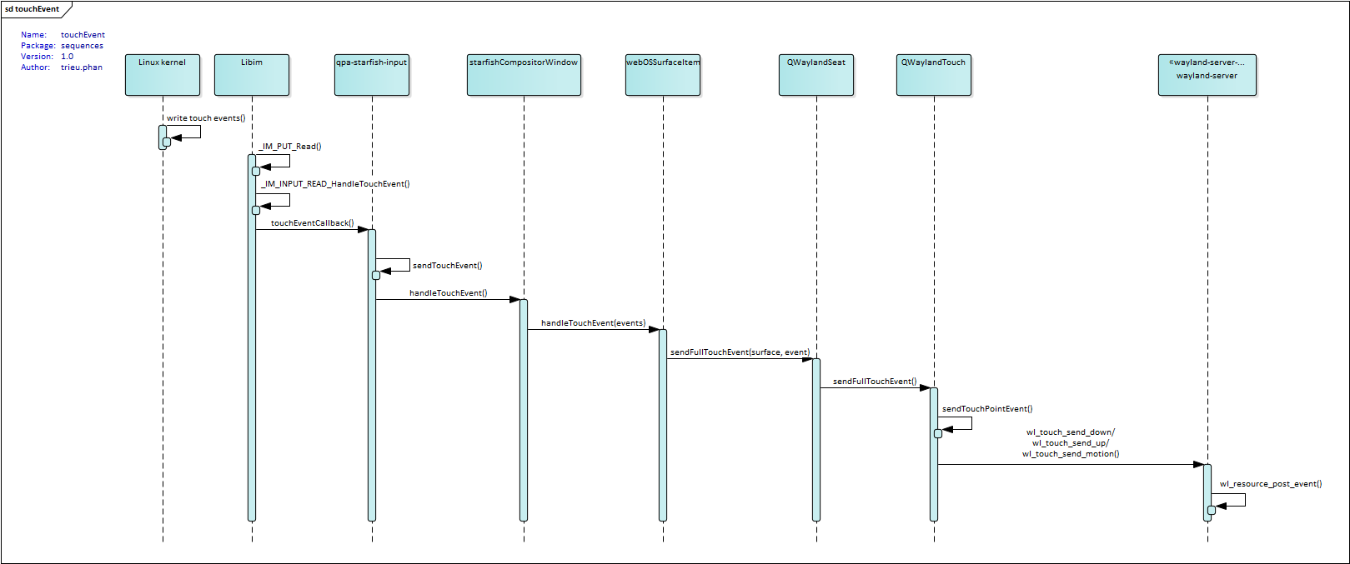
I. 4 QPA – Qt Platform Abstraction
2. qpa-input
A. Touch Event
LGEDV DANANG
2024.10

Slide 13
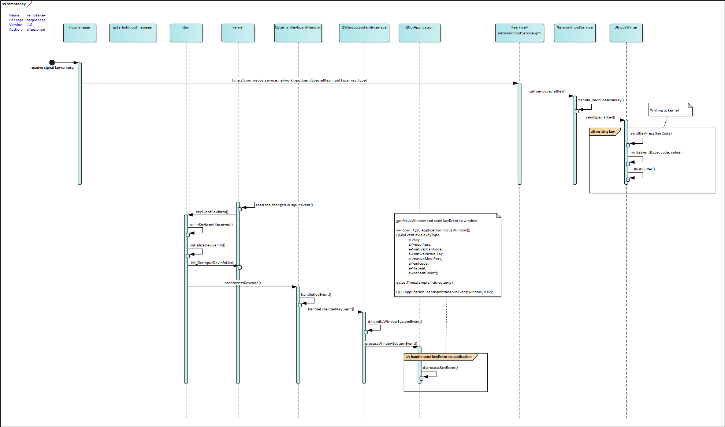
I. 4 QPA – Qt Platform Abstraction
2. qpa-input
A. Key Event
LGEDV DANANG
2024.10

Slide 14
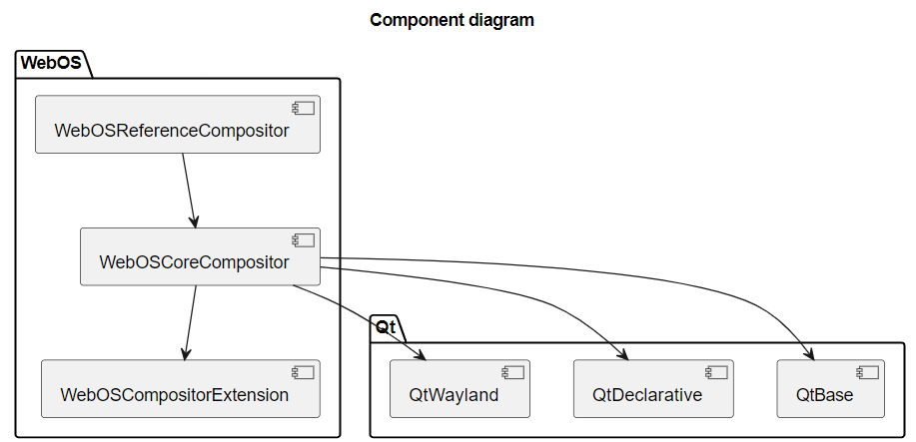
II. 1 Functionally in details of LSM, Starfish LSM
1. Core and custom compositors
Core Compositor: The core features of the Luna Service Manager available through a reusable generic component. Luna Surface Manager is a core compositor
Custom compositor: A derivative of the Core Compositor that can be used for customizing the compositor to suit platform and device specific needs. It provides guidance on best practices for compositor customization. Starfish LSM, Apolo LSM is custom compositor.
2. Features supported by the core compositor
Window and surface models
Surface lifecycle management
Configuration loading
Multi-Input
Input method support
Surface groups
3. Wayland adaptation Layer
When customizing the compositor the following options are available.
1. The C++ level compositor customization can be accomplished via sub-classing the WebOSCoreCompositor.
2. Customization related to QML and context properties compositor window customization can be done via sub-classing the WebOSCompositorWindow.

Slide 15
II.1 Functionally in details of LSM, Starfish LSM
1. Luna surface manager

Slide 16
II.1 Functionally in details of LSM, Starfish LSM
1. Starfish Luna surface manager

Slide 17
II. 2 Internal Sequences

Slide 18
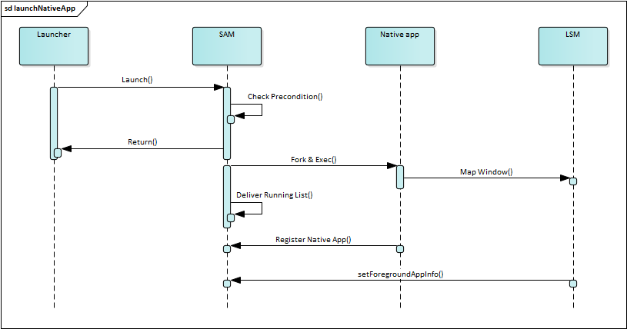
II. 3 External Sequences
1. Launch native app
LGEDV DANANG
2024.10

Slide 19
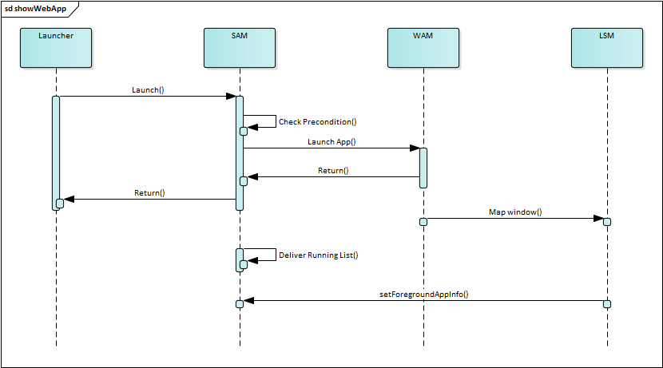
II. 3 External Sequences - API
1.1 Launch web app
LGEDV DANANG
2024.10

Slide 20
II. 3 External Sequences
1.3 Launch web app
LGEDV DANANG
2024.10
Notes:
Create surface
Mapping surface
Update view

Slide 21
II. 3 External Sequences
2. Close app
LGEDV DANANG
2024.10

Slide 22
II. 3 External Sequences
3. Notify webosTouch
LGEDV DANANG
2024.10

Slide 23
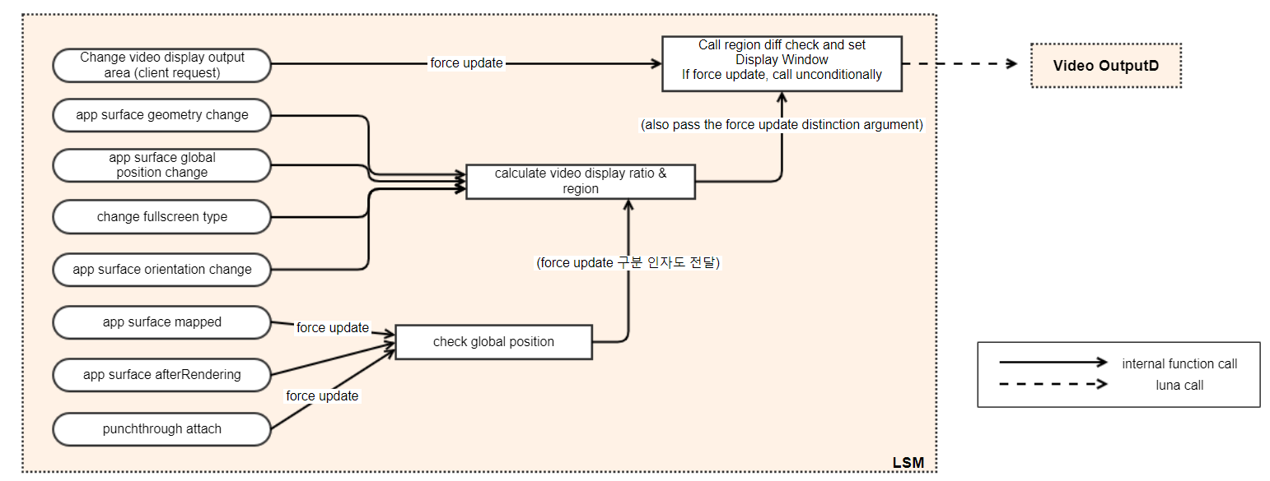
II. 3 External Sequences
4.1 videooutput/display/setDisplayWindow api - cases
Videooutput service connects the video source to the video output device and also controls post-processing and scaling on the video device
LGEDV DANANG
2024.10

Slide 24
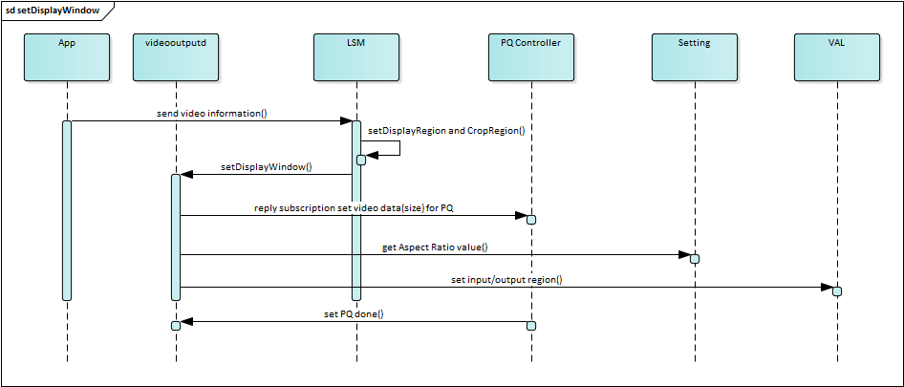
II. 3 External Sequences
4.2 videooutput/display/setDisplayWindow api – general flow
LGEDV DANANG
2024.10

Slide 25
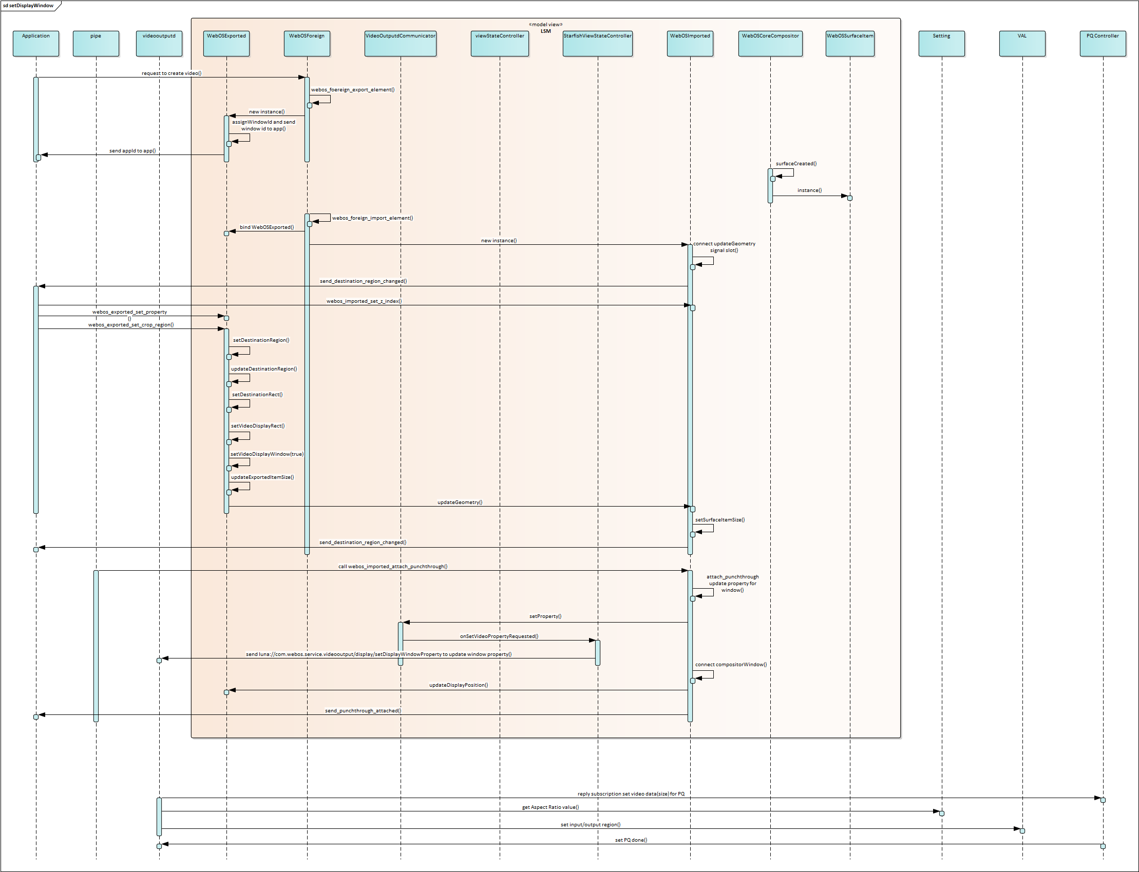
II. 3 External Sequences
4.3 videooutput/display/setDisplayWindow api - details
LGEDV DANANG
2024.10

Slide 26
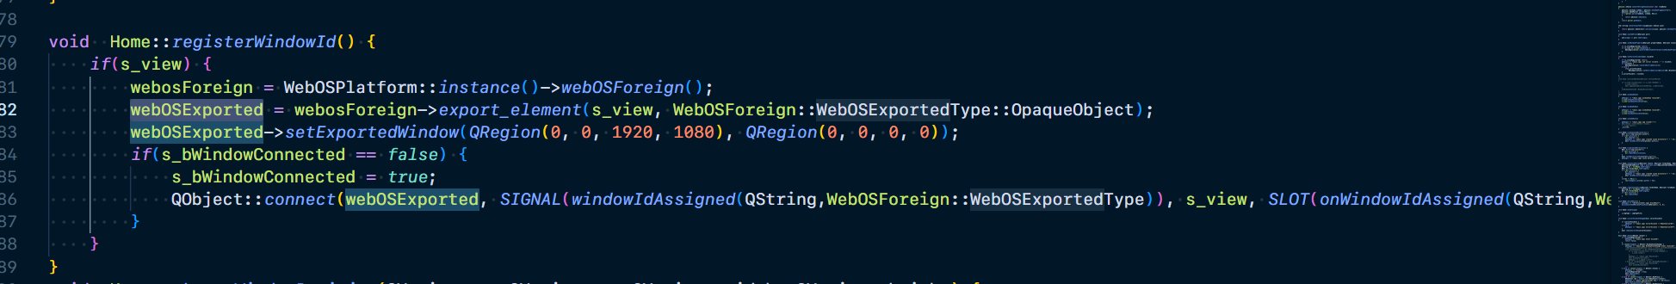
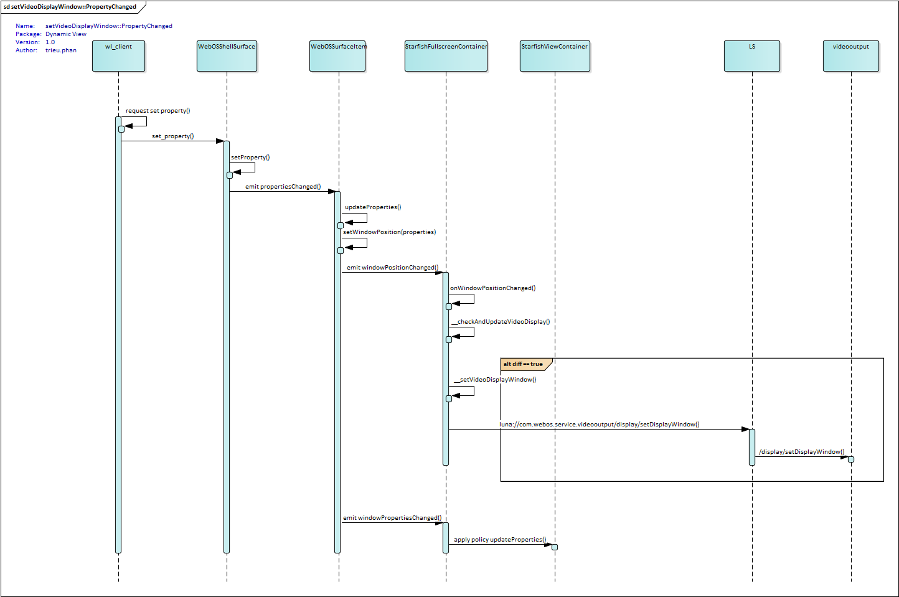
II. 3 External Sequences
4.4 videooutput/display/setDisplayWindow api – request change properties from client
LGEDV DANANG
2024.10

Slide 27

III. Thank You
LGEDV DANANG
2024.10

