Slide 1

LUNA SURFACE MANAGER
CONTENT
Introduction
LSM
Functionalities
Context Diagram
Wayland
Protocol
EGL
Adaptation
LSM Compositor
Details in functionalities (starfish)
Internal sequence
External API sequence
LGEDV DANANG
2024.10

Slide 2
Introduction
LGEDV DANANG
2024.10

Slide 3
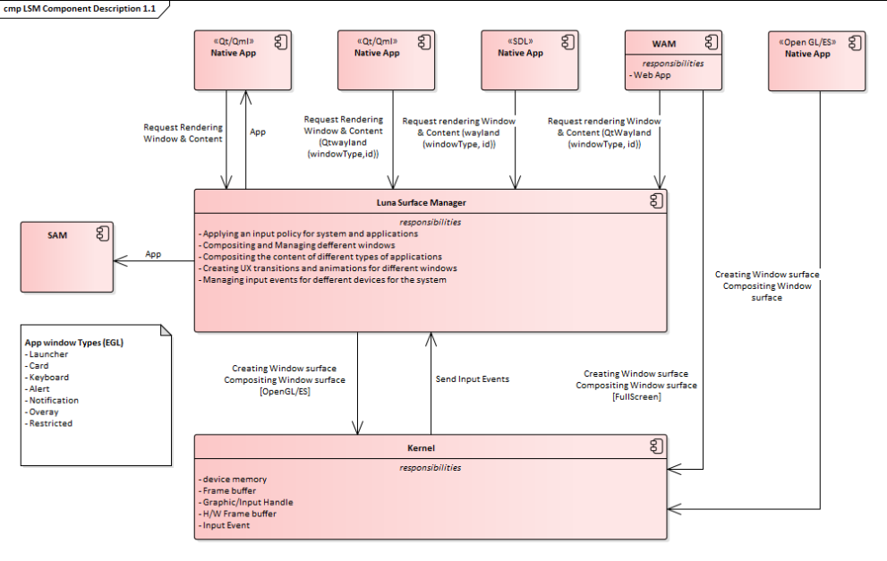
Introduction
LGEDV DANANG
2024.10

Slide 4
Wayland
LGEDV DANANG
2024.10

Slide 5
LSM Compositor
LGEDV DANANG
2024.10

