Slide 1
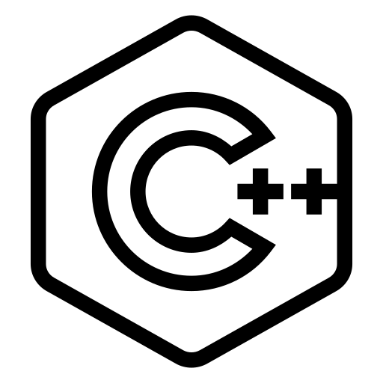
Exploring C++
From Beginner to Advanced

Slide 2
Index

Slide 3
Introduction
A computer program is a sequence of instructions that directs a computer to perform certain actions in a specified order.
The act (and art) of writing a program is called programming
When a computer is performing the actions described by the instructions in a computer program, we say it is running or executing the program. That typically requires the user to launch

Slide 4
Introduction
Programs are executed on the computer’s hardware, which consists of the physical components that make up a computer
Notable hardware found on a typical computing device includes:
A CPU (central processing unit, often called the “brain” of the computer), which actually executes the instructions.
Memory, where computer programs are loaded prior to execution
Interactive devices (e.g. a monitor, touch screen, keyboard, or mouse), which allow a person to interact with a computer.
Storage devices (e.g. a hard drive, SSD, or flash memory), which retain information (including installed programs) even when the computer is turned off.

Slide 5
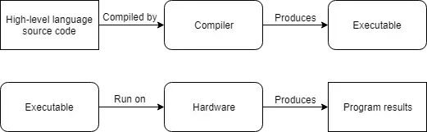
Introduction
the compiling process
the interpretation process
Difference between compiling and interpretation process

Slide 7

Introduction to C/C++
The C language was developed in 1972, primarily as a systems programming language (a language to write operating systems with)
In 1978, Brian Kernighan and Dennis Ritchie published a book called “The C Programming Language”
Dennis Ritchie

Slide 8

Introduction to C/C++
C++ (pronounced “see plus plus”) was developed by Bjarne Stroustrup at Bell Labs as an extension to C, starting in 1979
C++’s most notable innovation over C is that it supports object-oriented programming. As for what an “object” is and how it differs from traditional programming methods
Bjarne Stroustrup

Slide 9
Introduction to C/C++
C++ excels in situations where high performance and precise control over memory and other resources is needed. Here are a few types of applications that C++ would excel in:
Video games
Real-time systems (e.g. for transportation, manufacturing, etc…)
High-performance financial applications (e.g. high frequency trading)
Graphical applications and simulations
Productivity / office applications
Embedded software
Audio and video processing
Artificial intelligence and neural networks

