Slide 1

LUNA SURFACE MANAGER
CONTENT
Overview
Introduction to LSM
Wayland Protocol, Wayland EGL, Wayland Adaptation
QPA – Qt Platform Abstraction
Main Content
Functionality in details of LSM, starfish LSM and component diagram
Internal sequence
External API - sequence
LGEDV DANANG
2024.10

Slide 2
Introduction: LSM
Luna Surface Manager
A Wayland Compositor and Window Manager in WebOS
A component works as a graphics and window manager
Management of System UI (App Bar and Notification)
Implemented using Qt and System UI is implemented using QML
Developed using QML
Features/Roles:
- Compositing and managing different windows: webOS cards, Launcher, Showcase application, Notification, Virtual keyboard, Cursor Window
- Compositing the content of different types of applications into webOS Cards: web apps, Native apps (Qt/Qml, C/C++), Hybrid (Js/C++) apps
- Applying an input policy for system and applications
- Interacting with WAM and SAM over LS2
- Creating UX transitions and animations for different windows
LGEDV DANANG
2024.10

Slide 3
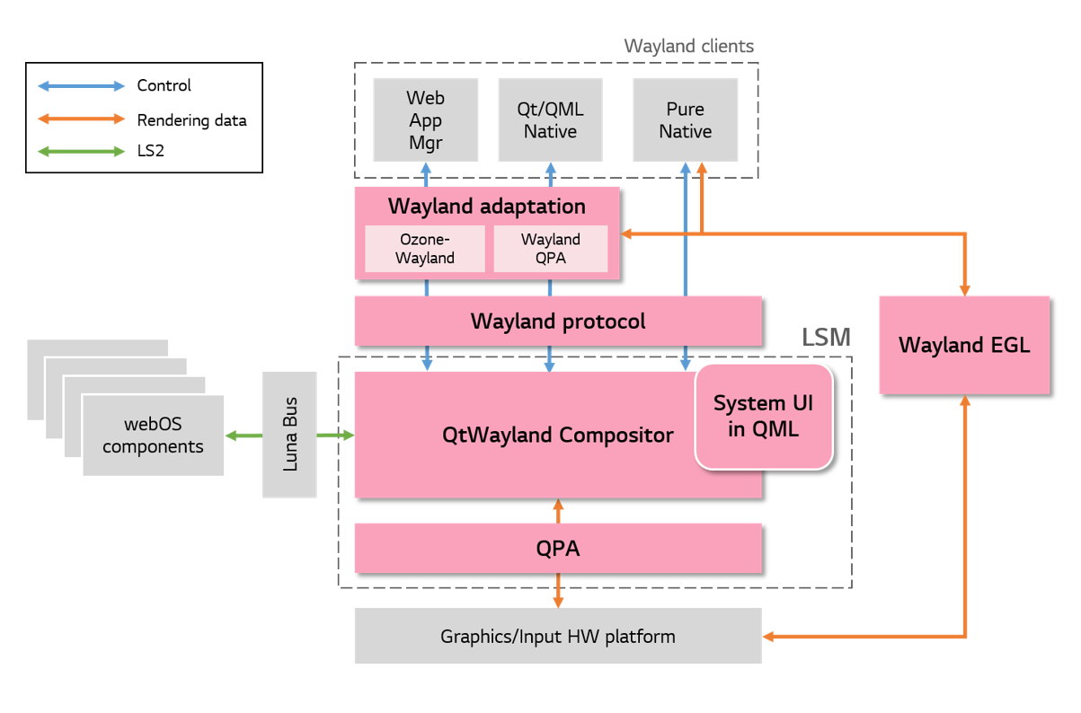
Introduction: LSM - Architecture
LGEDV DANANG
2024.10

Slide 4
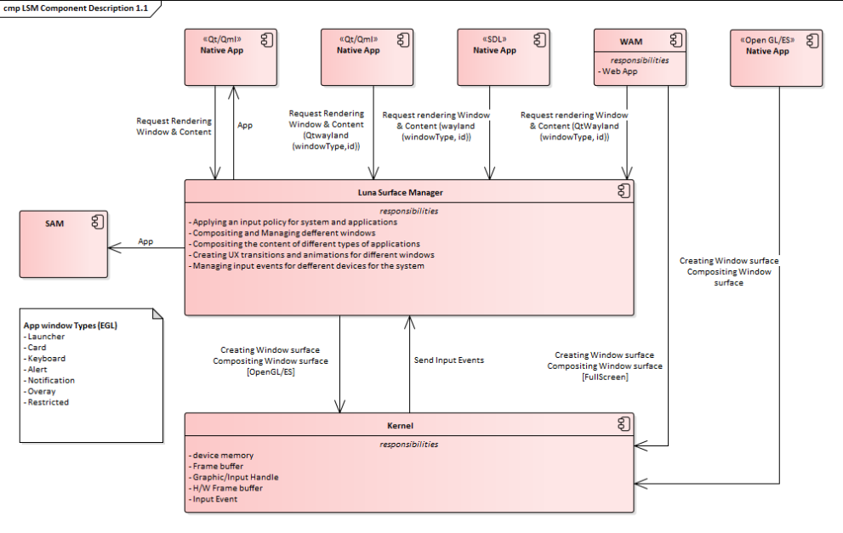
Introduction: LSM – Context Diagram
LGEDV DANANG
2024.10

Slide 5
LSM Compositor
LGEDV DANANG
2024.10

Slide 6
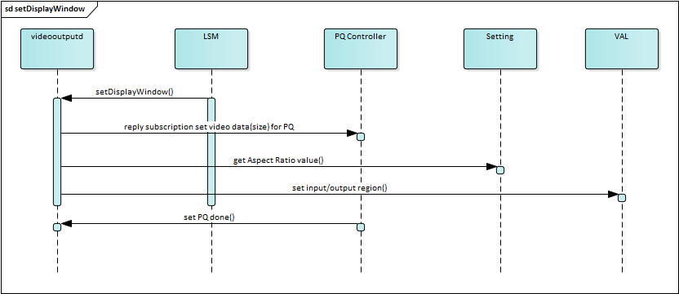
LSM – External APIs
API: setDisplayWindow
LGEDV DANANG
2024.10

