Slide 1
Introduction PL/SQL
Notes:
Schedule: Timing Topic
15 minutes Lecture
15 minutes Total

Slide 2
Objectives
  Understanding the Main Features of PL/SQL
  PL/SQL Architecture
Notes:
Introduction
Overview
This lesson introduces you to the Oracle9i Forms Developer: Build Internet Applications course:
The objectives that the course intends to meet
The topics that it covers
How the topics are structured over the duration of the course

Slide 3
Overview PL/SQL block
  DECLARE
  qty_on_hand NUMBER(5);
  BEGIN
  SELECT quantity INTO qty_on_hand FROM inventory
  WHERE product = ’TENNIS RACKET’
  FOR UPDATE OF quantity;
  IF qty_on_hand > 0 THEN -- check quantity
  UPDATE inventory SET quantity = quantity - 1
  WHERE product = ’TENNIS RACKET’;
  INSERT INTO purchase_record
  VALUES (’Tennis racket purchased’, SYSDATE);
  ELSE
  INSERT INTO purchase_record
  VALUES (’Out of tennis rackets’, SYSDATE);
  END IF;
  COMMIT;
  END;
Notes:
Course Objectives
Course Description
In this course, you will learn to build, test, and deploy interactive Internet applications. Working in a graphical user interface (GUI) environment, you will learn how to create and customize forms with user input items such as check boxes, list items, and radio groups. You will also learn how to modify data access by creating event-related triggers, and you will display Forms elements and data in multiple canvases and windows.

Slide 4
Understanding the Main Features of PL/SQL
  Block Structure
  Variables, data type and Constants
  Cursors
  Attributes
  Control Structures
  Modularity
  Data Abstraction
  Error Handling
Notes:
Course Objectives
Course Description
In this course, you will learn to build, test, and deploy interactive Internet applications. Working in a graphical user interface (GUI) environment, you will learn how to create and customize forms with user input items such as check boxes, list items, and radio groups. You will also learn how to modify data access by creating event-related triggers, and you will display Forms elements and data in multiple canvases and windows.

Slide 5
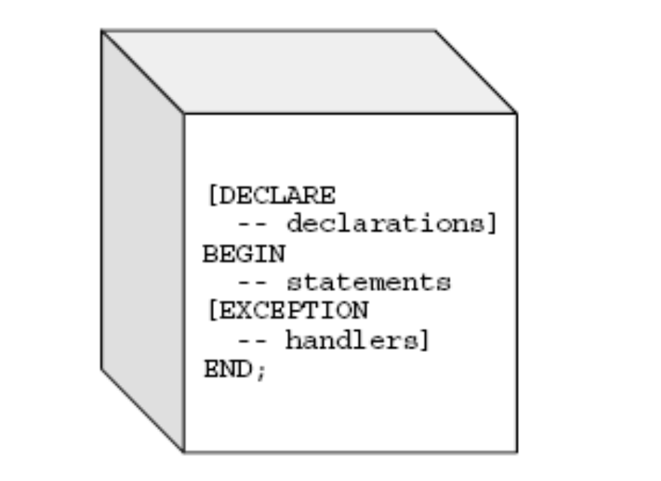
Understanding the Main Features of PL/SQL
  Block Structure
Notes:
Course Objectives
Course Description
In this course, you will learn to build, test, and deploy interactive Internet applications. Working in a graphical user interface (GUI) environment, you will learn how to create and customize forms with user input items such as check boxes, list items, and radio groups. You will also learn how to modify data access by creating event-related triggers, and you will display Forms elements and data in multiple canvases and windows.

Slide 6
Understanding the Main Features of PL/SQL
  Variables and Constants
    part_no NUMBER(4);
    in_stock BOOLEAN;
    credit_limit CONSTANT REAL := 5000.00;
    tax := price * tax_rate;
    valid_id := FALSE;
    bonus := current_salary * 0.10;
    wages := gross_pay(emp_id, st_hrs, ot_hrs) - deductions;
Notes:
Course Objectives
Course Description
In this course, you will learn to build, test, and deploy interactive Internet applications. Working in a graphical user interface (GUI) environment, you will learn how to create and customize forms with user input items such as check boxes, list items, and radio groups. You will also learn how to modify data access by creating event-related triggers, and you will display Forms elements and data in multiple canvases and windows.

Slide 7
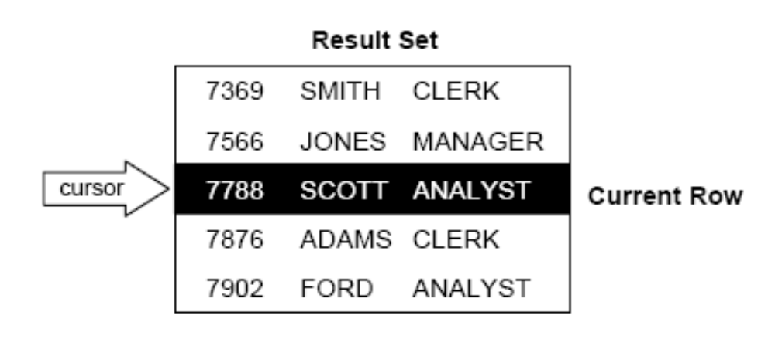
Understanding the Main Features of PL/SQL
  Cursors
Notes:
Course Objectives
Course Description
In this course, you will learn to build, test, and deploy interactive Internet applications. Working in a graphical user interface (GUI) environment, you will learn how to create and customize forms with user input items such as check boxes, list items, and radio groups. You will also learn how to modify data access by creating event-related triggers, and you will display Forms elements and data in multiple canvases and windows.

Slide 8
Understanding the Main Features of PL/SQL
  Attributes
    %TYPE
    %ROWTYPE
  EX:
  my_title books.title%TYPE;
  dept_rec dept%ROWTYPE;
Notes:
Course Objectives
Course Description
In this course, you will learn to build, test, and deploy interactive Internet applications. Working in a graphical user interface (GUI) environment, you will learn how to create and customize forms with user input items such as check boxes, list items, and radio groups. You will also learn how to modify data access by creating event-related triggers, and you will display Forms elements and data in multiple canvases and windows.

Slide 9
Understanding the Main Features of PL/SQL
  Control Structures
    Conditional Control
      IF (dk) THEN
      ELSE
      END IF;
    Iterative Control
      LOOP
      EXIT WHEN total > 25000;
      END LOOP;
    Sequential Control
      IF rating > 90 THEN
      GOTO calc_raise;
      END IF;
      <<calc_raise>>
Notes:
Course Objectives
Course Description
In this course, you will learn to build, test, and deploy interactive Internet applications. Working in a graphical user interface (GUI) environment, you will learn how to create and customize forms with user input items such as check boxes, list items, and radio groups. You will also learn how to modify data access by creating event-related triggers, and you will display Forms elements and data in multiple canvases and windows.

Slide 10
Understanding the Main Features of PL/SQL
  Modularity
  Subprograms
  Packages
Notes:
Course Objectives
Course Description
In this course, you will learn to build, test, and deploy interactive Internet applications. Working in a graphical user interface (GUI) environment, you will learn how to create and customize forms with user input items such as check boxes, list items, and radio groups. You will also learn how to modify data access by creating event-related triggers, and you will display Forms elements and data in multiple canvases and windows.

Slide 11
Understanding the Main Features of PL/SQL
  Data Abstraction
    Collections
    TABLE and VARRAY
        TYPE Staff IS TABLE OF Employee;
        staffer Employee;
    Records
      TYPE MeetingTyp IS RECORD (
      date_held DATE,
      duration TimeRec, -- nested record
      location VARCHAR2(20),
      purpose VARCHAR2(50));
    Object Types
Notes:
Course Objectives
Course Description
In this course, you will learn to build, test, and deploy interactive Internet applications. Working in a graphical user interface (GUI) environment, you will learn how to create and customize forms with user input items such as check boxes, list items, and radio groups. You will also learn how to modify data access by creating event-related triggers, and you will display Forms elements and data in multiple canvases and windows.

Slide 12
Understanding the Main Features of PL/SQL
  Data Abstraction
    Object Types
      CREATE TYPE Bank_Account AS OBJECT (
      acct_number INTEGER(5),
      balance REAL,
      status VARCHAR2(10),
      MEMBER PROCEDURE open (amount IN REAL),
      MEMBER PROCEDURE verify_acct (num IN INTEGER),
      MEMBER PROCEDURE close (num IN INTEGER, amount OUT REAL),
      MEMBER PROCEDURE deposit (num IN INTEGER, amount IN REAL),
      MEMBER PROCEDURE withdraw (num IN INTEGER, amount IN REAL),
      MEMBER FUNCTION curr_bal (num IN INTEGER) RETURN REAL
      );
Notes:
Course Objectives
Course Description
In this course, you will learn to build, test, and deploy interactive Internet applications. Working in a graphical user interface (GUI) environment, you will learn how to create and customize forms with user input items such as check boxes, list items, and radio groups. You will also learn how to modify data access by creating event-related triggers, and you will display Forms elements and data in multiple canvases and windows.

Slide 13
Understanding the Main Features of PL/SQL
  Error Handling
    DECLARE
    comm_missing EXCEPTION; -- declare exception
    BEGIN
    IF commission IS NULL THEN
    RAISE comm_missing; -- raise exception
    END IF;
    bonus := (salary * 0.10) + (commission * 0.15);
    EXCEPTION
    WHEN comm_missing THEN
    -- process the exception
Notes:
Course Objectives
Course Description
In this course, you will learn to build, test, and deploy interactive Internet applications. Working in a graphical user interface (GUI) environment, you will learn how to create and customize forms with user input items such as check boxes, list items, and radio groups. You will also learn how to modify data access by creating event-related triggers, and you will display Forms elements and data in multiple canvases and windows.

Slide 14
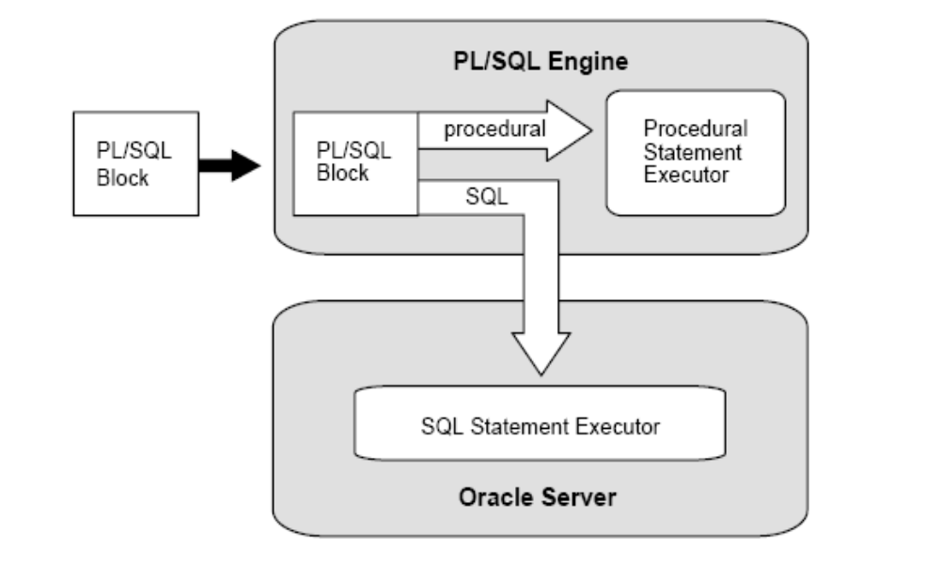
PL/SQL Architecture
Notes:
Course Objectives
Course Description
In this course, you will learn to build, test, and deploy interactive Internet applications. Working in a graphical user interface (GUI) environment, you will learn how to create and customize forms with user input items such as check boxes, list items, and radio groups. You will also learn how to modify data access by creating event-related triggers, and you will display Forms elements and data in multiple canvases and windows.

