Slide 1
CoreData & MVVM
Subtitle 24pt Arial
Nhan Phan
EMB Nov,2022

Slide 2
Agenda
NSUserDefault
CoreData
REST API
MVVM Architecture
XCTest

Slide 3
NSUserDefault
An interface to the user’s defaults database, where you store key-value pairs persistently across launches of your app.
NSData
NSString
NSNumber
NSDate
NSArray
NSDictionary
event

Slide 4
CoreData
Core Data is a framework that you use to manage the model layer objects in your application.
Managed object context
Persistent store coordinator
Persistent store
Data model
Managed object model

Slide 5
Network programing
NSURLConnection
NSURLSession
AFNetworking
Alamofire

Slide 6
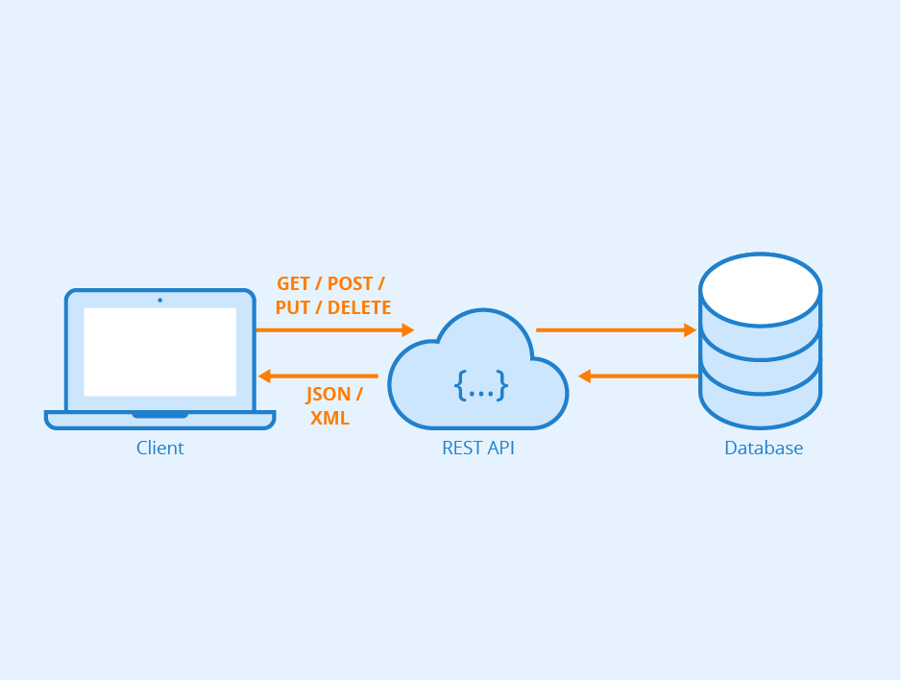
Rest API
GET
POST
PATCH
PUT
DELETE
TEXT EXAMPLE

Slide 7
MVVM Architecture
State Changes in an IOS app.
Notify
ViewModel
Event
Model
Update
Binding
View

Slide 8
XCTest
Test cases.
Test method.
TEXT EXAMPLE

Slide 9
Thank You

Slide 11
Recommended Graphic Styles
THEME COLORS AND GRADIENTS
HIGHLIGHT COLOR USAGE AND GRAPHIC ELEMENTS
Introducing deep blue!
Although it is very dark and may appear almost black, it adds great depth when used in large areas and backgrounds, as shown in the title and divider slides.
Less is more.
There are 3 new colors to highlight important elements or to add additional colors to charts and graphs. These aren’t meant to be used as background colors or for large areas.
DEEP BLUE
DEEP BLUE TO BLACK GRADIENT
Arrows and lines

Slide 12
PowerPoint Assets (View in Slideshow Mode to Activate Links in this Presentation)
We are currently updating our Brand Portal so please check back for updated versions of the following resources:
Additional Cover and Divider Slides
PowerPoint Icon Library
PowerPoint Diagram Library
Questions? Email us at brand@HitachiVantara.com

Slide 13
Bullet Slide Example 24pt Arial Bold
First-level bullet copy is 20pt Arial
Levels of bullets should have a 2pt difference
Minimum bulleted text size is 14pt
Try not to exceed 6 bullet points on a slide
Bulleted copy should be sentence case
Do not use punctuation within bulleted text
Use Arial bold and color to highlight text

Slide 14
Confidential Slide Example 24pt Arial Bold Subtitle Example 18pt Arial Regular
First-level bullet copy is 20pt Arial
Levels of bullets should have a 2pt difference
Minimum bulleted text size is 14pt
Try not to exceed 6 bullet points on a slide
Bulleted copy should be sentence case
Use Arial bold and color to highlight text
NOTE
If the full presentation is internal or confidential, every slide must include a confidentiality statement.

Slide 15

Photo and Text Slide Example
Keep text minimal
Minimum bulleted text size is 14pt
Find brand, business, industry photography and more on the Image Library in the Brand Assets section on the Brand Portal
View in slideshow mode to activate link
TEXT EXAMPLE

Slide 16





Photo and Icon Slide Example
MAIN POINT
MAIN POINT
MAIN POINT
NOTE
On interior image background slides, image should align below (orange) template guideline. Make sure ”Guides” is selected under “View” in PowerPoint.
© Hitachi Vantara LLC 2020. All Rights Reserved.

Slide 17




Icons and Text Example
Keep text minimal
Combine icons and symbols to convey ideas visually
Find a PowerPoint file of all icons on the Templates section of the Brand Portal
View in slideshow mode to activate link

Slide 18

Text and Quote or Callout Example
Two styles for highlighting key text or quotes with callout boxes
The top option works best for plain text
Use the bottom option if you include a logo
Keep text minimal
Minimum bulleted text size is 14pt
Insert your quotation or callout text in this box. Use Arial white text with a minimum size of 14pt.
– Source attribution
Insert your quotation or callout text in this box. Use Arial white text with a minimum size of 14pt.
– Source attribution

Slide 19
Divider Slide Sample

Slide 20
Divider Slide Sample

Slide 21
Divider Slide Sample

Slide 22
Agenda Example
First Topic
Second Topic
Third Topic
Fourth Topic
Fifth Topic

Slide 23
Matrix Example
 | MAY | JUNE | JULY
WEEK | 1 2 3 4 5 6 7 8 9 10 11 12 13
TASK 1
TASK 2
TASK 3
TASK 4
TASK 5

Slide 24
Map Example
45%
12%
28%
DATA CALLOUT
DATA CALLOUT
DATA CALLOUT

Slide 25
Diagram Slide Example
Use diagrams with text on on their own to communicate abstract ideas
Download examples of diagrams from the Templates section of the Brand Portal
View in slideshow mode to activate link
Sub
Point
Sub
Point
Sub
Point
MAIN POINT
Sub
Point
Sub
Point
Sub
Point

Slide 26
Table Example
 | HEADER EXAMPLE All capS | Arial | 16PT BOLD WHITE
FIRST ROW EXAMPLE | Arial | Table body copy should be sentence case | Optional bullet text Highlight bold with color
Arial 16PT BOLD | Minimum font size is 14pt | Tables should be concise and easy to read | Subtext Subtext Subtext
Headers should be All capitals | Do not fill the cells with too much information |  | Subtext

Slide 27
Bar Chart Example
NOTE
PPT CHARTS To preserve the chart style, right click on the chart and choose Edit Data. Type or paste your data into the linked spreadsheet.
SOURCE: DATA

Slide 28
Line Chart Example
SOURCE: DATA

Slide 29
Pie Chart Example
SOURCE: DATA

Slide 30
Thank You

