Slide 1
Prototype & Adapter
Software Design Pattern
GROUP 1
1

Slide 2


GROUP 1
20110432-Phan Tan Cuong
20110423-Nguyen Thanh Minh Triet
Leader of the group
Member
2

Slide 3
TABLE OF CONTENTS
01
04
Introduce
Pros & Cons
02
05
Purpose of use
Applicability
03
06
Architecture
Relation
3
Introduction to the concept
Strengths and weaknesses in use
Problems & Solution
Correct usage
Class diagram
Ralate with
other patterns

Slide 4
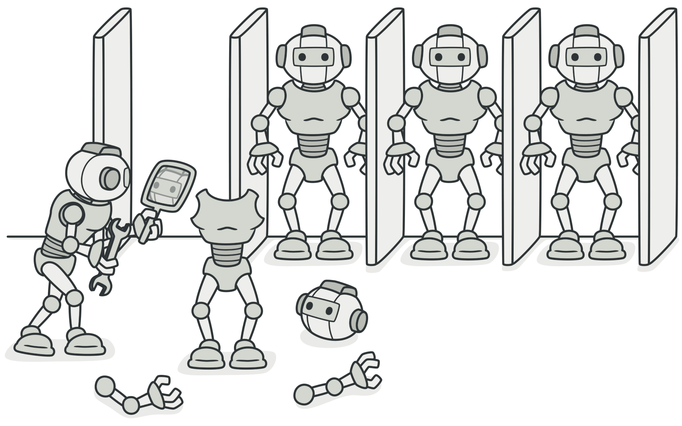
Prototype
Group 1
4

Slide 5
1a. Introduction
Prototype is a creational design pattern that lets you copy existing objects without making your code dependent on their classes.
5

Slide 6
1b. Definition:
Prototype pattern refers to creating duplicate object while keeping performance in mind. This type of design pattern comes under creational pattern as this pattern provides one of the best ways to create an object.
6

Slide 7
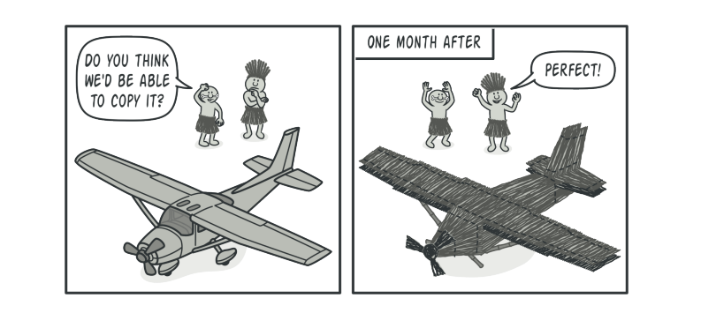
2. Purpose of use
Problem Say you have an object, and you want to create an exact copy of it. How would you do it?
7

Slide 8
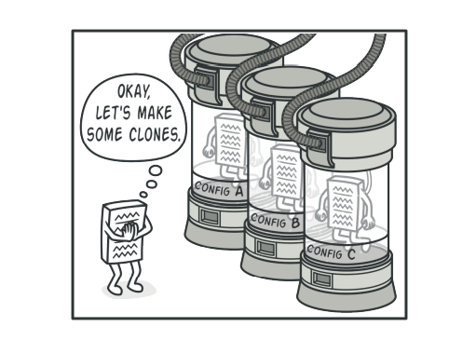
2. Purpose of use
SOLUTION You create a set create a set of objects, configured in various ways. When you need an object like the one you’ve configured, you just clone a prototype instead of constructing a new object from scratch.
8

Slide 9
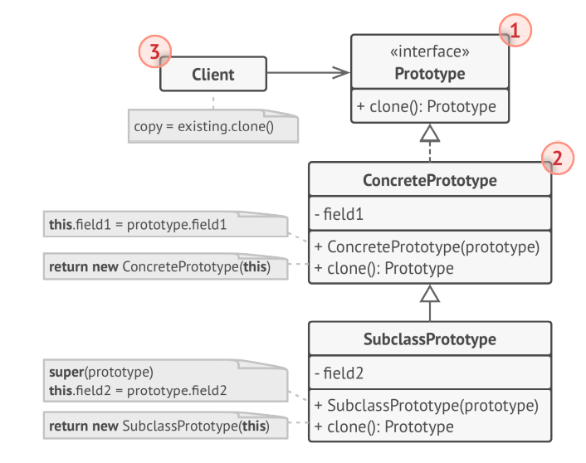
3. Architecture
Components: 1.The Prototype: interface declares the cloning methods. 2.The Concrete Prototype: class implements the cloning method. 3.The Client: can produce a copy of any object that follows the prototype interface.
9

Slide 10
3. Architecture
Prototype can avoid to creating too much subclasses like Abstract Factory Pattern
It reduces the cost of creating new “standard” object
Using prototype gains more performance than using new() operator to create new object.
10

Slide 11
3. Architecture
In prototype, there are two way to clone: +Shallow Copy - In shallow copy, we only clone the parent object and not its containing objects. +Deep Copy - In a deep copy, we clone the parent object as well as its containing objects.
11

Slide 12
4. Applicability
1.When the classes are instantiated at runtime. 2.When the cost of creating an object is expensive or complicated 3.When you want to keep the number of classes in an application minimum. 4.When the client application needs to be unaware of object creation and representation
12

Slide 13
Advantages: It reduces the need of sub-classing. It hides complexities of creating objects. The clients can get new objects without knowing which type of object it will be. It lets you add or remove objects at runtime.
5. Pros & Cons
13

Slide 14
5. Pros & Cons
Disadvantages: For projects, which require less number of objects, implementing prototype patterns can be an overkill. It hides the actual structure of the object/program from the client. Must implement, the clone() method, and in some cases, this implementation can be difficult. Cloning complex objects that have circular references might be very tricky.
14

Slide 15
6.Relations with other patterns
Many designs start by using Factory Method (less complicated and more customizable via subclasses) and evolve toward Abstract Factory, Prototype, or Builder (more flexible, but more complicated).
15
Abstract Factory classes are often based on a set of Factory Methods, but you can also use Prototype to compose the methods on these classes.

Slide 16
6.Relations with other patterns
Prototype isn’t based on inheritance, so it doesn’t have its drawbacks. On the other hand, Prototype requires a complicated initialization of the cloned object. Factory Method is based on inheritance but doesn’t require an initialization step.
16
Abstract Factories, Builders and Prototypes can all be implemented as Singletons.

Slide 17
6. Source code-Prototype
public class Person { public int Age; public DateTime BirthDate; public string Name; public IdInfo IdInfo; //Các object con bên trong chỉ được copy reference. Nghĩa là chỉ nhân bản được value type. public Person ShallowCopy() { return (Person)this.MemberwiseClone(); } //Các object con bên trong cũng được copy lại toàn bộ các thuộc tính. public Person DeepCopy() { Person clone = (Person)this.MemberwiseClone(); clone.IdInfo = new IdInfo(IdInfo.IdNumber); clone.Name = String.Copy(Name); return clone; } } public class IdInfo { public int IdNumber; public IdInfo(int idNumber) { this.IdNumber = idNumber; } }
class Program { static void Main(string[] args) { Person p1 = new Person(); p1.Age = 42; p1.BirthDate = Convert.ToDateTime("1977-01-01"); p1.Name = "Jack Daniels"; p1.IdInfo = new IdInfo(666); // Thực thi shallow copy của P1 và truyền nó cho P1 Person p2 = p1.ShallowCopy(); // Thực thi deep copy của P1 và truyền cho P3 Person p3 = p1.DeepCopy(); // Hiển thị giá trị P1, P2, P3 Console.WriteLine("Original values of p1, p2, p3:"); Console.WriteLine(" p1 instance values: "); DisplayValues(p1); Console.WriteLine(" p2 instance values:"); DisplayValues(p2); Console.WriteLine(" p3 instance values:"); DisplayValues(p3);
// Thay đổi giá trị của thuộc tính P1 và hiển thị giá trị P1, P2, P3 p1.Age = 32; p1.BirthDate = Convert.ToDateTime("1900-01-01"); p1.Name = "Frank"; p1.IdInfo.IdNumber = 7878; Console.WriteLine("\nValues of p1, p2 and p3 after changes to p1:"); Console.WriteLine(" p1 instance values: "); DisplayValues(p1); Console.WriteLine(" p2 instance values (reference values have changed):"); DisplayValues(p2); Console.WriteLine(" p3 instance values (everything was kept the same):"); DisplayValues(p3); } public static void DisplayValues(Person p) { Console.WriteLine(" Name: {0:s}, Age: {1:d}, BirthDate: {2:MM/dd/yy}", p.Name, p.Age, p.BirthDate); Console.WriteLine(" ID#: {0:d}", p.IdInfo.IdNumber); } }
17

Slide 18
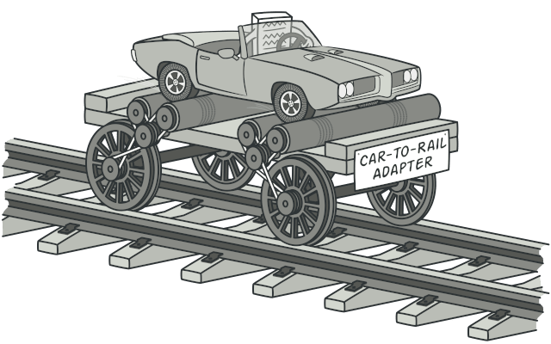
Adapter
Group 1
18

Slide 19
1a. Introduction
Adapter is a structural design pattern that allows objects with incompatible interfaces to collaborate.
19

Slide 20
1b. Definition:
Adapter pattern works as a bridge between two incompatible interfaces. This type of design pattern comes under structural pattern as this pattern combines the capability of two independent interfaces.
20

Slide 21
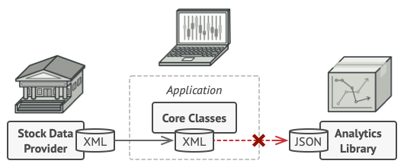
2. Purpose of use
Problem XML ><JSON
21

Slide 22
SOLUTION
The adapter gets an interface, compatible with one of the existing objects.
Using this interface, the existing object can safely call the adapter’s methods.
Upon receiving a call, the adapter passes the request to the second object, but in a format and order that the second object expects.
22

Slide 23
3.ARHITECTURE
Class Adapter Inheritance
Object Adapter Composition
23

Slide 24
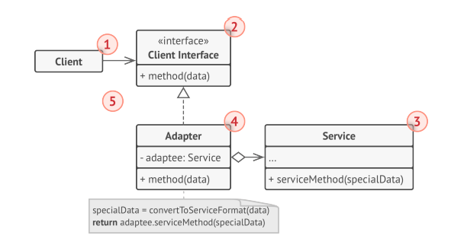
3.ARHITECTURE
CLIENT
CLIENT INTERFACE
SERVICE
Object adapter Composition
ADAPTER
24

Slide 25
NOTE
The client code doesn’t get coupled to the concrete adapter class as long as it works with the adapter via the client interface.
useful when the interface of the service class gets changed or replaced.
can introduce new types of adapters into the program without breaking the existing client code.
25

Slide 26
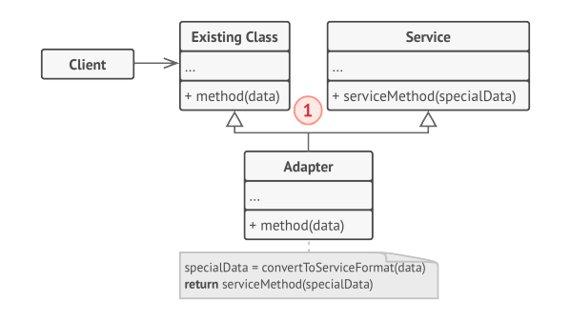
3. Architecture
Components: The Class Adapter: doesn’t need to wrap any objects because it inherits behaviors from both the client and the service. The adaptation happens within the overridden methods. The resulting adapter can be used in place of an existing client class.
Class adapter Inheritance
26

Slide 27
Difference between Class Adapter & Object Adapter
The main difference is that with class adapter we subclass the Target and the Adaptee, while the object adapter uses composition to pass requests to an adaptee. Object Adapters and Class Adapters use two different means of adapting the adaptee: composition versus inheritance.
27

Slide 28
4.Applicability
when you want to use some existing class, but its interface isn’t compatible with the rest of your code.
when you want to reuse several existing subclasses that lack some common functionality that can’t be added to the superclass.
28

Slide 29
5. Pros & Cons
Disadvantages: The overall complexity of the code increases because you need to introduce a set of new interfaces and classes. Sometimes it’s simpler just to change the service class so that it matches the rest of your code.
Advantages: Single Responsibility Principle. Open/Closed Principle.
29

Slide 30
6.Relations with other patterns
Bridge, State, Strategy (and to some degree Adapter) have very similar structures. However, they all solve different problems.
30
Adapter provides a different interface to the wrapped object, Proxy provides it with the same interface, and Decorator provides it with an enhanced interface.

Slide 31
DEMONSTRATION
HEADER
TEXT
SLIDER
ICONS
31

Slide 32
THANKS FOR LISTENING!
Does anyone have any question?
addyouremail@freepik.com
Group 1-Prototype & Adapter
32

