Slide 1

Factory Method

Slide 2
Group 6
Member:
Trịnh Văn Đông 20110636
Nguyễn Tấn Phước 20110392
Lê Diệp Trí 20110421
Lâm Trần Tuấn Khải 20110427

Slide 3
Table of contents
1
Introduction
5
The field of application
Advantages and
disadvantages
2
Purpose of use
6
7
Relevant designs
3
Architecture
Specific properties
Demo
4
8

Slide 4
Introduction
1

Slide 5
Introduction:
Factory method is an object-oriented pattern design in computer software design, which solves the problem of creating an object without necessarily specifying exactly which class to create.

Slide 6
Definition:
Factory Method provides an interface, method in creating an object (object) in the class. But let its derived subclass be overridable to specify which object will be created. Factory method assigns the creation of a specific object to the subclass.

Slide 7
Purpose of use
2

Slide 8
Purpose of use
Create a new way of instantiating objects through a common interface.
Hide the logic of the initialization method.
Reduce dependencies, easy to scale.
Reduce the possibility of compile errors.

Slide 9
Architecture
3

Slide 10
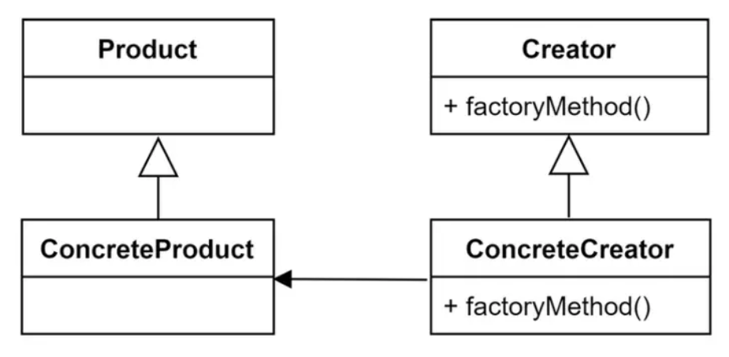
Architecture

Slide 11
Architecture
PRODUCT
Defines a template (interface) of the objects that the factory method creates
CONCRETEPRODUCT
Classes that are modeled product
P
C
CREATOR
Declare a factory method, which returns an object of type product. The creator can also define a default implementation of the factory method that returns a default concreteproduct object
CONCRETECREATOR
Override factory method to return an instance of concreteproduct
C
C

Slide 12
Specific properties
4

Slide 13
Specific properties
Reduced Coupling: Factory Method helps to reduce dependencies between classes in the system
Extensibility: Factory Method allows you to extend your system by adding new classes without affecting existing code.

Slide 14
Specific properties
Encapsulation: Factory Method helps encapsulate object creation into a separate class, making your code more readable and maintainable.
Polymorphism: The Factory Method allows you to use polymorphism to ensure that the object created fits your needs.
Reusable: Factory Method helps you reuse existing code without having to rewrite new code.

Slide 15
The field of application
5

Slide 16
The field of application
We have a super class with many subclasses and based on the input we need to return a subclass.
When needing to extend, create subclass and implement additional factory method for instantiating this subclass.

Slide 17
Advantages and disadvantages
6

Slide 18
Advantages and disadvantages
Advantage
Hide the logic of the initialization method
Limit dependencies between creators and concrete products
Easy to extend, add new code to the program
Help gather the code that creates the product into one place in the program
Reduce the possibility of compile errors
=> Commonly used in libraries

Slide 19
Advantages and disadvantages
Disadvantage
Source code can become more complex than usual
Refactoring (refactoring) an existing normal class into a class with Factory Method can lead to many errors in the system, breaking the existence of clients
Factory method pattern depends on using private constructor so classes cannot extend and inherit

Slide 20
Relevant designs
7

Slide 21
Relevant designs
Abstract factory: often used with Factory method.
Prototypes: Do not require classification from Creator. However, they often require initialization on Product. Creator uses Initialize to initialize the object.

Slide 22
Demo
8

Slide 23
THANKS!
ANY QUESTIONS?

