Slide 1
Hotel Management System

Slide 2
Project overview
What is it?
A full-stack web application that centralises all hotel operations — guest check-in, room booking, billing, housekeeping, and food orders — into one role-aware platform.

Slide 3
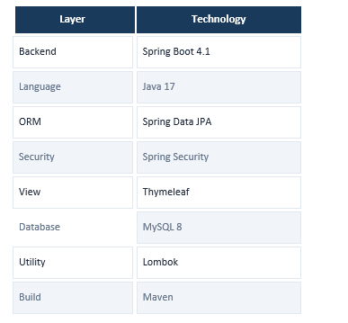
Technology stack
Layer
Technology
Why we chose it

Slide 4
System architecture
Browser (client)
Spring Boot application server
Controllers · Services · Repositories · Spring Security
MySQL database

Slide 5
Design Pattern
DTO
MVC
Repository
Service/Fade

Slide 6
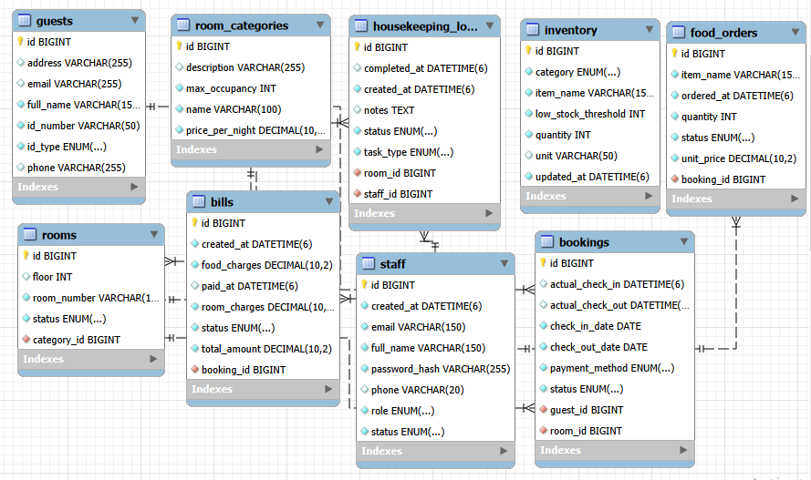
Database design — 9 tables

Slide 7
Security implementation
Password hashing
SQL injection
BCryptPasswordEncoder (strength 10). Plain-text passwords are never stored.
All queries use JPA @Param named parameters. No string concatenation in SQL.
XSS prevention
API field protection
Thymeleaf auto-escapes all output via th:text. No manual escaping needed.
@JsonIgnore on passwordHash prevents hash from appearing in JSON responses.

Slide 8
Known limitations & future work
No automated tests
Add JUnit 5 + Mockito unit tests for service layer; Spring Boot Test for API integration tests.
CSRF disabled
Re-enable Spring Security CSRF tokens before any production deployment.
No email notifications
Integrate Spring Mail or SendGrid to send booking confirmation to guests.
Single-server only
Switch to JWT-based stateless auth to support horizontal scaling and load balancing.
Inventory standalone
Link inventory to food_orders and housekeeping_logs for automatic stock deduction.

Slide 9
Demo

Slide 10
Thank you

