Slide 1
Chapter 03 NUMBERS
TS. Lê Đình Duy
TS. Nguyễn Tấn Trần Minh Khang
ThS. Mai Văn Cường
ThS. Võ Duy Nguyên
ThS. Nguyễn Hoàng Ngân
ThS. Nguyễn Thị Bảo Ngọc

Slide 2
3.1 INTEGERS AND DECIMAL NUMBERS

Slide 3
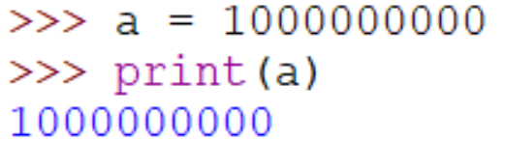
Integer
Integers in Python have no restrictions. They can be arbitrarily large.

Slide 4
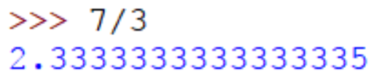
Decimal number
Decimal numbers are represented by what are called floating point numbers. You typically only get about 15 or so digits of precision.
The last digit is sometimes slightly off due to the fact that computers work in binary (base 2) whereas our human number system is base 10.

Slide 5
3.2 MATH OPERATORS

Slide 6
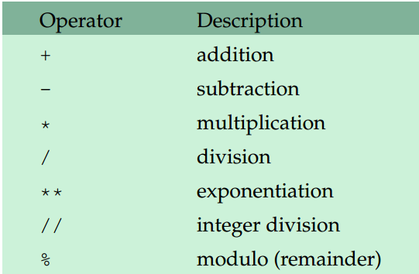
Common operators

Slide 7
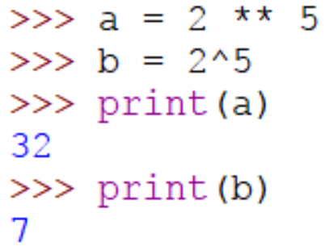
Exponentiation
Python uses ** for exponentiation. The caret, ^, is used for something else.

Slide 8
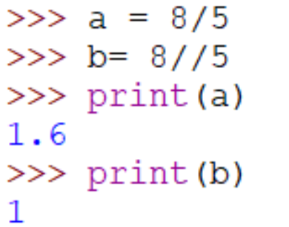
Integer division
For positive numbers, the integer division operator, //, behaves like ordinary division except that it throws away the decimal part of the result.

Slide 9
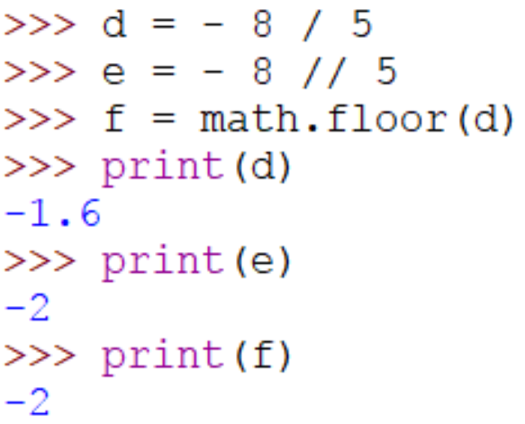
Integer division
For negative numbers, the integer division operator, //, the result is floored.

Slide 10
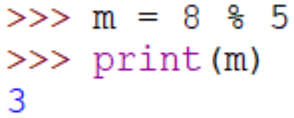
Modulo
The modulo operator, %, returns the remainder from a division.

Slide 11
3.3 ORDER OF OPERATIONS

Slide 12
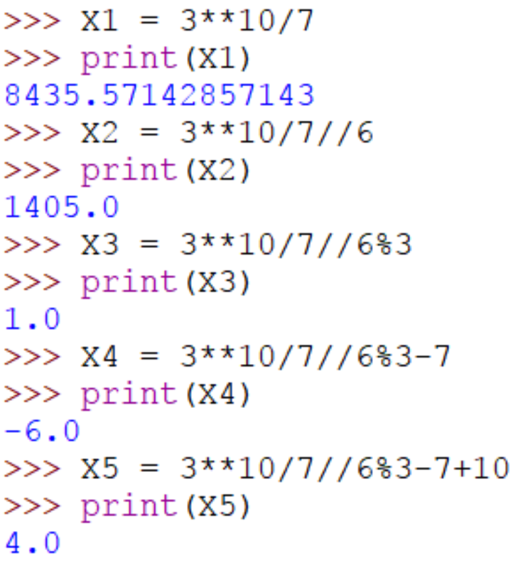
Order of operations
Exponentiation gets done first, followed by multiplication and division (including // and %), and addition and subtraction come last => PEMDAS (Please Excuse My Dear Aunt Sally)

Slide 13
3.4 RANDOM NUMBERS

Slide 14
Module
The core part of the Python language consists of things like for loops, if statements, math operators,... Everything else is contained in modules, and if we want to use something from a module we have to first import it.
To use:
or:
or:

Slide 15

The random module
The random module is random.
To use:

Slide 16
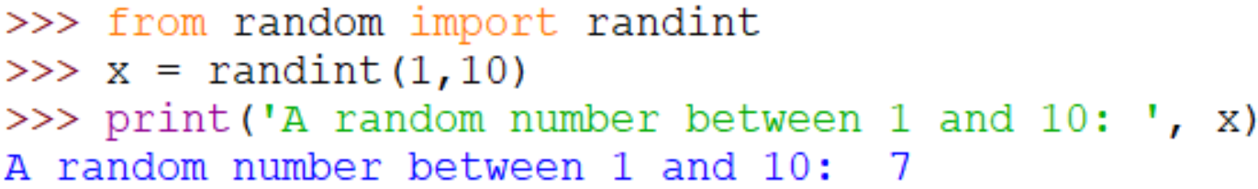
Random numbers
To get a random number, function randint from random module is used:

Slide 17
3.5 MATH FUNCTIONS

Slide 18
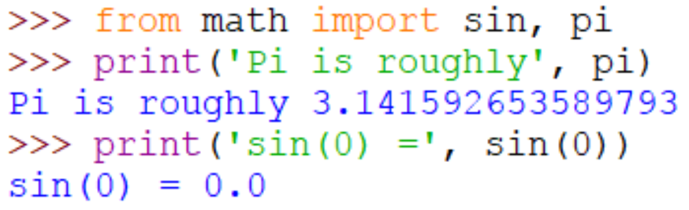
The math module
The math module is math. It contains familiar math functions, including sin, cos, tan, exp, log, log10, factorial, sqrt, floor, and ceil …

Slide 19
Built-in math functions
abs (absolute value) and round are two built in math functions that are available without importing the math module.

Slide 20
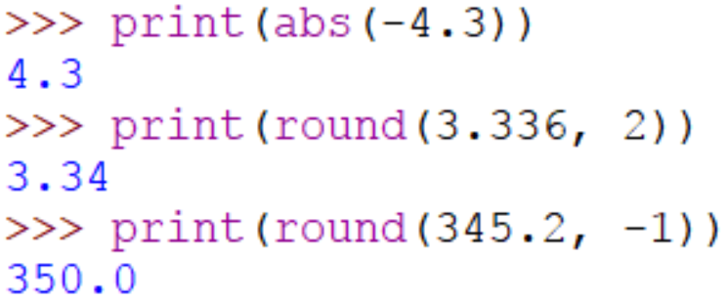
Built-in math functions
abs(x) Return the absolute value of a number. The argument may be a plain or long integer or a floating point number. If the argument is a complex number, its magnitude is returned.

Slide 21
Built-in math functions
round(number, ndigits) Return the floating point value number rounded to ndigits digits after the decimal point.

Slide 22
3.6 GETTING HELP FROM PYTHON

Slide 23
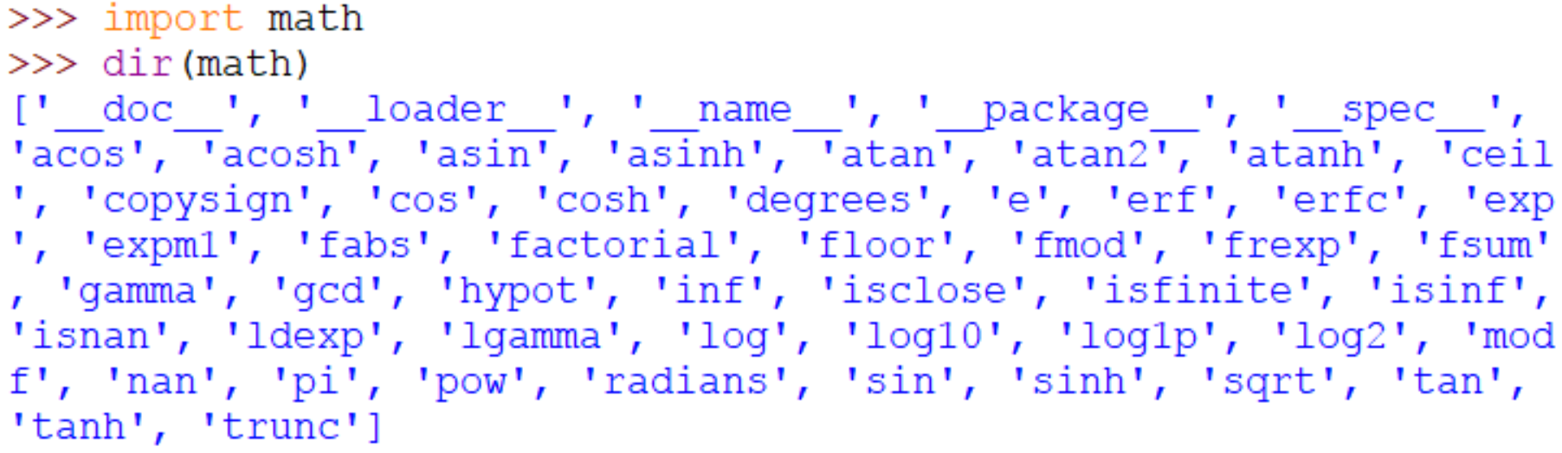
Getting help from Python
There is documentation built into Python. To get help on the math module, for example, type the following two lines:

Slide 24
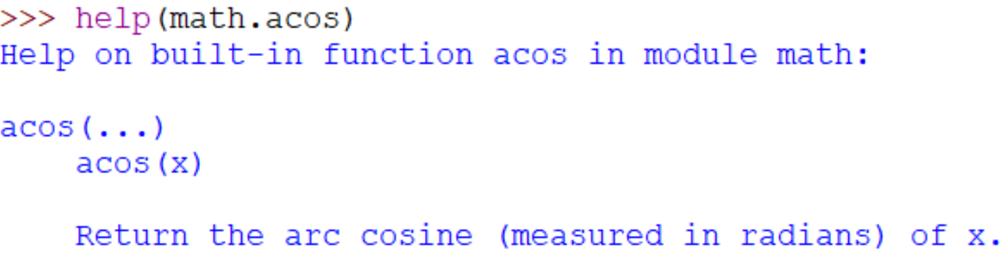
Getting help from Python
To get help on a specific function, say the acos function, you can type:

Slide 25
3.7 USING THE SHELL AS A CALCULATOR

Slide 26
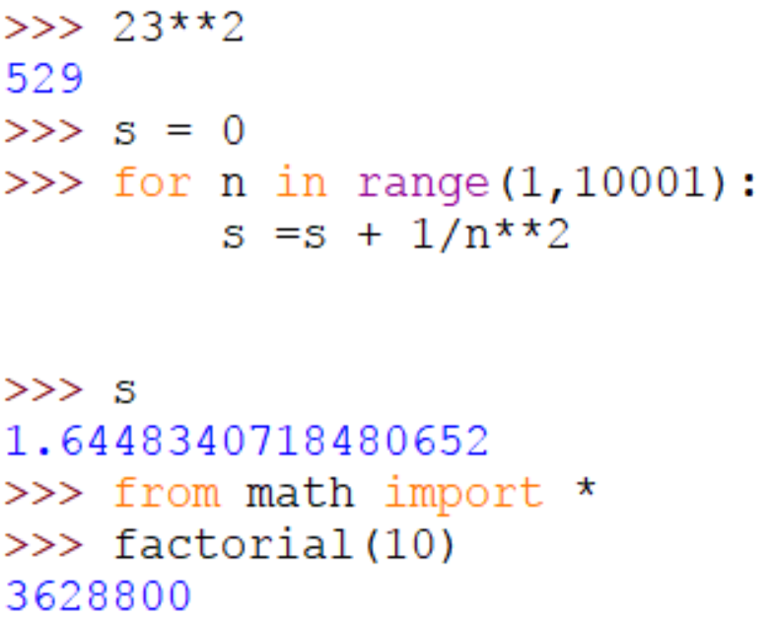
Using the Shell as a Calculator
The Python shell can be used as a very handy and powerful calculator.

Slide 27
3.8 EXERCISES

Slide 28
Exercise 3.8.1
Write a program that generates a random number between 1 and 10 and prints your name that many times.

Slide 29
Exercise 3.8.1
from random import randint
for i in range(50):
print(randint(3,6), end=' ')
Result

Slide 30
Exercise 3.8.2
Write a program that generates a random number, x, between 1 and 50, a random number y between 2 and 5, and computes x^{y}.

Slide 31
Exercise 3.8.2
from random import randint
x = randint(1,50)
y = randint(2,5)
print(x, '^', y, ' = ', x**y)
Use randint to create random integer numbers.
Result:

Slide 32
Exercise 3.8.3
Write a program that generates a random number between 1 and 10 and prints your name that many times.

Slide 33
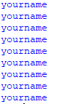
Exercise 3.8.3
from random import randint
temp = randint(1,10)
for i in range(temp):
print('yourname')
Result

Slide 34
Exercise 3.8.4
Write a program that generates a random decimal number between 1 and 10 with two decimal places of accuracy. Examples are 1.23, 3.45, 9.80, and 5.00.

Slide 35
Exercise 3.8.4
from random import randint
from decimal import Decimal
print(round(Decimal(randint(100,1000)/100),2))
Result:

Slide 36
Exercise 3.8.5
Write a program that generates 50 random numbers such that the first number is between 1 and 2, the second is between 1 and 3, the third is between 1 and 4, . . . , and the last is between 1 and 51.

Slide 37
Exercise 3.8.5
from random import randint
for i in range(2, 52):
print(randint(1,i))
Result:

Slide 38

Exercise 3.8.6
Write a program that asks the user to enter two numbers, x and y, and computes $\frac{|x−y|}{x+y}$.

Slide 39

Exercise 3.8.6
x = eval(input('Enter x = '))
y = eval(input('Enter y = '))
print('|x-y|/(x+y) = ', abs(x-y)/(x+y))
Result:

Slide 40
Exercise 3.8.7
Write a program that asks the user to enter an angle between −180◦ and 180◦ . Using an expression with the modulo operator, convert the angle to its equivalent between 0◦ and 360◦.

Slide 41

Exercise 3.8.7
angle = eval(input('Enter the angle: '))
angle += 360
angle %= 360
print('Angle =', angle)
Result:

Slide 42
Exercise 3.8.8
Write a program that asks the user for a number of seconds and prints out how many minutes and seconds that is. For instance, 200 seconds is 3 minutes and 20 seconds. [Hint: Use the // operator to get minutes and the % operator to get seconds.]

Slide 43

3.8.8
seconds = eval(input('Enter number of second(s): '))
minutes = seconds//60
seconds = seconds%60
print(minutes, 'minute(s)', seconds, 'second(s)')
Result:

Slide 44
3.8.8
seconds = eval(input('Enter number of second(s): '))
minutes = seconds//60
seconds = seconds%60
print(minutes, 'minute(s)', seconds, 'second(s)')
Result:

Slide 45
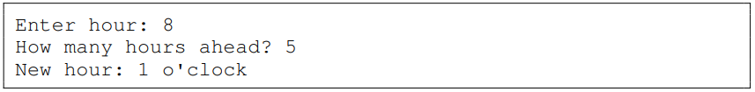
3.8.9
Write a program that asks the user for an hour between 1 and 12 and for how many hours in the future they want to go. Print out what the hour will be that many hours into the future. An example is shown below.

Slide 46

3.8.9
time = eval(input('Enter hour: '))
time_ahead = eval(input('How many hours ahead? '))
print('New hour:', (time+time_ahead-1)%12+1, 'o\'clock')
Result:

Slide 47
3.8.9
time = eval(input('Enter hour: '))
time_ahead = eval(input('How many hours ahead? '))
print('New hour:', (time+time_ahead-1)%12+1, 'o\'clock')
Result:

Slide 48
3.8.10(a)
One way to find out the last digit of a number is to mod the number by 10. Write a program that asks the user to enter a power. Then find the last digit of 2 raised to that power.

Slide 49

3.8.10(a)
power_number = eval(input('Enter a power: '))
print('The last digit of 2^', power_number, ' is ', (2**power_number)%10, sep='')
Result:

Slide 50
3.8.10(b)
(b) One way to find out the last two digits of a number is to mod the number by 100. Write a program that asks the user to enter a power. Then find the last two digits of 2 raised to that power.

Slide 51

3.8.10(b)
power_number = eval(input('Enter a power: '))
print('The last 2 digits of 2^', power_number, ' are ', (2**power_number)%100, sep='')
Result:

Slide 52
3.8.10(c)
(c) Write a program that asks the user to enter a power and how many digits they want. Find the last that many digits of 2 raised to the power the user entered.

Slide 53

3.8.10(c)
power_number = eval(input('Enter a power: '))
number_of_digit = eval(input('How many digit do you want? '))
print('The last ', number_of_digit, ' digit(s) of 2^', power_number, ' is ', (2**power_number)%(10**number_of_digit), sep='')
Result:

Slide 54
3.8.11
Write a program that asks the user to enter a weight in kilograms. The program should convert it to pounds, printing the answer rounded to the nearest tenth of a pound.

Slide 55

3.8.11
weight_in_kg = eval(input('Enter weight in kg: '))
weight_in_pound = weight_in_kg*2.20462262
print('Weight in pound (approximately):', round(weight_in_pound, 10))
Result:

Slide 56
3.8.12
Write a program that asks the user for a number and prints out the factorial of that number.

Slide 57
3.8.12
from math import factorial
num = eval(input('Enter a number: '))
print(num, '! = ', factorial(num), sep='')
Result:

Slide 58
3.8.13
Write a program that asks the user for a number and then prints out the sine, cosine, and tangent of that number

Slide 59
3.8.13
from math import sin, cos, tan
num = eval(input('Enter a number: '))
print('sin(', num, ') = ', sin(num), '; cos(', num, ') = ', cos(num), '; tan(', num, ') = ', tan(num), sep='')
Result:

Slide 60
3.8.14
Write a program that asks the user to enter an angle in degrees and prints out the sine of that angle.

Slide 61

3.8.14
from math import pi, sin
angle_in_degree = eval(input('Enter an angle in degree: '))
angle_in_radius = angle_in_degree*pi/180
print('sin(', angle_in_degree, ') = ', round(sin(angle_in_radius), 4), sep='')
Result:

Slide 62
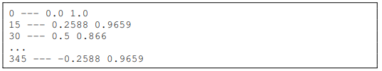
3.8.15
Write a program that prints out the sine and cosine of the angles ranging from 0 to 345◦ in 15◦ increments. Each result should be rounded to 4 decimal places. Sample output is shown below:

Slide 63
3.8.15
from math import pi, sin, cos
for i in range(0, 346, 15):
angle_in_radius = i*pi/180
sin_result = sin(angle_in_radius)
cos_result = cos(angle_in_radius)
print(i, '---', round(sin_result, 4), round(cos_result, 4))

Slide 64
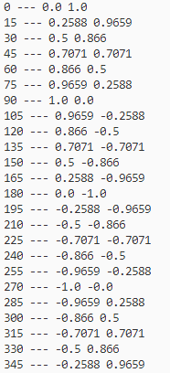
3.8.15
Result:

Slide 65
3.8.16
Below is described how to find the date of Easter in any year. Despite its intimidating appearance, this is not a hard problem. Note that [x] is the floor function, which for positive numbers just drops the decimal part of the number. For instance [3.14] = 3. The floor function is part of the math module.
C = century (1900’s → C = 19)
Y = year (all four digits)
m = (15 + C − b C 4 c − b 8C+13 25 c) mod 30
n = (4 + C − b C 4 c) mod 7
a = Y mod 4

Slide 66
3.8.16
b = Y mod 7
c = Y mod 19
d = (19c + m) mod 30
e = (2a + 4b + 6d + n) mod 7
Easter is either March (22+d +e) or April (d +e−9). There is an exception if d = 29 and e = 6. In this case, Easter falls one week earlier on April 19. There is another exception if d = 28, e = 6, and m = 2, 5, 10, 13, 16, 21, 24, or 39. In this case, Easter falls one week earlier on April 18. Write a program that asks the user to enter a year and prints out the date of Easter in that year. (See Tattersall, Elementary Number Theory in Nine Chapters, 2nd ed., page 167)

Slide 67
3.8.16
from math import floor
Y = eval(input('Enter year: '))
C = (Y+1)//100
m = (15+C-(floor(C/4))-(floor((8*C+13)/25)))%30
n = (4+C-(floor(C/4)))%7
a = Y%4
b = Y%7
c = Y%19
d = (19*c+m)%30
e = (2*a+4*b+6*d+n)%7

Slide 68
3.8.16
if((22+d+e)>31):
day = d+e-9
month = 4
else:
day = 22+d+e
month = 3
if(d==29 and e==6):
month = 4
day = 19

Slide 69

3.8.16
if((d==28 and e==6) and (m==2 or m==5 or m==10 or m==13 or m==16 or m==21 or m==24 or m==39)):
month = 4
day = 18
print(month, day, Y, sep='-')
Result:

Slide 70
3.8.17
A year is a leap year if it is divisible by 4, except that years divisible by 100 are not leap years unless they are also divisible by 400. Ask the user to enter a year, and, using the // operator, determine how many leap years there have been between 1600 and that year.

Slide 71
3.8.17
year = eval(input('Enter a year: '))
sub = abs(1600-year)
a = sub//4
b = sub//100
c = sub//400
d = a - b + c
e = 0
for i in range(1601, year+1):
if((i%4==0 and i%100!=0) or i%400==0):
e = e+1
print(d, e)

Slide 72

3.8.17
Result:

Slide 73
3.8.18
Write a program that given an amount of change less than $1.00 will print out exactly how many quarters, dimes, nickels, and pennies will be needed to efficiently make that change. [Hint: the // operator may be useful.]

Slide 74
3.8.18
p = int(100*(eval(input('Enter the amount ($): '))))
q = p//25
p = p%25
d = p//10
p = p%10
n = p//5
p = p%5
print(q,'quarter(s) -', d, 'dime(s) -', n, 'nickel(s) -', p, 'penny(pennies)')

Slide 75
3.8.18
Result:

Slide 76
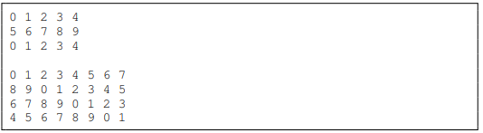
3.8.19
Write a program that draws “modular rectangles” like the ones below. The user specifies the width and height of the rectangle, and the entries start at 0 and increase typewriter fashion from left to right and top to bottom, but are all done mod 10. Below are examples of a 3×5 rectangle and a 4×8.

Slide 77
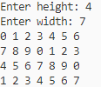
3.8.19
width = eval(input('Enter height : '))
height = eval(input('Enter width: '))
for i in range (width*height):
print(i%10, end=' ')
if(i>1 and (i+1)%height==0):
print('')
Result:

