Slide 1
Passerelles numériques
A Gateway for Life
SQL

Slide 2
Objectives
Create database
Create table
Manage table
Accessing data in database
Notes:
I want to show them between the command line vs sql vs gui

Slide 3
What is SQL?
Structure Query Language
Not a programing language
Is a data sub language used to
Define and manage database (Data Definition Language)
Create, Read, Update and Delete data (Data Manipulation Language)
Create user accounts, manage permission,.. (Data Control Language)
Notes:
We could use it with many RDBMS like mysql, sqlserver, oracle, ibmdb2,….

Slide 4

MySQL
Notes:
Mysql client : command line
Phpmyadmin: web interface
Mysql workbench: gui with er diagram cabability

Slide 5
DDL
CREATE
Create Database, table
ALTER
Modify table
DROP
Delete existing Database, table

Slide 6
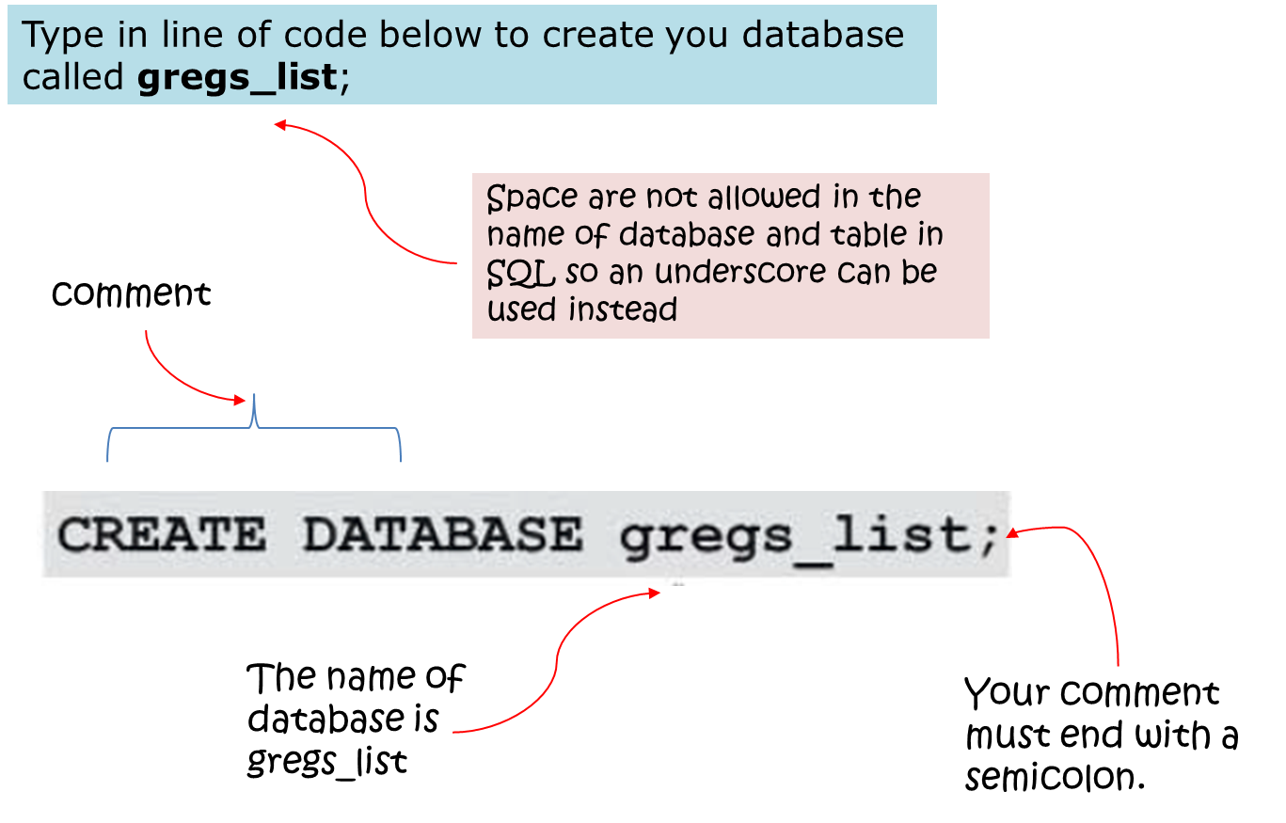
CREATE Database
Notes:
Show them on the fly how to create db using command line then phpmyadmin

Slide 7
Activity
Create your Database using
Command line
Open command prompt from your mysql bin directory
Type : mysql –u root
Phpmyadmin in the sql tab
CREATE DATABASE database_name;
15 minutes

Slide 8
CREATE DATABASE IF NOT EXISTS database_name;
To check exiting database before we create.

Slide 9
Activity
Create your Database using
Command line
Phpmyadmin in the sql tab
CREATE DATABASE IF NOT EXISTS database_name;
15 minutes

Slide 10

Displaying Databases
You can use the SHOW DATABASE statement to check the database that you’ve created or to see all the databases on the database server before you create a new database.
Syntax:
SHOW DATABASES;

Slide 11
Activity
Show your Database using
Command line
Phpmyadmin in the sql tab
SHOW DATABASES;
05 minutes

Slide 12
Selecting a database to work with
You must tell MySQL which database you want to work with by using the USE statement.
Syntax
USE database_name;
The result is: Database changed in command line

Slide 13
Activity
Use your Database by using
Command line
Phpmyadmin in the sql tab
USE database_name;
10 minutes

Slide 14
Removing Databases
Syntax:
DROP DATABASE [IF EXISTS] database_name;
Notes:
Similar to the CREATE DATABASE statement, the IF EXISTS is an optional part of the statement to prevent you from removing a database that does not exist in the database server.
Followed the DROP DATABASE is the database name that you want to remove.
Similar to the CREATE DATABASE statement, the IF EXISTS is an optional part of the statement to prevent you from removing a database that does not exist in the database server.

Slide 15
Activity
Delete your Database using
Command line
Phpmyadmin in the sql tab
CREATE DATABASE IF NOT EXISTS temp_database;
SHOW DATABASES;
DROP DATABASE IF EXISTS temp_database;
15 minutes

Slide 16
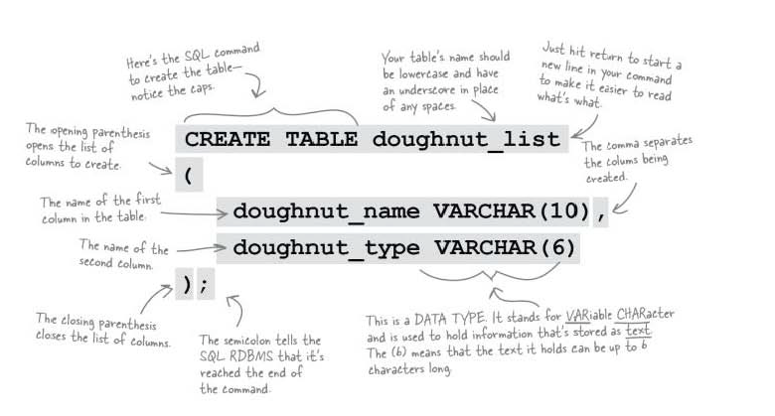
CREATE Table

Slide 17

Example
Now we want to create a table called "Persons" that contains five columns: P_Id, LastName, FirstName, Address, and City.

Slide 18
CREATE TABLE Persons ( P_Id int, LastName varchar(10), FirstName varchar(30), Address varchar(255), City varchar(255) );
Notes:
Show them and ask them to do activity

Slide 19
Activity
CREATE TABLE Persons ( P_Id int, LastName varchar(10), FirstName varchar(30), Address varchar(255), City varchar(255) );
15 minutes

Slide 20
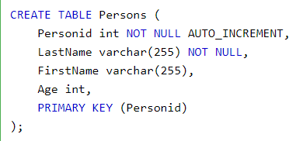
Primary Key
Notes:
Change this to the diagram we had in the previous lesson but do similar match

Slide 21
Activity
CREATE TABLE IF NOT EXISTS pnc_student(
identification int not null auto_increment, last_name varchar(30),
family_name varchar(20), specialization varchar(5), batch varchar(50),
PRIMARY KEY (identification ) );
15 minutes

Slide 22
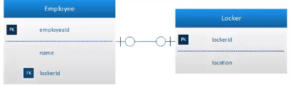
1:1

Slide 23
1st : create table “locker”
CREATE TABLE locker(
lockerId int,
location varchar(200),
CONSTRAINT locIDpk PRIMARY KEY(lockerId)
);
2nd: create table “employee” with relationship with locker
CREATE TABLE employee(
empId int,
locId int,
name varchar(200),
CONSTRAINT empIdpk PRIMARY KEY(empId ),
CONSTRAINT lockIdfk FOREIGN KEY (locId) REFERENCES locker(lockerId)
);

Slide 24
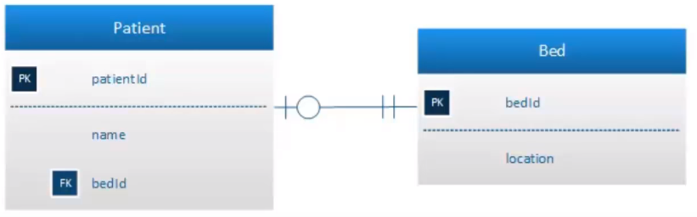
Activity
Create these 2 tables and their relationship in MySQL
15 minutes
Notes:
CREATE TABLE bed(
bedID int,
location varchar(50),
CONSTRAINT bedID PRIMARY KEY(bedID)
);
CREATE TABLE Patient(
patientID int,
bedID int,
name varchar(50),
CONSTRAINT patientID PRIMARY KEY(patientID),
CONSTRAINT bedID FOREIGN KEY(bedID) REFERENCES bed(bedID)
);

Slide 25
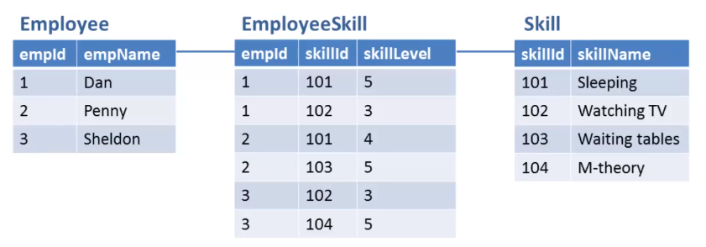
M:N

Slide 26
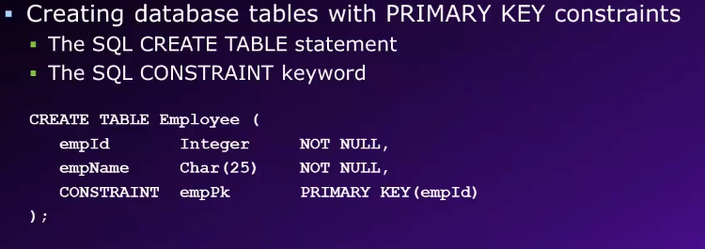

Slide 27
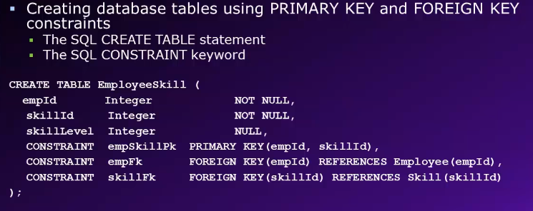

Slide 28
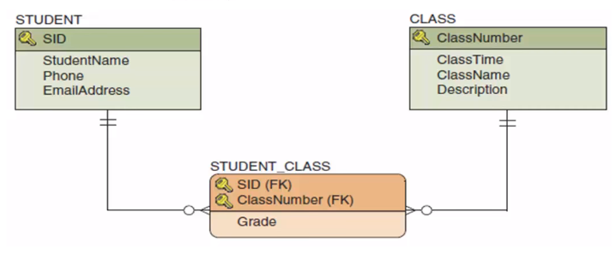
15 minutes

Slide 29
Constraints
SQL constraints are used to specify rules for data in a table
Constraint is created with the CREATE TABLE statement, or after the table is created with the ALTER TABLE statement
Notes:
Constraints are used to limit the type of data that can go into a table. This ensures the accuracy and reliability of the data in the table. If there is any violation between the constraint and the data action, the action is aborted.
Constraints can be column level or table level. Column level constraints apply to a column, and table level constraints apply to the whole table.

Slide 30
Common Constraints
NOT NULL
UNIQUE
PRIMARY KEY
FOREIGN KEY

Slide 31
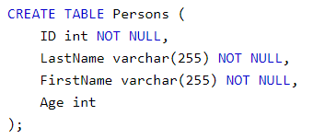
NOT NULL
By default, a column accepts NULL value
NOT NULL constraint enforces a column to not accept NULL value
Notes:
This enforces a field to always contain a value, which means that you cannot insert a new record, or update a record without adding a value to this field.
Ex:
CREATE TABLE Persons ( ID int NOT NULL, LastName varchar(255) NOT NULL, FirstName varchar(255) NOT NULL, Age int );
ID, lname,fname can’t be null except Age.
Try to insert a record with null values to those fields what would happen?
INSERT INTO persons(ID,FirstName,LastName,Age)
VALUES(null,'Channak','Chhon',30);

Slide 32
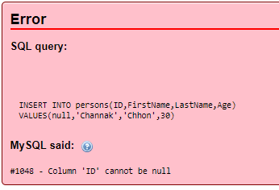

Slide 33
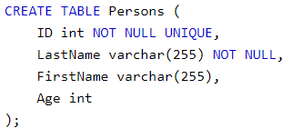
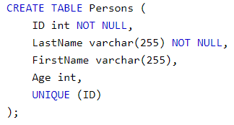
UNIQUE
The UNIQUE constraint ensures that all values in a column are different
SQL Server / Oracle / MS Access
MySQL
Notes:
Both the UNIQUE and PRIMARY KEY constraints provide a guarantee for uniqueness for a column or set of columns.
A PRIMARY KEY constraint automatically has a UNIQUE constraint.
However, you can have many UNIQUE constraints per table, but only one PRIMARY KEY constraint per table.
CREATE TABLE Persons ( ID int NOT NULL UNIQUE, LastName varchar(255) NOT NULL, FirstName varchar(255), Age int );
CREATE TABLE Persons ( ID int NOT NULL, LastName varchar(255) NOT NULL, FirstName varchar(255), Age int, UNIQUE (ID) );

Slide 34
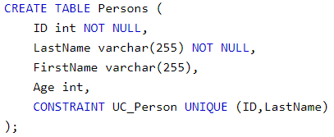
UNIQUE
to define a UNIQUE constraint on multiple columns, use the following SQL syntax:
Notes:
CREATE TABLE Persons ( ID int NOT NULL, LastName varchar(255) NOT NULL, FirstName varchar(255), Age int, CONSTRAINT UC_Person UNIQUE (ID,LastName) );
ALTER TABLE persons ADD CONSTRAINT UC_Person UNIQUE(ID,FirstName);

Slide 35
Why Naming Constraint?
Easy to spot and fix errors
Easy to modify or update later
Easy for the next database designer or administrator
Notes:
If a query (insert, update, delete) violates a constraint, SQL will generate an error message that will contain the constraint name. If the constraint name is clear and descriptive, the error message will be easier to understand;
(2) If a constraint needs to be modified in the future (yes, it happens), it's very hard to do if you don't know what it's named. (ALTER TABLE MyTable drop CONSTRAINT um...)
(3) If the person who gets to support your code (aka a DBA) has to waste a lot of pointless time dealing with case (1) or case (2) at 3am on Sunday, they're quite probably in a position to identify where the code came from and be able to react accordingly.

Slide 36
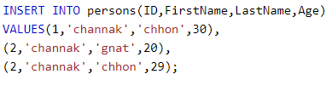
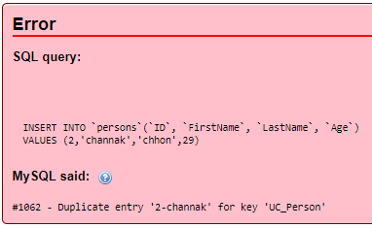
Why Naming Constraint?
What will happen?
Notes:
INSERT INTO persons(ID,FirstName,LastName,Age) VALUES(1,'channak','chhon',30), (2,'channak','gnat',20),(2,'channak','chhon',29);
What if we don’t have any constraint name?
`ALTER TABLE ``persons`` DROP INDEX ``UC_Person``;`

Slide 37
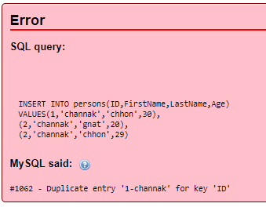
Why Naming Constraint?
What if we don’t have any constraint name?
Notes:
Clues less error : this example seem not well explained

Slide 38
PRIMARY KEY
The PRIMARY KEY constraint uniquely identifies each record in a database table
Primary keys must contain UNIQUE values, and cannot contain NULL values
A table can have only one primary key, which may consist of single or multiple fields
Notes:
The GUI works the same as scripting.
At the meantime, we will focus on the scripting and we will have some extra demonstration at the end or on the weekend
With the GUI.
Learn the concept first, the tool is just the other way to make thing done even more faster.
We will discover about it later together.

Slide 39
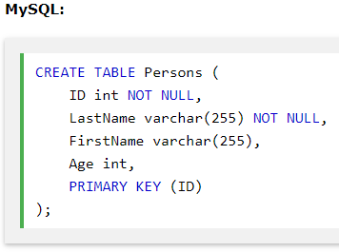
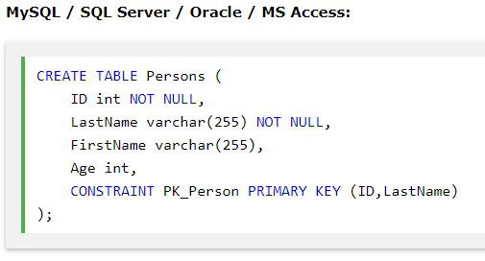
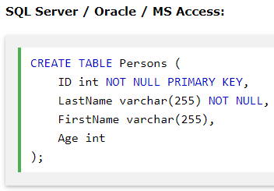
Notes:
CREATE TABLE Persons ( ID int NOT NULL, LastName varchar(255) NOT NULL, FirstName varchar(255), Age int, PRIMARY KEY (ID) );
CREATE TABLE Persons ( ID int NOT NULL PRIMARY KEY AUTO_INCREMENT, LastName varchar(255) NOT NULL, FirstName varchar(255), Age int );

Slide 40

Note
The PRIMARY KEY constraint uniquely identifies each record in a database table.
Primary keys must contain UNIQUE values.
A primary key column cannot contain NULL values.
Most tables should have a primary key, and each table can have only ONE primary key.

Slide 41
FOREIGN KEY
A FOREIGN KEY is a key used to link two tables together
A FOREIGN KEY is a field (or collection of fields) in one table that refers to the PRIMARY KEY in another table
The table containing the foreign key is called the child table, and the table containing the candidate key is called the referenced or parent table

Slide 42
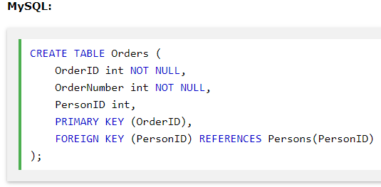
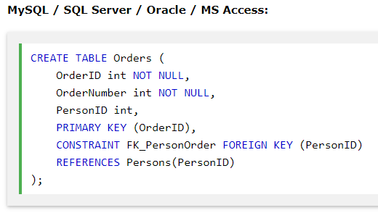
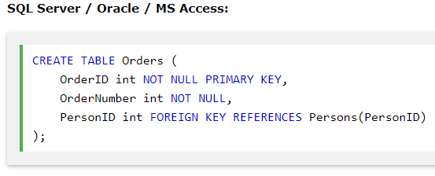

Slide 43
[CONSTRAINT [symbol]] FOREIGN KEY
[index_name] (index_col_name, ...)
REFERENCES tbl_name (index_col_name,...)
[ON DELETE reference_option]
[ON UPDATE reference_option]
reference_option: RESTRICT | CASCADE | SET NULL | NO ACTION
CASCADE: Delete or update the row from the parent table, and automatically delete or update the matching rows in the child table
RESTRICT: Rejects the delete or update operation for the parent table
SET NULL: Delete or update the row from the parent table, and set the foreign key column or columns in the child table to NULL.
Notes:
Want to have small demo!!!
CASCADE: Delete or update the row from the parent table, and automatically delete or update the matching rows in the child table. Both ON DELETE CASCADE and ON UPDATE CASCADE are supported. Between two tables, do not define several ON UPDATE CASCADE clauses that act on the same column in the parent table or in the child table.
RESTRICT: Rejects the delete or update operation for the parent table. Specifying RESTRICT (or NO ACTION) is the same as omitting the ON DELETE or ON UPDATE clause.
SET NULL: Delete or update the row from the parent table, and set the foreign key column or columns in the child table to NULL. Both ON DELETE SET NULL and ON UPDATE SET NULL clauses are supported.
If you specify a SET NULL action, make sure that you have not declared the columns in the child table as NOT NULL.
NO ACTION: A keyword from standard SQL. In MySQL, equivalent to RESTRICT. InnoDB rejects the delete or update operation for the parent table if there is a related foreign key value in the referenced table. Some database systems have deferred checks, and NO ACTION is a deferred check. In MySQL, foreign key constraints are checked immediately, so NO ACTION is the same as RESTRICT.

Slide 44
FK Constraint
We put the FK constraint on the Child table (table that stores the PK of the other table as FK) so whatever happens to the Parent table it will check against this constraint before executing the query statement
Note: This constraint for the column doesn’t effect the other value of the same row

Slide 45
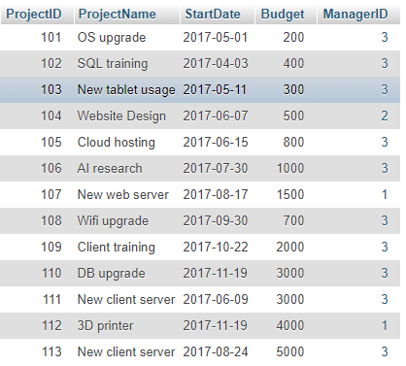
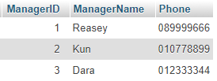
Parent
Child
Notes:
ALTER TABLE project
ADD CONSTRAINT projectfk FOREIGN KEY (ManagerID) REFERENCES manager(ManagerID)
ON DELETE RESTRICT ON UPDATE RESTRICT;

Slide 46
Altering Existing Table Structures
SQL ALTER TABLE Statement
The ALTER TABLE statement is used to add, delete, or modify columns in an existing table
The ALTER TABLE statement is also used to add and drop various constraints on an existing table

Slide 47

ALTER TABLE - ADD Column
Add a new column into the table

Slide 48
CREATE TABLE Persons ( ID int NOT NULL, LastName varchar(10) NOT NULL, FirstName varchar(30) NOT NULL, Address varchar(255) NOT NULL,
Age int, City varchar(255) );
Add new column
DOB: date
05 minutes
Notes:
Suppose we already had the table persons (if not you can create it now)
ALTER TABLE Persons ADD DOB date;

Slide 49

ALTER TABLE - DROP COLUMN
Delete any column
Ex:
ALTER TABLE Persons DROP COLUMN DOB;

Slide 50
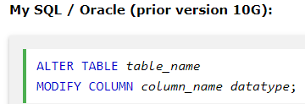
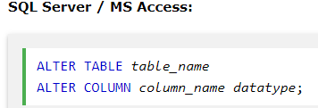
ALTER/MODIFY COLUMN
To change the data type of a column in a table

Slide 51
Ex: Change the datatype of DOB column from date to year
ALTER TABLE Persons MODIFY COLUMN DOB year;
05 minutes
Notes:
ALTER TABLE persons
MODIFY Age int NOT NULL -> change from null to not null

Slide 52
ALTER NULL
Ex: Change constraint of Age column from NULL to NOT NULL
ALTER TABLE Persons MODIFY Age int NOT NULL;
Ex: Change constraint of Age column from NOT NULL to NULL
ALTER TABLE Persons MODIFY Age int NULL;
10 minutes
Notes:
ALTER TABLE persons
MODIFY Age int NOT NULL -> change from null to not null

Slide 53


SQL UNIQUE Constraint on ALTER TABLE
To create a UNIQUE constraint on the "ID" column when the table is already created
To name a UNIQUE constraint, and to define a UNIQUE constraint on multiple columns

Slide 54
SQL UNIQUE Constraint on ALTER TABLE
To create a UNIQUE constraint on the "ID" column when the table is already created
To name a UNIQUE constraint, and to define a UNIQUE constraint on multiple columns
10 minutes

Slide 55
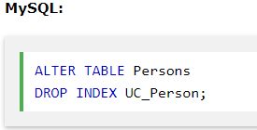
DROP a UNIQUE Constraint
To drop a UNIQUE constraint
Notes:
ALTER TABLE Persons DROP INDEX UC_Person;
You could try: ALTER TABLE Persons DROP UNIQUE CONSTRAINT UC_Person; ///wrong 0s
What will happen?

Slide 56


SQL PRIMARY KEY on ALTER TABLE
To create a PRIMARY KEY constraint on the “ID" column when the table is already created
Two columns key
Note: If you use the ALTER TABLE statement to add a primary key, the primary key column(s) must already have been declared to not contain NULL values (when the table was first created).
Notes:
ALTER TABLE Persons ADD PRIMARY KEY (ID);
ALTER TABLE Persons ADD CONSTRAINT PK_Person PRIMARY KEY (ID,LastName);

Slide 57
SQL PRIMARY KEY on ALTER TABLE
To create a PRIMARY KEY constraint on the “ID" column when the table is already created
Two columns key
10 minutes
Notes:
ALTER TABLE Persons ADD PRIMARY KEY (ID);
ALTER TABLE Persons ADD CONSTRAINT PK_Person PRIMARY KEY (ID,LastName);

Slide 58
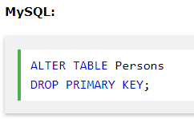
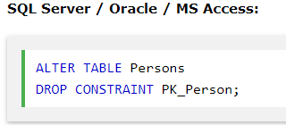
DROP a PRIMARY KEY Constraint
To drop a PRIMARY KEY constraint

Slide 59
DROP a PRIMARY KEY Constraint
To drop a PRIMARY KEY constraint
05 minutes

Slide 60


SQL FOREIGN KEY on ALTER TABLE
To create a FOREIGN KEY constraint on the "PersonID" column when the "Orders" table is already created

Slide 61
SQL FOREIGN KEY on ALTER TABLE
To create a FOREIGN KEY constraint on the "PersonID" column when the "Orders" table is already created
05 minutes

Slide 62

DROP a FOREIGN KEY Constraint
To drop a FOREIGN KEY constraint
05 minutes
Notes:
ALTER TABLE child DROP FOREIGN KEY ?
We don’t know the symbol name because we let the system create constraint automatically
So we need to see the code that the system auto generated
Code: SHOW CREATE TABLE table_name

Slide 63
Exercise
Notes:
DDL.docx in exercise folder

Slide 64

Accessing data in database
Create, Read, Update and Delete data (Data Manipulation Language)

Slide 65
INSERT Statement
The INSERT statement allows you to insert data into MySQL tables
Syntax:
INSERT [INTO] tablename [(col1, col2, col3,….)]
VALUES (value1, value2, value3,…);

Slide 66
INSERT Statement
CREATE TABLE Category
( id int not null auto_increment,
catname varchar(300),
description varchar(500),
primary key(id)
);
INSERT INTO specific columns
INSERT INTO Category(catname,description)
VALUES (‘cat1’,’description1’);

Slide 67
INSERT Statement
CREATE TABLE Category
(id int not null auto_increment,
catname varchar(300),
description varchar(500),
primary key(id)
);
INSERT INTO specific columns
INSERT INTO Category(catname,description)
VALUES (‘cat1’,’description1’);
05 minutes
Notes:
Maybe to save time upload the sql file and ask them to import it into mysql and practise

Slide 68

INSERT Statement
Insert data into a table with auto increment column
INSERT INTO Category
VALUES (NULL,‘cat1’,’description1’);
INSERT INTO Category
VALUES (‘cat1’,’description1’);

Slide 69


INSERT INTO Category(catname,description)
VALUES (‘cat1’,’description1’);
INSERT INTO Category
VALUES (NULL,‘cat1’,’description1’);
INSERT INTO Category
VALUES (‘cat1’,’description1’);
10 minutes

Slide 70
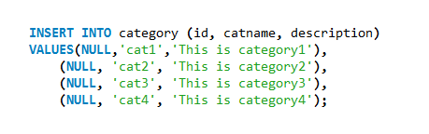
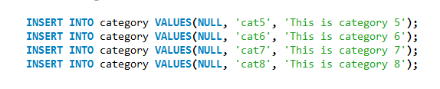
INSERT Statement
Insert multiple rows with a single INSERT statement:
INSERT INTO Category
VALUES (NULL,‘cat1’,’description1’),
(NULL,‘cat1’,’description1’),
(NULL,‘cat1’,’description1’);
Notes:
INSERT category VALUES(null,'cat1','category1'), (null,'cat1','category1'), (null,'cat1','category1'), (null,'cat1','category1')

Slide 71
INSERT INTO Category
VALUES (NULL,‘cat1’,’description1’),
(NULL,‘cat1’,’description1’),
(NULL,‘cat1’,’description1’);
15 minutes

Slide 72
SELECT Statement
SELECT *
WHERE
AND & OR Operator (&&,||)
SELECT ORDER BY
SELECT GROUP BY HAVING
SELECT LIMIT
SELECT DISTINCT

Slide 73
SELECT Statement
The SQL SELECT statement is used to SELECT data FROM a table. The table result is stored in a result table (called the result-set).
Note: SQL statements are not case sensitive. “SELECT” is the same as “select”.
SELECT [columns,...] FROM [tables,…] [WHERE conditions] [GROUP BY group [HAVING group_conditions]] [ORDER BY sort_columns] [LIMIT number_row_start, number_row_end];

Slide 74
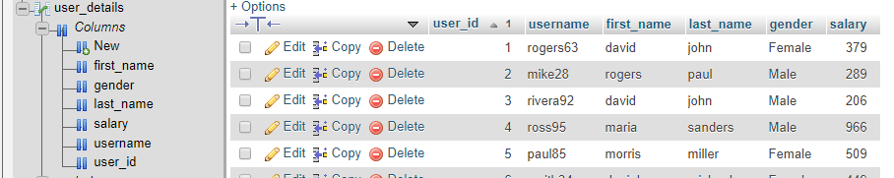
user_details.sql

Slide 75
SELECT *
Select all data of all columns from a table
Syntax:
Ex: select * from user_details;
SELECT * FROM tablename;

Slide 76
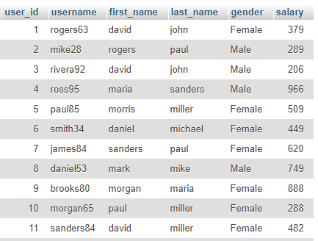

Slide 77
Select Columns
Select data of some columns from a table
Syntax:
Ex: select username, gender, salary from user_details;
SELECT colname1, colname2,… FROM tablename;

Slide 78
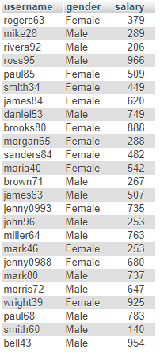

Slide 79
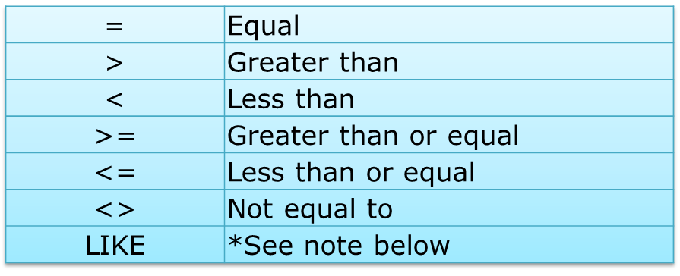
Select with WHERE condition
WHERE is used to select and set condition for columns
Conditional selections used in the where clause
SELECT username FROM user_details WHERE username LIKE “sa%";
SELECT username FROM user_details WHERE username LIKE “%63";

Slide 80
AND & OR Operators (&&, ||)
The AND or && operator displays a record if both the first condition AND the second condition are true.
The OR or || operator displays a record if either the first condition OR the second condition is true.
Ex:
SELECT username, salary, gender FROM user_details WHERE salary= 300 AND status = ‘Female’;
SELECT username, salary, gender FROM user_details WHERE salary= 300 AND status = ‘Female’;

Slide 81
SELECT ORDER BY
Sort data: ASC, DESC
Syntax:
Ex: SELECT * FROM `user_details` ORDER BY salary DESC
SELECT colname,… FROM tablename ORDER BY colname ASC;
SELECT colname,… FROM tablename ORDER BY colname DESC;

Slide 82
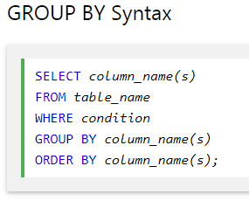
Group By
The GROUP BY statement is often used with aggregate functions (COUNT, MAX, MIN, SUM, AVG) to group the result-set by one or more columns.

Slide 83
Group By
Ex: We want to count number of user based on gender
SELECT COUNT(user_id), gender FROM user_details GROUP BY gender
Notes:
SELECT COUNT(last_name) FROM user_details WHERE last_name ='miller'

Slide 84
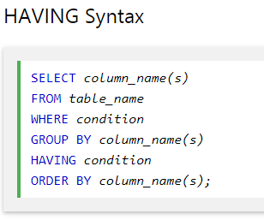
Having
The HAVING clause was added to SQL because the WHERE keyword could not be used with aggregate functions.

Slide 85
Having
Ex: We want to count user whose salary is higher than 500 based on gender
SELECT COUNT(user_id), AVG(salary), gender FROM user_details
GROUP BY gender
HAVING AVG(salary)>500
Notes:
SELECT COUNT(user_id), AVG(salary) as AverageSal, gender FROM user_details
GROUP BY gender
HAVING AVG(salary)>500

Slide 86
Limit
LIMIT is used select and limit records.
LIMIT start,end
Ex: We want to see list user in top two records
SELECT * FROM `user_details` LIMIT 2
Ex: we want to see list user in buttom 5 records
????
Notes:
SELECT * FROM `user_details` ORDER BY user_id DESC LIMIT 5
In sql sever: select top number

Slide 87
Distinct
Return different values
Syntax:
Ex: SELECT DISTINCT last_name, first_name FROM `user_details`
SELECT DISTINCT colname,… FROM tablename;

Slide 88
ALIASES (AS)
SQL aliases are used to give a database table, or a column in a table, a temporary name.
Syntax:
Ex:
SELECT COUNT(user_id), AVG(salary) as AverageSal, gender FROM user_details as ud
GROUP BY ud.gender
HAVING AverageSal >500
SELECT column_name AS alias_name FROM table_name alias_name;

Slide 89
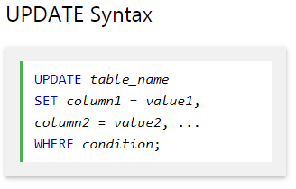

UPDATE
The UPDATE statement allows you to update data in the existing tables.

Slide 90
UPDATE
Ex1: UPDATE user_details SET first_name='channak' WHERE user_id=1;
Ex2: UPDATE user_details SET first_name='channak', last_name='chhon' WHERE user_id=2;
Ex3: UPDATE user_details SET first_name='channak';

Slide 91
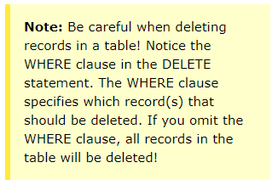
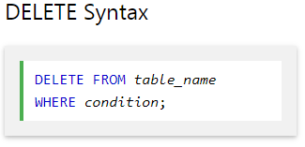
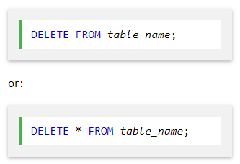
DELETE
The DELETE statement is used to delete existing records in a table.

Slide 92
Conditions in WHERE
Operators | Description
= | Equality
> | Greater than
< | Less than
>= | Greater than or equal to
<= | Less than or equal to
!= or <> | Not equal to
AND, OR | Logical AND, OR
Between … And … | Check a range of values
Not Between … And … | Check if not a range of values
IS NULL | Check if null
IS NOT NULL | Check if not null
LIKE | Simple pattern matching
NOT LIKE | Negate of LIKE
IN | Set of values

Slide 93


