Slide 1
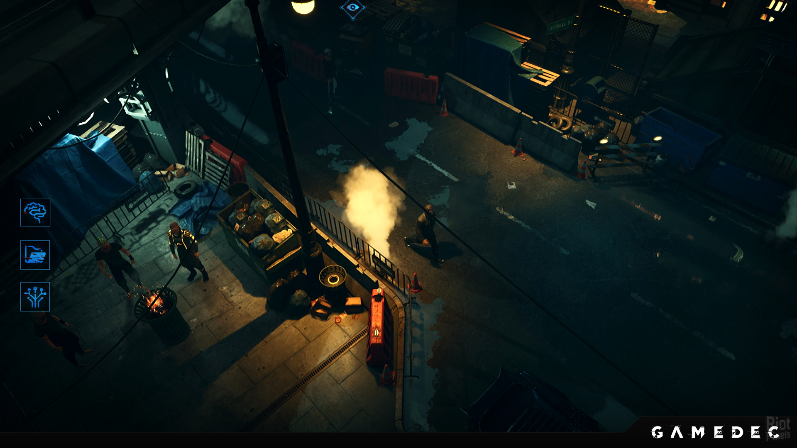

Slide 2

GEAR
CONS
AUGS
SKILLS
LOG
GEAR
CONS
AUGS
SKILLS
LOG
UI screens
Player Info (name, level, level progress)
Equipped gear and augs (spells)
Inventory – credits
Inventory – gear
Inventory – consumables
Inventory – augments
Missions log
EQUIPPED
i
!!ACTIVE!!
!!ACTIVE!!
REMOVE

Slide 3
GEAR
CONS
AUGS
SKILLS
LOG
GEAR
CONS
AUGS
SKILLS
LOG
UI screens
Player Info (name, level, level progress)
Equipped gear and augs (spells)
Inventory – credits
Inventory – gear
Inventory – consumables
Inventory – augments
Missions log
EQUIPPED
i
!!ACTIVE!!
CREDITS
!!ACTIVE!!
REMOVE

Slide 4
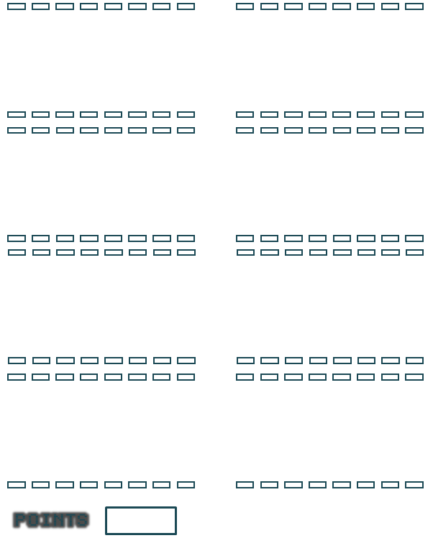

INVENTORIES
MISSION LOG
UI screens
Player Info (name, level, level progress)
Equipped gear and augs (spells)
Inventory – credits
Inventory – gear
Inventory – consumables
Inventory – augments
Missions log
EQUIPPED
i
!!ACTIVE!!
CREDITS
!!ACTIVE!!
REMOVE

Slide 5
INVENTORIES
MISSION LOG
UI screens
Player Info (name, level, level progress)
Equipped gear and augs (spells)
Inventory – credits
Inventory – gear
Inventory – consumables
Inventory – augments
Missions log
EQUIPPED
i
!!ACTIVE!!
!!ACTIVE!!
REMOVE

Slide 6
!!ACTIVE!!
UI screens
Player Info (name, level, level progress)
Equipped gear and augs (spells)
Inventory – credits
Inventory – gear
Inventory – consumables
Inventory – augments
Missions log
INVENTORIES
MISSION LOG
EQPT
CONS
AUGS
EQUIPPED
i
!!ACTIVE!!
CREDITS
REMOVE

Slide 7
INVENTORIES
MISSION LOG
UI screens
Player Info (name, level, level progress)
Equipped gear and augs (spells)
Inventory – credits
Inventory – gear
Inventory – consumables
Inventory – augments (spells)
Abilities (skills)
Missions log
INVENTORIES
MISSION LOG
EQUIPPED
!!ACTIVE!!
REMOVE

Slide 8
EQPT
CONS
AUGS
EQPT
CONS
AUGS
INVTY
INV
MISSION
SKILLS
INV
MISSION
SKILLS

