Slide 1

Author: SKR PHANEENDRA
f
PGDDM48
PHISHING URL DETECTION
USING MACHINE LEARNING

Slide 2
Presentation Outline
Problem Statement
Pre - Processing
Model deployment
Identification of the Problem
Feature Engineering and EDA
Through Streamlit
Dataset Descriptions
Optimization by Random search
Data Collection
Model Optimization

Slide 3
PROBLEM STATEMENT

Slide 4
Phishing URL Detection using Machine Learning Techniques
The objective is to detect if a URL is a phishing URL.
A phishing URL is a URL that is made with the intention of scam or theft of sensitive information.
The goal is to create a model that can detect new phishing URLs.
While minimizing false positives and false negatives.

Slide 5
Datasets: all these will be combined into one
ISCX-URL 2016 Dataset | 35,300 benign URLs 10,000 phishing URLs
Ebbu 2017 Dataset | 36,400 benign URLs 37,175 phishing URLs
Dataset from Kaggle Balanced URL dataset | 316,254 benign URLs 316,254 phishing URLs

Slide 6
PRE-PROCESSING & MODEL TRAINING

Slide 7
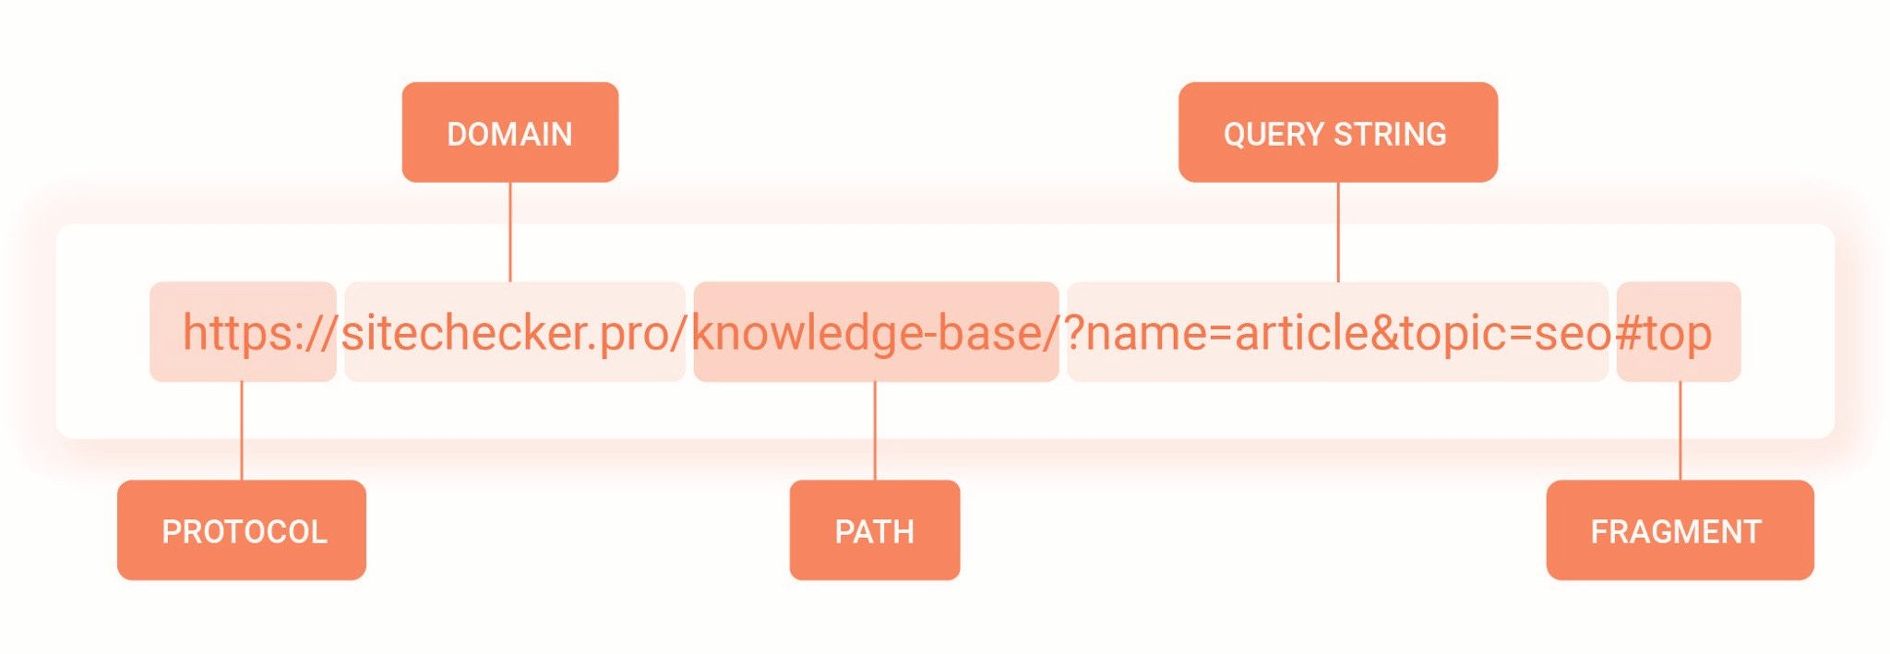
Feature Extraction

Slide 8
Feature Extraction
I've evaluated various characteristics of URLs, including URL length, the number of subdomains, the occurrence of 'www', path length, domain length, counts of letters, special characters, and digits.
Additionally, I've analyzed the number of directories and distinguished between 'http' and 'https'. Furthermore, I've incorporated URL entropy as a metric to assess the level of randomness within the URL.

Slide 9
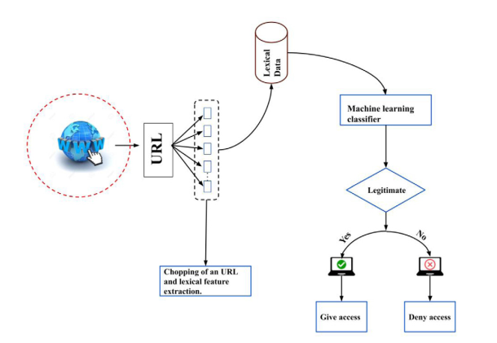
Model Architecture

Slide 10
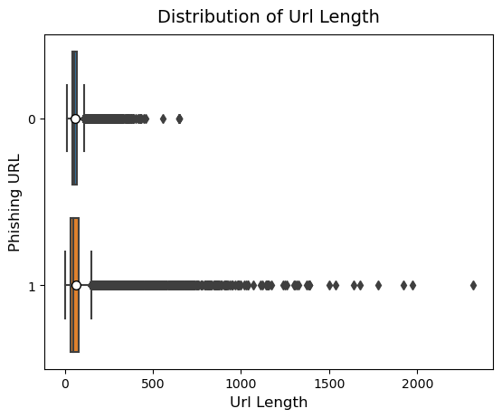
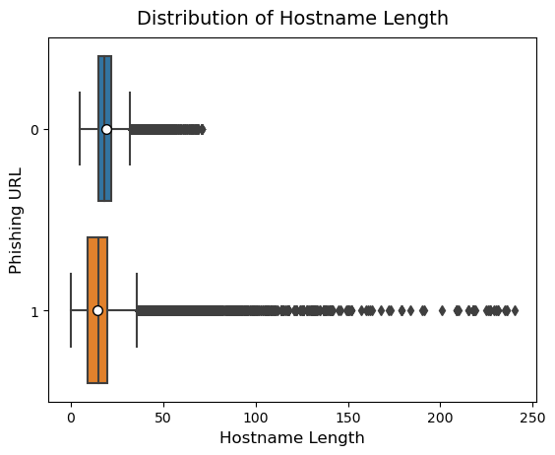
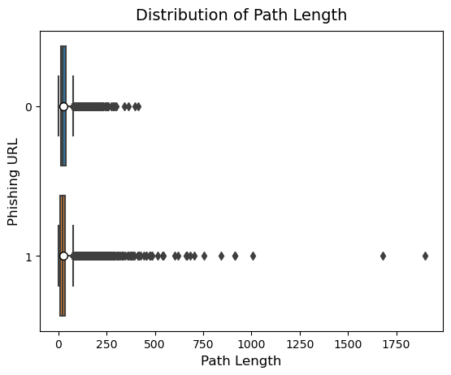
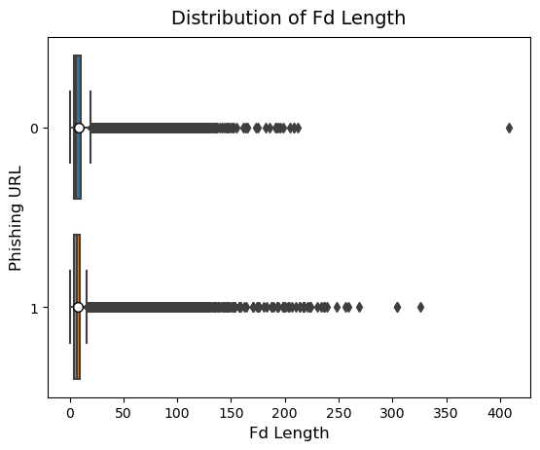
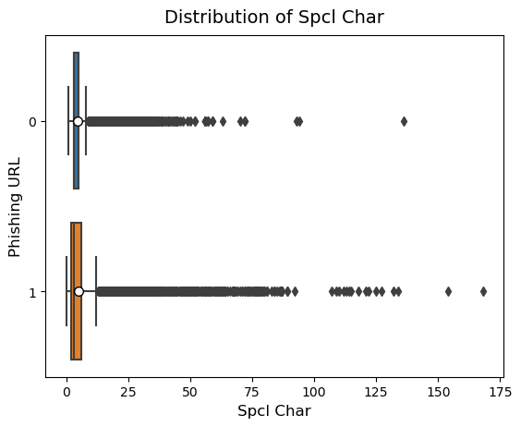
EDA on Features

Slide 11
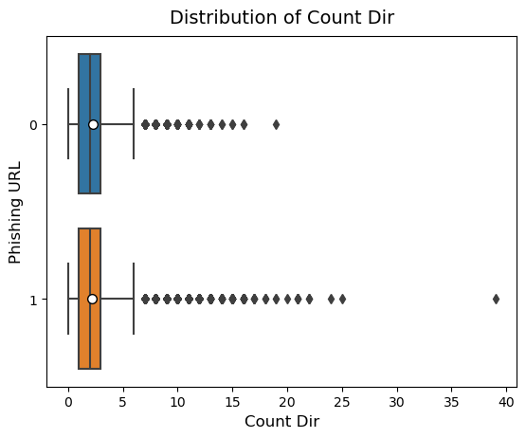
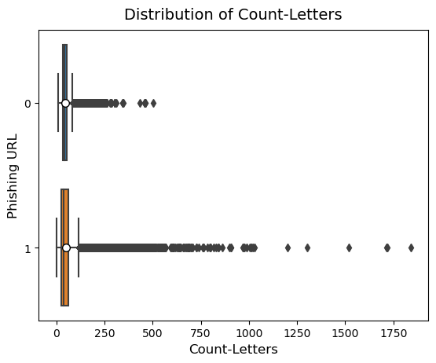
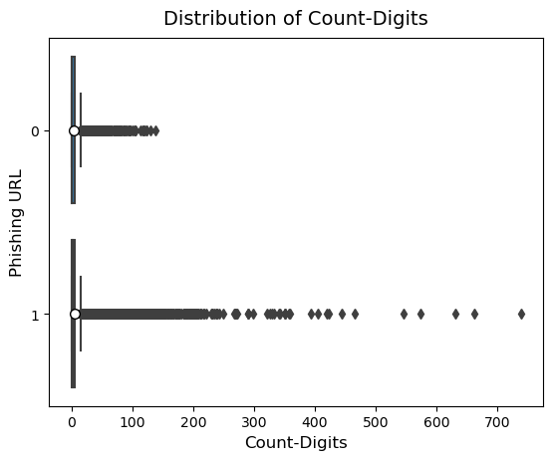
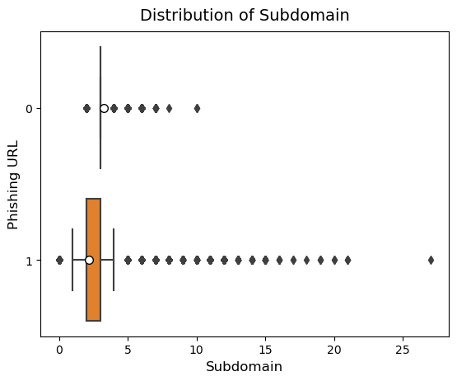
EDA cont.
Understanding the distribution of data in benign and phishing urls will help in understanding the differences between them both.

Slide 12
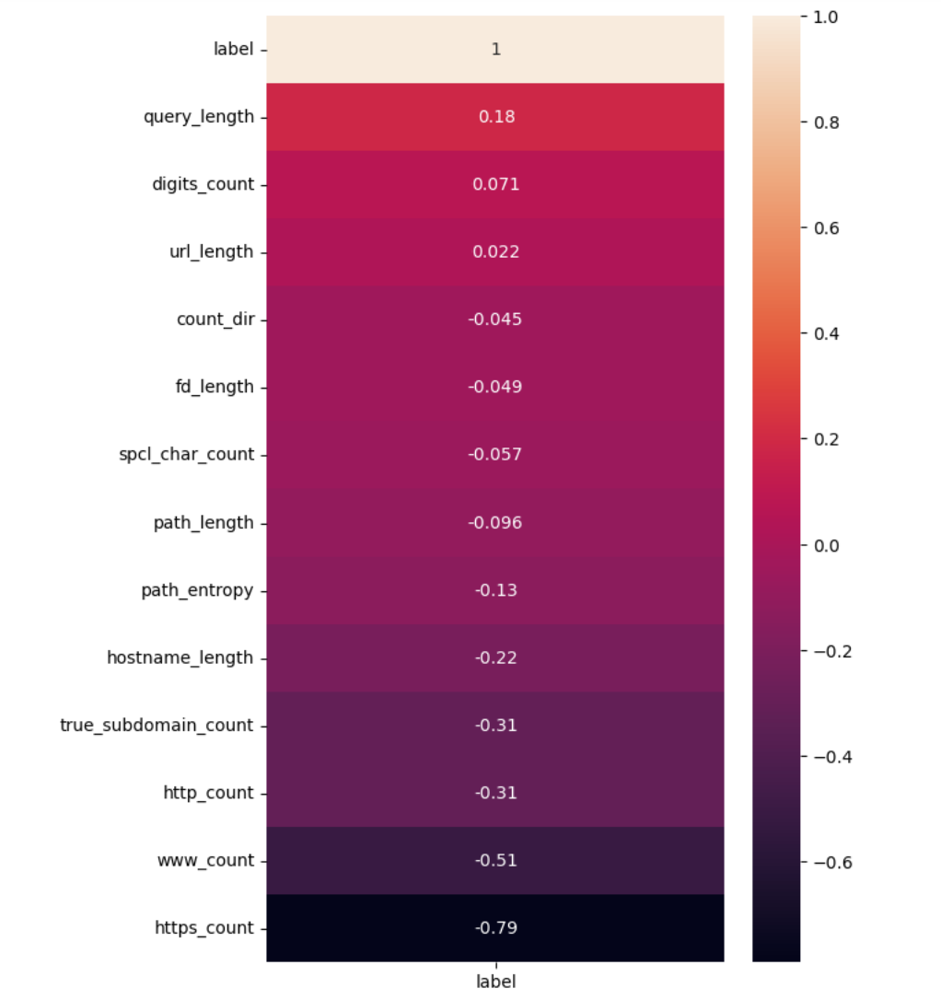
EDA cont.
A heatmap is constructed in order to understand how all the features are correlated.
In this heatmap, correlation between every feature and the label is considered.
Features with the strongest correlations often have the most impact on predicting the target variable. This aids in feature selection.

Slide 13
Models Tested
Support Vector Machine
Decision Tree Classifier
K-Nearest Neighbors Classifier
Random Forest Classifier
Logistic Regression
SGD Classifier
Naïve Bayes
AdaBoost Classifier
Gradient Boosting Classifier
Extra Trees Classifier
Bagging Classifier

Slide 14
MODEL OPTIMIZATION & DEPLOYMENT

Slide 15
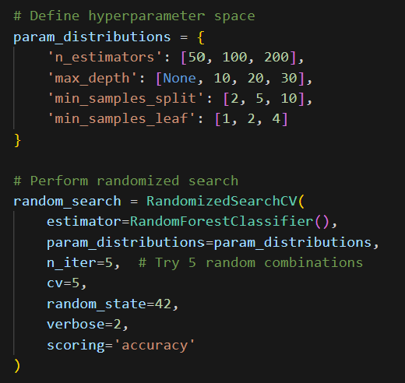
Model Optimization
Optimization
Randomized Search CV is used over Grid search CV in order to reduce unnecessary complications.
Once the best model was determined, hyperparameter tuning is applied to optimize the model.

Slide 16
Hyperparameter Tuning using Randomized search with Cross validation:
Params_distributions contain various hyperparameters and their respective values that we want to tune.
These parameters include number of trees (n_estimators),
maximum depth of tree(max_depth),
minimum number of samples required to split internal node(min_samples_split),(this can prevent overfitting)
minimum number of samples required to be in leafs.

Slide 17
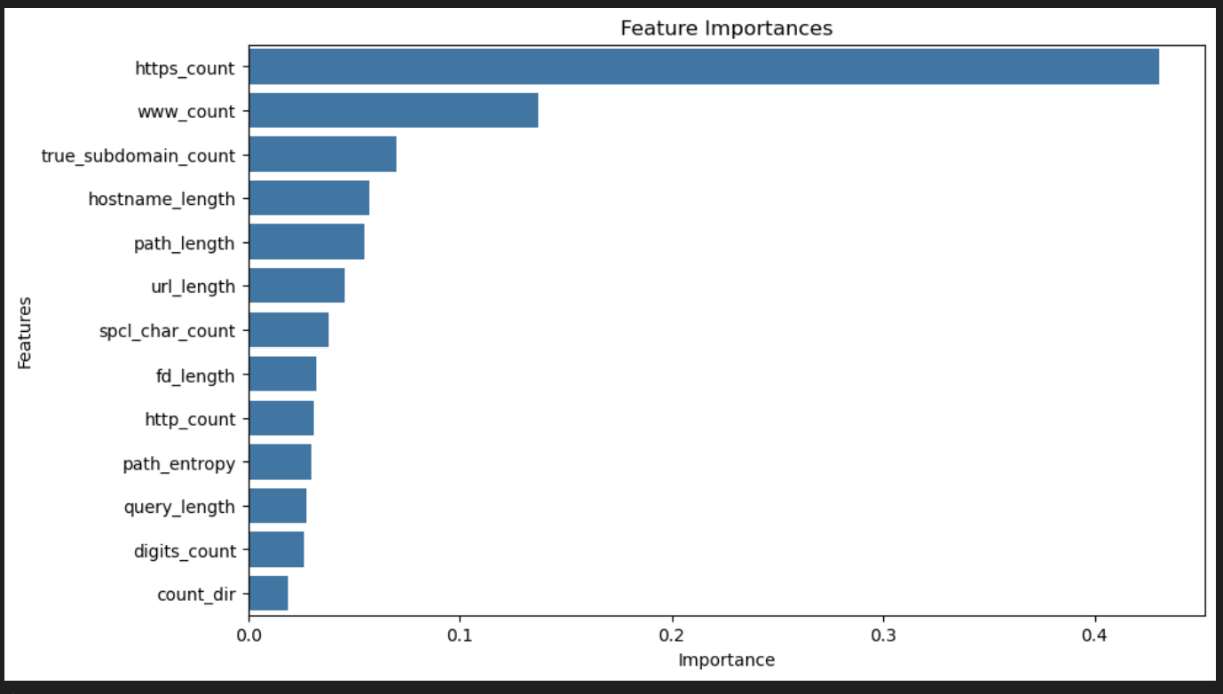
Feature Importances
Need for Importances:
Feature importances uncover which features matter most in predicting the target.
Help pick influential features, simplifying models and reducing overfitting.
Aids in understanding how the model uses features to make predictions.
Highlights redundant or highly correlated features that could be removed.

Slide 18
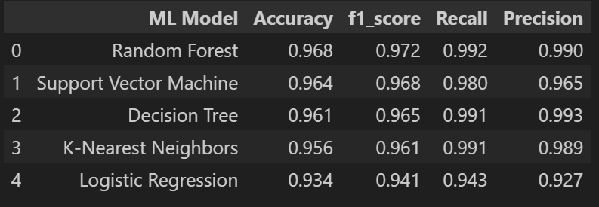
Model Selection
I got better results for Random Forest classifier on the dataset, hence I used this model to develop a streamlit application that takes input as URL, extracts features from URL and predicts.

Slide 19
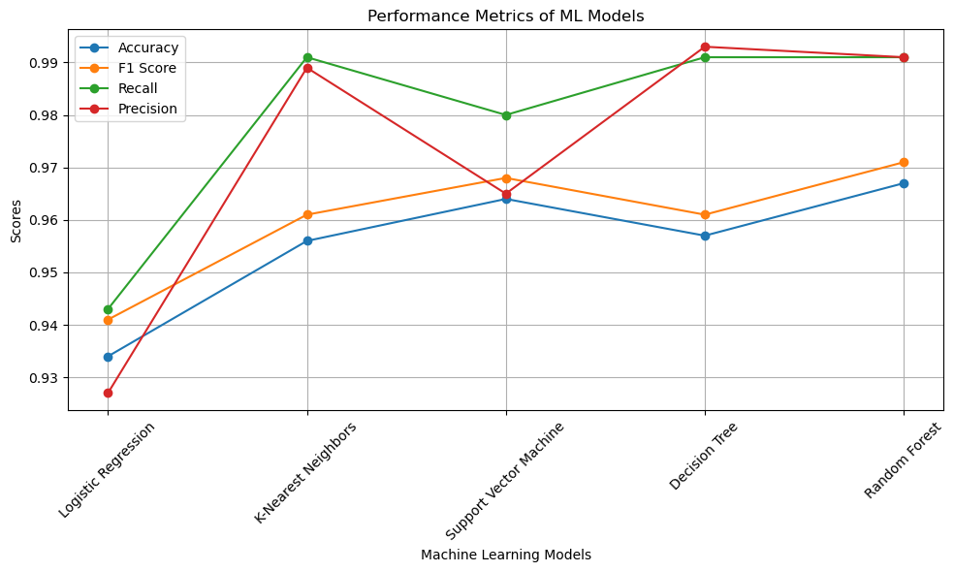
Evaluation Metrics :

Slide 20
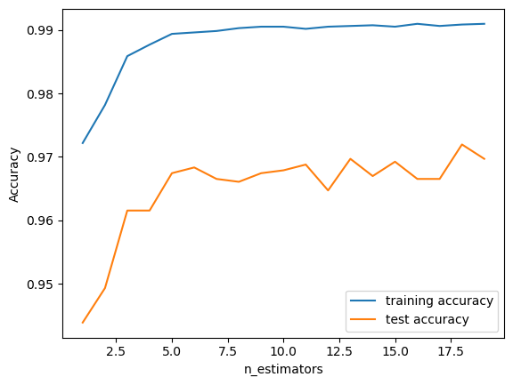
Training vs Testing on Random Forest Classifier:

Slide 21
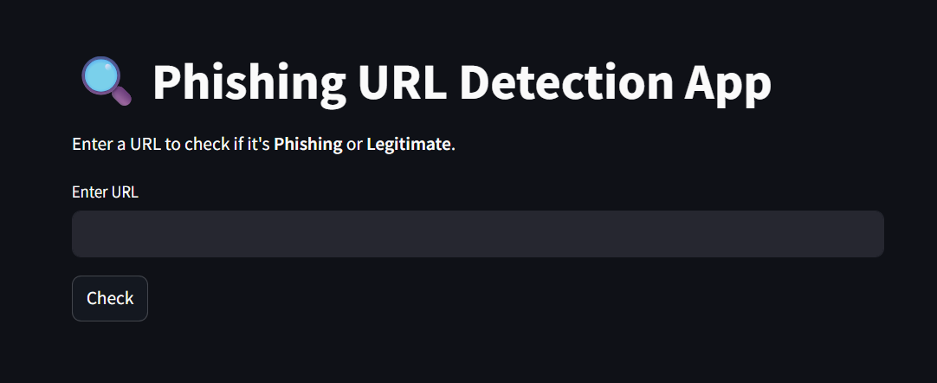
Development and Deployment
Development: It includes the creation of a web application using Streamlit, including tasks like model evaluation, storing model scores, selecting models based on F1 scores, and saving of the chosen model into a pkl file.
This constitutes the development phase, where the application's functionality and features are crafted.
Deployment: After the development phase, the saved model file (pkl) is hosted and made accessible on a local server using Streamlit. This makes the model available for use within the server environment. It is hosted on port 8000.

Slide 22
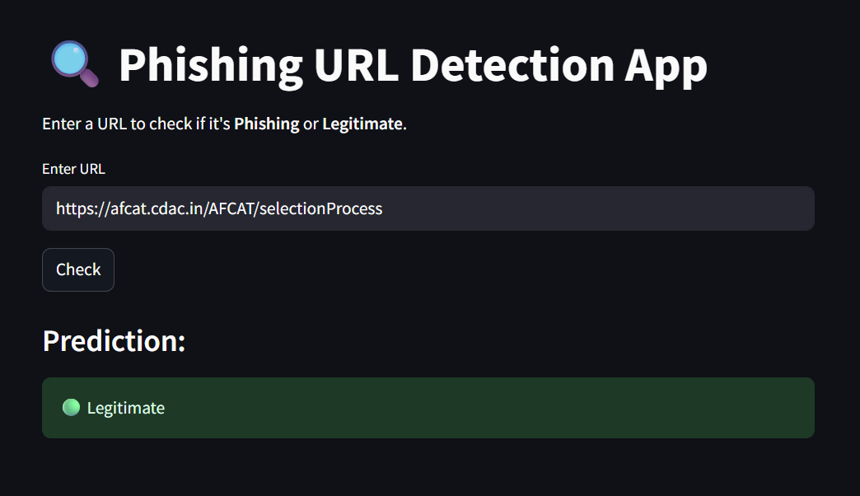
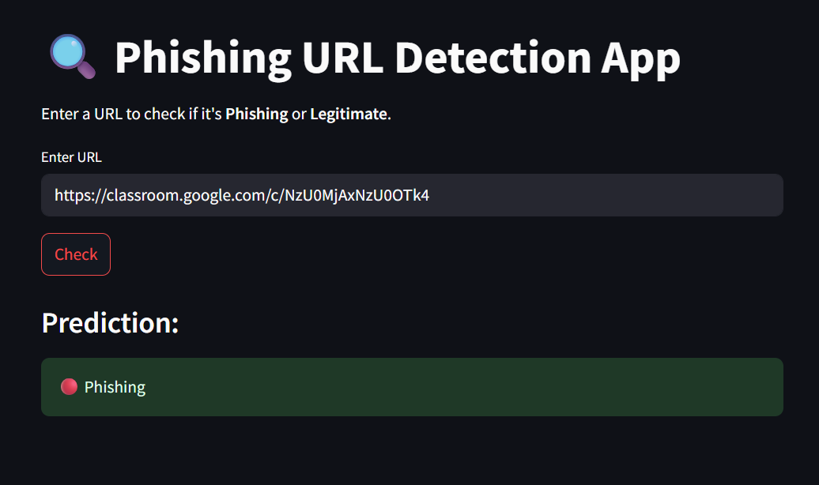
Detecting a Phishing URL:

Slide 23
CONCLUSION

Slide 24
Inference Pipeline
[ 1] Input URL
[2] Feature Extraction
[3] Feed to model
[4] Output Prediction (Phishing/Legit)
[5] Creating a GUI

Slide 25
Inference Examples
Legit URL: https://amazon.com → Legit
Phishing URL: http://192.168.1.1/freeprize → Phishing
Edgecases are possible, as no model is perfect

Slide 26
Conclusion
Developed an URL only detection method
Feature Engineering played a key role
Random Forest outperformed others, but some boosting algos came close
Achieved 97% accuracy without page content

Slide 27
Future Work
Add WHOIS/domain age features
Integrate HTML & visual content features
Realtime detection via browser plugin
Continuous model updates for evolving threats

Slide 28

Thank You!

