Slide 1
Internal Knowledge Management API Bellamkonda Sri Venkat Vijay John Mathew Phaneendra Babu

Slide 2
Table of Contents
Introduction
Problem Statement
Key Features & Techniques
Technology Stack
System Architecture
Domain Model
Security Model
REST API Overview
Testing Strategy
Conclusion

Slide 3
Introduction
This project is about building an Internal Knowledge Management System that helps organizations store, organize, and share important documents like FAQs, SOPs, and process notes in one secure place. It is designed using Spring Boot and PostgreSQL, making it reliable and scalable for long-term use. The system also provides advanced search, version control, and role-based access, so that employees can quickly find the right information while keeping sensitive data safe. Overall, it aims to make knowledge easy to manage, easy to access, and more useful for everyone in the organization.

Slide 4
Problem Statement
A secure, scalable Spring Boot microservice for storing, tagging, and retrieving internal documents like FAQs, SOPs, and process documentation. It features comprehensive role-based access control and advanced search capabilities.

Slide 5
Key Features
What We Built: Spring Boot + PostgreSQL backend for storing and retrieving internal knowledge as Articles, organized by Departments and labeled with Tags.
Key Capabilities:
CRUD with Versioning: Complete article lifecycle management and tracking
Flexible Search: Keyword, title, tags, department-based, PostgreSQL trigram indexing
Role-Based Security: Three-tier access VIEWER, CONTRIBUTOR, ADMIN
API Documentation: Swagger integration
Technical Highlights:
PostgreSQL, Flyway migrations, trigram indexes
MapStruct for DTO mapping
Unit and integration testing

Slide 6
Technology Stack
Core Technologies: Java 17, Spring Boot 3.x, PostgreSQL, Hibernate JPA, Flyway Migrations, MapStruct, Maven
Spring Boot Modules:
Web & Security: web, security, validation, actuator
Data & Docs: data-jpa, springdoc-openapi, Lombok, JUnit 5 + Mockito
Development Tools:
Database: pgAdmin
API Testing: Insomnia collections

Slide 7
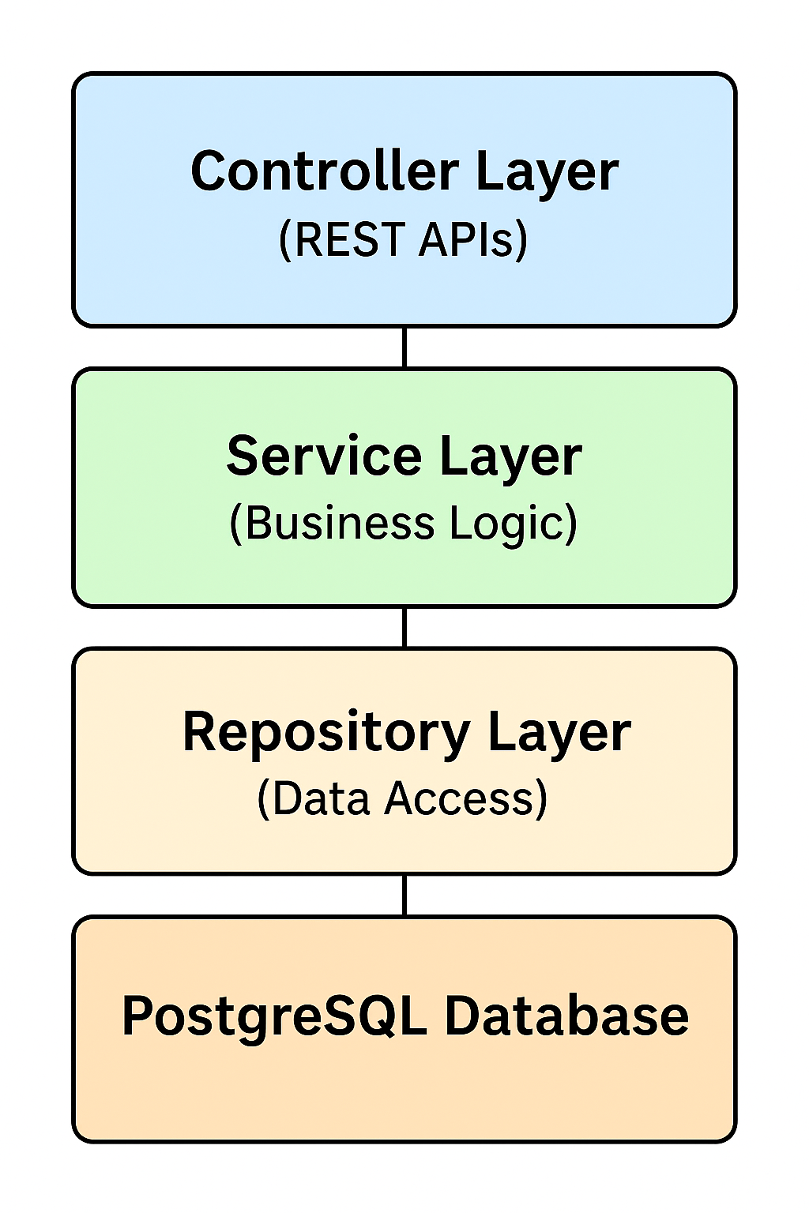
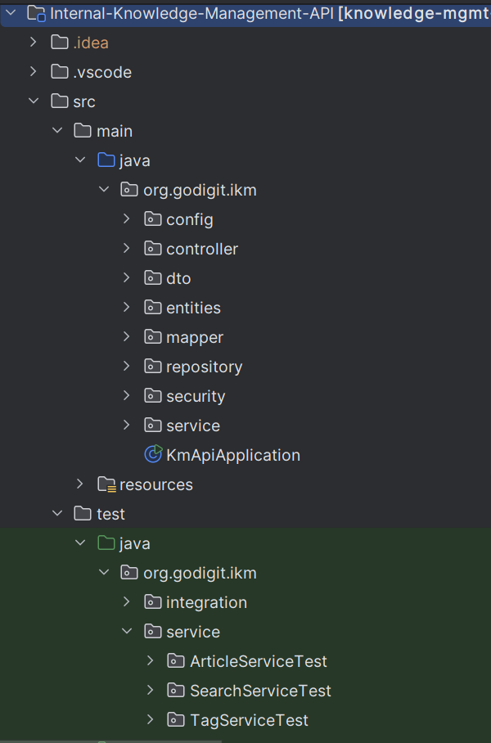
System Architecture
Layered Architecture
Package Structure

Slide 8
Domain Model
Core Entities:
Article: Main content entity with title, body, department, tags, and versioning
Department: Organizational units (ENG, OPS, HR, etc.)
Tag: Keywords for categorization and filtering
ArticleVersion: Historical snapshots of article changes
User: System users with role-based permissions
Role: VIEWER, CONTRIBUTOR, ADMIN permissions
Key Relationships:
Article ←→ Department (Many-to-One)
Article ←→ Tags (Many-to-Many)
Article ←→ ArticleVersion (One-to-Many)
User → Role (Enumeration)

Slide 9



Security Model
User Roles & Permissions
ADMIN
CONTRIBUTOR
VIEWER
Full system access including delete operations
canView() ✓
canUpdate() ✓ canDelete() ✓
Create and update articles in their department
canView() ✓
canUpdate() ✓
Read-only access to department articles canView() ✓

Slide 10
REST API Overview(Article Controller)
Base URL: http://localhost:8080/
Method | Path | Description
POST | articles | Create a new article
GET | articles/{id} | Get article by ID
PUT | articles/{id} | Update article by ID
DELETE | articles/{id} | Delete article by ID

Slide 11
Search Controller
Base URL: http://localhost:8080/
Method | Path | Description
POST | /api/search | Flexible search with multiple filters (request body)
GET | /api/search | Flexible search with query parameters
GET | /api/search/by-id | Search article by ID
GET | /api/search/by-title | Search articles by title
GET | /api/search/by-tags | Search articles by tags
GET | /api/search/by-department | Search articles by department ID
GET | /api/search/by-keyword | Search articles by keyword

Slide 12
Department Controller
Base URL: http://localhost:8080/
Method | Path | Description
POST | /api/departments | Create a new department
GET | /api/departments/{id} | Get department by ID
GET | /api/departments/by-code/{code} | Get department by code
GET | /api/departments/{id}/articles | List articles in a department (paginated)

Slide 13
Service Endpoints
Service | URL | Purpose
API | http://localhost:8080 | Main application
Swagger UI | http://localhost:8080/swagger-ui/index.html | API documentation
pgAdmin | http://localhost:5050 | DB management
Health Check | http://localhost:8080/actuator/health | Service monitoring

Slide 14
Testing Strategy
Testing Framework:
Unit Tests: JUnit 5 + Mockito for service and repository layer testing
Integration Tests: @SpringBootTest with TestContainers for full stack testing
Test Data: BasePostgresTest class with reusable test fixtures
Performance Tests: Search performance testing with large datasets
Key Test Classes:
ArticleServiceTest : Business logic validation
SearchServiceTest : Search functionality testing
TagServiceTest : Tag management testing
ContextLoadsIT : Application context validation

Slide 15
Conclusion
The project successfully built a safe and scalable system for managing internal knowledge, making sure that important documents like FAQs, SOPs, and processes can be stored and used easily. With search features and version control, the system helps users find information quickly and correctly. To keep information safe, it uses role-based access, so only the right people can view or edit content.

Slide 16
Thank You

