Slide 1
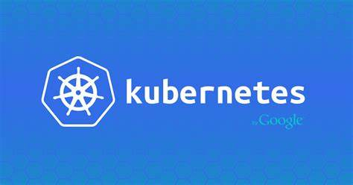
By Malleswaraiah

Slide 2
Topics
Kubernetes Architecture
Kubernetes Deployment

Slide 3
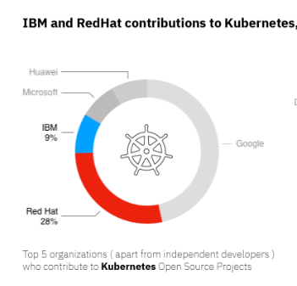
Introduction:
Kubernetes(K8) is an open-source container orchestration tool used for automating deployment, scaling and management of containerized applications.
K8’s developed by Google.
K8’s developed by using the Go language.
Google has open sourced the K8s in 2014 and now its managed by CNCF(Cloud Native Computing Foundation)

Slide 4
K8’s Features:
Self-Healing: It restarts container that failed or kills the container that do not respond to container health check endpoint. It always maintains user defined number of replicas
Secret and configuration management: It maintains an application-level configuration and secrets in a separate location. So, it can be modified without re-building and deploying container
Horizontal scaling: It is easy to scale-up/down containers with a simple command or automatically based on CPU usage.
Automatic bin packing: It automatically places containers into the required Worker nodes based on specified CPU/Memory.
Storage orchestration: It allows to mount a local storage or cloud providers
Automated rollouts and rollbacks: It allows to rollout new application changes by spinning up new container without killing existing container until proper health check verified. It will rollback automatically if new container does not respond to user defined health check.
Service discovery and Load balancing: It does by using Labels and Selectors associated with PODs and Services and can load-balance across them.

Slide 5
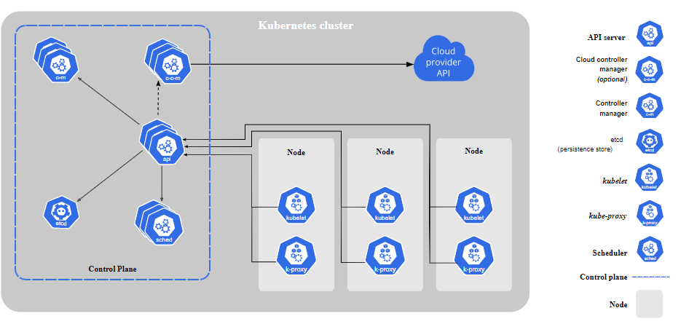

Slide 6
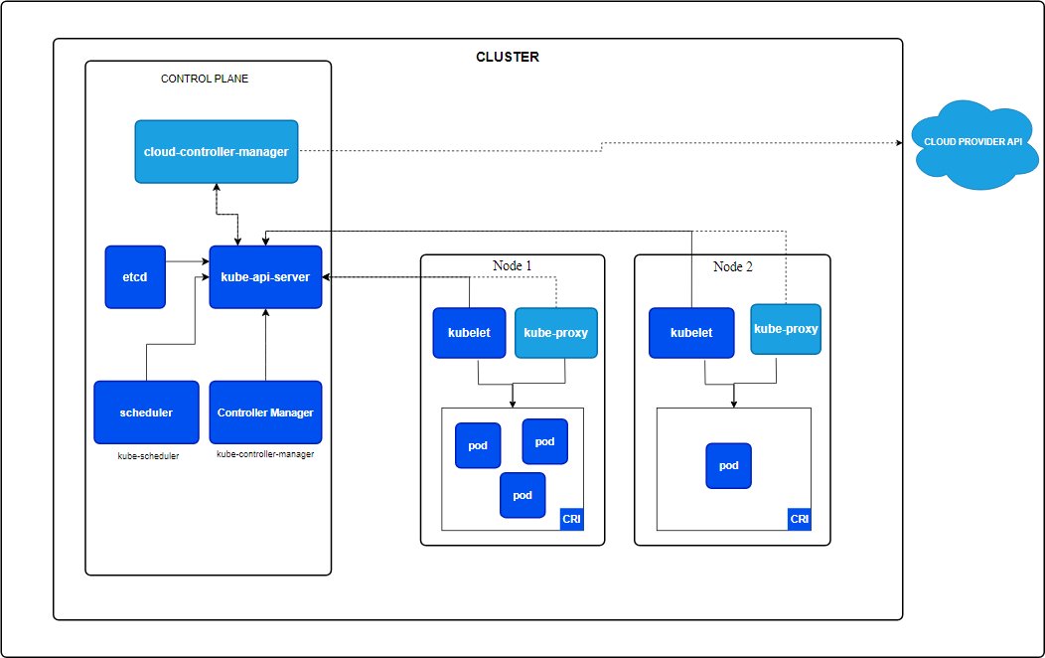

Slide 7
Control Plane or Master:
Kube-Episerver: A central management component that treats all REST requests. Runs all of the administrative tasks on the master node
Etcd storage: A distributed key-value storage that stores the Kubernetes cluster data. i.e. The cluster state.
Kube-controller-manager: Runs many distinct controller processes in the background. Control loops that regulate the Kubernetes clusters state.
Cloud-controller-manager: Manages controller processes on the underlying cloud provider.
Kube-scheduler: Schedules the work between many worker nodes. Schedules the pods on the various nodes based on resource utilization.
DNS server: Configures the individual containers using the DNS and schedules the DNS Pod on the cluster.

Slide 8
Worker Nodes:
Kubelet:
An agent on each node that checks the containers running in the pods. it Receives the pod specifications from API server and interact with the container runtime to perform start/stop of the container, mount pod volume and secrets.
It monitors the state of the pods by using heartbeat messages and transmit data to master node API server.
Kube-proxy: A network proxy that contains all the rules of nodes in a cluster.
Container runtime: It is the software needs to be installed in each worker node to run the containers i.e. Docker, containerd etc.
Pod: It is the place where single or multiple containers run together.

Slide 9
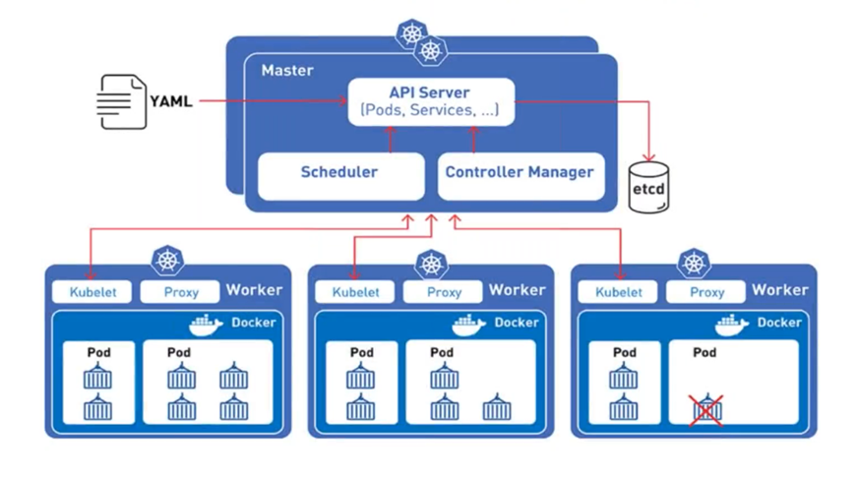

Slide 10
Components in K8’s
Pods: One or more containers running together in a cluster.
Namespace: Supports multi virtual clusters in one physical cluster.
Nodes: The machines that are running Kubernetes.
Cluster: A group of machine nodes running applications on Kubernetes.
Volume: A data directory accessed by pods.
ReplicaSet: A number of replicas of running pods.
Kubectl: A command-line tool for calling with the Kubernetes API server.
Worker Node: A virtual or physical pod server controlled by the master node.

Slide 11
Deployments:
Deployment provides declarative updates for Pods and ReplicaSets.
Deployment controller changes the actual state to the desired state in controlled manner.
Deployment controller creates the replica set to maintain the replicas.
The ReplicaSet creates the pods in background.
Advantages:
1. High availability or Zero downtime.
2. Easy to deploy new versions.
3. Automatic rollback
3. Easy Scale up and Scale down the pods to based on load.

Slide 12
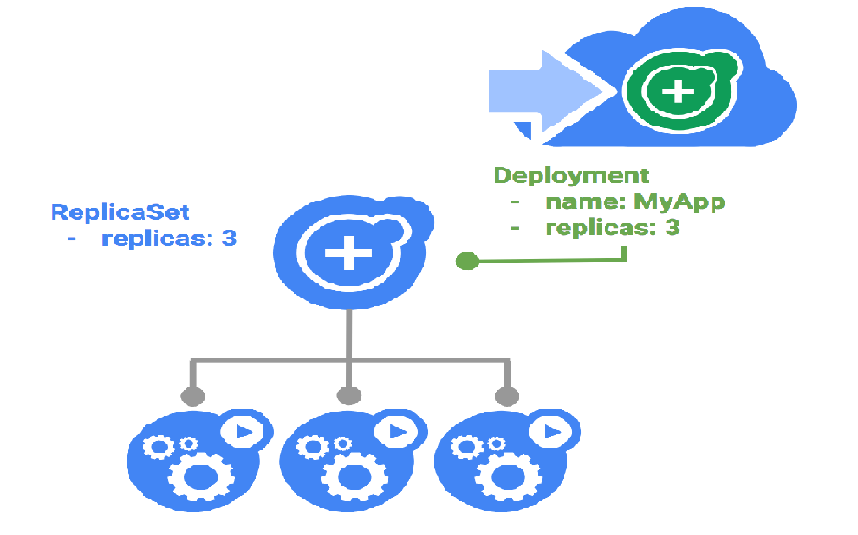

Slide 13
Deployments(cont.….)
Deployment has two type of strategy.
Recreate
RollingUpdate
Yaml snippet to specify strategy.
strategy:
type: Recreate
Yaml snippet to specify surge and unavailable.
rollingUpdate:
maxSurge: 25%
maxUnavailable: 25%

Slide 14
Deployments commands:
kubectl get deploy or kubectl get deployments or kubectl get deployment
kubectl get replicaset or kubectl get rs or kubectl get replicasets
kubectl rollout status deployment/my-test-deployment
kubectl set image deployment.v1.apps/my-test-deployment nginx=nginx:1.16.1
kubectl set image deployment/my-test-deployment nginx=nginx:1.16.1
kubectl edit deployment/my-test-deployment
kubectl describe deploy or kubectl describe deployments or kubectl describe deployment
kubectl rollout history deployment/my-test-deployment
kubectl rollout history deployment/my-test-deployment --revision=2
kubectl rollout undo deployment/my-test-deployment
kubectl rollout undo deployment/my-test-deployment –to-revision=2
kubectl scale deployment my-test-deployment --replicas=5
kubectl rollout pause deployment/my-test-deployment

Slide 15



