Slide 1
Azure Cloud Computing – 2 Day Fresher Program
Phaniraj
Notes:
Welcome freshers. Explain that this is a beginner-friendly program. No prior cloud knowledge is expected. Over 2 days, they will understand, use, and confidently explain cloud computing with Azure.

Slide 2
Course Overview
• What is Cloud Computing
• Azure Basics
• SaaS Model
• Virtualization
Notes:
Explain the course flow. Mention that Day 1 focuses on fundamentals, and Day 2 focuses on hands-on and real usage.

Slide 3
What is Cloud Computing?
• On-demand IT resources
• Delivered via Internet
• Pay-as-you-go
User
(Browser)
Azure Service
VM / DB
Notes:
Explain cloud using simple words. Cloud means renting IT resources when needed.

Slide 4
Traditional IT Model
• Buy servers
• Install OS
• Fixed capacity
Notes:
Explain how companies earlier purchased servers and maintained data centers.

Slide 5
Problems with Traditional IT
• High cost
• Maintenance
• Underutilization
Notes:
Explain wasted capacity and slow setup in traditional IT.

Slide 6
Cloud Solution
• Rent instead of buy
• Scale anytime
• Faster deployment
Notes:
Explain how cloud solves traditional IT problems.

Slide 7
Cloud Real-Life Examples
• Gmail
• Google Drive
• Netflix
Notes:
Ask students which cloud apps they use daily.

Slide 8
Cloud Characteristics
• On-demand
• Elastic
• Measured service
Notes:
Explain each characteristic with a real-life example.

Slide 9
On-Demand Self Service
• Create VM anytime
• No provider interaction
Notes:
Explain that users can create resources themselves.
On-Demand Self-Service in Cloud Computing means that users can provision and manage computing resources (like servers, storage, or applications) whenever they need them, without requiring human intervention from the service provider.
Real-World Scenario:
A startup hosting an e-commerce site can scale servers automatically during a holiday sale.
Developers can spin up test environments in minutes, run experiments, and shut them down when finished.
Businesses can add cloud storage instantly when their local storage runs out.
Demo:
Here's a realistic, annotated walkthrough of provisioning a virtual machine using Azure's on-demand self-service interface.
Step 1: Log in to Azure Portal
URL: https://portal.azure.com
Interface: Dark-themed dashboard with navigation pane on the left.
Key Panels:
Azure Services
Quickstart Center
Cost Management
Resource Groups
Step 2: Create a Resource
Navigation: Click on "Create a resource" from the left menu or dashboard.
Marketplace Panel:
Popular options: Windows Server, Ubuntu Server, SQL Database, Web App
Search bar to find specific services
Select "Virtual Machine"
Step 3: Configure Virtual Machine
Basics Tab:
Subscription: Choose your billing subscription
Resource Group: Select existing or create new
VM Name: Enter a unique name
Region: Choose closest or preferred data center
Image: Select OS (e.g., Ubuntu 20.04 LTS, Windows Server)
Size: Choose based on CPU/RAM needs
Authentication: Password or SSH public key
Inbound Ports: Allow RDP (Windows) or SSH (Linux)
Disks Tab:
Choose OS disk type (Standard HDD, SSD)
Add data disks if needed
Networking Tab:
Configure virtual network, subnet, public IP
Set network security group (NSG) rules
Step 4: Review + Create
Validation: Azure checks configuration
Summary Panel: Review all settings
Click "Create" to deploy VM
Step 5: Monitor Deployment
Notifications: Track progress in top-right bell icon
Resource Panel: VM appears under "Virtual Machines"
Actions Available:
Start/Stop/Restart
Resize VM
Connect via SSH/RDP
View metrics and logs
This guide mirrors the actual Azure interface and is ideal for training, documentation, or onboarding new users to cloud provisioning.

Slide 10
Elasticity
• Scale up
• Scale down
Notes:
Explain traffic increase example like online shopping sale.

Slide 11
Measured Service
• Pay only for usage
Notes:
Compare cloud billing with electricity bill.

Slide 12
Benefits of Cloud
• Cost saving
• Speed
• Global reach
Notes:
Summarize why companies move to cloud.

Slide 13
Cloud Deployment Models
• Public
• Private
• Hybrid
Notes:
Introduce deployment models.

Slide 14
Public Cloud
• Shared infra
• Azure example
  Computing resources owned and operated by a third-party provider, delivered over the internet to multiple customers.
  Shared infrastructure, accessible to anyone who subscribes or pays.
Examples: Microsoft Azure, Amazon Web Services (AWS), Google Cloud Platform (GCP).
Notes:
Explain Azure as public cloud.

Slide 15
Microsoft Azure
Virtual Machines (VMs)
Azure Storage (Blob, File, Queue, Table)
Azure SQL Database
Networking (Virtual Network, Load Balancer)
Azure is widely used for hosting apps, databases, and enterprise solutions.

Slide 16
Private Cloud
• Dedicated infra
Notes:
Explain why banks use private cloud.

Slide 17
Hybrid Cloud
• On-prem + Azure
Notes:
Explain hybrid as most common enterprise model.

Slide 18
Why Hybrid is Popular
• Security
• Compliance
Notes:
Explain regulatory requirements.

Slide 19
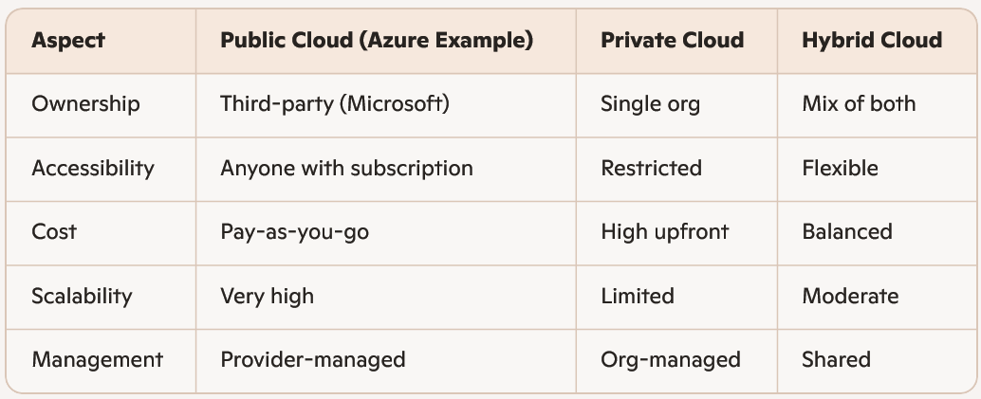
Comparisons

Slide 20
Introduction to Microsoft Azure
• Microsoft cloud platform
• Global
Notes:
Introduce Azure and Microsoft ecosystem.

Slide 21
Azure Global Infrastructure
• Regions
• Availability Zones
Notes:
Explain Azure data centers across world.

Slide 22
Azure Region
• Geographical area
Notes:
Explain region with India example.

Slide 23
Availability Zones
• Multiple DCs
• High availability
Notes:
Explain fault tolerance.

Slide 24
Azure Account Structure
• Subscription
• Resource Group
• Resource
Notes:
Explain hierarchy clearly.

Slide 25
Azure Subscription
• Billing boundary
Notes:
Explain subscription as billing container.

Slide 26
Resource Group
• Logical container
Notes:
Explain grouping of related resources.

Slide 27
Azure Resources
• VM
• Storage
• DB
Notes:
Explain actual usable services.

Slide 28
Azure Portal
• Web console
Notes:
Explain portal usage.

Slide 29
Azure Service Categories
• Compute
• Storage
• Network
Notes:
Introduce service categories.

Slide 30
What is Virtualization?
• Multiple OS on one server
Notes:
Explain virtualization concept.

Slide 31
Why Virtualization
• Better utilization
Notes:
Explain resource sharing.

Slide 32
Virtual Machine
• Software computer
Notes:
Explain VM like laptop inside server.

Slide 33
Hypervisor
• VM manager
Notes:
Explain hypervisor role.

Slide 34
Type 1 Hypervisor
• Bare metal
Notes:
Explain Hyper-V.

Slide 35
Type 2 Hypervisor
• Hosted
Notes:
Explain VirtualBox.

Slide 36
Azure Hypervisor
• Hyper-V
Notes:
Explain Azure uses Type 1.

Slide 37
Virtualization + Cloud
• Cloud exists because of virtualization
Notes:
Stress importance.

Slide 38
Introduction to SaaS
• Software via browser
Notes:
Introduce SaaS.

Slide 39
SaaS Characteristics
• Subscription
• No install
Notes:
Explain SaaS behavior.

Slide 40
SaaS Examples
• Gmail
• Microsoft 365
Notes:
Ask students examples.

Slide 41
Traditional Software
• Install locally
Notes:
Explain old model.

Slide 42
Traditional vs SaaS
• Ownership vs subscription
Notes:
Compare both.

Slide 43
SaaS Advantages
• No maintenance
Notes:
Explain benefits.

Slide 44
SaaS Limitations
• Less control
Notes:
Explain drawbacks.

Slide 45
Day 1 Summary
• Cloud basics
• Azure
• SaaS
• Virtualization
Notes:
Quick recap and prepare for Day 2.

Slide 46
Day 2 Agenda
• IaaS
• PaaS
• Labs
• Monitoring
Notes:
Explain focus on hands-on Day 2.

Slide 47
Introduction to IaaS
• Infrastructure as a Service
User
Azure VM
(OS + App)
Azure Hardware
Notes:
Explain IaaS gives full server control.

Slide 48
IaaS Responsibility
• User manages OS & apps
Notes:
Explain responsibility model.

Slide 49
Azure Virtual Machines
• Core IaaS service
Notes:
Introduce Azure VM.

Slide 50
VM Components
• CPU
• RAM
• Disk
• Network
Notes:
Explain VM parts.

Slide 51
When to Use IaaS
• Custom OS
• Full control
Notes:
Explain use cases.

Slide 52
Hands-on Lab 1 – VM Creation
• Azure Portal guided steps
Notes:
Do live demo slowly.

Slide 53
Lab 1 – Login
• Login to portal
Notes:
Ensure everyone logged in.

Slide 54
Lab 1 – Resource Group
• Create RG
Notes:
Explain why RG needed.

Slide 55
Lab 1 – Create VM
• Select VM
Notes:
Explain options.

Slide 56
Lab 1 – OS & Size
• Choose OS
Notes:
Explain sizing.

Slide 57
Lab 1 – Networking
• Open port 80
Notes:
Explain NSG.

Slide 58
Lab 1 – Review
• Create VM
Notes:
Wait for deployment.

Slide 59
Lab 1 Outcome
• VM running
Notes:
Celebrate success.

Slide 60
Introduction to PaaS
• Platform as a Service
User
Azure App Service
(Code)
Azure Managed OS
Notes:
Explain PaaS focus on code.

Slide 61
Why PaaS
• No server management
Notes:
Explain benefits.

Slide 62
Azure App Service
• PaaS offering
Notes:
Introduce service.

Slide 63
PaaS Architecture
• User → App → DB
Notes:
Explain managed platform.

Slide 64
PaaS vs IaaS
• Less control
• Faster dev
Notes:
Comparison.

Slide 65
Hands-on Lab 2 – App Service
• Deploy sample app
Notes:
Live demo.

Slide 66
Lab 2 – Create App
• App Service
Notes:
Explain runtime.

Slide 67
Lab 2 – Deploy
• Sample app
Notes:
Show deployment.

Slide 68
Lab 2 – Test
• Public URL
Notes:
Verify output.

Slide 69
Lab 2 Outcome
• App running
Notes:
Confidence boost.

Slide 70
Monitoring Basics
• Why monitor
Notes:
Explain importance.

Slide 71
Azure Monitor
• Metrics & logs
Notes:
Introduce monitoring.

Slide 72
Metrics
• CPU
• Memory
Notes:
Explain metrics.

Slide 73
Hands-on Lab 3 – Monitoring
• View metrics
Notes:
Live demo.

Slide 74
Lab 3 – Alerts
• Create alert
Notes:
Explain alerts.

Slide 75
Cloud Pricing Basics
• Pay-as-you-go
Notes:
Explain billing.

Slide 76
Azure Pricing Models
• Reserved
• Spot
Notes:
Explain pricing.

Slide 77
Cost Optimization
• Stop unused VMs
Notes:
Explain savings.

Slide 78
SaaS vs PaaS vs IaaS
• Comparison
Notes:
Important interview topic.

Slide 79
Responsibility Matrix
• Who manages what
Notes:
Explain clearly.

Slide 80
Corporate Case Study
• App migration
Notes:
Explain real example.

Slide 81
Cloud Challenges
• Security
• Cost
Notes:
Discuss issues.

Slide 82
Best Practices
• Monitoring
• RBAC
Notes:
Explain best practices.

Slide 83
Career Paths
• Cloud Engineer
Notes:
Motivate students.

Slide 84
Certification
• AZ-900
Notes:
Explain next step.

Slide 85
Day 2 Summary
• IaaS
• PaaS
• Labs
Notes:
Final recap.

Slide 86
Course Conclusion
• Fundamentals mastered
Notes:
Encourage practice.

Slide 87
Q & A
Thank You
Notes:
Invite questions.

