Slide 1
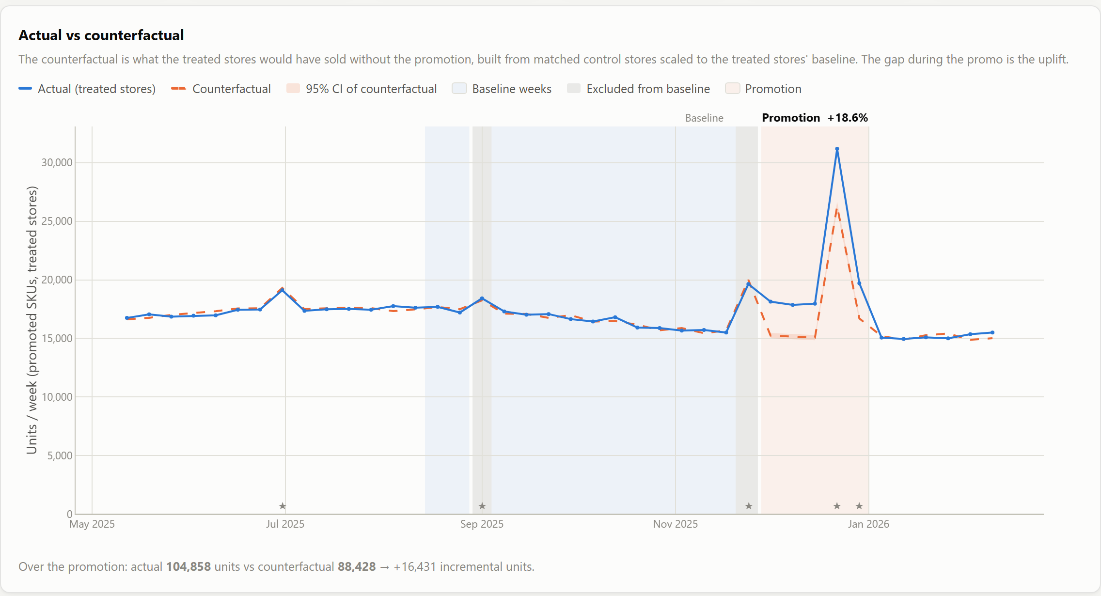
Promotion Performance Attribution
Measured, not argued: a promotion uplift method you can audit, test and trust
Actual sales (blue) vs the counterfactual (orange): what would have happened without the promotion
Capstone demo · Retail Marketing & Sales Analytics
Live app: http://127.0.0.1:8000
Notes:
Opening. Introduce yourself and the capstone: Retail, Marketing & Sales Analytics, project 20.
One-line pitch: we turned promotion post-mortems from an argument into a measurement, with a method you can audit, test and trust.
Agenda: the problem, how it works, results, then the proof (validation, reproducibility, the merge gate), with a live demo throughout.

Slide 2
Same promotion, opposite conclusions
Yogurt 15% Off (P07): one data set, three ways of measuring it
Sales team
Category team
This method
Pre/post: promo weeks vs the weeks before
Stores that ran it vs stores that didn't
Matched twin stores + fixed baseline
−4.7%
+114.6%
+15.3%
“It failed”
“Huge success”
Planted truth: +15.0%
The calculation lived in personal spreadsheets, so the answer depended on who reported it.
Promotion Performance Attribution · method v1.2.0
2 / 13
Notes:
Hook. "Did that promotion work?" Take Yogurt 15% Off.
The sales team compares promo weeks with the weeks just before: sales went DOWN 4.7%, so it failed.
The category team compares stores that ran it with stores that didn't: +115%, a huge success.
Same promotion, same data, opposite conclusions; it depends whose spreadsheet you trust.
The real answer is +15%. We know that for certain because we planted it, and the method recovers +15.3%.

Slide 3
The method is the deliverable, not just the number
1
2
3
Method as code
Counterfactual + confidence interval
Proven and gated
Baseline rules, control selection and the uplift formula live in version-controlled code and a config file, documented in METHOD.md.
Every uplift is shown against what would have happened without the promotion, with a 95% interval, not just a headline.
Validated on synthetic data with planted effects. A method change cannot merge unless it still recovers them.
method_config.yaml · v1.2.0
Bootstrap · 1,000 draws
89 tests · CI merge gate
Delivered: FastAPI service · 8-page web app · Ask (grounded Q&A) · test suite · CI workflow · synthetic data generator
Promotion Performance Attribution · method v1.2.0
3 / 13
Notes:
Instead of a spreadsheet, the calculation is now a service: software with the rules written down in code.
Three things make it trustworthy.
1. The method is fixed and written down: what counts as normal sales, which stores we compare against, and how uplift is computed are decided once, documented and version-numbered.
2. Every number comes with its counterfactual and its margin of error.
3. We proved it works on data with hidden answers, and any change to the method must pass that test before it ships.
TECH: Python + FastAPI service, versioned attribution package with a YAML config, pytest suite, CI workflow gating merges.

Slide 4
How the attribution works, in five steps
1
2
3
4
5
Sales data
Baseline by rule
Twin stores
Counterfactual & uplift
Confidence interval
Weekly units by store × product × week
13 normal weeks before launch; skip holidays and other promos
3 untreated stores per promoted store: same format + region, closest sales pattern
Twins scaled to the store's baseline; uplift = actual ÷ counterfactual − 1
Re-estimate 1,000 times with stores reshuffled; keep the middle 95%
416k rows
Rules B1–B5
Matched pairs
Ratio DiD
Bootstrap
Wrapped around every step: synthetic ground-truth validation · reproducibility fingerprints · a merge gate that blocks any method change that stops recovering the planted effects
Promotion Performance Attribution · method v1.2.0
4 / 13
Notes:
Walk left to right.
1 Sales data: weekly sales by store and product.
2 Baseline by rule: the 13 normal weeks before launch, skipping holidays, the week before launch, and weeks with another promotion on the same products. If there's too little history, it refuses to report.
3 Twin stores: for each promoted store, the 3 untreated stores of the same format and region whose sales tracked it most closely before launch.
4 Counterfactual and uplift: twin-store sales scaled to the promoted store's baseline; uplift = actual / counterfactual - 1. Seasonality, holidays and trend cancel because twins share them.
5 Confidence interval: re-run 1,000 times with stores reshuffled; report the middle 95%.
Validation and the gate wrap the whole pipeline.
TECH: difference-in-differences in ratio form; two-stage bootstrap (Poisson re-weighting of controls + resampling of treated stores), seeded.

Slide 5
10 of 12 promotions lifted sales, but only 5 paid back
10
significant uplift
1
no measurable effect
1
significant decline
5/12
paid back their funding (ROI > 0)
Promotion Performance Attribution · method v1.2.0
5 / 13
Notes:
DEMO: Portfolio page.
Twelve promotions, all measured the same way: 10 genuinely increased sales, 1 had no measurable effect, and 1 hurt sales.
The chart compares the method (blue) with what a pre/post spreadsheet would have said (grey). Summer Soda: spreadsheet +49.1%, method +22.9%. Teams were taking credit for twice the real result.
ROI: only 5 promotions paid back their funding. Both buy-one-get-one promotions drove big volume but lost money.

Slide 6
The counterfactual shows what would have happened anyway
+18.6%
uplift, 95% CI +16.9% to +20.3%
+18.0%
planted truth: recovered within 0.6pp
Christmas
spike is in the counterfactual too, so it isn't credited to the promo
28 twins
control stores matched to 15 promoted stores (same format + region)
Promotion Performance Attribution · method v1.2.0
6 / 13
Notes:
DEMO: Promotion deep-dive, P09 Holiday Chocolate Gifting.
Blue is what the promoted stores actually sold. The orange dashed line is the counterfactual: what they would have sold without the promotion, built from twin stores.
The Christmas spike: a naive analysis credits it to the promotion. The twin stores spiked at Christmas too, so the counterfactual rises with it. Only the gap counts: +18.6%.
Light blue = baseline weeks; grey = weeks thrown out by rule (a holiday, the week before launch).
Margin of error: +16.9% to +20.3%. The planted effect was +18%.
Then show "one promotion, three answers" and the matched-pairs table: every store and its twins are auditable.

Slide 7
BOGO drives the most volume, and loses the most money
Read-out: BOGO lifts volume +27.8% on average but returns −241% ROI. Averages over few promotions are descriptive; each promotion's uplift is measured causally.
Promotion Performance Attribution · method v1.2.0
7 / 13
Notes:
Business insight from the Ask page: "Which mechanics work best on average?"
BOGO has the biggest uplift but the worst ROI: giving away half the product costs more than the extra sales earn.
Bundles and simple price cuts (TPR) pay back.
Caveat: these are averages over a handful of promotions. Each promotion's uplift is measured causally, but the comparison between mechanics is descriptive.

Slide 8
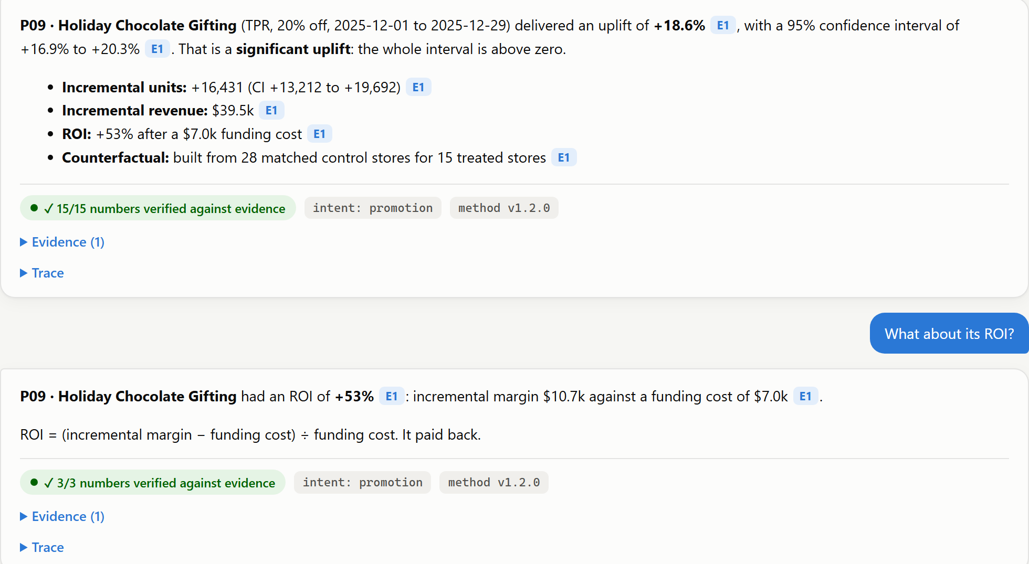
Ask: plain-English answers where every number is checked
1
Cites its evidence
Every claim carries an [E#] tag that opens the exact attribution record behind it.
2
Checks every number
Each figure must match the evidence before the answer is shown: “15/15 verified”.
3
Follows the conversation
“What about its ROI?” resolves to the promotion just discussed.
4
Deterministic
No AI model, so the same question always gets the same answer; guarded by a 17-question eval set.
Promotion Performance Attribution · method v1.2.0
8 / 13
Notes:
DEMO: Ask page. Click "How did P09 perform?" then "What about its ROI?".
Not everyone wants to read charts; here a manager can just ask.
Every number has an E1 tag: the evidence it came from. Click it to see the exact record.
The green badge: before any answer is shown, every number in it is checked against the evidence. It can't make numbers up.
It understood "its ROI" meant the chocolate promotion from the previous question.
No AI model: same question, same answer. A 17-question evaluation set in the test suite guards it.

Slide 9
We hid the answers, and the method found every one
12/12
planted effects recovered within ±2.0pp
0.98pp
largest error (mean 0.51pp)
99.2%
of 360 estimates within ±2pp across 30 new worlds
95%
of 95% intervals contained the truth (target 95%)
Promotion Performance Attribution · method v1.2.0
9 / 13
Notes:
DEMO: Ground-truth validation page.
With real sales you never know the true effect, so you can't grade a method. So we built a realistic simulated retailer (100 stores, 40 products, two years of weekly sales) and planted a known effect in each promotion, like hiding an answer key.
The method ran without seeing the answers. Planted (dark) vs found (blue): 12 of 12 within ±2 points; the largest miss was 0.98 points.
It correctly found the zero-effect promotion and the negative one.
One test could be lucky, so we generated 30 different simulated retailers: 99.2% of 360 estimates landed within ±2 points. That's why the tolerance can be stated with confidence.

Slide 10
Same data, same version, same answer: every time
What is pinned
5 independent runs · result fingerprint (SHA-256)
#1
4f41dcd2aac283b6498fc308cf732469a451a91b…
Method version
✓
v1.2.0
#2
4f41dcd2aac283b6498fc308cf732469a451a91b…
✓
Config hash
b977a3eae90d
#3
4f41dcd2aac283b6498fc308cf732469a451a91b…
✓
#4
4f41dcd2aac283b6498fc308cf732469a451a91b…
✓
Data hash
daedbb25e20f3e17
#5
4f41dcd2aac283b6498fc308cf732469a451a91b…
✓
Random seed
fixed in config, one stream per promotion
All runs identical, down to the last digit
Automated tests: repeat runs, fresh load, run order, byte-identical data
Promotion Performance Attribution · method v1.2.0
10 / 13
Notes:
DEMO: Reproducibility page, Run 5x.
"It depends who reports it" is gone: we re-run the whole analysis from scratch 5 times. Each run produces a fingerprint, a unique code for every number in the results. All identical.
Pinned: method version, config hash, data hash, and the random seed (each promotion gets its own stream, so results don't depend on run order).
TECH: SHA-256 over all reported values; tests also prove the data generator reproduces the CSVs byte for byte.

Slide 11
A method change cannot ship unmeasured
Proposed change | Version | Recovered | Verdict
More bootstrap iterations | v1.2.1 | 12/12 · max 0.98pp | ✓ PASS
Two controls per treated store | v1.2.1 | 12/12 · max 1.09pp | ✓ PASS
Use every untreated store as control | v1.3.0 | 2/12 · max 9.48pp | ✕ BLOCK
Match controls on format only | v1.3.0 | 11/12 · max 2.56pp | ✕ BLOCK
Pre/post run-rate (no control group) | v2.0.0 | 1/12 · max 36.22pp | ✕ BLOCK
Every change must pass
G1
Planted effects recovered within ±2pp
G2
Identical result across two runs
G3
Version bumped for any method change
G4
Reference data matches pinned checksums
The subtle one: “match on format only” sounds reasonable, but stores in other regions grow at different rates. It misses Summer Soda by 2.6pp, so the gate blocks it.
Proposal can't loosen its own tolerance
G5
Runs on every pull request in CI
Promotion Performance Attribution · method v1.2.0
11 / 13
Notes:
DEMO: Method-change gate page.
Methods evolve and someone always has a small improvement; the danger is a change that silently shifts every number.
Run "More bootstrap iterations": PASS, safe to ship.
Run "Match controls on format only": sounds sensible (more candidate stores) but it's BLOCKED: Summer Soda misses by 2.6 points. Stores in different regions grow at different rates, so the twins stop being twins.
"Use every untreated store": BLOCKED, only 2 of 12 recovered. Bigger isn't better if the comparison is unfair.
Build your own change, set tolerance to 50: G5 blocks a proposal that tries to loosen its own bar.
In GitHub, the same gate runs on every pull request; a BLOCK fails the build.

Slide 12
All four success metrics are met
✓
Recovery of the planted effect within a stated tolerance
✓
Baseline-definition test coverage
12/12 within ±2.0pp
100% line coverage
Max error 0.98pp; 99.2% within tolerance across 30 new worlds
Every rule B1–B5 has its own test; CI enforces a 95% floor on the baseline module
✓
Reproducibility of a result across runs
✓
Gate demonstration on a method change
Identical fingerprints
2 PASS · 3 BLOCK
Repeat runs, fresh data load and run order all give the same SHA-256 result hash
“Match on format only” blocked at 2.6pp; G5 stops a proposal loosening its own tolerance
Promotion Performance Attribution · method v1.2.0
12 / 13
Notes:
Close the loop on the brief. Four success metrics, with the evidence for each:
1 Recovery within a stated tolerance: 12/12 within ±2pp; 99.2% across 30 simulated retailers.
2 Baseline-definition test coverage: 100% line coverage, every rule B1-B5 has its own test; CI enforces a 95% floor.
3 Reproducibility: identical fingerprints, every run.
4 Gate on a method change: good changes pass; plausible-but-wrong changes are blocked.

Slide 13
From one argued number to one measured method
1
Pilot on real sales
2
Plan holdout stores
Run alongside today's reports; keep the synthetic test as the safety net
Keep 3+ untreated stores per format × region in every promotion
3
Widen the scope
4
Tighten the null rate
Halo, cannibalisation and the post-promotion dip
13% false positives across 30 worlds → 5% target, proven through the gate
Questions? · Live app: http://127.0.0.1:8000 · Code, METHOD.md and tests in promo_attribution/
Promotion Performance Attribution · method v1.2.0
13 / 13
Notes:
Close. Promotion reviews stop being an argument about whose spreadsheet is right: there's one method, written down, tested and versioned, and every number comes with its counterfactual and its margin of error.
Next steps:
1 Pilot on real sales alongside current reports, keeping the synthetic test as the permanent safety net.
2 Build holdout stores into promotion planning, so every format and region has twins.
3 Extend scope: halo, cannibalisation, post-promotion dip.
4 Bring the null false-positive rate (13% across 30 worlds) down to the 5% target; the gate is how we'd prove it.
5 Optional: AI phrasing for Ask, with the number check as a guardrail.
Then open for questions.

