Slide 1
Software Development Life Cycle
Phaniraj

Slide 2
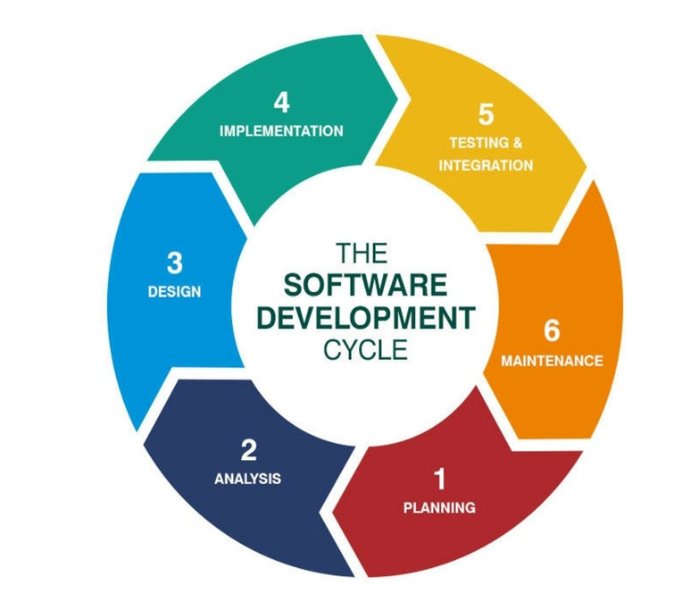
Introduction to SDLC
SDLC (Software Development Life Cycle) is a structured process for developing high-quality software
Its purpose is to ensure software meets requirements, quality standards, and user needs.
Requirements, Design, Development, Testing, Deployment, Maintenance

Slide 3
Phases of SDLC
Requirement Gathering: Collect and analyse project requirements.
Design: Architect the solution, from high-level design to detailed designs.
Development: Code the solution according to design specifications.
Testing: Validate the software against requirements.
Deployment: Release the software to production.
Maintenance: Provide ongoing support and updates.

Slide 4
SDLC Models Overview
Different SDLC models provide varying approaches for project types.
Factors influencing model choice: Project size, complexity, flexibility needs, and risk tolerance.
Waterfall (linear), Agile (iterative), and others.

Slide 5
Waterfall Model
Process: Each phase flows sequentially; one must complete before the next begins.
Pros: Simple, easy to manage, good for small projects with clear requirements.
Cons: Rigid, difficult to adapt to changes, limited testing until the end.
When to Use: Projects with well-defined requirements that are unlikely to change.

Slide 6
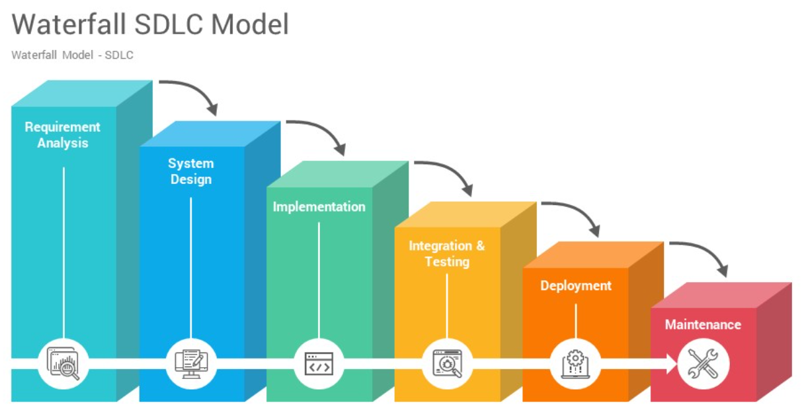
Water Flow Model

Slide 7
Water Flow Model
Requirements: The first phase involves gathering requirements from stakeholders and analyzing them to understand the scope and objectives of the project.
Design: Once the requirements are understood, the design phase begins. This involves creating a detailed design document that outlines the software architecture, user interface, and system components.
Development: The Development phase include implementation involves coding the software based on the design specifications. This phase also includes unit testing to ensure that each component of the software is working as expected.

Slide 8
Water Flow Model
Testing: In the testing phase, the software is tested to ensure that it meets the requirements and is free from defects.
Deployment: Once the software has been tested and approved, it is deployed to the production environment.
Maintenance: The final phase of the Waterfall Model is maintenance, which involves fixing any issues that arise after the software has been deployed and ensuring that it continues to meet the requirements over time.

Slide 9
Feasibility Study
The main goal of this phase is to determine whether the process is financially and technically feasible to develop the software.
The feasibility study involves understanding the problem and then determining the various possible strategies to solve the problem.
These different identified solutions are analyzed based on their benefits and drawbacks.
The best solution is chosen and all the other phases are carried out as per this solution strategy.

Slide 10
Requirements Analysis and Specification
The requirement analysis and specification phase aims to understand the exact requirements of the customer and document them properly. This phase consists of two different activities.
Requirement gathering and analysis.
Requirement specification:
Notes:
Firstly all the requirements regarding the software are gathered from the customer and then the gathered requirements are analyzed. The goal of the analysis part is to remove incompleteness (an incomplete requirement is one in which some parts of the actual requirements have been omitted) and inconsistencies (an inconsistent requirement is one in which some part of the requirement contradicts some other part).
These analyzed requirements are documented in a software requirement specification (SRS) document. SRS document serves as a contract between the development team and customers. Any future dispute between the customers and the developers can be settled by examining the SRS document.

Slide 11
Design
The goal of this phase is to convert the requirements acquired in the SRS into a format that can be coded in a programming language.
It includes high-level and detailed design as well as the overall software architecture.
A Software Design Document is used to document all of this effort (SDD).

Slide 12
Coding and Unit Testing
In the coding phase software design is translated into source code using any suitable programming language.
Thus each designed module is coded.
The unit testing phase aims to check whether each module is working properly or not.

Slide 13
Integration and System testing
Integration of different modules is undertaken soon after they have been coded and unit tested.
Integration of various modules is carried out incrementally over several steps. During each integration step, previously planned modules are added to the partially integrated system and the resultant system is tested.
Finally, after all the modules have been successfully integrated and tested, the full working system is obtained and system testing is carried out on this.

Slide 14
System Testing
Alpha testing: Alpha testing is the system testing performed by the development team.
Beta testing: Beta testing is the system testing performed by a friendly set of customers.
Acceptance testing: After the software has been delivered, the customer performs acceptance testing to determine whether to accept the delivered software or reject it.

Slide 15
Maintenance
Maintenance is the most important phase of a software life cycle.
There are three types of maintenance:
Corrective Maintenance: This type of maintenance is carried out to correct errors that were not discovered during the product development phase.
Perfective Maintenance: This type of maintenance is carried out to enhance the functionalities of the system based on the customer’s request.
Adaptive Maintenance: Adaptive maintenance is usually required for porting the software to work in a new environment such as working on a new computer platform or with a new operating system.
Notes:
The effort spent on maintenance is 60% of the total effort spent to develop a full software

Slide 16
Advantages of Waterfall Model
An idealistic model for software development. It’s very simple, can be considered the basis for other SDLC models.
Individual Processing
Properly Defined.
Clear Milestones.
Properly Documented.
Reinforces Good Habits.
Working.
Notes:
Easy to Understand: The Classical Waterfall Model is very simple and easy to understand.
Individual Processing: Phases in the Classical Waterfall model are processed one at a time.
Properly Defined: In the classical waterfall model, each stage in the model is clearly defined.
Clear Milestones: The classical Waterfall model has very clear and well-understood milestones.
Properly Documented: Processes, actions, and results are very well documented.
Reinforces Good Habits: The Classical Waterfall Model reinforces good habits like define-before-design and design-before-code.
Working: Classical Waterfall Model works well for smaller projects and projects where requirements are well understood.

Slide 17
Disadvantages of Waterfall Model
No Feedback Path
Difficult to accommodate Change Requests:
No Overlapping of Phases
Limited Flexibility
Limited Stakeholder Involvement.
Late Defect Detection.
Lengthy Development Cycle.
Notes:
In the classical waterfall model evolution of software from one phase to another phase is like a waterfall. It assumes that no error is ever committed by developers during any phase. Therefore, it does not incorporate any mechanism for error correction.
This model assumes that all the customer requirements can be completely and correctly defined at the beginning of the project, but the customer’s requirements keep on changing with time. It is difficult to accommodate any change requests after the requirements specification phase is complete.
This model recommends that a new phase can start only after the completion of the previous phase. But in real projects, this can’t be maintained. To increase efficiency and reduce cost, phases may overlap.
The Waterfall Model is a rigid and linear approach to software development, which means that it is not well-suited for projects with changing or uncertain requirements. Once a phase has been completed, it is difficult to make changes or go back to a previous phase.
: The Waterfall Model is a structured and sequential approach, which means that stakeholders are typically involved in the early phases of the project (requirements gathering and analysis) but may not be involved in the later phases (implementation, testing, and deployment).
: In the Waterfall Model, testing is typically done toward the end of the development process. This means that defects may not be discovered until late in the development process, which can be expensive and time-consuming to fix.
: The Waterfall Model can result in a lengthy development cycle, as each phase must be completed before moving on to the next. This can result in delays and increased costs if requirements change or new issues arise

Slide 18
When to Use Waterfall Model?
Well-understood Requirements.
Very Little Changes Expected
Small to Medium-Sized Projects
Predictable.
Regulatory Compliance is Critical.
Client Prefers a Linear and Sequential Approach.
Limited Resources.
Notes:
Before beginning development, there are precise, reliable, and thoroughly documented requirements available.
: During development, very little adjustments or expansions to the project’s scope are anticipated.
Ideal for more manageable projects with a clear development path and little complexity.
Projects that are predictable, low-risk, and able to be addressed early in the development life cycle are those that have known, controllable risks
Circumstances in which paperwork is of utmost importance and stringent regulatory compliance is required
This situation describes the client’s preference for a linear and sequential approach to project development
Projects with limited resources can benefit from a set-up strategy, which enables targeted resource allocation.

Slide 19
Applications of Waterfall Model
Large-scale Software Development Projects.
Safety-Critical Systems.
Government and Defense Projects
Projects with well-defined Requirements
Projects with Stable Requirements
Notes:
Large-scale Software Development Projects: The Waterfall Model is often used for large-scale software development projects, where a structured and sequential approach is necessary to ensure that the project is completed on time and within budget.
Safety-Critical Systems: The Waterfall Model is often used in the development of safety-critical systems, such as aerospace or medical systems, where the consequences of errors or defects can be severe.
Government and Defense Projects: The Waterfall Model is also commonly used in government and defense projects, where a rigorous and structured approach is necessary to ensure that the project meets all requirements and is delivered on time.
Projects with well-defined Requirements: The Waterfall Model is best suited for projects with well-defined requirements, as the sequential nature of the model requires a clear understanding of the project objectives and scope.
Projects with Stable Requirements: The Waterfall Model is also well-suited for projects with stable requirements, as the linear nature of the model does not allow for changes to be made once a phase has been completed.

Slide 20
V Model
The V-Model is a software development life cycle (SDLC) model that provides a systematic and visual representation of the software development process.
It is based on the idea of a “V” shape, with the two legs of the “V” representing the progression of the software development process from requirements gathering and analysis to design, implementation, testing, and maintenance

Slide 21
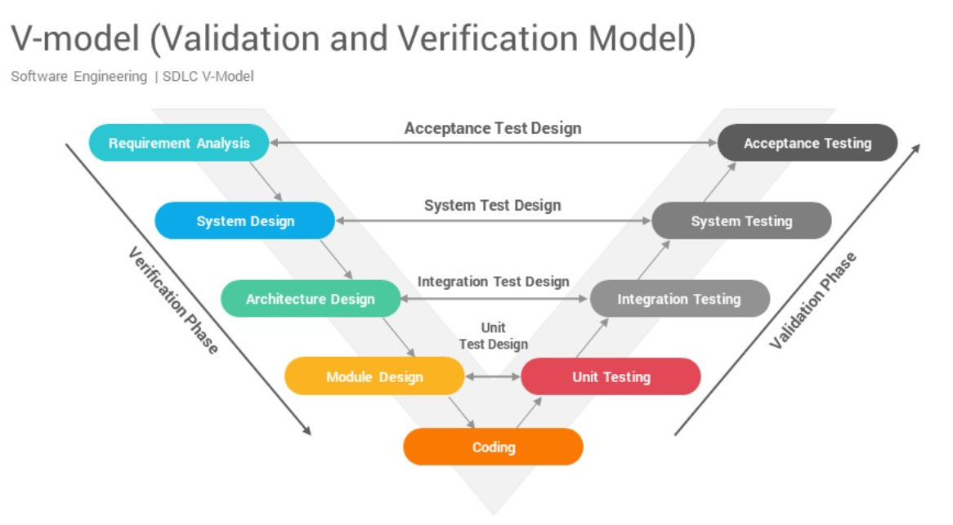

Slide 22
V Model Design
Requirements Gathering and Analysis: The first phase of the V-Model is the requirements gathering and analysis phase, where the customer’s requirements for the software are gathered and analyzed to determine the scope of the project.
Design: In the design phase, the software architecture and design are developed, including the high-level design and detailed design.
Implementation: In the implementation phase, the software is built based on the design.
Testing: In the testing phase, the software is tested to ensure that it meets the customer’s requirements and is of high quality.

Slide 23
V Model Design
Deployment: In the deployment phase, the software is deployed and put into use.
Maintenance: In the maintenance phase, the software is maintained to ensure that it continues to meet the customer’s needs and expectations.
The V-Model is often used in safety: critical systems, such as aerospace and defence systems, because of its emphasis on thorough testing and its ability to clearly define the steps involved in the software development process.

Slide 24
Different phases of V-Model
Verification Phase
Business Requirement Analysis
System Design
Architectural Design
Module Design
Coding Phase
Validation Phase
Unit Testing
Integration Testing
System Testing
UAT
Notes:
Verification Phases:
It involves a static analysis technique (review) done without executing code. It is the process of evaluation of the product development phase to find whether specified requirements are met.
There are several Verification phases in the V-Model:
Business Requirement Analysis:
This is the first step of the designation of the development cycle where product requirement needs to be cured from the customer’s perspective. in these phases include proper communication with the customer to understand the requirements of the customers. these are the very important activities that need to be handled properly, as most of the time customers do not know exactly what they want, and they are not sure about it at that time then we use an acceptance test design planning which is done at the time of business requirement it will be used as an input for acceptance testing.
System Design:
Design of the system will start when the overall we are clear with the product requirements, and then need to design the system completely. This understanding will be at the beginning of complete under the product development process. these will be beneficial for the future execution of test cases.
Architectural Design:
In this stage, architectural specifications are comprehended and designed. Usually, several technical approaches are put out, and the ultimate choice is made after considering both the technical and financial viability. The system architecture is further divided into modules that each handle a distinct function. Another name for this is High-Level Design (HLD).
At this point, the exchange of data and communication between the internal modules and external systems are well understood and defined. During this phase, integration tests can be created and documented using the information provided.
Module Design:
This phase, known as Low-Level Design (LLD), specifies the comprehensive internal design for every system module. Compatibility between the design and other external systems as well as other modules in the system architecture is crucial. Unit tests are a crucial component of any development process since they assist in identifying and eradicating the majority of mistakes and flaws at an early stage. Based on the internal module designs, these unit tests may now be created.
Coding Phase:
The Coding step involves writing the code for the system modules that were created during the Design phase. The system and architectural requirements are used to determine which programming language is most appropriate.
The coding standards and principles are followed when performing the coding. Before the final build is checked into the repository, the code undergoes many code reviews and is optimized for optimal performance.
Validation Phases:
It involves dynamic analysis techniques (functional, and non-functional), and testing done by executing code. Validation is the process of evaluating the software after the completion of the development phase to determine whether the software meets the customer’s expectations and requirements.
So, V-Model contains Verification phases on one side of the Validation phases on the other side. The verification and Validation phases are joined by the coding phase in a V-shape. Thus, it is called V-Model.
There are several Validation phases in the V-Model:
Unit Testing:
Unit Test Plans are developed during the module design phase. These Unit Test Plans are executed to eliminate bugs in code or unit level.
Integration testing:
After completion of unit testing Integration testing is performed. In integration testing, the modules are integrated and the system is tested. Integration testing is performed in the Architecture design phase. This test verifies the communication of modules among themselves.
System Testing:
System testing tests the complete application with its functionality, inter-dependency, and communication. It tests the functional and non-functional requirements of the developed application.
User Acceptance Testing (UAT):
UAT is performed in a user environment that resembles the production environment. UAT verifies that the delivered system meets the user’s requirement and the system is ready for use in the real world.

Slide 25
Principles of V Model
Large to Small: In V-Model, testing is done in a hierarchical perspective, for example, requirements identified by the project team, creating High-Level Design, and Detailed Design phases of the project. As each of these phases are completed the requirements, they are defining become more and more refined and detailed.
Data/Process Integrity: This principle states that the successful design of any project requires the incorporation and cohesion of both data and processes. Process elements must be identified at every requirement.
Scalability: This principle states that the V-Model concept has the flexibility to accommodate any IT project irrespective of its size, complexity, or duration.

Slide 26
Principles of V Model
Cross Referencing: A direct correlation between requirements and corresponding testing activity is known as cross-referencing.
Tangible Documentation: This principle states that every project needs to create a document. This documentation is required and applied by both the project development team and the support team.
Notes:
Documentation is used to maintain the application once it is available in a production environment.

Slide 27
Why is it preferred?
It is easy to manage due to the rigidity of the model.
Each phase of V-Model has specific deliverables and a review process.
Proactive defect tracking – that is defects are found at an early stage.

Slide 28
When to Use of V-Model?
Traceability of Requirements
Complex Projects
Waterfall-Like Projects with improvizations
Safety-Critical Systems
Notes:
Traceability of Requirements: The V-Model proves beneficial in situations when it’s imperative to create precise traceability between the requirements and their related test cases.
Complex Projects: The V-Model offers a methodical way to manage testing activities and reduce risks related to integration and interface problems for projects with a high level of complexity and interdependencies among system components.
Waterfall-Like Projects: Since the V-Model offers an approachable structure for organizing, carrying out, and monitoring testing activities at every level of development, it is appropriate for projects that use a sequential approach to development, much like the waterfall model.
Safety-Critical Systems: These systems are used in the aerospace, automotive, and healthcare industries. They place a strong emphasis on rigid verification and validation procedures, which help to guarantee that essential system requirements are fulfilled and that possible risks are found and eliminated early in the development process.

Slide 29
Advantages of V Model.
This is a highly disciplined model and Phases are completed one at a time.
V-Model is used for small projects where project requirements are clear.
Simple and easy to understand and use.
This model focuses on verification and validation activities early in the life cycle thereby enhancing the probability of building an error-free and good quality product.
It enables project management to track progress accurately.
Clear and Structured Process
Emphasis on Testing
Improved Traceability.
Better Communication.
Notes:
The V-Model provides a clear and structured process for software development, making it easier to understand and follow.
The V-Model places a strong emphasis on testing, which helps to ensure the quality and reliability of the software.
Improved Traceability: The V-Model provides a clear link between the requirements and the final product, making it easier to trace and manage changes to the software.
The clear structure of the V-Model helps to improve communication between the customer and the development team

Slide 30
Disadvantages of V-Model
High risk and uncertainty.
It is not good for complex and object-oriented projects.
It is not suitable for projects where requirements are not clear and contain a high risk of changing.
This model does not support iteration of phases.
It does not easily handle concurrent events.
Inflexibility
Time-Consuming.
Overreliance on Documentation.
Notes:
Inflexibility: The V-Model is a linear and sequential model, which can make it difficult to adapt to changing requirements or unexpected events.
Time-Consuming: The V-Model can be time-consuming, as it requires a lot of documentation and testing.
Overreliance on Documentation: The V-Model places a strong emphasis on documentation, which can lead to an overreliance on documentation at the expense of actual development work.

Slide 31
Agile Development
The Agile Group models are iterative and incremental software development models which emphasize flexibility and customer collaboration.
The Agile Group models include Extreme Programming (XP), Scrum, and Lean Software Development.
These models are based on the Agile Manifesto, which values individuals and interactions over processes and tools, working software over comprehensive documentation, customer collaboration over contract negotiation, and responding to change over following a plan.
The Agile Group models have been adopted by organizations of all sizes in many industries, including software development, manufacturing, defense, automotive, aerospace, government, marketing, finance, and others.
The Agile Group models have helped organizations improve their software development processes by increasing transparency and communication, decreasing bureaucracy, and improving project management.

Slide 32
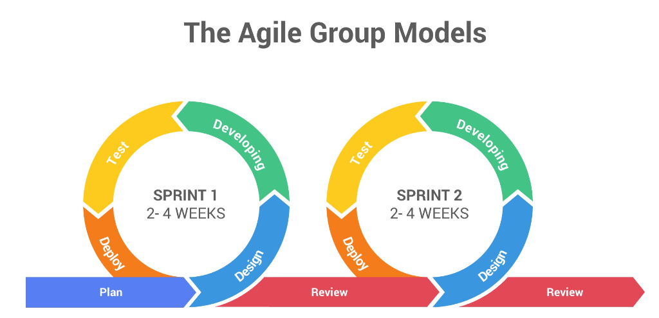
Notes:
Process: Iterative with sprints, where each sprint delivers a usable part of the product.
Key Components: Sprints (2-4 weeks), daily stand-ups, retrospective meetings.
Pros: Flexible, encourages collaboration, adaptable to change.
Cons: Requires close collaboration and constant feedback.
When to Use: Complex projects where requirements might evolve over time.

Slide 33
What is Agile SDLC?
An iterative and incremental software development methodology that prioritizes flexibility, collaboration, and customer feedback.
Unlike traditional SDLC models, such as the waterfall model, which completes each step sequentially, the agile SDLC divides the development process into smaller iterations or increments called SPRINTS.

Slide 34
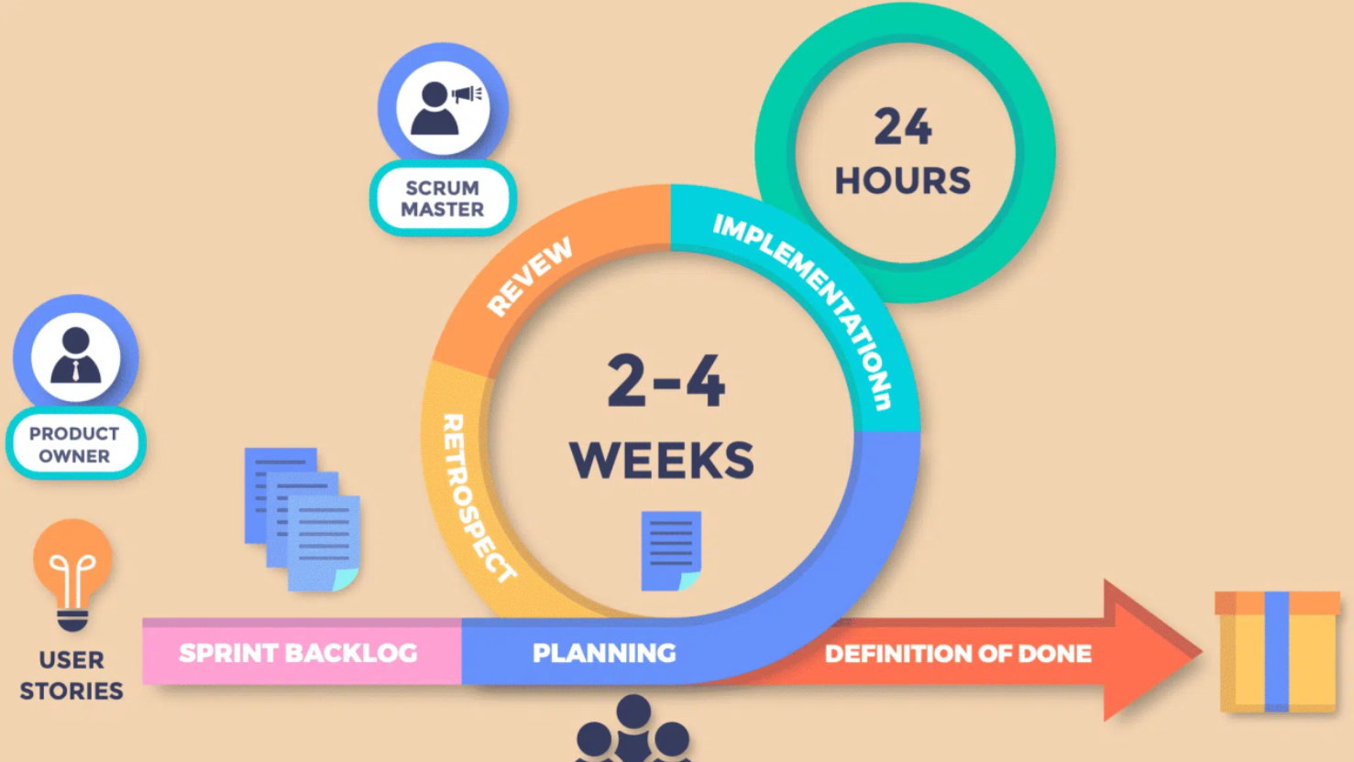

Slide 35
The major factors of agile:
Early customer involvement
Iterative development
Self-organizing teams
Adaptation to change

Slide 36
Core Values of Agile
Individuals and Interactions over Processes and Tools
Working Software over Comprehensive Documentation
Customer Collaboration over Contract Negotiation
Responding to Change over Following a Plan

Slide 37
Principles
Ensuring customer satisfaction through the early delivery of software.
Being open to changing requirements in the stages of the development.
Frequently delivering working software with a main focus on preference for timeframes.
Promoting collaboration between business stakeholders and developers as an element.
Structuring the projects around individuals. Providing them with the necessary environment and support.
Prioritizing face to face communication whenever needed.
Considering working software as the measure of the progress.
Fostering development by allowing teams to maintain a pace indefinitely.
Placing attention on excellence and good design practices.
Recognizing the simplicity as crucial factor aiming to maximize productivity by minimizing the work.

Slide 38
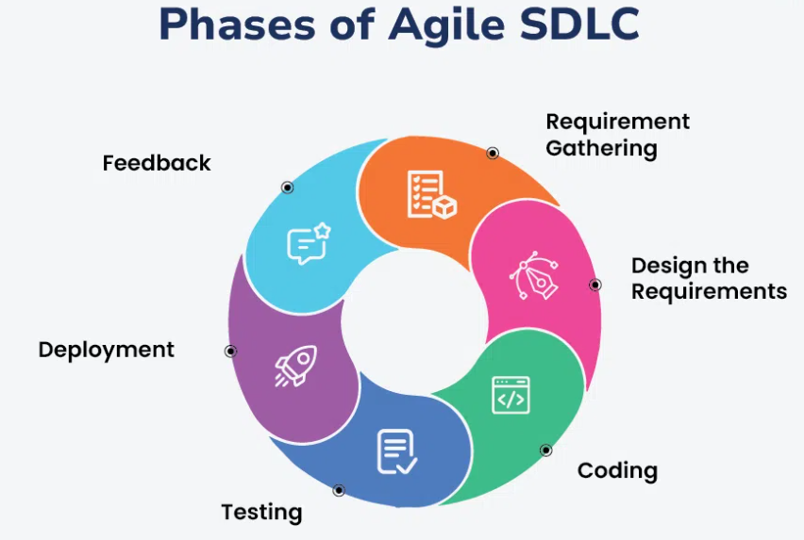

Slide 39
Steps of Agile SDLC Model
The agile model is a combination of iterative and incremental process models.
The steps involve in agile SDLC models are:
Requirement gathering
Design the Requirements
Coding
Testing
Deployment
Feedback
Notes:
Requirement Gathering: In requirement Gathering collaboration takes place with stakeholders to understand and prioritize needs for the project, that focus on delivering value. In this step techniques like user stories and workshops for effective communication.
2. Design the Requirements: In design the requirement step that gathered requirements is translated into actionable tasks, breaking them down into smaller, manageable chunks. In this step developers develop visual representations of the solution, such as wireframes or prototypes, to get early feedback and ensure alignment with stakeholder expectations.
3. Coding: During the coding step, the development team implements the software in short, iterative cycles known as sprints. Each sprint focuses on delivering small, functional increments of the product. Developers write code, continuously integrate it into the main codebase, and regularly commit changes to detect and address issues early.
4. Testing / Quality Assurance: Testing is an integral part of each iteration, ensuring the quality and functionality of the software. Unit tests are written to verify individual components, while integration tests check that different parts of the system work together as intended. User Acceptance Testing (UAT) involves end-users testing the software in real-world scenarios to ensure it meets their needs.
5. Deployment: Deployment involves releasing the software increments to production frequently and reliably. Automated deployment tools makes the process, allowing for quick and consistent releases. Monitoring the deployment process and system performance helps identify and resolve any issues promptly.
6. Feedback: Feedback is crucial for continuous improvement in Agile. Stakeholders and end-users provide feedback through surveys, direct communication, and usage analytics. This feedback is used to refine requirements, prioritize changes, and identify areas for improvement.

Slide 40
Agile SDLC Process Flow
Concept
Inception
Iteration/Construction
Release
Production
Notes:
Concept: In concept phase vision of the project, its scope, objectives, and goals are set.
Inception: This stage is conducted before Construction. The major goal of this phase is to complete just enough work to get your team moving in the correct direction.
Iteration/Construction: The main goal of this phase is to create a consumable solution with enough functionality to satisfy your stakeholders’ present needs, or to configure it in the event of a package implementation.
Release: This stage normally involves final performance testing, security assessments, and documentation updates, as well as user acceptability testing (UAT), which ensures that user demands are satisfied and the product is successful. When the software is complete, it is released into production or made available to users.
Production: The Production Phase aims to keep systems viable and productive after they have been deployed to the user population.

Slide 41
Popular Agile Software Development Frameworks
Scrum
Kanban
Lean Software Development.
SAFe (Scaled Agile Framework)

Slide 42
SCRUM
Scrum is the type of Agile Framework, widely known for its incremental approach. It involves sprint cycles, daily stand-up meetings, and a focus, on product backlogs.
Scrum is light-weighted framework
Scrum emphasizes self-organization
Scrum is simple to understand
Scrum framework help the team to work together

Slide 43
Kanban
Kanban focuses on visualizing the workflow, limiting work in progress, and optimizing work flow. It’s a framework for both technical and non-technical teams.
Features of Kanban in Software Development
Kanban visualizes the workflow, It is crucial to visualize and make visible the workflow in order to understand how work is done.
Kanban encourages small incremental, continuous, and evolutionary changes.
Kanban sets limits on the number of tasks that can be worked on at the same time, promoting a steady controlled workflow.
Kanban support early feedback from clients and the pull system are important

Slide 44
Lean Software Development(LSD)
An agile framework that aim to eliminate waste improve efficiency and maximize the value delivery. They can be applied not only to software development but across various industries.
LSD removes the unnecessary process stages when designing software.
LSD simplifies the development process and saves time by removing unnecessary stages.
LSD reduces waste by minimizing unnecessary features.
LSD enhance innovation through experimentation and creativity.

Slide 45
SAFe (Scaled Agile Framework)
SAFe is specifically designed for the use of organizations.
It provides a framework for scaling practices to an enterprise level while ensuring both alignment and collaboration across teams.
SAFe promotes alignment between teams and individuals at all levels of the organization.
SAFe accelerates product development and delivery.
SAFe enhanced product quality
SAFe enhance a culture of openness and visibility within organizations.

Slide 46
Extreme Programming (XP)
Extreme Programming is an agile framework that focuses on practices and it is particularly suitable for software development projects.
It encourages integration, test driven development and close collaboration, with customers.
The XP model is very useful in small projects.
The XP model is well-suited for web development projects.
The XP model is useful for collaborative projects
The XP model can be used in projects that have a tight deadline.

Slide 47
Advantage of Agile SDLC
Responds to Change
Iterative Development
Continuous Testing
Incremental Releases
Frequent Feedback
Cross-Functional Teams
Focus on Priorities
Early Issue Detection
Transparency
Retrospectives.
Notes:
Responds to Change: Agile allows for changes in requirements even late in the development process, adapting to evolving business needs and market conditions.
Iterative Development: Features are developed in small, manageable increments, making it easier to pivot or refine the product as necessary.
Continuous Testing: Regular testing at each iteration helps identify and fix defects early, ensuring higher quality.
Incremental Releases: By delivering small, functional parts of the project regularly, Agile ensures that valuable features reach users faster.
Frequent Feedback: Regular interaction with customers and stakeholders ensures that their needs are met and their feedback is incorporated.
Cross-Functional Teams: Agile promotes collaboration among diverse team members, including developers, testers, designers, and business analysts.
Focus on Priorities: Agile helps teams prioritize tasks that deliver the most value, reducing waste and focusing efforts on what matters most.
Early Issue Detection: Regular iterations and continuous integration help identify and address risks early in the development process.
Transparency: Agile methodologies like Scrum involve daily stand-ups, sprint reviews, and retrospectives, providing clear visibility into progress and challenges.
Retrospectives: Regular reflection on processes and outcomes allows teams to identify areas for improvement and implement changes effectively.

Slide 48
Benefits of Agile Software Development
Increased flexibility: Agile allows for adapting requirements and priorities to ensure that the final product meets customer needs.
Time to market: By using iterations and incremental development valuable features or products can be delivered faster.
Enhanced quality: Continuous feedback and testing together contribute to the production of higher quality deliverables.
Improved collaboration: Agile promotes collaboration and communication among functional teams fostering better teamwork.
Heightened customer satisfaction: Regular feedback, from customers drives product improvements and ensures customer satisfaction.

Slide 49
Limitations of Agile Methodology
Less Documentation: Agile methodologies focus on less documentation; it prioritizes working on projects rather than paperwork.
Challenges in Large Organizations: Busy schedule of clients can make daily meetup and face-to-face communication difficult.
Need for Senior Programmers: It may require experienced programmers to make critical decisions during the development of software.
Limited Scope Control: It has less rigid scope control, which may not be suitable in certain situations.
Predictability: Compared to more structured project management methods, it may lack predictability.

Slide 50
SCRUM
The best Agile practice in today’s world.
Agile moto is “Build short, Build often”.
Scrum is using agile methodology, rather than viewing it as a methodology, think of it as a framework for managing the process development.
Notes:
Suppose there is one product called “MyProduct”. In scrum features of the product are written from the perspective of the end-user. Features are known as user stories. The collection of user stories is called a Product backlog. It is the wish list of features of the product. After creating a product backlog. For developing a product, we need a variety of people.

Slide 51
Roles in SCRUM:
Product Owner :
The product owner helps to identify the features to make them correct into the product. The product owner also directs the flow of the work of product development.
Scrum Master:
The responsibility of the scrum master is to ensure that project is going smoothly and every team member is following agile values and principles to develop the project. They are like a project manager.
Team:
In the team, there are a tester, developer, and executives.

Slide 52
Release Planning
The team starts with this. They identify the user stories which want to put into the release.
Then those user stories are being the part of release backlog.
They prioritize the user stories and estimates them according to timing.
Now release backlog is divided as sprint backlog and each sprint backlog contain sprints.
Sprints are short-duration milestones. They are several incremental releases.
Each Sprint contains different stages like quick planning, build, test and reviews. After completing these stages, you get the potentially shippable product.
If a sprint is not completed within time, i.e, the project is not on schedule and something needs to be done. Therefore, it extremely needs to monitor the progress of each sprint with the help of the Burndown chart.

Slide 53
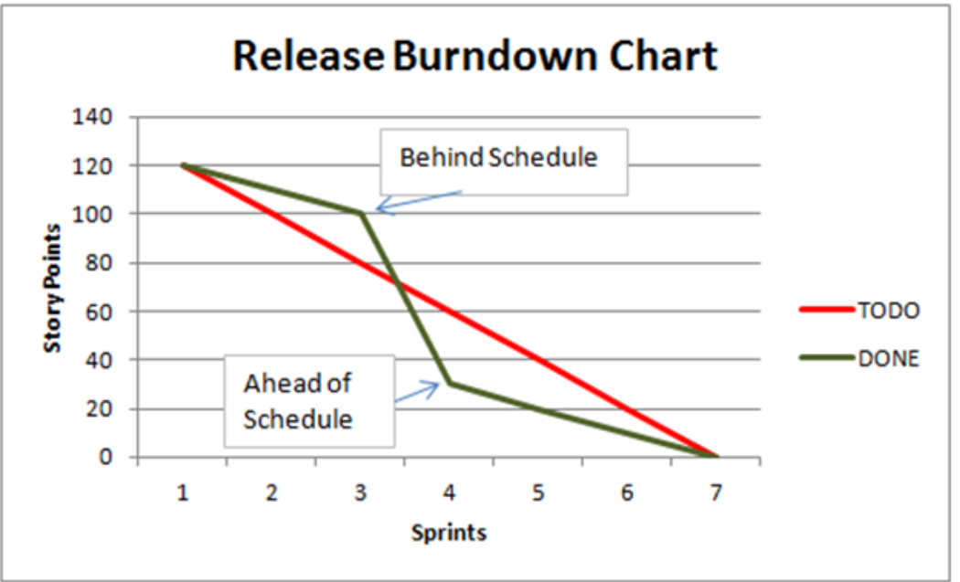
Burndown chart
This is the number one reason for the popularity of scrum methodology.
It is one of the best project visibility tools to ensure that project is on track.
It helps the team to make adjustments to get the project on track. It is proof that the project is on track.
Notes:
A burndown chart helps analyze the work you have to do versus the time it takes you to complete it. This can be an excellent tool to visualize and better manage your team’s workload so you can prioritize your schedule. Let’s dig into what a burndown chart is and how to create one of your own.
A burndown chart is a visual representation of the remaining work versus the time required to complete it. By estimating the time it takes to complete tasks, issues, and testing, you can determine the project completion date.

Slide 54
Daily scrums
The daily scrum is essential for having daily communication between team members.
Arranged by Scrum master to understand the current status of the work and tasks and challenges of each team member discussed for a brief period of time.
It’s important to have a sprint retrospective meeting and discuss what can be improved for the next time around.

Slide 55
Spiral Model
Process: Combines iterative nature with risk assessment in each phase.
- Phases: Planning, Risk Analysis, Engineering, Evaluation.
- Pros: Risk management and client feedback are prioritized.
- Cons: Expensive, complex to manage.
- When to Use: High-risk projects or projects with frequent changes in requirements

Slide 56
Traceability Matrix (RTM)
A Traceability Matrix (RTM) is a document that maps and traces user requirements with test cases.
It ensures that every requirement is tested and validated, preventing scope creep, missing requirements, or overlooked testing.

Slide 57
Purpose:
1. Requirement Coverage: Ensures all requirements are addressed during development and testing.
2. Scope Management: Tracks changes in requirements and their impact on the system.
3. Defect Tracking: Identifies gaps where requirements are not met or validated.
4. Accountability: Provides a clear mapping for accountability across teams (e.g., developers, testers).
5. Compliance: Helps in audit and compliance by showing how requirements have been tested.

Slide 58
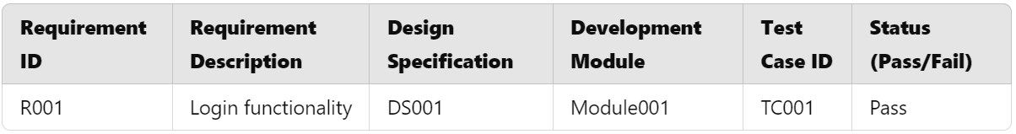
Structure of a Traceability Matrix

Slide 59
Types of Traceability Matrices
Forward Traceability:
Tracks requirements to the corresponding design, implementation, and test cases.
Ensures all requirements are implemented.
Backward Traceability:
Tracks test cases and implementation back to requirements.
Ensures no over-engineering or unnecessary development.
Bidirectional Traceability:
Combines forward and backward traceability for comprehensive coverage.

Slide 60
Steps to Create a Traceability Matrix
Gather Requirements:
Collect all functional and non-functional requirements.
Assign unique IDs to each requirement.
Map Requirements to Design:
Link requirements to specific design components.
Map Requirements to Test Cases:
Associate each requirement with relevant test cases.
Validate Coverage:
Verify that every requirement is covered by design, development, and testing.
Update Regularly:
Maintain the matrix throughout the project lifecycle, especially during changes.

Slide 61
Advantages of RTM
Reduces project risks by ensuring comprehensive coverage.
Improves communication between stakeholders.
Facilitates easy identification of missing or conflicting requirements.
Helps in project audits and quality assurance.

Slide 62
Requirement Validations
It is the process of ensuring that gathered requirements are correct, complete, feasible, and aligned with stakeholder needs.
It helps identify ambiguities, inconsistencies, and conflicts early in the software development lifecycle.
Importance:
Prevents Costly Errors: Errors in requirements can lead to significant issues during later stages of development.
Ensures Stakeholder Satisfaction: Validating requirements ensures that the final product meets stakeholder expectations.
Improves Quality: Helps in delivering a robust and reliable software product.

Slide 63
Key Activities in Requirement Validation
Review Sessions
Stakeholders and team members review requirements for clarity, consistency, and feasibility.
Tools: Peer review meetings, walkthroughs.
Prototyping:
Create a prototype or mock-up to validate the understanding of requirements with stakeholders.
Model Validation:
Use models like UML diagrams or flowcharts to validate system behavior.
Test Case Derivation:
Write test cases based on requirements to ensure they are testable

Slide 64
Characteristics of Valid Requirements
Correct: Accurately describe the stakeholder's need.
Complete: Contain all necessary information.
Feasible: Technically and financially achievable.
Consistent: No contradictions with other requirements.
Verifiable: Can be tested for correctness.

Slide 65
Techniques for Requirement Validation
Inspection:
Formal reviews conducted by a group of experts.
Walkthroughs:
Informal group meetings to discuss requirements.
Simulation and Prototyping:
Using models or prototypes to visualize requirements.
Use Case Analysis:
Breaking down requirements into use cases and validating their accuracy.
Checklists:
Using predefined checklists to validate the completeness and correctness of requirements.

Slide 66
Common Challenges in Requirement Validation
Ambiguity: Misunderstood or vague requirements.
Changing Requirements: Frequent changes lead to inconsistencies.
Stakeholder Misalignment: Conflicting views among stakeholders.

Slide 67
Best practises
Engage stakeholders early and regularly.
Use diagrams and prototypes to visualize requirements.
Keep requirements documentation clear and concise.
Conduct periodic validation sessions.
Trace requirements to test cases using the Traceability Matrix.

Slide 68
Finally….
The Traceability Matrix ensures all requirements are properly traced and validated throughout the project lifecycle.
Requirement Validation ensures that the system being developed aligns with user needs and expectations, reducing errors and improving quality.
By integrating both techniques, teams can ensure successful delivery of projects that meet stakeholder needs and adhere to quality standards.

Slide 69
Software Requirements Specification (SRS) Document
A Software Requirements Specification (SRS) is a detailed description of a software system to be developed.
It lays out the functional, non-functional, and business requirements and acts as a contract between the client and the development team.
Importance of SRS Documents:
Clarity
Communication.
Scope Management.
Testing Foundation
Risk Reduction
Notes:
1. **Clarity**: Serves as a single source of truth for the project.
2. **Communication**: Bridges the gap between stakeholders and developers.
3. **Scope Management**: Clearly defines what is in scope and out of scope.
4. **Testing Foundation**: Forms the basis for creating test cases.
5. **Risk Reduction**: Minimizes ambiguities, reducing potential rework.

Slide 70
Key Components of an SRS Document
Purpose: States the document’s objectives.
Scope: High-level overview of the software.
Definitions: Technical terms and acronyms.
References: Links to related documents or standards.
Assumptions: Constraints or expectations about the system.

Slide 71
Overall Description
System Perspective: How the system fits into the overall workflow or environment.
User Characteristics: Who will use the system and their expertise levels.
Constraints: Hardware, software, regulatory, or operational limitations.
Dependencies: External systems or components the software relies on.

Slide 72
Functional and Non Functional Requirements
Detailed list of features or services the system must provide.
Includes input, process, and output for each feature.
Non-Functional Requirements:
Performance: Response time, scalability, and throughput.
Security: Authentication, authorization, and data protection.
Usability: Accessibility and user-friendliness.
Maintainability: Extensibility and adaptability.
Reliability: System uptime and fault tolerance.

Slide 73
Use cases:
Specific scenarios of how users will interact with the system.
Includes actors, preconditions, steps, and expected outcomes.

Slide 74
Data Requirements
Data models, schema definitions, and storage requirements

Slide 75
External Interface Requirements
User Interface (UI): Screens, layouts, and interaction flows.
Hardware Interface: Devices and their communication protocols.
Software Interface: APIs, libraries, and external systems.
Provide the list of external libraries and frameworks that are used in the Application.
Provide licence information also.

Slide 76
Validation and Acceptance Criteria
Criteria for verifying the system meets the specified requirements.
Provide list of sample inputs and expected outputs for each use case.

Slide 77
Efficient Ways of Creating an SRS Document
Understand Stakeholder Needs:
Stakeholder Interviews: Understand the business goals and user expectations.
Workshops: Gather inputs from all stakeholders to ensure alignment.
Observation: Analyze the current systems or workflows for insights.
Use Standard Templates:
Use established SRS templates like IEEE 830 for consistency.
Include predefined sections for functional, non-functional, and interface requirements.

Slide 78
Efficient Ways of Creating an SRS Document
Collaborate with Teams:
Cross-Functional Input:
- Collaborate with developers, testers, UX designers, and business analysts.
Iterative Refinement:
- Share drafts and incorporate feedback iteratively.
Visualize Requirements:
Diagrams: UML diagrams like use case, sequence, and class diagrams
Mockups: Wireframes or prototypes for UI/UX requirements
Flowcharts: Represent complex workflows for better understanding

Slide 79
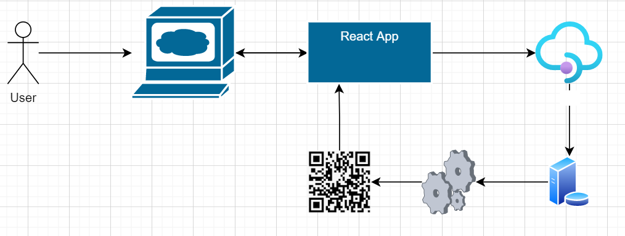
Sequence diagram for a QR Code Reader use case

Slide 80
Efficient Ways of Creating an SRS Document
Prioritize Requirements:
Use techniques like MoSCoW (Must have, Should have, Could have, Won’t have) to rank requirements based on importance
Ensure Traceability:
Link each requirement to its corresponding use case, test case, or design document using a Traceability Matrix.
Write Clear and Concise Requirements:
Use simple and unambiguous language.
Avoid jargon and technical terms unless necessary
Use the SMART principle
Notes:
- **S**pecific
- **M**easurable
- **A**chievable
- **R**elevant
- **T**ime-bound

Slide 81
Efficient Ways of Creating an SRS Document
Validate and Review:
Peer Reviews:
Ensure completeness and correctness through team reviews.
Internal Review and Team Review.
Stakeholder Validation:
Confirm that the SRS aligns with stakeholder expectations.

Slide 82
Challenges in Creating SRS Documents
Ambiguity: Misunderstanding requirements due to unclear language.
Scope Creep: Requirements changing after finalization.
Incomplete Information: Missing inputs from stakeholders.
Technical Constraints: Failing to account for hardware/software limitations.

Slide 83
Tools for Creating SRS Documents
Microsoft Word: For simple and detailed documentation.
Jira/Confluence: For collaborative and agile projects.
Lucidchart: For visualizing workflows and diagrams.
Draw.io: For creating system and data flow diagrams.
Requirement Management Tools: Like Jama, DOORS, or ReQtest for traceability.

Slide 84
Benefits of a Well-Written SRS Document
Reduces misunderstandings and errors during development.
Facilitates better planning and resource allocation.
Serves as a reference point for future enhancements or debugging.
Helps in maintaining compliance with industry standards.

Slide 85
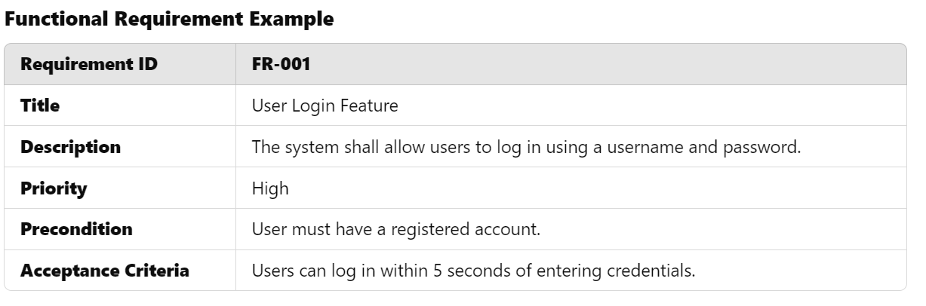
Example of an SRS Entry

Slide 86
Summary
Creating an efficient SRS document involves:
Understanding stakeholder needs.
Using templates and standards for consistency.
Collaborating across teams and validating the requirements.
Ensuring traceability and prioritizing effectively.
A well-structured SRS document is a cornerstone for successful software development, minimizing risks, and ensuring project success.

Slide 87
Introduction to Design Principles
Design principles are fundamental guidelines that help create software that is scalable, maintainable, and efficient.
Purpose:
- Ensure code is easy to understand and modify.
- Minimize complexity and redundancy.
- Promote reuse and reliability.

Slide 88
Common Design Principles
SOLID: Focuses on object-oriented programming best practices.
KISS: Encourages simplicity.
DRY: Reduces redundancy.
YAGNI: Avoid over-engineering.

Slide 89
SOLID Principles
Single Responsibility Principle (SRP)
Open/Closed Principle (OCP)
Liskov Substitution Principle (LSP)
Interface Segregation Principle (ISP).
Dependency Inversion Principle (DIP).
Notes:
1. **Single Responsibility Principle (SRP)**:
- **Definition**: A class should have only one reason to change.
- **Explanation**: This ensures that each class has a single responsibility, making it easier to understand and modify.
- **Example**: Split a "UserManager" class into "UserAuthentication" and "UserProfileManagement".
2. **Open/Closed Principle (OCP)**:
- **Definition**: Software entities should be open for extension but closed for modification.
- **Explanation**: Add new features via extension, not by altering existing code.
- **Example**: Use interfaces or abstract classes to allow new implementations.
3. **Liskov Substitution Principle (LSP)**:
- **Definition**: Subtypes must be substitutable for their base types without altering program behavior.
- **Explanation**: Derived classes should maintain the behavior expected of their base classes.
- **Example**: Avoid overriding methods that change a base class's intended behavior.
4. **Interface Segregation Principle (ISP)**:
- **Definition**: A class should not be forced to implement interfaces it does not use.
- **Explanation**: Break down large interfaces into smaller, more specific ones.
- **Example**: Instead of one large "IWorker" interface, create "ICoder" and "ITester" interfaces.
5. **Dependency Inversion Principle (DIP)**:
- **Definition**: High-level modules should not depend on low-level modules. Both should depend on abstractions.
- **Explanation**: Decouple classes by depending on interfaces or abstract classes.
- **Example**: Use dependency injection to pass dependencies into a class.

Slide 90
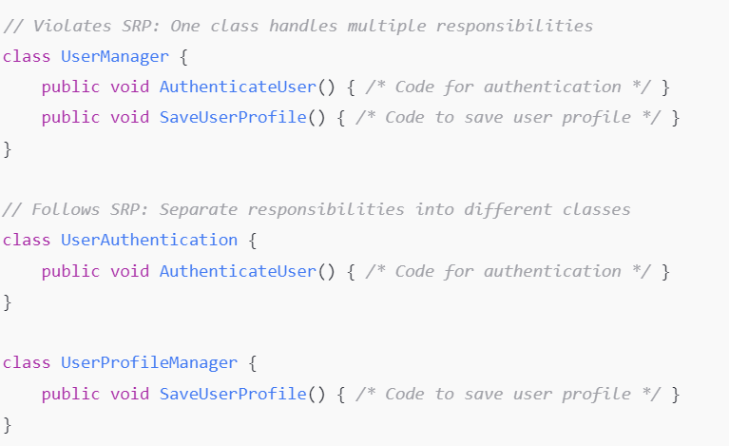
Sample Code for Single Responsibility Principle.

Slide 91
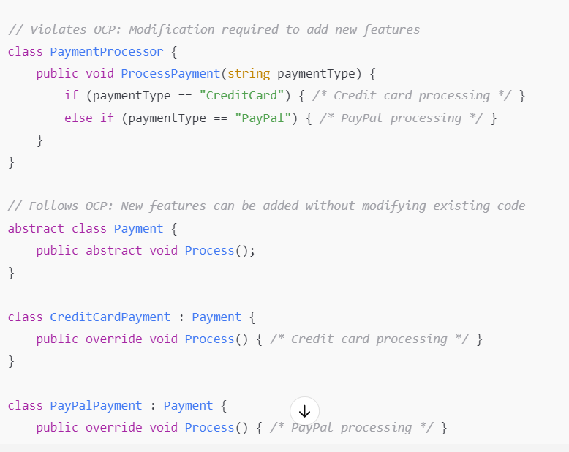
Open Closed Principle
Notes:
Before: A single class or method with conditional logic.
After: Base Payment class and multiple subclasses (e.g., CreditCardPayment, PayPalPayment).

Slide 92
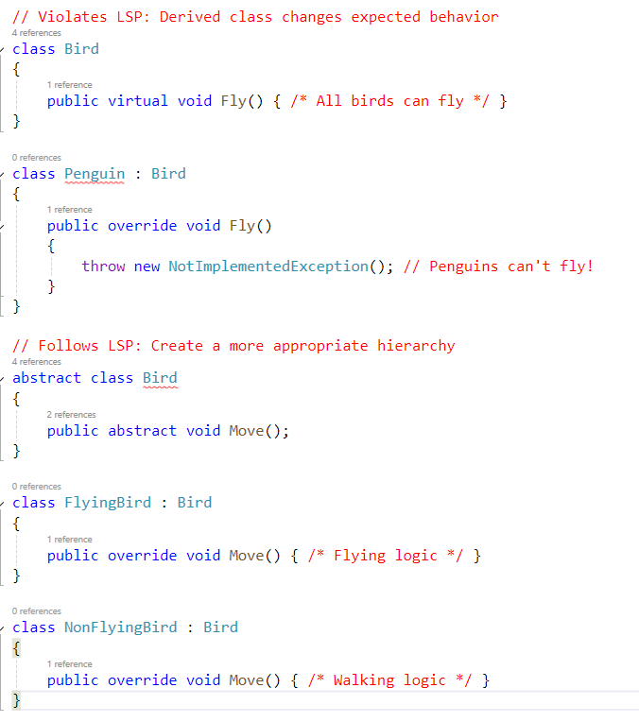
Liskov Substitution Principle (LSP)

Slide 93
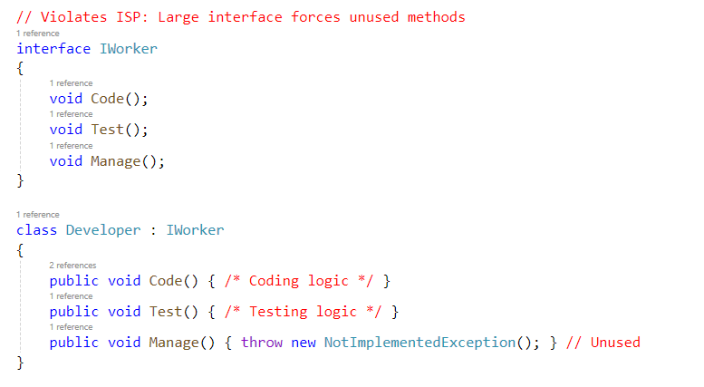
Interface Segregation Principle (ISP)

Slide 94
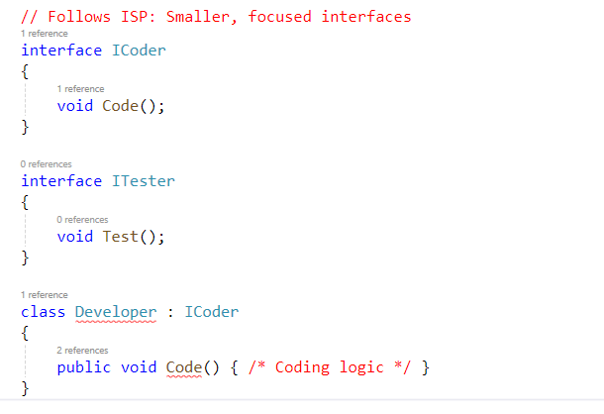
ISP Contd…

Slide 95
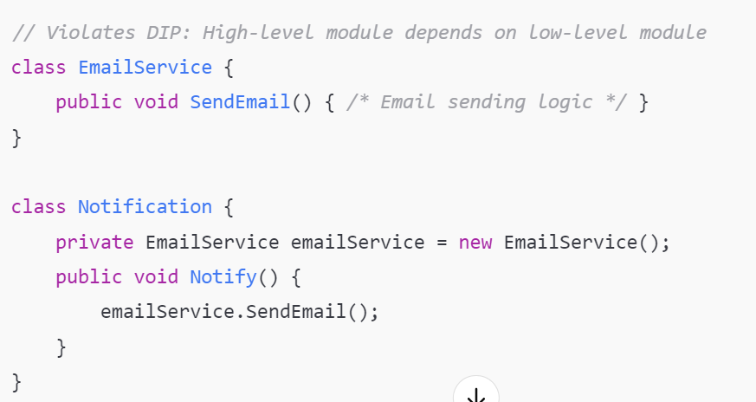
Dependency Inversion

Slide 96
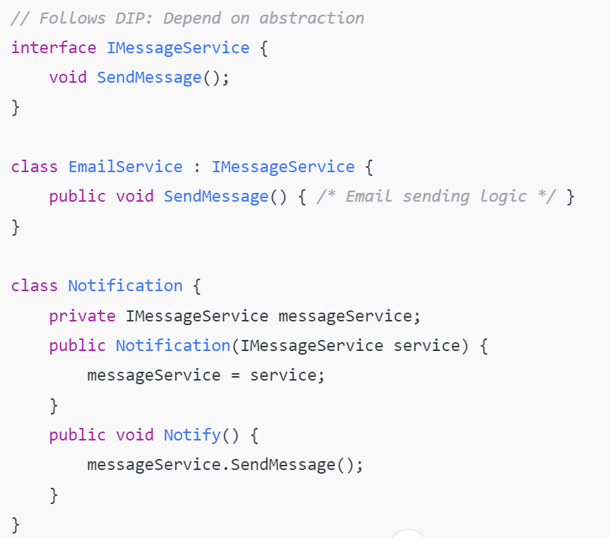

Slide 97
KISS Principle
Definition: Keep It Simple, Stupid.
Explanation: Simplicity should be a key goal in software design. Avoid overcomplicating solutions.
Best Practices:
- Write clear and straightforward code.
- Avoid unnecessary features or complexity.
Example: Instead of creating an elaborate method for sorting, use built-in language functions.

Slide 98


Slide 99
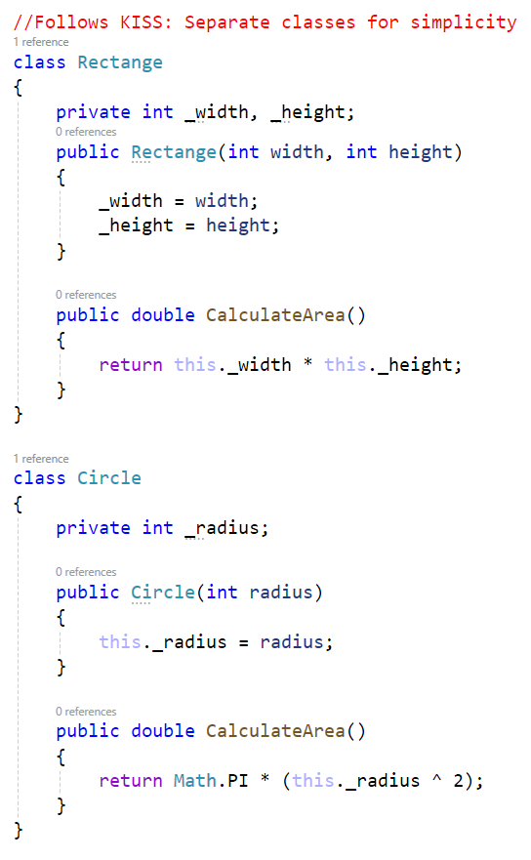
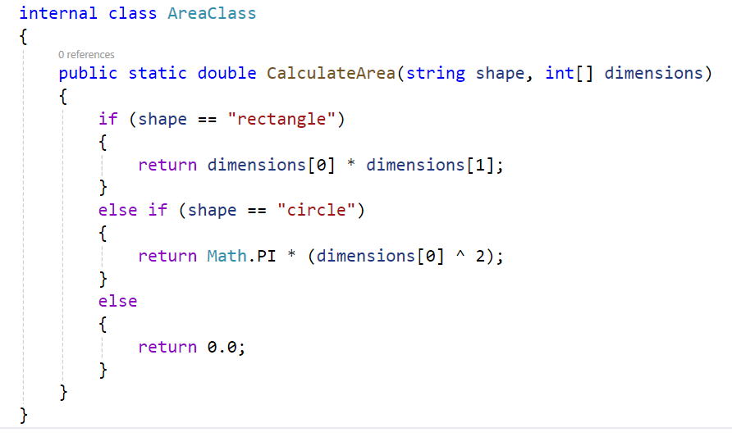
Example

Slide 100
DRY Principle
Definition: Don’t Repeat Yourself.
Explanation: Eliminate duplicate logic by centralizing reusable code.
Best Practices:
- Use functions, modules, or libraries for common functionality.
- Refactor repetitive code into shared methods.
Example: Instead of duplicating a validation function in multiple classes, create a single utility class for validation.

Slide 101
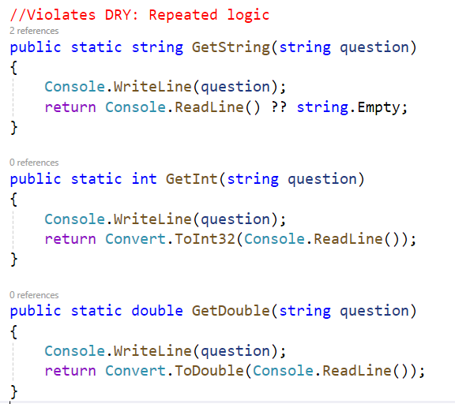
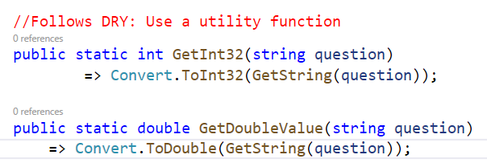
Example

Slide 102
YAGNI Principle
Definition: You Aren’t Gonna Need It.
Explanation: Do not add functionality until it is required.
Best Practices:
- Avoid premature optimization or speculative features.
- Focus on current requirements.
Example: Instead of building a complex reporting feature upfront, implement it later when there's a need.

Slide 103
Benefits of Following Design Principles
Improved Code Quality: Code becomes more readable and maintainable.
Scalability: Easier to add new features without breaking existing functionality.
Reusability: Promotes reusable code, reducing development time.
Reduced Technical Debt: Avoid messy, hard-to-maintain codebases.

Slide 104
Common Design Patterns and Their Relation to Principles
Many design patterns (like Singleton, Factory, Observer) align closely with design principles:
Factory Pattern: Implements DIP by relying on abstraction for object creation.
Strategy Pattern: Promotes OCP by allowing algorithms to be swapped dynamically.
Adapter Pattern: Reduces duplication and aligns with DRY.

Slide 105
Factory Pattern
Scenario: A program that can create and manage different types of shapes (e.g., Circle, Rectangle, and Square).
Steps:
Define a common interface or abstract class.
Create concrete implementations of the interface for various kinds of Shapes.
Create the Factory class that returns the interface object abstracting the actual concrete object.
Benefits:
Centralized Object Creation: You can easily manage and extend creation logic without modifying the client code.
Encapsulation: The Factory isolates the instantiation process, reducing code duplication.
Scalability: Adding new shapes is as simple as creating a new class and extending the factory.
Notes:
Develop an example in C# to explain.

Slide 106
Adapter Pattern
A structural design pattern that allows incompatible interfaces to work together by creating a wrapper (adapter) that translates the interface of one class
Scenario: Media Player Adapter
Suppose you have an application that uses a media player to play audio files. The existing media player can only play .mp3 files. A new library is introduced that can play advanced formats like .mp4 and .vlc, but its interface is different from the one your application uses. To integrate this library, you can use the Adapter Pattern.into a form that another class can understand.
Notes:
Explain with an Example.

