Slide 1

Dropping Indexes in SQL

Slide 2

What are Indexes?
Indexes in SQL are database objects that are used to improve the speed of data retrieval operations on a table
They are created on one or more columns of a table, and they allow the database engine to find rows more quickly and efficiently
Types of Indexes : Primary Key, Unique Index, Clustered Index, Non-Clustered Index, Covering Index, Full-Text Index, Filtered Index, Spatial Index, XML Index, Hash Index, and Bitmap Index

Slide 3

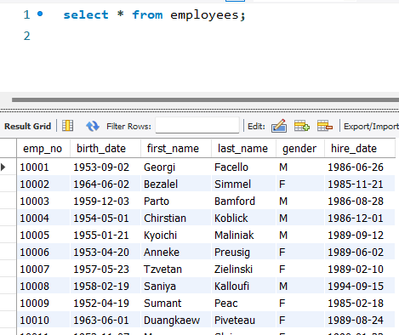
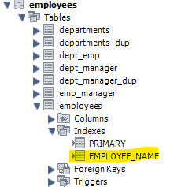
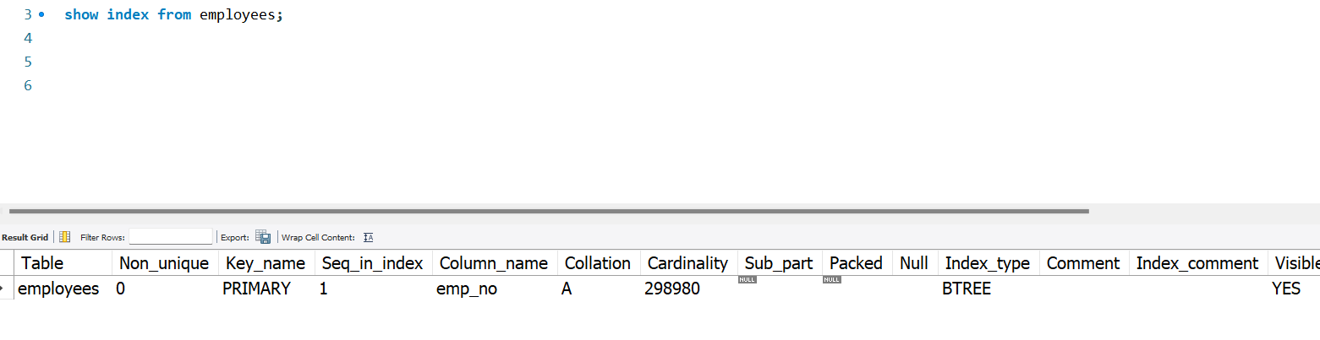
Indexes in MySQL?
Syntax to create index
Example : Employees Table
Place to find created Index

Slide 4
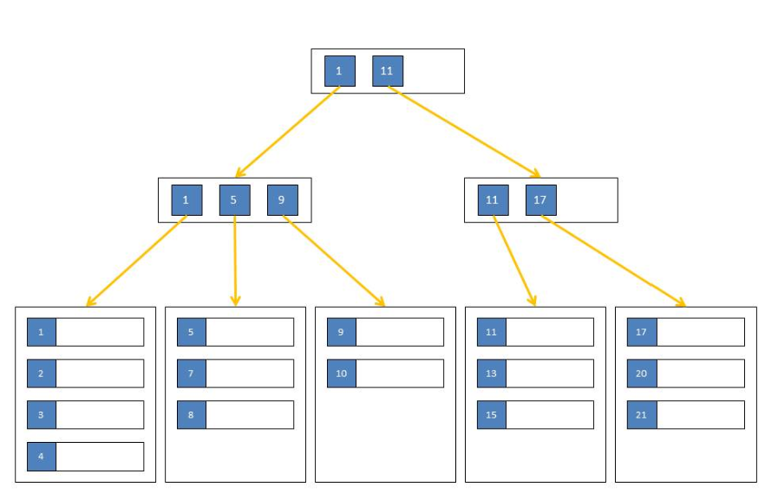
How Indexes work?
An index creates an entry for each value that appears in the indexed columns.
These entries are stored in a data structure (usually a B-tree or hash table) that allows for fast searches, lookups, and sorted order.

Slide 5
Benefits of Indexes
Faster query performance, especially on large tables.
Efficient retrieval of rows that match certain criteria.
Drawbacks of Indexes
Additional storage space required for the index data.
Slower performance for INSERT, UPDATE, and DELETE operations due to the overhead of maintaining the index.

Slide 6
Why Drop Indexes?
Improve database performance
Remove redundant or unused indexes
Adapt to changing data requirements
Optimize storage space

Slide 7

Syntax to Drop Indexes in SQL
Drop Index Index_name on table_name;

Slide 8
Pre-Drop Considerations
Assess the impact on query performance.
Ensure no dependencies on the index
Backup the current state of the database
Use tools to analyze index usage (e.g., DMVs in SQL Server)

Slide 9


