Slide 1
Sales Analytics project

Slide 2







DATA FLOW ARCHITECTURE
SNOWSIGHT
DATABASE
INTERNAL STAGE
COPY INTO
TABLES
TABLEAU

Slide 3
DATA MODELING
Customers Table CUSTOMER_ID FIRST_NAME LAST_NAME EMAIL PHONE STREET CITY STATE ZIP_CODE
Stores Tables STORE_ID STORE_NAME LOCATION MANAGER OPENING_DATE STORE_TYPE REVENUE EMPLOYEE_COUNT
Sales_Transaction Table TRANSACTION_ID CUSTOMER_ID PRODUCT_ID STORE_ID SUPPLIER_ID QUANTITY PRICE TRANSACTION_DATE PAYMENT_METHOD
1 :N
1:N
N:1
Products Tables PRODUCT_ID PRODUCT_NAME CATEGORY PRICE SUPPLIER_ID STOCK_QUANTITY REORDER_LEVEL DISCONTINUED
N:1
Suppliers Tables SUPPLIER_ID SUPPLIER_NAME CONTACT_NAME CONTACT_EMAIL CONTACT_PHONE ADDRESS CITY STATE ZIP_CODE

Slide 4
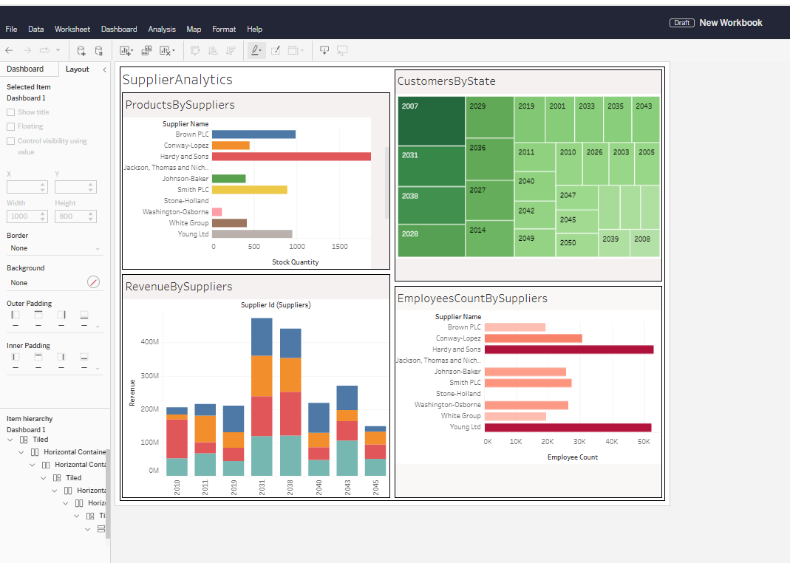
Suppliers Analytics -Dashboard

Slide 5
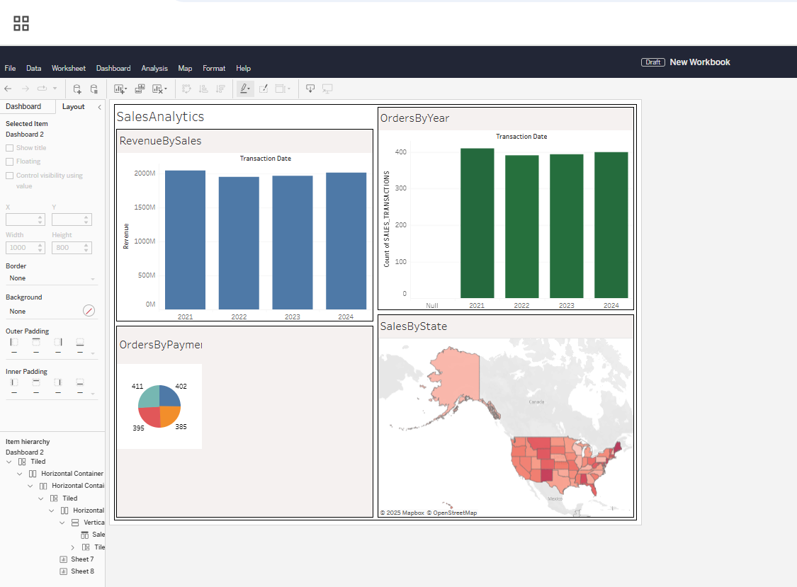
Sales Analytics-Dashboard

Slide 6
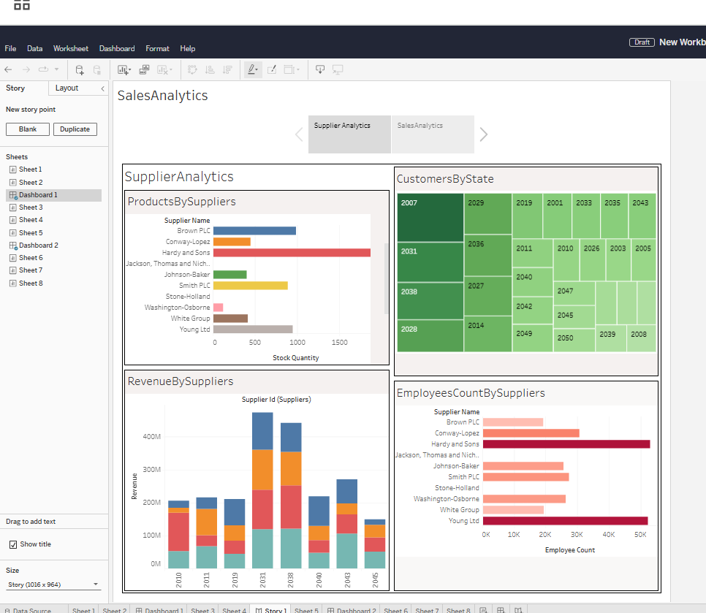
Sales Analytics –Story Board

Slide 7
Thank you

