Slide 1

SmartCalc
05/09/19 | Hyderabad

Slide 2
Team Members
Doppalapudi Ragha
Sikakollu Phani
Ravula Shravan
Prasad Abhishek
Sunkara Keerthivardhan Naidu
Lakshmi Menon

Slide 3
How much you can save in Taxes when you increase your Voluntary Deductions contributions?

Slide 4
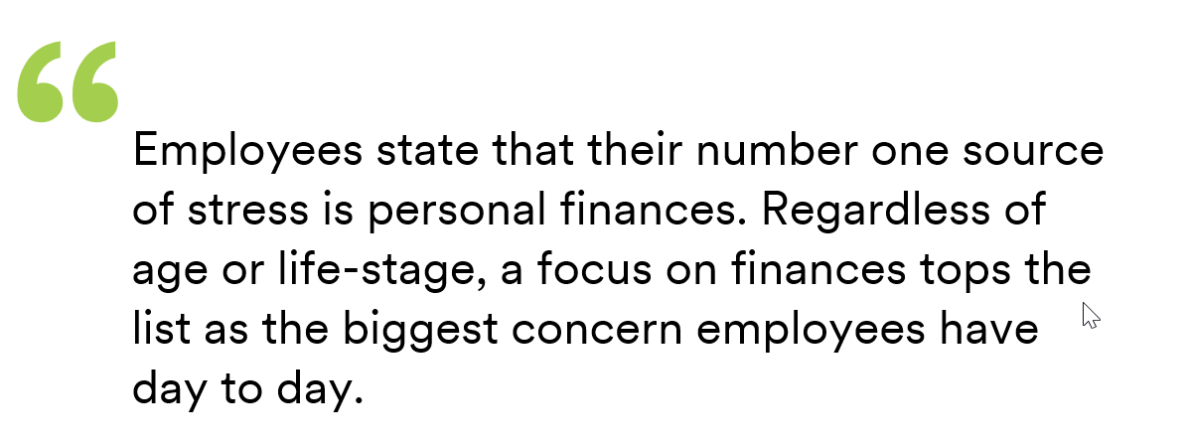
What we found in our research?
Per MetLife's 17th Annual US Employee Benefit Trends Study 2019:

Slide 5
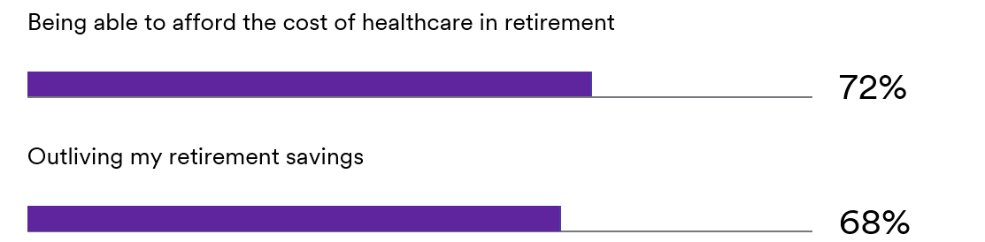
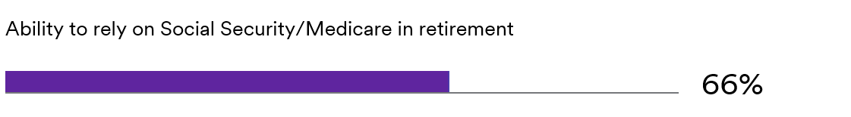
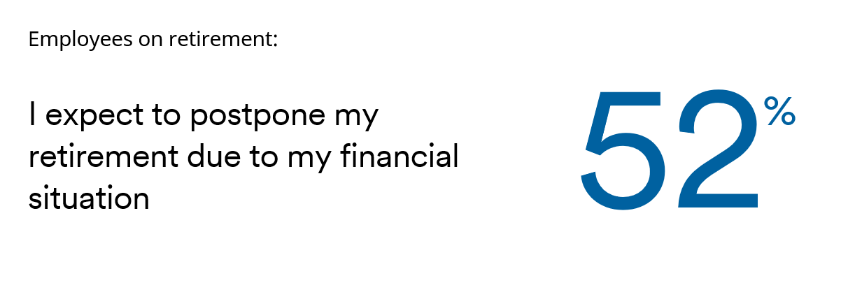
What are employees’ top 3 sources of financial stress?

Slide 6
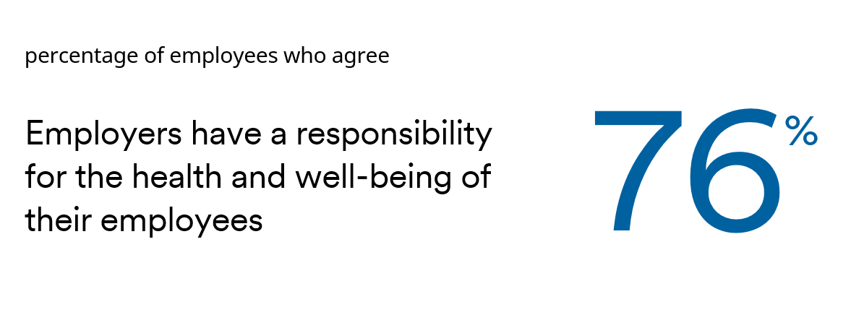
How can we assist?
Because personal finances is employees’ top concern, assisting them better manage short-term and long-term financial situations will help prevent burnout and enhance work-life enrichment

Slide 7
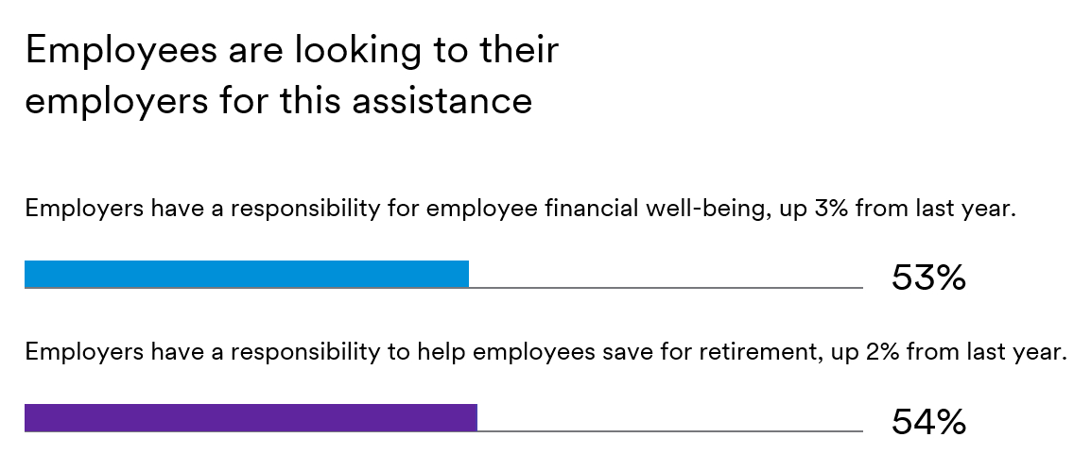

Slide 8
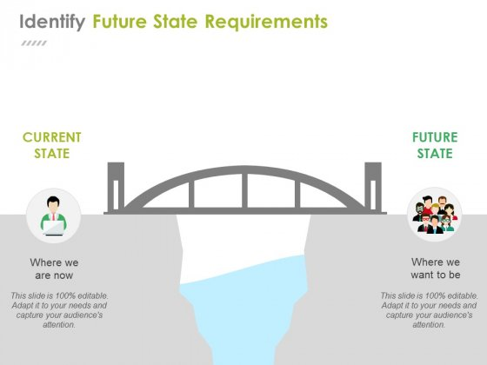
Deriving the Problem Statement
.
A simple and easy process that provides quick assistance on,
“How much you can save in Taxes when you increase your Voluntary Deductions contributions?”
Users are using a third party Paycheck Calculator to calculate all the gross-to-net calculations and estimate taxes.

Slide 9
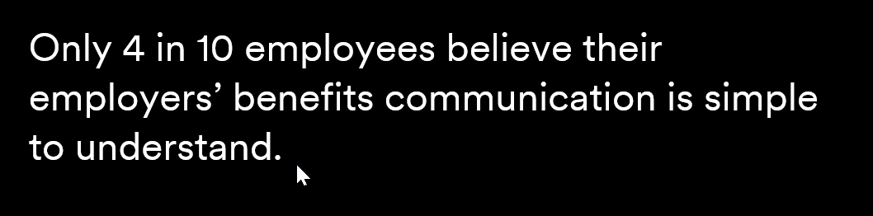
Gaps in the Current System
Navigation
Navigate to various third party screens to determine the taxes.
Speed and Time
Manually, enter all the payroll and with-holding information which is a time consuming process.
Human Errors
Because you are entering all your information manually, they are prone to errors.
Lack of One-on-One Guidance
.

Slide 10
Bridge these gaps with our SmartCalc idea
Introducing a new feature in ADP Mobile Solutions > Pay > Manage Your Contributions that provides estimated $ savings by contributing more or opting towards Voluntary Deductions such as Benefits and 401K. It also provides a customized Tip to employees that displays statistics related to additional contributions vs additional tax savings based on employee’s payroll and withholding information.
<<< Demo Time >>>
By providing statistics related to contributions towards Voluntary Deductions vs Taxes Saved, we can educate employees that diverting a little more to voluntary deductions can make a big difference resulting in:
Better financial security in old age
Better family health protection coverage
Tax savings

Slide 11
Business Value
ADP Retirement Services has a population of over 1M employees that are eligible to participate in their employers ADP retirement plan but are not currently enrolled!
If we can encourage just 2% of these employees to enroll, we will be helping more people secure their financial future. In addition, this 2% lift in contributions would result in $6.6M in additional annual recurring revenue for ADP over 5 years..
.

Slide 12
Other Benefits
Simple and easy to implement.
Time saving and guaranteed accuracy
One-on-One guidance
Employee Satisfaction ☹ to 😊 >> Employee Retention >> Client Satisfaction >> Higher Net Promoter Score (NPS)

Slide 13
(ADP Benefits Team) Architect’s Feedback
From: Marsh, Karen (CORP) Sent: Tuesday, May 7, 2019 7:21 PM To: Ravula, Shravan (CORP) <Shravan.Ravula@adp.com>; Sunkara, Keerthivardhan Naidu (CORP) <Keerthi.Sunkara@adp.com>; Tashjian, Chuck (CORP) <Chuck.Tashjian@adp.com> Cc: Vice, Matt (CORP) <matt.vice@adp.com> Subject: RE: #MS# Question on 'How ADP Benefits work'
I’m not sure if we have anything like this, but I think it could be a good idea. I’m not sure if we have anything that clearly shows if you put x dollars into pretax savings, i.e 401k, HSA, that it will then reduce your taxable income by x and thus save you additional x$.
Is this what you mean Shravan?
Karen

Slide 14
Q&A

