Slide 1
Secure data hiding using image stenography
CAPSTONE PROJECT
Presented By Student Name : Phanendra Adari
College Name: MVGR College of Engineering
Department : Computer Science and Engineering

Slide 2
OUTLINE
Problem Statement
Technology used
Wow factor
End users
Result
Conclusion
Git-hub Link
Future scope

Slide 3
Problem Statement
With the rise in digital communication, securing sensitive data has become a significant challenge. Traditional encryption techniques protect data but can attract attention from adversaries. Image steganography offers a solution by encrypting secret information within digital images, making it nearly undetectable.

Slide 4
Technology used
Python – The core programming language used for scripting the steganography process.
OpenCV (cv2) – Used for image processing (reading, modifying, and saving images).
Tkinter (tk) – Provides a Graphical User Interface (GUI) for user interaction.
OS Module (os) – Used to interact with the operating system (e.g., opening the encrypted image).
Encryption using LSB manipulation – The secret message is embedded into image pixel values.

Slide 5
Wow factors
Encryption – By using LSB manipulation the secret message is embedded into image pixel values.
Simple XOR encryption – A password-based encryption mechanism ensures data security.
Decryption with Password Protection – Only users with the correct password can retrieve the message.
GUI Interface using Tkinter – Users can input messages and passwords easily.
Automatic Image Handling – Reads, modifies, and saves the encrypted image.

Slide 6
End users
Government & Defence for confidential information
Cybersecurity Professionals & Ethical Hackers for secure communication
Individuals for data privacy in communication
Corporate Organizations for important business information

Slide 7
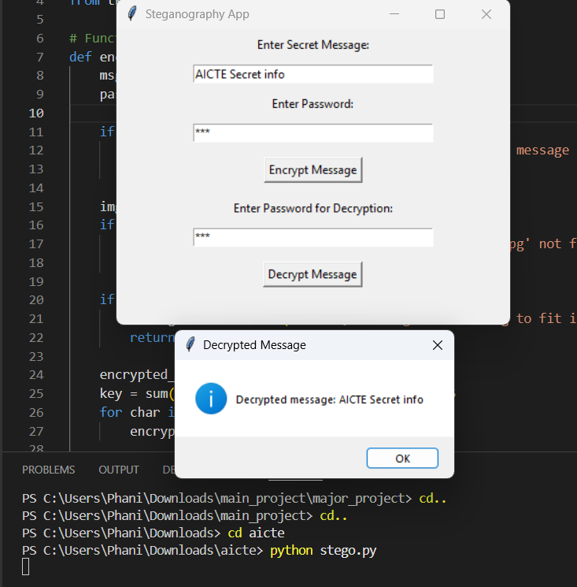
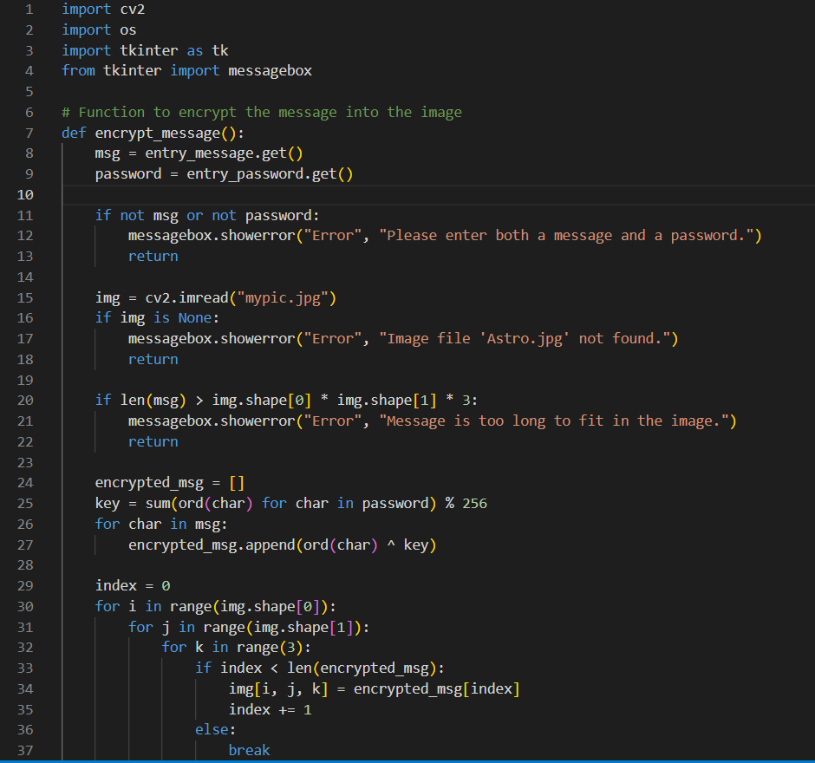

Results
CODE Output
Encrypted Image

Slide 8
Conclusion
Steganography is a powerful technique for hiding secret messages inside digital images, ensuring discreet communication.
The LSB (Least Significant Bit) method allows data to be embedded in an image without noticeable changes to its appearance.
Password protection enhances security, making it harder for unauthorized users to extract the hidden message.
This project provides a simple and effective tool for secure data hiding and retrieval using Python, OpenCV, and Tkinter.

Slide 9
GitHub Link
https://github.com/Phani519/AICTE-Project.git

Slide 10
Future scope(optional)
Advanced AI & Machine Learning Detection – AI-based tools to detect and counter steganography misuse.
Enhanced Audio & Video Steganography – Improved techniques for hiding data in multimedia files
Cybersecurity & Anti-Steganalysis Tools – Stronger encryption to prevent detection by attackers.
User-Friendly Applications – Developing mobile and web-based steganography tools for everyday privacy.
Blockchain Integration – Securely embedding hidden data in blockchain transactions.

Slide 11
THANK YOU

