Slide 1
CSCI -6660 Intro Artificial Intelligence
Team Members :
Phani Rupa Mamidala
Chandra Kumar Reddy Gade

Slide 2
WEATHER PREDICTION MODEL
PROJECT PROPOSAL TITLE:

Slide 3
PROJECT OBJECTIVES:
In this project we are predicting weather by training data set with different machine learning algorithms and comparing performance of each model.
We will build a model on historic usage rates and observed weather.
Machine Learning models like
Decision Tree Regressor

Slide 4
DATA SET :
https://challenger.ai/competition/wf2018

Slide 5
APPROACH:
Retrieve the data set from API.
Exploratory data analysis
Train the data set with ML model
Predict the model with Test data
Metrics – Confusion matrix , F1 score, K Fold cross validation.
Retrieve Data
EDA
Train the Model
Performance Evaluation

Slide 6
FEATURE ENGINEERING:
Checked for any missing values in the data set.
Correlation between features.
Set date’ as target and create a new dataset X by dropping this column from original dataset

Slide 7
IMPLEMENTATION:
Created the train and test data set.
From SKLearn Imported the ML model.
Performed train data set on those models.
Predicting the model by using test data set.
Evaluated the model by R2 score ,Mean Square error and Root Mean Square error .

Slide 8
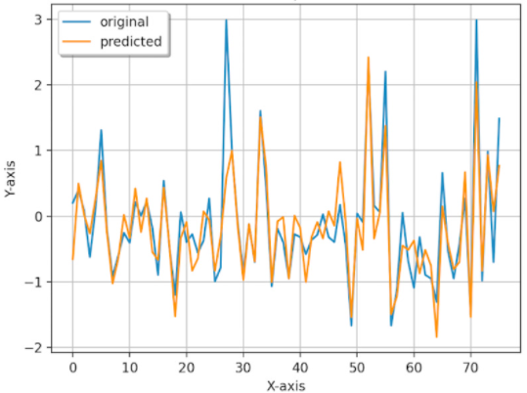
Plot between Test and Predicted:

Slide 9
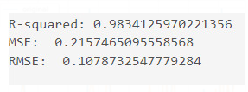
PERFORMANCE:
Following is the performance of models used.

Slide 10
EVALUATION METHODOLOGY:
The methods include persistence, climatologic, looking at the sky, use of barometer, nowcasting, use of forecasting models, analogue and ensemble forecasting.
Forecasting could be applied in air traffic, severe weather alerts, marine, agriculture, utility companies, private sector and military application.

Slide 11
REFERENCES:
https://github.com/yinglung174/Weather-Forecast-And-Prediction-by-Machine-Learning
https://github.com/NAMYUNWOO/Weather_prediction_GPR

