Slide 1
Data Engineering

Slide 2
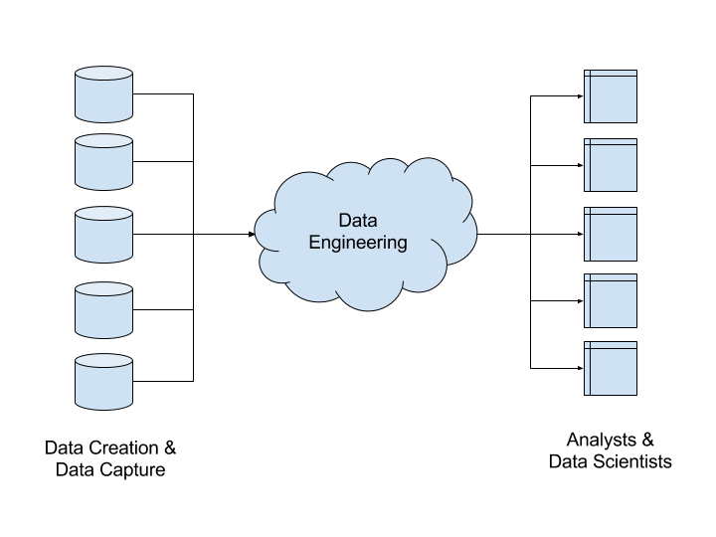
What is Data Engineering
A data engineer transforms data into a useful format for analysis

Slide 3
Data engineering Path
Programming
Database
Python
SQL
Scala
MS SQL
Cloud
Data Processing
Azure
Spark
Aws
MPP Databases
Orchestration
Recent Trends
Databricks
Serverless Architecture
ADF
Hybrid Cloud

Slide 4
Programming - Python
Python Intro
Python Setup
Pip
Google Colab & Databricks Community Edition
DataTypes and Variables
String Operations
Loops and Conditional Statements
Collections
Python Functions
Anonymous Functions
Multi processings
flatmap
Oops with Python
Magic Dunder Methods
Positional/inline parameters
os and sys modules
beautiful soap & lmlxl
datetime operations
Logging
Multi Threads

Slide 5
SQL Intro
What is RDBMS
What is SQL
What is a database
what is a schema
What is Table
What are Datatype
Types - DDL,DML,DCL-
What are tables
constraints on table : Primary Key, foreign key, unique key,not null
Auto Increment
What is a relation
Sql Syntaxes : Select, insert, update and delete
Data types and Type casting
Sorting Data - Order by
Filtering data - Where condition
Distinct Data
Limiting Data
Top n rows
Aliases (column and Table aliases)

Slide 6
SQL Operations
Operators :
  Comparison Operators: =,!=,<,<=,>,>=
  Logical Operators : And,OR,BETWEEN,EXISTS,LIKE,NOT,IS NULL,IN.
Aliases
case statement : in select cluase and where clause, using case statement to convert rows to columns
datetime conversions
string functions : substring,char_index,datetime conversions,ltrim,rtrim,trim,upper,lower,length of string
Aggregations : AVG,COUNT,MIN,MAX,SUM
Group by:
Having
Where vs Having
subqueries
corelated sub queries

Slide 7
Advanced SQL
Operations between two tables :
  Inner join, outer joins(left,right,cross)
  union and unionall
  EXISTS and NOT EXISTS
Window Functions : Rank,Row_number,dense_rank,max,min,sum,lead and lag
Group by Vs Partition by
CTE example
pivot and unpivot example
Merge
Temp Tables

Slide 8
spark
Spark Introduction
Spark Core
Pyspark Architecture
Spark SQL
Different types of File Formats : Parquet, Avro, Json,CSV
Spark UI
Dataframe And Dataset
Dataframe Operations
Optimizations in Spark
Spark Structured Streaming

Slide 9
Cloud computing
What is Cloud Computing
Onprem Vs cloud
IAAS
PAAS
SAAS

Slide 10
Azure
What is Azure
Services in Azure
Azure Accounts
Azure Tenants and Subscriptions
Azure Regions and Resource Manager
Azure Active Directory
Azure Storage
Azure Compute Services
Azure Datalake Gen2
Azure Security Services
Azure Datafactory
Azure Databricks
Azure SQL
Azure VM
Azure Synapse(Introduction)
Azure CosmosDB(Introduction)
Azure Functions
Azure Logic Apps

Slide 11
Azure - Basics
What is Azure
Services in Azure
Azure Accounts
Azure Tenants and Subscriptions
Azure Regions and Resource Manager
Azure Active Directory
Azure Storage
Azure Compute Services
Azure Datalake Gen2
Azure Security Services
Azure Datafactory
Azure Databricks
Azure SQL
Azure VM
Azure Synapse(Introduction)
Azure CosmosDB(Introduction)
Azure Functions
Azure Logic Apps

