Slide 1
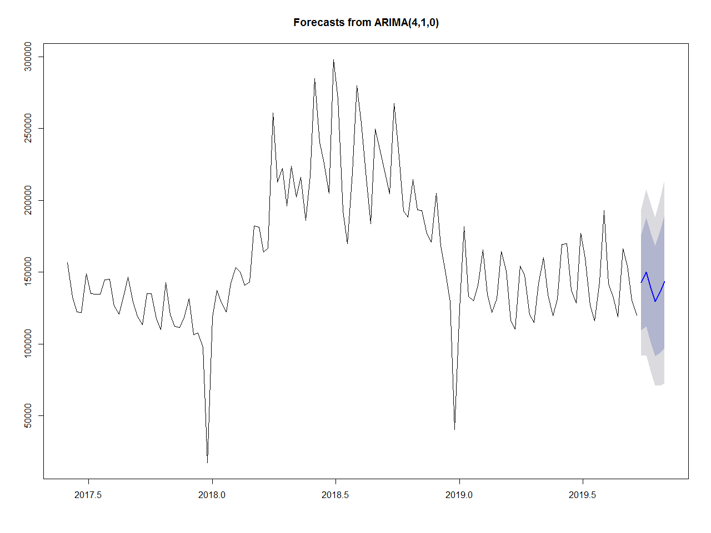
Results and Suggestions –ARIMA
Future Week | Calls Forecast
Week – 37 | 142664.9
Week – 38 | 149975.1
Week – 39 | 139145.8
Week – 40 | 129602.1
Week – 41 | 136057.0
Week – 42 | 143473.1
MAPE
16.68 %

Slide 2
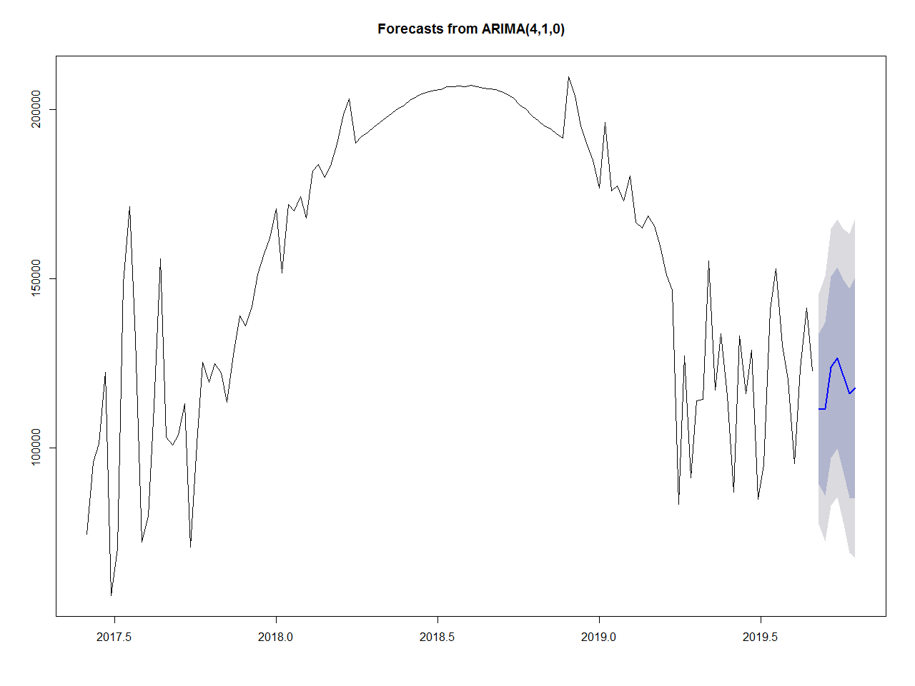
Results and Suggestions – De Seasonal ARIMA
Future Week | Calls Forecast
Week – 37 | 122906.7
Week – 38 | 124722.3
Week – 39 | 121638.0
Week – 40 | 120014.0
Week – 41 | 120664.1
Week – 42 | 122408.3
MAPE
9.51 %

Slide 3
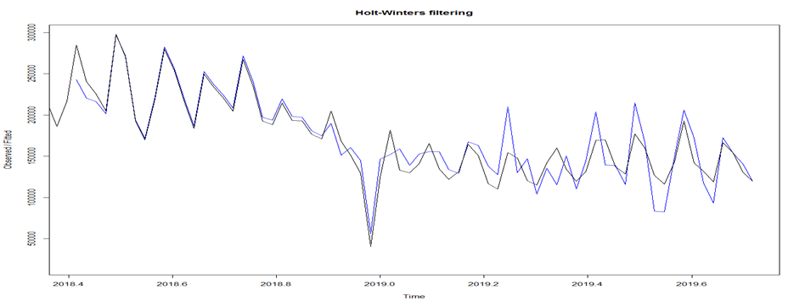
Results and Suggestions – Holt Winters Method
Future Week | Calls Forecast
Week – 37 | 183443.0
Week – 38 | 152630.2
Week – 39 | 110683.5
Week – 40 | 108101.0
Week – 41 | 135355.7
Week – 42 | 115076.1
MAPE
12.61 %

Slide 4
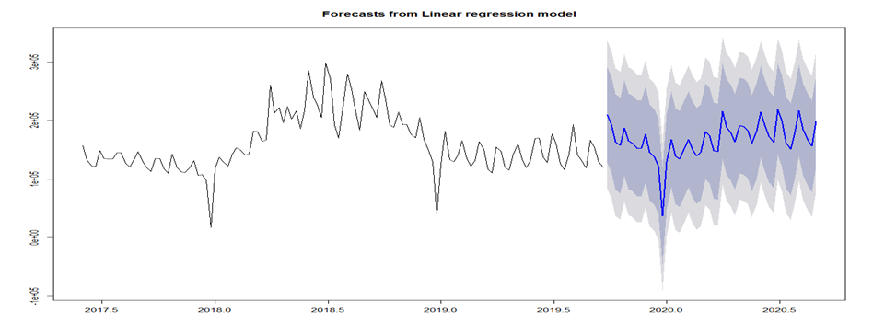
Results and Suggestions – Regression Time Series
Future Week | Calls Forecast
Week – 37 | 209375.6
Week – 38 | 193336.1
Week – 39 | 163228.6
Week – 40 | 157282.1
Week – 41 | 186915.1
Week – 42 | 164963.6
MAPE
20.53 %

Slide 5
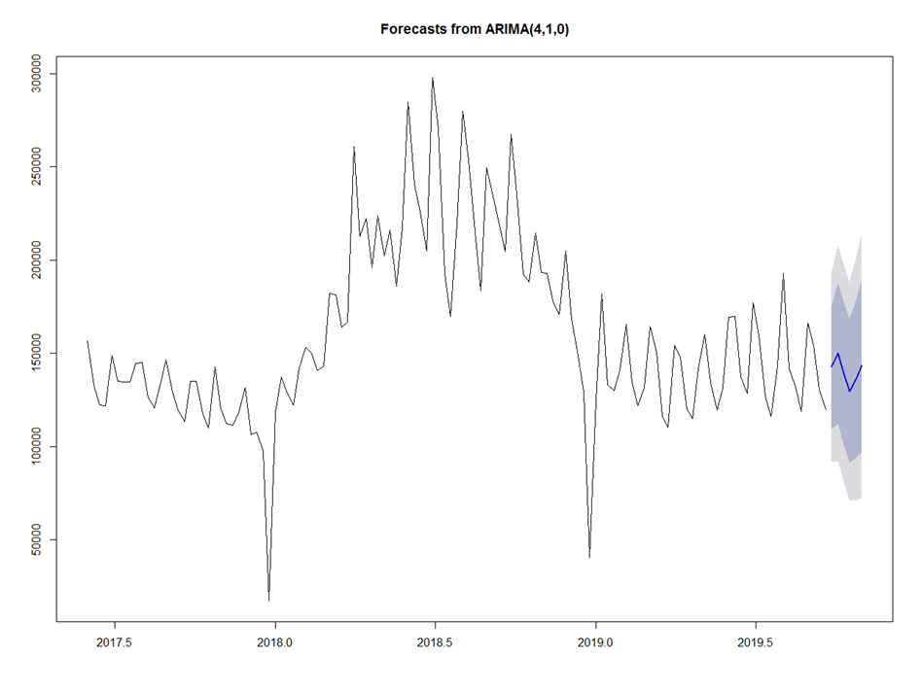
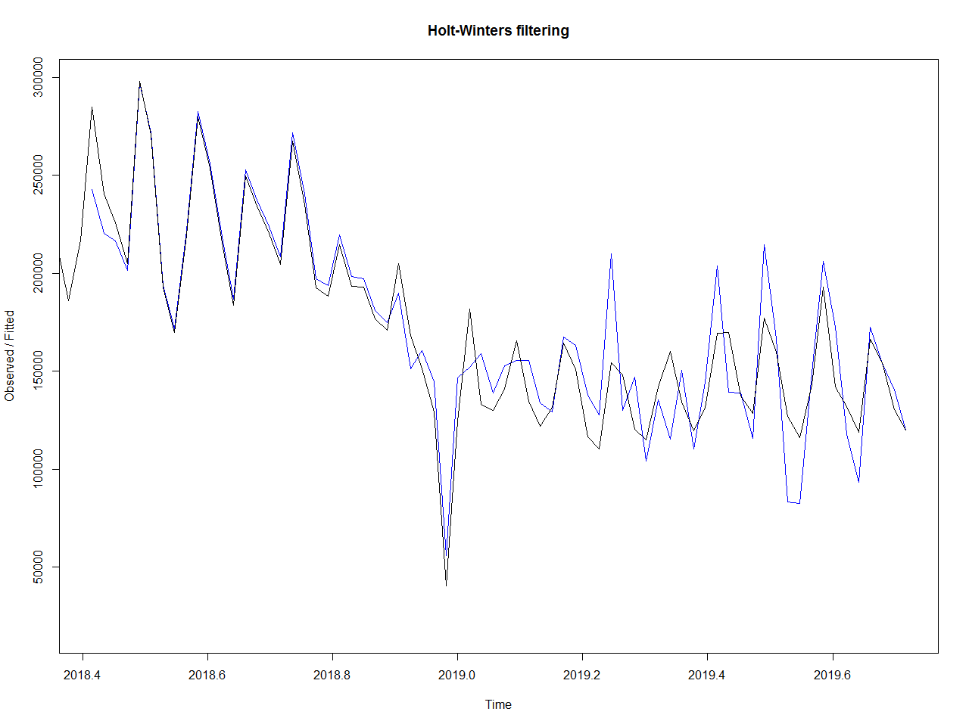
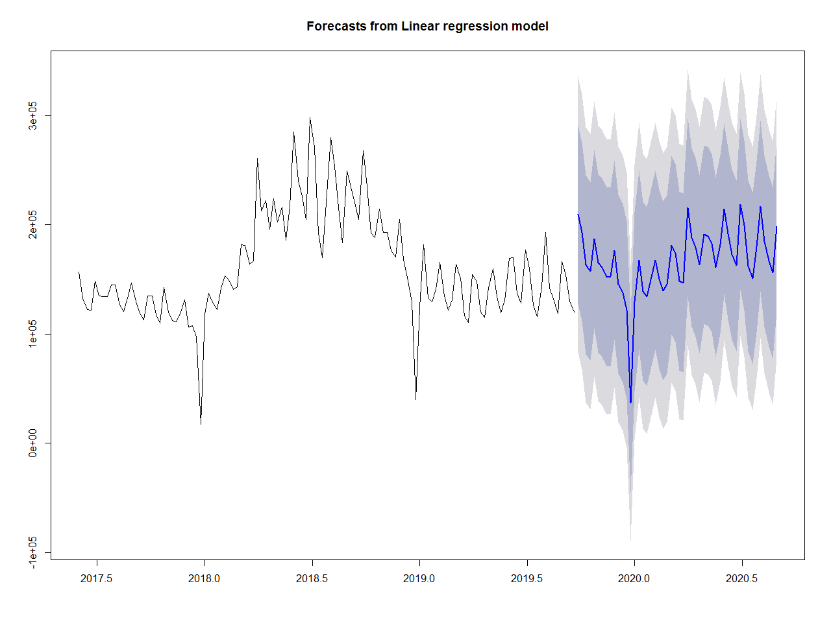
Forecasting Results Comparison
ARIMA Forecasting
MAPE = 16.683
Holt Winters Method
MAPE = 9.61
Deseasonal ARIMA Forecasting
MAPE = 9.181
Time Series Regression
MAPE = 20.536

Slide 6
Time Series Forecasting – Model Comparisons
Model | Accuracy | MAPE
ARIMA | 83.317 | 16.683
De Seasonal ARIMA | 90.49 | 9.51
Holt Winters | 87.39 | 12.61
Linear Regression | 79.464 | 20.536

