Slide 1
Remote sensing and image processing project : Crowd Monitoring System
PREPARED BY
DODDAKA SAI PHANI DEEPAK-2017A7PS0010H
PERAM CHAITANYA SAI-2017A7PS0273H

Slide 2
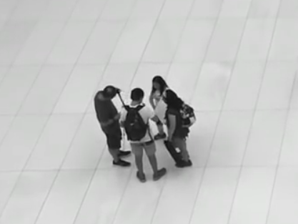
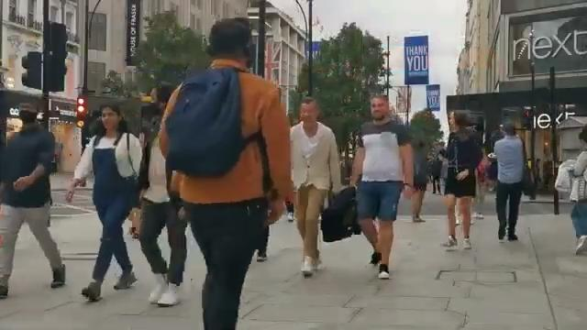
Introduction
The crowd are group of people that move close to each other in public places. The crowd are group of people with their own objective and behavior pattern.
There are different types of crowds, stationary crowd and moving crowd. Stationary crowd is nothing but gathering of the people at a single place for long time.
The crowd monitoring is essential task in designing the pedestrian facilities, improving existing design and preventing crowd induced disasters. Crowd details such as crowd density and behavior are crucial in crowd monitoring.
a.) Stationary Crowd
b.) Moving Crowd

Slide 3
The continuous crowd monitoring on the public places with huge inflow and outflow of the people helps in guiding the people on evacuation during disasters.
The crowd density is defined as the number of people detected within a unit area. Crowd density is an indicator to the crowd congestion in fixed areas.
Crowd density is calculated by dividing number of people detected in an image frame with total pixel area of image frame. It is factor that indicates the occupancy of people in a particular area.
Video is sequence of image frames that are played one after another for certain time duration. An video containing crowd or people movement is used as an input for this project.
Deep neural network module in OpenCV is used to detect people in the video.
The crowds are identified as the cluster of people that are at distance less than threshold value. The crowds in the video may be varying with the given time.
The plot between crowd density and time intervals is good indicator to check the crowd congestion in public places.

Slide 4
The objective of the project
To detect the movement of the people in the video by using OpenCV libraries and count number of people available in the video for every frame.
To distinguish the people moving in the crowds and people moving individually. People who has separation less than threshold distance are classified as the crowd. The threshold distance is decided to be 50 pixels in every image frame of video. The people in crowds are indicated with red boxes and individual people are indicated with the green boxes.
To calculate the crowd density for certain time intervals and plot the graph between crowd density and time. The plot is good indicator to prevent crowd congestion.

Slide 5
Previous literature study
An research has been done by Jia Hong Yin, Sergio A. Velastin and Anthony C. Davies on crowd density in their paper. The paper discusses about calculation of crowd density using a background image as reference.
The technique proposed in this paper is to classify pixels into pedestrian pixels and non pedestrian pixels by comparing with the background image as reference.
The background image is obtained by taking the pixel intensities of A-R and A. A is average pixel intensity of image and R is intensity of variable pixels. The background image is free from pedestrians. Background image is formed by non moving pixels for certain time interval.
The number of people detected in the background image is calculated by observation and crowd density is calculated as no of peoples divided by area of background image.
This technique fails in the case where stationary crowds are present. The background image cannot be extracted when pedestrian pixels belong to stationary crowd. This technique fails when pixels of pedestrian clothing is similar to background.
The results from direct image in footage are better than the results from background image. This technique does not work with stationary crowds that stay for long time.

Slide 6
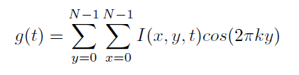
The same authors published another paper on “Crowd Monitoring using Image Processing”. This paper discuss the discrete cosine transform application for detecting the stationary crowd in the image frames of the video.
The up-and-down oscillatory head movements of an individual are continuous in a freely moving crowd, whereas those head movements of individuals stop suddenly when the crowd gets congested, avoiding free movement.
The technique proposed in the paper is to use Discrete Cosine Transform (DCT) on the two-dimensional image frames in time sequence.
DCT of two dimensional image is given by:
Where K is the Nyquist criteria and I(x,y,t) are image of Size N*N. If T is the Time interval between any two image frames of the video.
I(x,y,0), I(x,y,*T)........ I(x,y,(m-1)*T) represents the image frames for every time interval respectively.

Slide 7
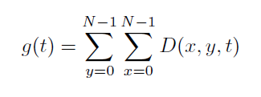
D(x,y,0), D(x,y,T),D(x,y,2T) .. D(x,y,(m-1)T) is interframe sequence obtained by subtraction of adjacent frames(image subtraction) i.e D(x,y,T) is absolute value of I(x,y,2T)-I(x,y,T). Non zero values in interframe sequence corresponds to the region of movements in image. g(t) is sum of all the values of interframe sequences. g(t) is calculated by
The peak value in g(t) curve versus time will indicate the motion of the crowd in the image and lower values will indicate the stationary nature of the crowds

Slide 8
Methodology
Detection of people using deep neural networks in OpenCV:
a.) The function to detect people takes the image frame as the input and constructs the blob object from the image. The blob object is passed as the input to convolutional neural network. CNN gives layer outputs. b.) For every layer output, If there is a object detected, extract the class identifier and confidence of the detected object. Check if object detected is person and confidence of the object is greater than minimum confidence. If a person is detected with required confidence, scale the bounding box relative to image coordinates. Use the centroid of boxes to find top and left corner of box. c.) Store the centroid coordinates, box coordinates such as width,height, top corner, left corner and confidence values in separate arrays respectively for every person deduction. d.) Apply non maxima suppression on boxes and confidences to remove weak and overlapping bounding boxes.

Slide 9
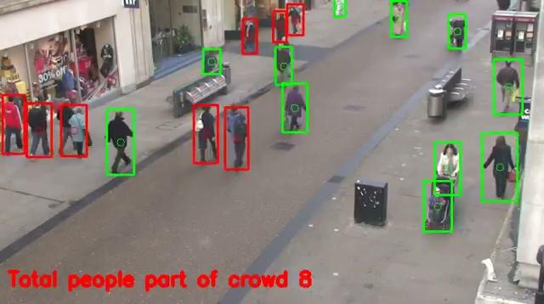
Results and discussion
The project outputs the video that contains detected people and people who are part of the crowd. The video also shows number of people in the crowd. The video is below.

Slide 10
e.) For every person deduction, save the box coordinates, centroid coordinates, confidence value in the results list. Note: The entire above procedure is implemented as python function and later imported by main python class.
2. Detected People classification and video splitting into image frames:
a.) The main python file is used to run entire project. An image of .mp4 is passed as an input to the python program.
b.) COCO dataset is used to provide labels to all the common objects that can be detected in image(video). It may include person, cycle,bike etc,
c.) Yolo is an single CNN simultaneously predicts multiple bounding boxes and class probabilities for those boxes. Yolo trains on full images and directly optimizes detection performance.
d.) Get the configuration and weights required by Yolo CNN and create Yolo object detector on COCO dataset using dnn model in open cvv. Get output layers of Yolo.
e.) Split the given video into image frames and run detect people algorithm or function on every image frame of the video.

Slide 11
f.) After getting detected people details, find the euclidean distance between centroids of any two bounding boxes/persons . If the distance is less than minimum threshold distance, then these two persons will be classified as crowd otherwise each of person is independent.
g.) Persons classified as crowd marked as red and independent persons will be marked as green. 3. Calculate crowd density: a.) Crowd density is nothing but the ratio of number of people detected divided by the pixel area of the image frames. b.) For every image frame, the total number of people who are part of crowd will be displayed.
c.) Count number of frames in the video and calculate the frames second.
d.) The time interval between any two frames will be reciprocal of frames per second.
e.) Plot the graph crowd densities versus time for every time interval.

Slide 12
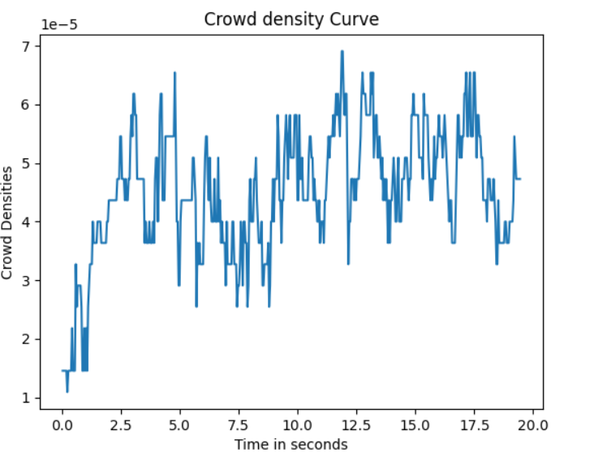
The crowd density versus time interval graph is drawn below:
Maximum Crowd density is 6.9066 e-05 and it is noticed at time 11.88 seconds. The graph is good indicator to monitor crowd congestion in the public places.

Slide 13
The people detection in the video is done using Yolo v3 convolutional neural network. Every node in this convolutional neural network will detect edges of the object in image.
The crowds are formed by clustering the people who are separated at the distance less than minimum threshold distance. The distance is calculated between the centroids of people detected.
The non maxima suppression algorithm is used to select detected rectangles from overlapping rectangle boxes. The algorithm removes unwanted rectangle boxes that are detected. If a detected person is enclosed by two concentric rectangle boxes, this algorithm selects rectangle box that has maximum length.
The graph between crowd density and time indicates the dynamic nature of the crowds. The crowds can be changed with inflow and outflow of the people into the public places.
The sudden crowd congestion can be identified by sudden peak value in the crowd density graph.

Slide 14
Conclusion
In this project, crowd monitoring contains three steps: people detection, crowd classification, crowd density estimation. People detection in the video is done by using Yolo convolutional neural networks. The people are clustered into the crowds based on minimum threshold distance i.e 50 pixels in image. The people who are at distance less than threshold distance are classified into crowds otherwise people are independent. The crowd density is calculate for every image frame of the video. Crowd density curve is a good indicator to monitor the crowd congestion in public places. Most of the researchers used these procedures to analyze, detect and recognize the abnormal in crowded scene. However, what we have identified here, only a little attention has been paid to learning the motion pattern in a crowded scene despite its importance in video surveillance in which reliable track are harder to obtain. For future work, we will explore and classify the variant learning based motion pattern in a crowded scene.

