Slide 1
Organic Farming

Slide 2
Problem Statement
People are getting affected by diseases after eating the food which was being produced by the farmers using fertilizers and pesticides.

Slide 3
Solution
As we know that the problem is due to the use of fertilizers and pesticides so it can be replaced with organic farming.
To enlighten the farmers regarding the organic farming and let them know the farming procedures so we planned to start a website where they can get all the information regarding organic farming

Slide 4
Facilities Provided
In this the farmers are provided with the information such that it gives them the crop to be cultivated in their region according to the climatic conditions.
This website helps them in finding the crop that produces good yield in that region and season.

Slide 5
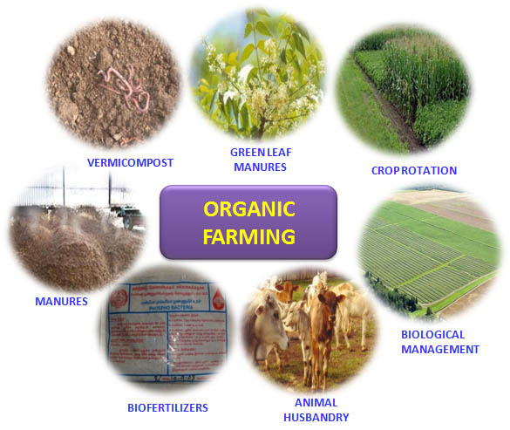
ORGANIC FARMING

Slide 6

IDEAL VIEW

Slide 7
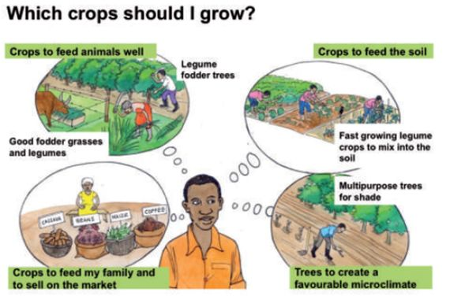

Slide 8


Slide 9
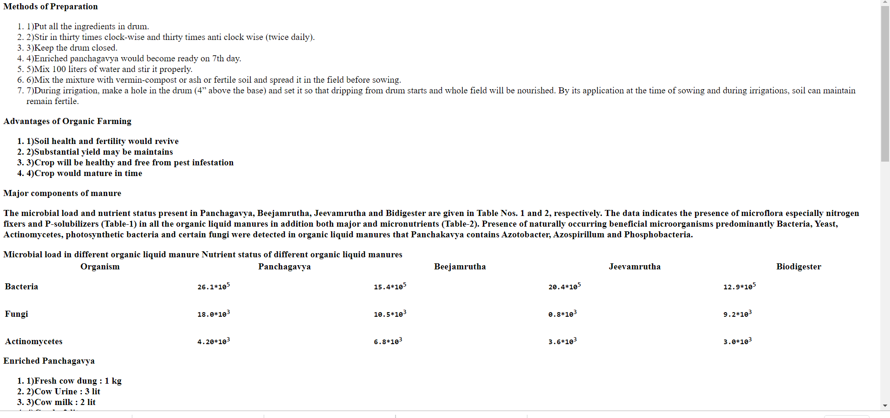

Slide 10
THANK YOU

