Slide 1

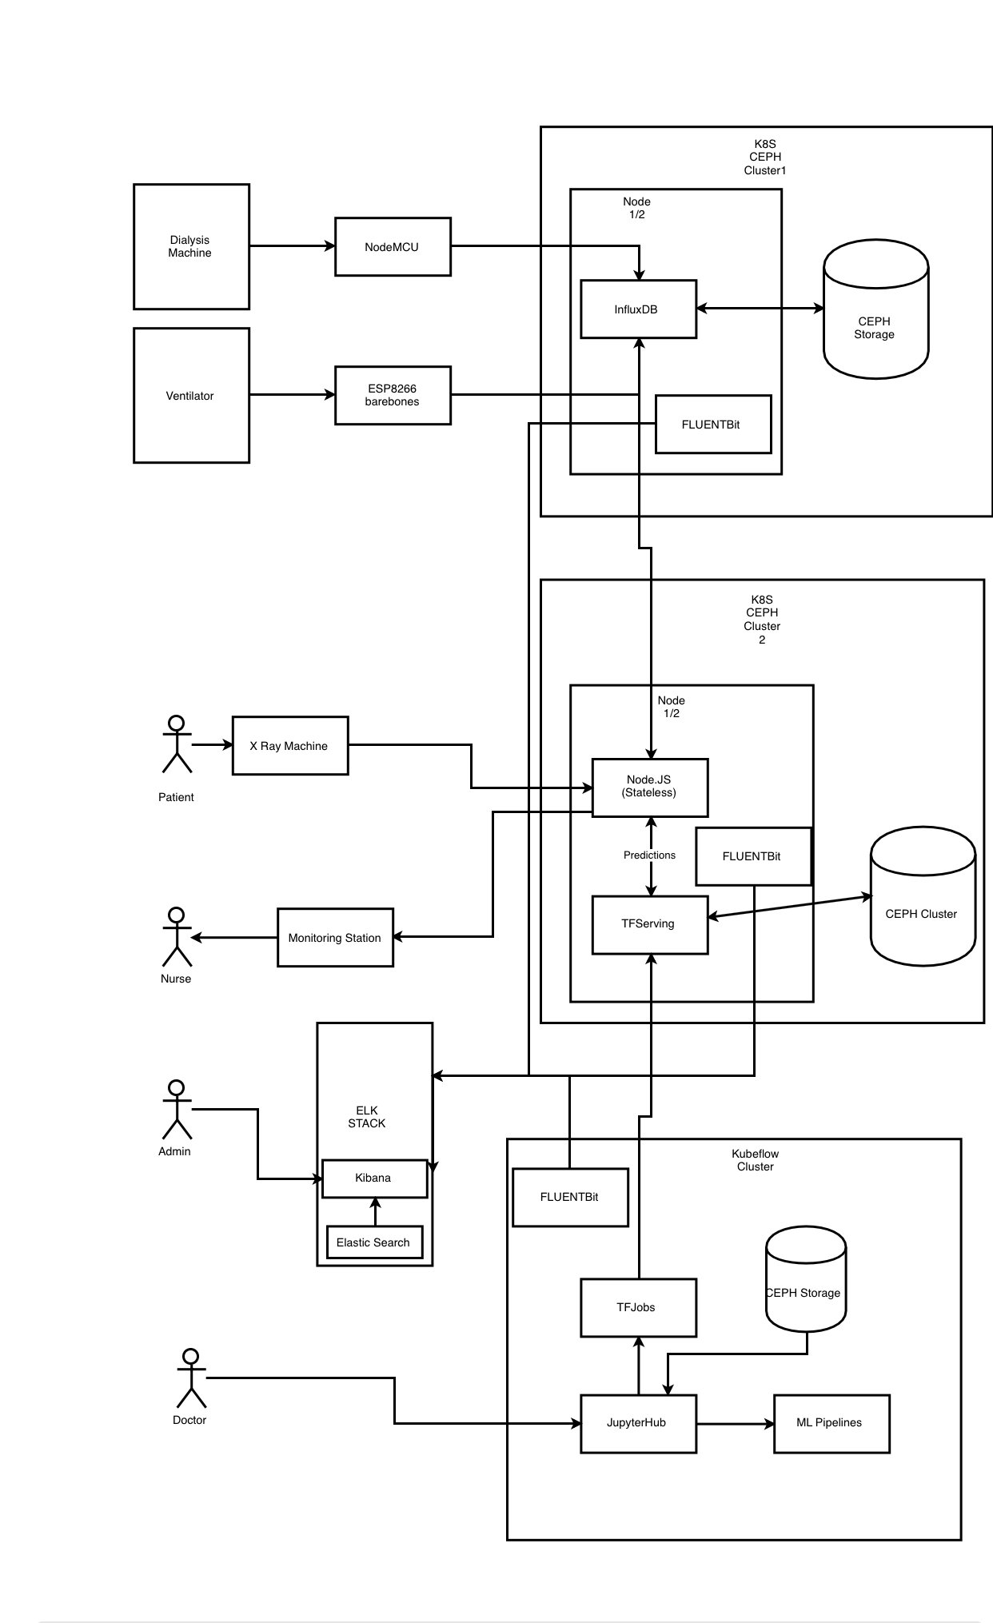
SMART HOSPITAL SYSTEM
Course: TARP Project
Faculty Advisor: Dr. M. Poongodi
VIT Chennai
ABSTRACT
Social Relevance
Concept Development and Prototype
Methodology
As per information provided by the Medical Council of India, there were a total 10,22,859 allopathic doctors registered with the state medical councils or Medical Council of India as on March 31 2017.
There is a great need for making doctors availability for the patients needed whenever it is considered an emergency. We had brainstormed and moulded our thought process as to make the hospital system automated and we have demonstrated the same.
This project will find its relevance in creating sustainable eco-spaces in automation of Hospital management. The health sector is very important when a developing nation is considered. With adopting and implementing technologies that can bring the change we can expect development in leaps and bounds.
The main idea behind the Smart Hospital System is that it can help in automating the visitor's flow and help doctors take care of patients who are in an emergency or need. We have demonstrated Pneumonia detection with implementing Deep learning ( ResNet algorithm) and also successfully demonstrated how can patient 's vitals be analyzed and examined by Doctor 24*7 round the clock. We have trained Tensor Flow serving model and implemented our image dataset on it. We have successfully implemented and demonstrated storage solution( CEPH Storage). We have used Kibana and Elastic Search for log reports generation. Using nodeJS we have created a dashboard. We have integrated all the above into a single working solution.
Objectives
Team Members
1. To make automation at ease to hospitals.
2. To make doctor availability to those in emergency need.
3. To build a complete prototype that can be implemented.
4. To make understand people with little technical knowledge also entire operations in the project.
Kartik Sharma – 16BCE1124
Vivek Reddy – 16BCE1306
Madhu Sudhan Reddy – 16BCE1316
Sai Anil – 16BCE1318
Sai Susanth – 16BCE1047
Sai Phanindra – 16BCE1075
Sreekanth Reddy – 16BCE1362
Akash – 16BCE1373

