Slide 1
Smart Hospital System

Slide 2
TEAM MEMBERS
Kartik Sharma 16BCE1124
Sai Anil 16BCE1318
Akash 16BCE1373
Sai Susanth 16BCE1047
Vivek Reddy 16BCE1306
Sai Phanindra 16BCE1075
Madhusudhan Reddy 16BCE1316
Sreekanth Reddy 16BCE1362

Slide 3
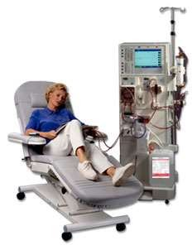
Haemodialysis
Medical procedure to remove fluid
& waste products from blood & to correct electrolyte
imbalance.
done using a haemodialysis machine & dialyzer also called as ‘artificial kidney.’

Slide 4

Indications For Dialysis
Acidosis ( pH< 7.1)
Electrolyte imbalance ( K+ > 6.5 mEq/ L)
GFR <10ml/min
Overload of fluids ( pulmonary oedema)
Uremic symptoms (↑ed level of nitrogenous waste products)

Slide 5
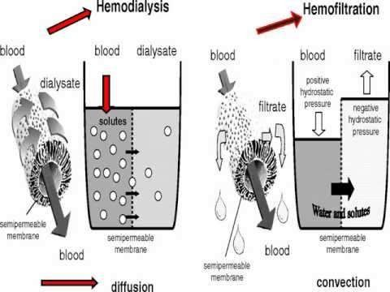
Principle Of Haemodialysis
DIFFUSION : Passive movement of solute across a semipermeable membrane
ULTRAFILTRATION : Solute + fluid removal across semipermeable membrane down a pressure gradient

Slide 6
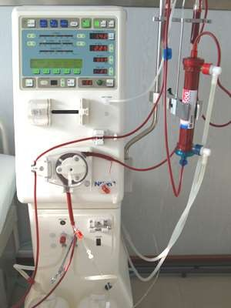
Haemodialysis Apparatus
Dialyzer
Dialysate
Blood delivery system

Slide 7
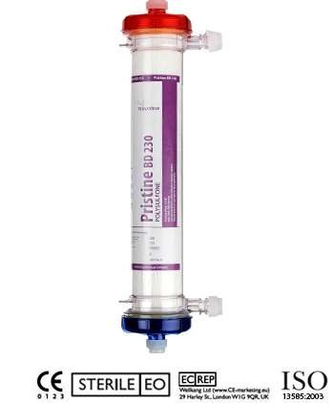
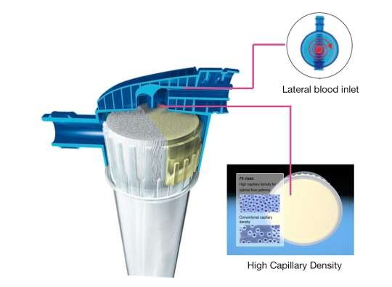
Dialyzer(Artificial Kidney)
Plastic chamber – contains bundles of capillary tube through which blood circulates while dialysis solution travels outside the bundle in opposite counter current direction.
Diffusion & ultrafiltration happens here.

Slide 8
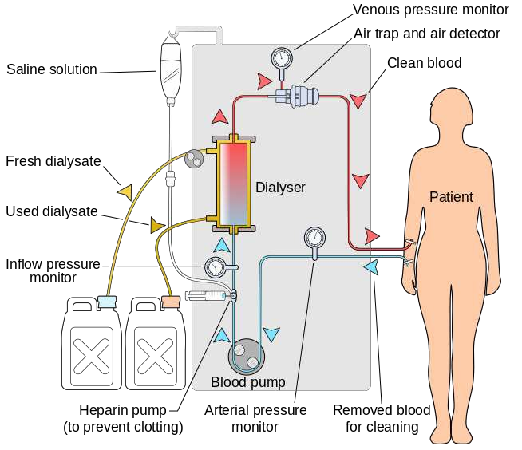
Procedure
Blood Flow Rate- 300-500 ml/min
Dialysate - 500-800ml/min
Usually done – 3 times a week & each dialysis lasts for 4 hours.

Slide 9
Complications Of Haemodialysis
Hypotension (25-55%)
Cramps (5-20%)
Nausea and vomiting (5-15%)
Headache (5%)
Chest pain (2-5%)
Back pain (2-5%)
Itching (5%)
Fever and chills (<1%)

Slide 10
Hypotension
 Causes
Large weight gain
Volume Related
Short dialysis
High dialysis solution
temperature
Antihypertensives
Eating during treatment
Inadequate Vasoconstriction
Cardiac Factors
_{Arrhythmia} Diastolic dysfunction

Slide 11
Muscle Cramps
 Predisposing Factors
Hypotension
Hypovolemia
Leads to vasoconstriction cause
muscle hypoperfusion leading to
muscle cramps
High filtration Rate
Low sodium dialysis solution

Slide 12
Nausea & Vomitting
due to hypotension
Headache
Common
Chestpain & Back pain
Itching
precipitated by dialysis. May be due to hypersensitivity reaction to dialyzer
Fever & Chills

Slide 13
Less Common But Serious Complications
Disequilibrium Syndrome
set of systemic & neurologic symptoms with characteristics
electroencephalographic findings occur either during / following dialysis
Early Manifestation- Nausea , Vomitting, Restlessness & headache
Serious Manifestation- Seizure ,Obtundation, Coma
o Cause
Acute increase in brain water content

Slide 14
Dialyzer reactions
can be Anaphylactic type (type A) & nonspecific type (type B)
Arrhythmia
common in patients receiving digitalis & those with coronary artery
disease
Cadiac Tamponade
recurrent hypotension – sign of impending cardiac tamponade
Hemolysis
its a medical emergency. Can be due to obstruction/narrowing in the
blood line & if there is any problem with dialysis solution

Slide 15
Thank you

