Slide 1
Video and Display Quality Analysis using Machine Learning

Slide 2
Problem Statement & Solution Proposed
Problem Statement
Videos are subject to wide variety of distortions during transmission, acquisition, processing, compression, storage and reproduction any of which may result in degradation of visual quality of an video.
Manually finding the E2E quality issues for Video playback and Display is a challenge for all the use cases.
Solution
We are coming up with Machine Learning Solution to identify and report the quality issues.
We have explored few algorithms and chosen Inception V3 algorithm.
Currently we trained algorithm to detect Blur and few of the Flickers.

Slide 3
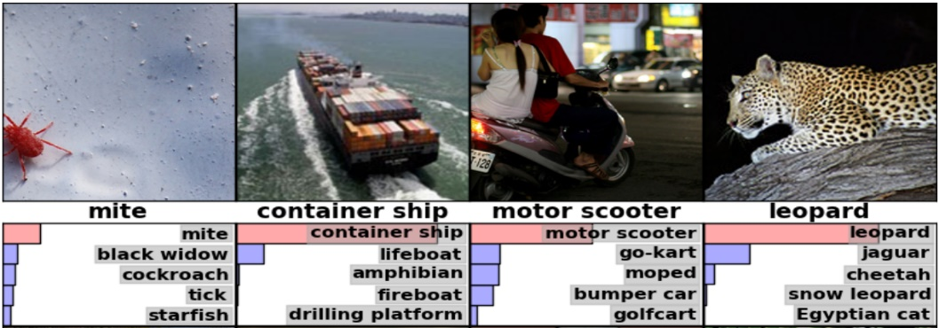
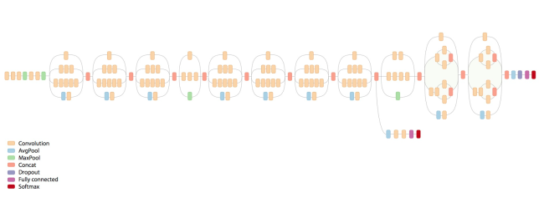
Inception-V3 model
Inception-v3 is trained for the ImageNet Large Visual Recognition Challenge using the data from 2012. This is a standard task in computer vision, where models try to classify entire images into 1000 classes, like "Zebra", "Dalmatian" and "Dishwasher".
The model consists of the following layers:

Slide 4
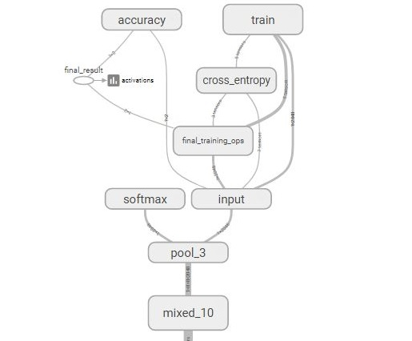
Final Layer Trained
Used Transfer Learning and leveraged this model to find Video and Display Quality Issues.
Trained only the last layer of this model from scratch and have left the other layers untouched.
The images are categorized according to our problem statement and fed into the model to change the existing weights of the final layer.
After training the model for the number of iterations we specify, we get a graph for the entire training.
For each test input image, we get scores (ranging from 0 to 1) for each classes.
The score implies the prediction value of the model for that specific test image.
Currently the model is trained for Blur detection (Video) and Flicker Detection (Display) quality analysis.

Slide 5
Video Quality – Blur Detection

Slide 6
Video Quality Analysis - Blur
Blur Detection Training Details:
#Training Steps | % of Accuracy in Training | Cross Entropy (how far the categories are from each other after Training) | # Images used in Training
 |  |  | Blur | Normal
12000 | 96.7 | 0.075507 | 4049 | 4074

Slide 7

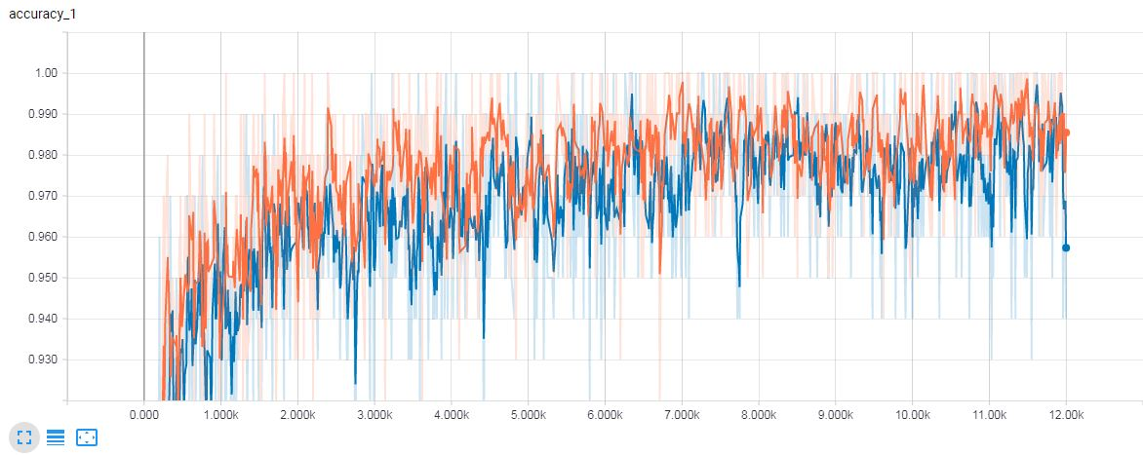
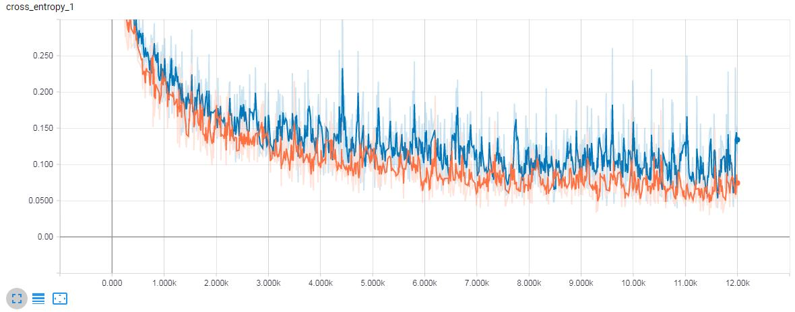
Tensor board results for Blur detection after 12K iterations
Accuracy -> increasing towards 1
Cross Entropy -> decreasing towards 0

Slide 8
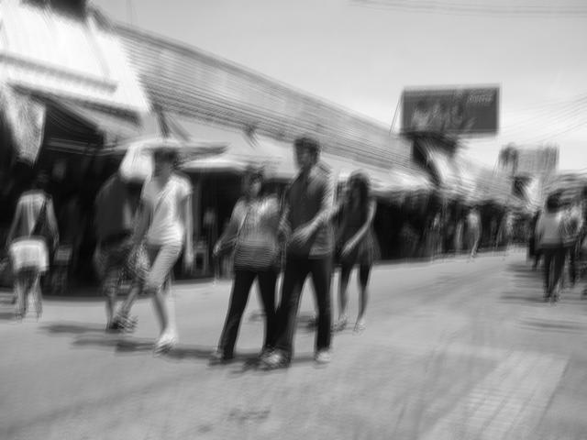

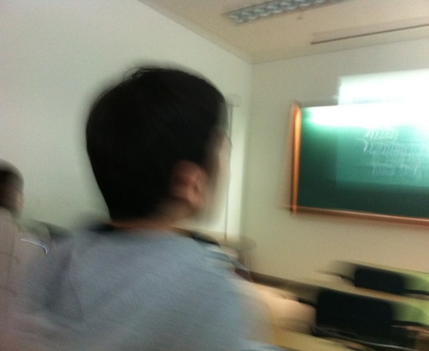
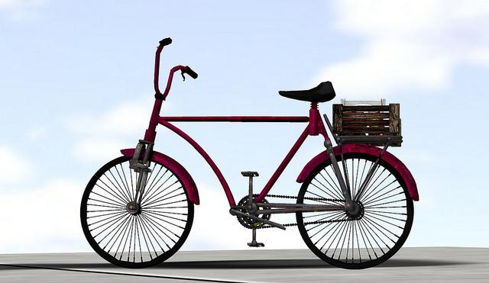
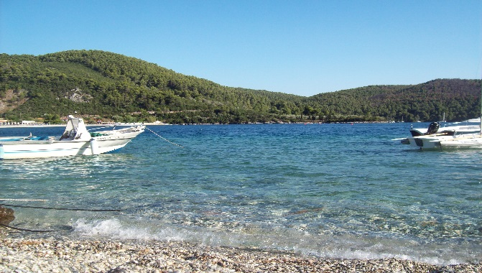
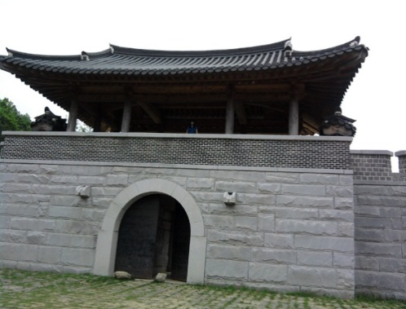
Sample Images
Blur
Non-Blur

Slide 9
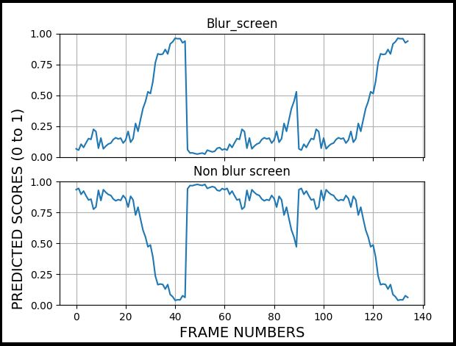
Sample Graph for Blur Detection

Slide 10
Display Quality – Flicker Detection

Slide 11
Types of Flickers that we could categorize:
Display Quality Analysis - Flickr
Type of Flicker | Description
Complete Black | The whole frame is black
Half Black | Half of the frame is black
Diagonal Black | The black frame comes diagonally
Gray Screen | Black and white mix together
Half White | Half of the screen flickers white
Out of these classes, we have trained the model for the first 4 classes.

Slide 12

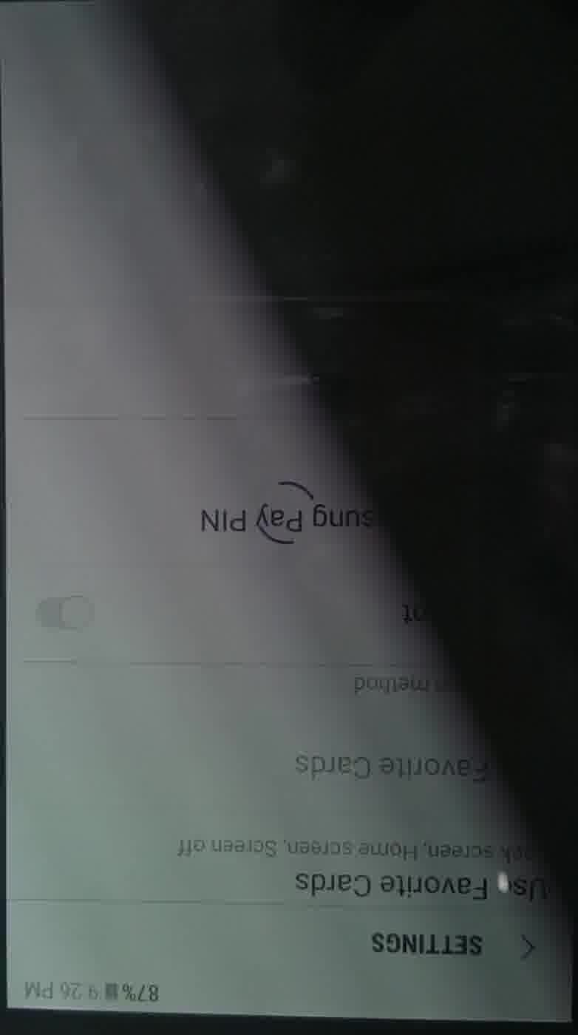

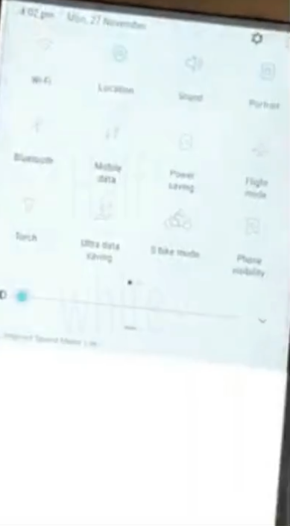
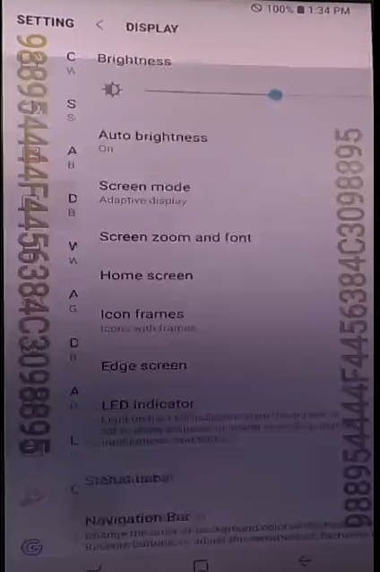
Sample Images
Complete Black
Diagonal Black
Half Black
Half White
Gray

Slide 13
Display Quality Analysis
Flicker Detection Training Details:
Types of Flicker | # Training Steps | Accuracy in Training( in %) | Cross Entropy | #Images used for training
 |  |  |  | Flicker | Normal
Complete Black | 5000 | 100 | 0.000625 | 50 | 90
Diagonal Black | 5000 | 87.5 | 0.000625 | 48 | 90
Half Black | 5000 | 100 | 0.004358 | 46 | 90
Gray Screen | 5000 | 100 | 0.005864 | 52 | 90
Combined Model | 10000 | 100 | 0.009668 | 50+48+46+52 | 90

Slide 14
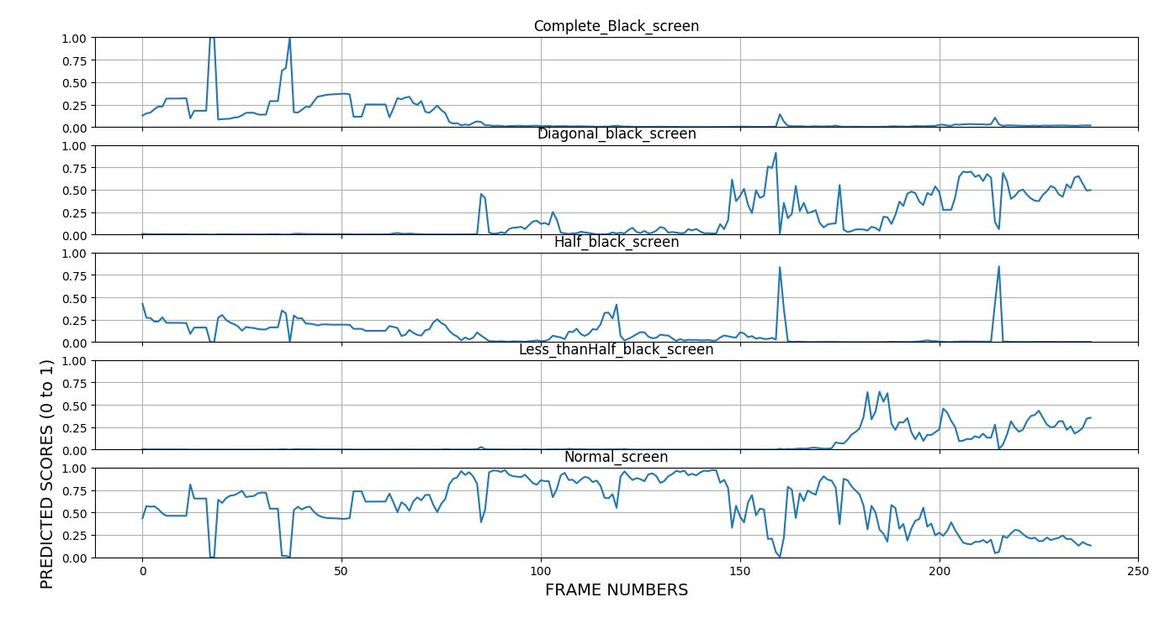
Sample Graph for Various Flickr Detection

Slide 15
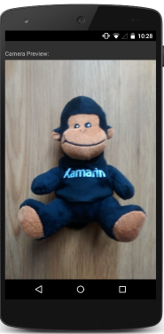

E2E Setup for Deploying ML Solution
Camcorder
DUT
E2E Setup: Working on coming up with automation to initiate the camcorder session on one MTP and actual Video/Display Test cases on DUT.
In Light Booth, we will place the DUT and Camcorder in such a way that camcorder records the DUT display screen only without any reflections.
Step#1
Initiate Video/Display Test case on DUT and Camcorder Session on another MTP at same time.
Once the test execution completed, stop the camcorder session.
Step#2
Pull the recorded video to PC
Step#3
Run the ML solution on recorded video to find the quality issues, generate the report and update the result for the test case.
1
1
2
3

Slide 16
Demo of the Trained Model

Slide 17
Current Status, Roadmap & Challenges
Current Status
The trained model works for Blur and Flickr (Complete Black, Half-black, Diagonal Black, Gray Screen).
Generate/Find more test data and train the model.
E2E Setup Bring-up & Deployment
Need to bring up E2E setup and automation. If we can’t limit the camcorder FoV to DUT display screen, come up with solution to process the recorded video to get only the display portion of the video (using Edge detection).
Road Map
Extend the solution to other quality issues – Blockiness, Flickr (partial Flickr on the screen), Corruption (Snowy Screen, Corrupted screen, MB Corruption).
Enhancing the post-processing to avoid false-positives
Reducing the processing time
Possibility of running the ML solution on DUT itself for camcorder quality issues.
Challenges:
Finding/Generating the more data for training the model.

Slide 18
Backup

Slide 19
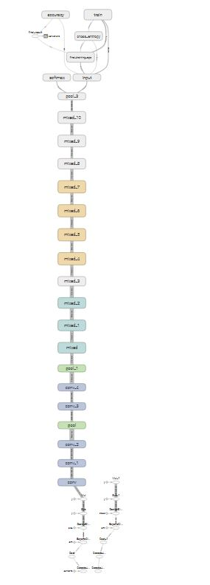
Overall Inception V3 model

Slide 20
Flickr - Complete Black Training Details
When flicker occurs and makes the frames complete black for less than a second.
Type of flicker | # Training steps | Accuracy in Training( in %) | Cross Entropy | # Training videos used | # Test Video present | # Images in training (Flicker:Normal)
Complete Black | 5000 | 100 | 0.000973 | 4 | 2 | (74:91)
Test video | Duration of video | Fps | Resolution | #images made | Time taken to run model
Test1.mp4 | 17 sec | 33.78 | 1080x1920 | 605 | 9:52
Test1_640.mp4 | 17 sec | 59.9 | 640x320 | 1017 | 17:39
Test2.mp4 | 5 sec | 29.74 | 1080x1920 | 161 | 2:14
Test2_640.mp4 | 5 sec | 29.74 | 640x320 | 161 | 2:10

Slide 21
Video Processing Experiments
Video name | Video duration | Resolution | input read format | o/p being displayed | time taken
test.mp4 | 11sec | 720x1280 | Video | yes | 223 sec
test.mp4 | 11sec | 720x1280 | Video | no | 222sec
test.mp4 | 11sec | 720x1280 | images | no | 187 sec
test_480.mp4 | 11sec | 480x640 | Video | yes | 196sec
test_480.mp4 | 11sec | 480x640 | Video | no | 194sec
test_480.mp4 | 11sec | 480x640 | images | no | 186sec
test_240.mp4 | 11sec | 240x360 | Video | yes | 196sec
test_240.mp4 | 11sec | 240x360 | Video | no | 189sec
test_240.mp4 | 11sec | 240x360 | images | no | 177sec

Slide 22
After threading: The input and process
One thread which will queue the input frames and the other for processing. Taken two queue length (128 and 1280 for experiment)
Video name | Video duration | Resolution | input read format | o/p being displayed | queue length | time taken
test_240.mp4 | 11sec | 240x360 | video | yes | 1280 | 180sec
test_240.mp4 | 11sec | 240x360 | video | no | 1280 | 187sec
test_240.mp4 | 11sec | 240x360 | video | no | 128 | 191sec
The overall observation:
We can use lower resolution videos as an input as it is saving around 30sec.
Scaling to 480 or 240 was not making much difference.
Using images as input saves 10sec as compared to video inputs.
Displaying the video to the user hardly makes a difference of 2 sec
By using multithreading with 1280 queue size, the time save is 10sec (which is very less) . Need to see more on this.

Slide 23
Use for Qualcomm Incorporated

