Slide 1
Regression/Controlled Experiments
Prof. Harpreet Singh

Slide 2
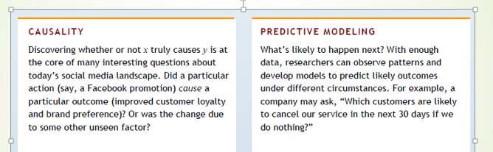
Causal vs. predictive

Slide 3
Causal vs. predictive
When does one do prediction vs. causal analytics?
Suppose an insurance company wants to know whether people who do
exercise live longer?
What analysis method should they use?
Suppose a policy maker wants to know whether people who do
exercise live longer?
What analysis method should they use?

Slide 4
Causal vs. predictive
Insurance company
If they find “yes they do live longer”, then based on who exercises they can offer lower premiums
However, it is possible that people who choose to exercise are just healthier to begin with –but for the insurance company that doesn’t matter, those who choose to do exercise may be healthier to begin with, or they become healthier due to exercise – outcome for insurance company is same –so they will do predictive analytics

Slide 5
Causal vs. predictive
Policy maker
Suppose purpose of policy maker is to give coupons for exercise programs that can be used at local gyms
they would like to know whether exercise would cause an improvement in health of that individual. So need to do causal analytics

Slide 6
Regression methods
Regression methods can be used to answer both causal and predictive questions
The basic regression formulation for the previous question will be
Life expectancy = a + b* Amount of exercise
Regression analysis will discover value of a and b from the data – so you have equation of the line
In case of prediction, we are interested in finding value of “Life expectancy” given the “Amount of exercise” for someone
In case of casual analysis, we are interested in finding what is the true value of “b”

Slide 7
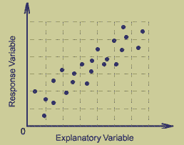
Regression analysis
At its simplest, it is fitting a line to a scatterplot of data
Equation of a line: Y = a + b X
Suppose a=1 and b=2
I can say that at X=5, the value of Y
is predicted to be: Y = 1+ 2*5= 11
I can also say that that increasing X
by 1 unit increases Y by 2 units
(as b=2), which is a causal statement
So, the regression method can be used for both prediction and causal analytics; but there
are differences in how it is used.

Slide 8
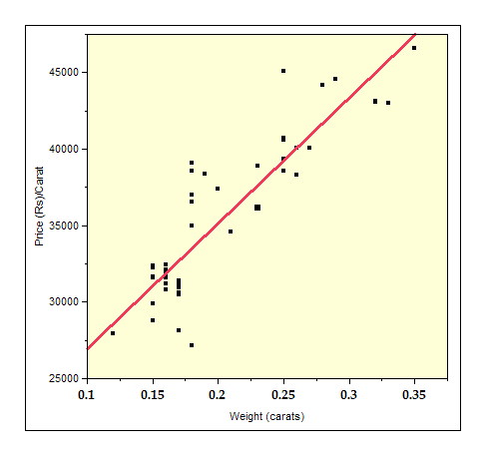
Regression Analysis
There can be many possible lines that seem to fit the data well. We have to find a way to find the “best line”
Given a data set, we use a method called ordinary least squares (OLS) to find a and b
The method finds the value of a and b that minimizes the sum of squares of the errors across all data points

Slide 9
Regression Analysis
Typically, we have a sample of data from the population
So, the value of a and b that we have depends on what sample we have
In a different sample, value of a and b may differ
So, can we be sure that the values of a and b that we are seeing are
a reasonable representation of the population
p-value of the coefficient of the x variable should be small (typically less than 0.05)
Size of the sample should be large

Slide 10
Regression Analysis
p-value (Type –I error) (needed to establish causal impact of a factor)
Represents the chance of being incorrect in saying that the coefficient of the x variable (b) is different from 0
So small p-value means that it is very likely that the coefficient of the variable is different from 0
When the coefficient is 0, then it means that the factor does not have an impact on the y variable
R² (needed to establish whether model has predictive power for the y-variable)
High value means that the variables in the model explain a lot of variation in the data and so the model can be expected to have good predictive power
Caution: Both of these are starting points and much more may be required to establish causal impact, or prediction

Slide 11

Example: Retail Sales
We wish to understand how competition impacts sales (INR/sq ft) at a chain of women’s apparel stores of same size in shopping malls. (MallSales1)
Conduct a regression analysis and observe
the results. What is odd?

Slide 12
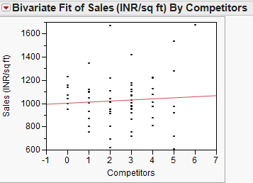

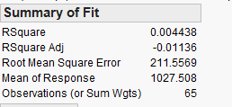
Regressing sales on competition

Slide 13
Example: Retail Sales
Besides competition, another potential factor that impacts sales is the affluence of the catchment area of the mall. We measure it through the median income in the area served by the mall (INR ‘000)
(MallSales2)
What do you observe about the coefficient of
competition?

Slide 14
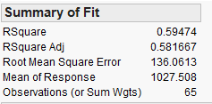

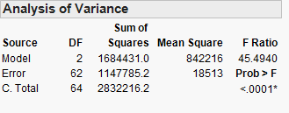
Results of multiple regression
Estimated Sales (INR/SqFt) = 120.72 + 3.19 Income – 48.33 Competitors
Interpretation of the coefficients:
Income: For stores with equal number of competitors, an income that is higher by INR 1000, results in sales that are higher by INR 3.19 per square feet, on average.
Competitors: For stores in locations with equal income, an extra competitor results in reduction of sales by INR 48.33 per square feet, on average
Notes:
Spend time interpreting all the different sections of the regression output.

Slide 15
Comparison of simple and multiple regression estimates
Variable | Simple regression estimate | Multiple regression estimate
Income | 2.58 | 3.19
Competitors | 9.27 | -48.33
Coefficients from multiple regression are called partial coefficients while those from simple regression are called marginal coefficients
They are different because the marginal coefficients include the impact of the association of one independent variable with the other
In the example of Mall Sales, competitors and income are associated
Income = 277.33 + 18.1*Competitors

Slide 16
Omitted Variable Bias
Omitting “Income” in the regression of “Sales” and “Competitors” introduces a bias
This is because the omitted variable is correlated with the included independent variable and also with the dependent variable
In other words, in the regression of “Sales” and “Competitors”, the error term is correlated with the independent variable
Thus, omission fundamentally violates the OLS assumption E[ε|X] = 0, or Cov(ε,X) = 0
Notes:
OVB and multi-colinearity are two sides of the same coin.

Slide 17
Implication of omitted variable bias
What is the causal interpretation of the simple regression of competition on income?
A causal interpretation of regression coefficients may not be correct

Slide 18
Example: Correlations due to Common Cause
Article in Nature: leaving the night-light on in the nursery made the child myopic later in life
CNN publishes summary of article
A year later, an important observation was made:
Myopic parents are more likely to leave the light on, and
Myopic parents are more likely to have myopic children
A common factor was identified
Once you control for the parents’ myopia, the relationship in the original study disappears
See How Science Works: The Story of Night-Light Myopia
Slide BORROWED FROM Ronny Kohavi’S PPT at University of Minnesota Technology Forum

Slide 19
What about Observational Studies?
Why not compare with historical data?
Here’s an example of Kindle Sales over time. You changed the site, and there was an amazing spike
Slide BORROWED FROM Ronny Kohavi’S PPT at University of Minnesota Technology Forum

Slide 20

External Events can Dwarf Your Changes
Oprah calls Kindle "her new favorite thing"
In this example of an A/B test, you’d be better off with version A
In controlled experiments, both versions are impacted the same way by external events
Slide BORROWED FROM Ronny Kohavi’S PPT at University of Minnesota Technology Forum

Slide 21
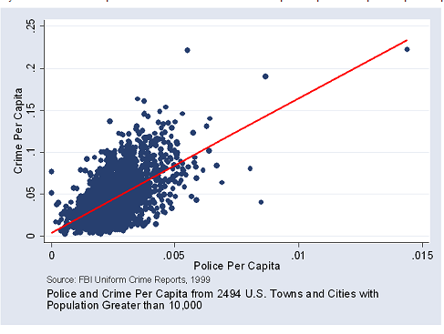
Causal vs. Correlation

Slide 22
Causal vs. Correlation
Reverse Causality
Third factor correlated with both
Selection Bias
Difference in reporting

Slide 23
Implication of omitted variable bias
A causal interpretation of regression coefficients may not be correct
But, we want to make causal interpretations. E.g. ROI related – How much does an extra display ad impression improve the chance of conversion.
How to deal with omitted variable bias (OVB)?

Slide 24
How to deal with OVB?
Include the missing variable in the regression
We will always be missing some variables, so how do we know that we have the right regression coefficient
Can rely on domain knowledge, or use statistical methods like instrument variables. Both of these approaches have their limitations.
Instead of using “regular” data for analysis, collect data using randomized field experiments – find the causal impact of some factor A on the outcome of interest

Slide 25

Controlled Experiments in One Slide
Concept is trivial
Randomly split traffic between two (or more) versions
A (Control)
B (Treatment)
Collect metrics of interest
Analyze
Must run statistical tests to confirm differences are not due to chance
Best scientific way to prove causality, i.e., the changes in metrics are caused by changes introduced in the treatment(s)
Slide BORROWED FROM Ronny Kohavi’S PPT at University of Minnesota Technology Forum

Slide 26
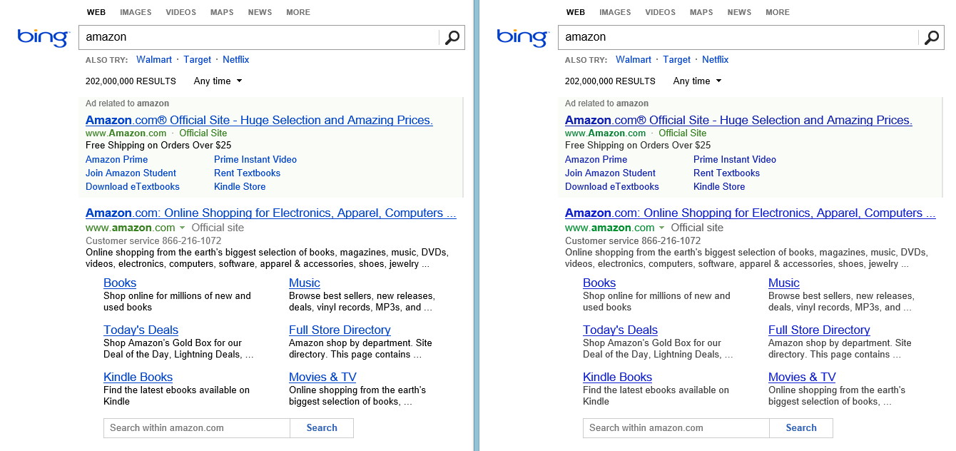


Lesson: Small Changes can have High ROI
We made small changes to font colors in August 2013
Can you see? Can you figure out which is better?
Slide BORROWED FROM Ronny Kohavi’S PPT at University of Minnesota Technology Forum

Slide 27
A/B Experiment Design
To find the causal effect of advertising on an outcome e.g. pageviews
Have a test group of restaurants which are randomly selected and have them advertise
Have control group of restaurants who are randomly selected and who do not advertise
RG chose 10000 restaurants in test group and same number in control group
Randomization ensures that firms of all types are in test group and in control group. Now, the average response to ads for test group firms and control group firms should be same.
Now we compare the conversion rates of test and control groups to find the causal effect of ads

Slide 28
Advantage of Controlled Experiments
Controlled experiments test for causal relationships, not simply correlations
When the variants run concurrently, only two things could explain a change in metrics:
The “feature(s)” (A vs. B)
Random chance
Everything else happening affects both the variants
For #2, we conduct statistical tests for significance (“Student’s t-test”)
The gold standard in science and the only way to prove efficacy of drugs in FDA drug tests
Controlled experiments are not the panacea for everything. Issues discussed in the journal survey paper
Slide BORROWED FROM Ronny Kohavi’S PPT at University of Minnesota Technology Forum

Slide 29
Is the difference between test and control groups significant (i.e. the difference is not die to random chance ?
Idea of population and sample, and sampling variation
Need to do a statistical analysis using regression
No. of page views= a + b*dummy for treatment group, and check whether b is positive and statistically significant
What can you conclude if the results are insignificant?

Slide 30
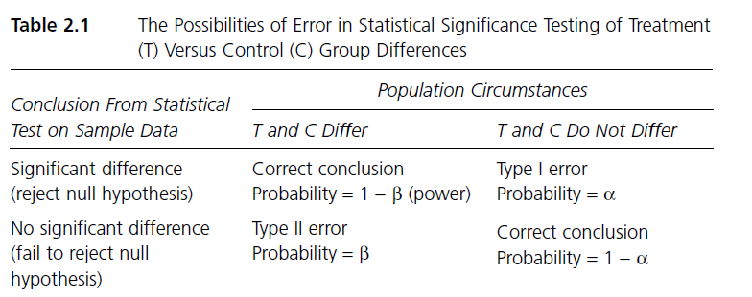
Type -1 and Type –II Errors

Slide 31
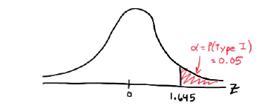
Type -1 Error (Reject null hypothesis when Null is true)

Slide 32
Is the difference between test and control groups significant?
What can you conclude if the results are insignificant but there are only 10 restaurants in test group and 10 restaurants in control group?

Slide 33
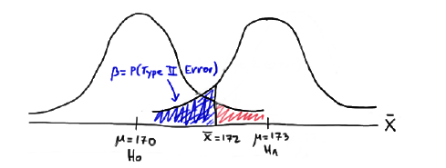
Type -II Error (Fail to reject null hypothesis when alternative is true)

Slide 34
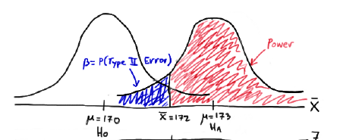
Power of test (Reject null hypothesis when alternative is true)

Slide 35
Sample Size
A larger sample size has a higher statistical power
Power of the test is related to Type II error (β) and is represented by (1- β)
What’s type II error here?
The chance that advertising is effective, but the test fails to catch it
What’s power of test?
The chance that advertising is effective, and the test is able to catch it (i.e. you reject H0 when H0 is false)
You want a high power in a test, or you want the test to be sensitive to be able to catch the effect if there is one
Notes:
Reading on Power and Sample Size
http://www.uta.edu/faculty/sawasthi/Statistics/stpowan.html#power_doe3

Slide 36
Power depends on…
The type of test
The size of the true effect
Variability in data
The chosen significance level (α)
The sample size
We usually try to determine a sample size to get a statistical power of 80%

Slide 37
Power and Sample Size Calculators
Free
http://powerandsamplesize.com/Calculators/
Paid
http://www.power-analysis.com/

Slide 38
Assignment – Controlled Experiments
Reflect on decisions you made in previous jobs or projects. Are there any situations where experiments would have helped you make a decision? Describe the situation, how you handled it, and how would you improve decision making using controlled experiments?
The assignment to be answered in ppt format; max of 5 slides.
This is a Group Assignment

Slide 39
Experiment for Ad Effectiveness – RestaurentGrades (RG) Case
Platform (RG) is interested in knowing the effectiveness of digital advertising campaign on the platform
What is wrong with this statement?
Advertisers on this platform receive twice as many clicks as non-advertisers.
After buying advertisements, sellers tripled their sales

Slide 40
Experiment for Ad Effectiveness – RestaurentGrades (RG) Case
Platform (RG) is interested in knowing the effectiveness of digital advertising campaign on the platform
What is wrong with this statement?
Advertisers on this platform receive twice as many clicks as non-advertisers
After buying advertisements, sellers tripled their sales
Firms that self-select to do advertising may be such that customers click on their advertisement if they see one. So high number of pageviews could be simply because of the nature of firms and not due to advertising.

Slide 41
Restaurant Grades data
Business id | Restaurant unique identifier
Treatment | 0 for control/ 1 for current ad design/ 2 for second ad design
Restaurant type | Chain/ independent restaurant
Page views | No of visits to restaurant’s RG page per month
Calls | No of phone calls made from restaurant’s mobile RG page per month
reservations | No of reservations made from restaurant’s RG page per month

Slide 42
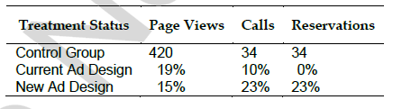
Comparing average behavior of test and control groups

Slide 43
Assignment - RG case
Should RG stick to current ad design, or switch to the alternative?
Which outcome variable is most useful to consider? Are there other outcome variables that may be useful to measure?
Which ad design is better for independent restaurants?
Which ad design is better for chain restaurants?

