Slide 1
Regression/Controlled Experiments
Prof. Harpreet Singh

Slide 2
Star Digital Case: What data to collect?
What data do we need?
Customer level data, or aggregate data like no of exposures per day and revenues per day
Aggregate level may lose important information
Individual level may be more difficult to collect
This tradeoff must be accounted for while making this choice

Slide 3
Experiment Design
10% in control group and 90% in test group
This generally reduces the power of the test. Then, why do it this way?
170 m impression delivered to 45 m users
Publisher websites 1 to 5 were in one category and website 6 was in the other
Only 0.153% of people purchased. So analysis sample was constructed by
50% people who bought and rest did not
Whether they were from control group or test group was random
This method of sample construction is called “oversampling”

Slide 4
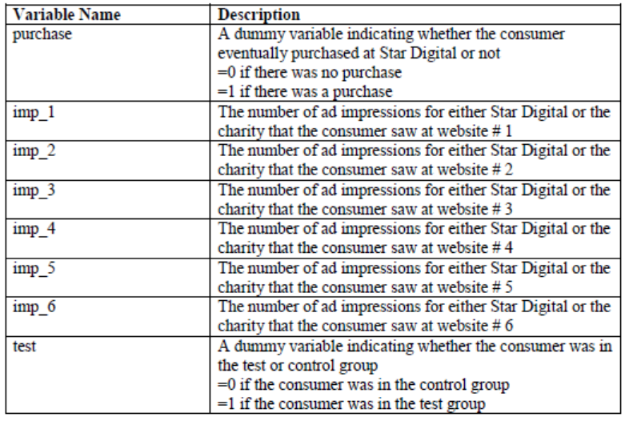
Variables Measured

Slide 5
Star Digital Assignment – Part 1
Use linear regression in answering following questions
Does online display advertising increase purchase probability (Hint : conversion probability higher in test group than control group) ?
Is there a frequency effect of advertising on purchase? In particular the question is whether increasing the frequency of advertisement increases purchase probability (Hint : the effect of total number of impressions higher for test group than control group) ?
Are sites 1 to 5, or site 6 more effective in increasing sales (Hint: The difference in effect of total impression between test and control group higher for sites 1 to 5 than site 6)?
Do sites 1 to 5, have better ROI than site 6 (Hint: ROI = (Revenue from 1 impression/ cost per impression)?
Notes:
Diff between 3rd and 4th bullet point is that ROI must include cost dimension as well.

Slide 6
Revenue – Calculations
Lottery Example :
Winning Probability – 5%
Winning Amount - $100
Cost - $10
Should you buy this lottery Ticket or not ?

Slide 7
Revenue – Calculations
Lottery Example :
Winning Probability – 5%
Winning Amount - $100
Cost - $10
Expected Revenue – 100* 5/100= $5
Expected Revenue < Cost
No you should not buy this ticket
ROI = Revenue/Cost= 5/10= 0.5

Slide 8
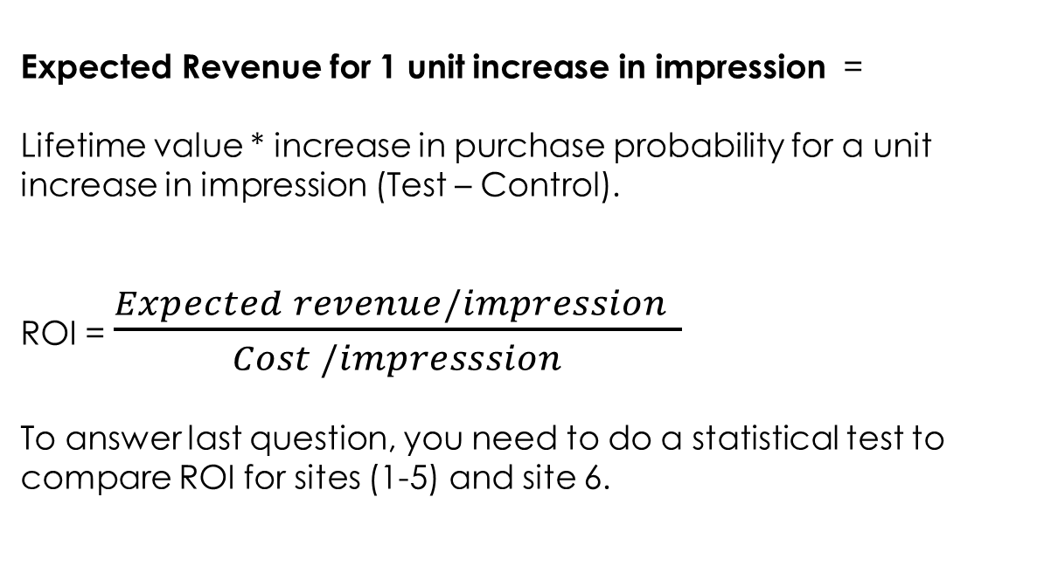
Revenue – Star digital
Expected Revenue for 1 unit increase in impression =
Lifetime value * increase in purchase probability for a unit increase in impression (Test – Control).
ROI = $\frac{Expected revenue/impression }{Cost /impresssion}$
To answer last question, you need to do a statistical test to compare ROI for sites (1-5) and site 6.

Slide 9
Possible Problems in Using Linear Regression
We assume a normal distribution of the outcome variable
But, here the outcome is only 0, or 1
Using linear regression could result in nonsensical predictions
Predicted outcome > 1 or < 0
Fix is to use the logistic regression model

Slide 10
Idea of Logistic Regression
In linear regression, continuous Y, but here Y is binary
Can we transform Y so that it goes from binary to continuous
Logical idea is to use probability of Y=1 as the Y variable
Prob of purchase (p)= a + b no. of ad impressions
The predicted value of Prob of purchase may still be beyond 0, or 1 for extreme values of ad impressions
So, need a better Y variable that can take a broader range
Next idea is to use odds ratio, which is p/(1-p)
To have whole range from – infinity to + infinity, we can use ln(odds), also called logit

Slide 11
Logistic Regression
The odds ratio is probability of success versus failure, or
Note that,
How to estimate the coefficients in model above – Note we don’t have Prob, or P in the records – So, can’t do simple transformation and of P and use OLS method for linear regression
Coefficients are found by Maximum Likelihood estimation, which is like saying that we try to find coefficients that maximize the chance of observing the data we have
Interpretation is if X increases by 1 unit, then the odds of the event increases by a factor of
Notes:
Odds vary between 0 and infty and prob varies between 0 and 1. And ln (odds) varies between –inft and +infty.

Slide 12
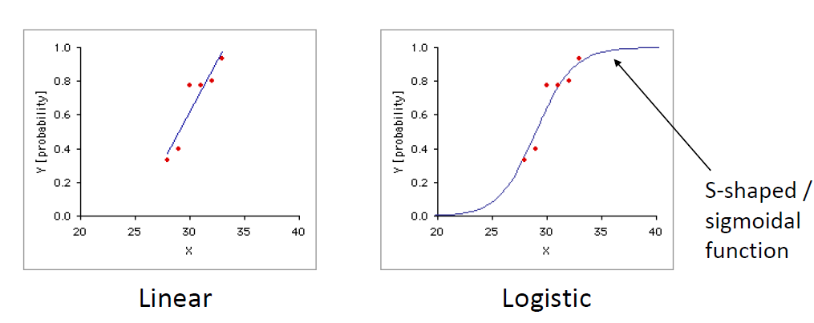
Linear vs. Logistic Regression
Interesting things to note:
In the middle, the linear regression and logistic regression will give similar predictions
In large data sets: linear regression can still be used and interpreted for binary Y
See blog by Galit Shmueli: http://www.bzst.com/2012/05/linear-regression-for-binary-outcome-is.html

Slide 13
Can We Predict Purchase Probabilities?
Suppose, we need to get an idea of the inventory needed
Being able to predict purchase probability after ad exposure will be useful to determine demand and therefore, inventory

Slide 14
Oversampling for Prediction
Oversampling causes a distortion in the intercept which becomes
Where, η is fraction of events in population, and s is fraction of events in sample
Here, η = 0.00153 and s = 0.5

