Slide 1
Diabetes Readmission Prediction
By
Phaniraj Bhatkal Goverdhan
Srikrishna Ram

Slide 2
Objective:
Predicting the readmission rate using Random Forest and synthetic data balancing techniques.

Slide 3
Dataset:
Dataset used is taken from UCI Machine Learning website
Analyzed dataset which represents 10 years of clinical care at 130 US hospitals and integrated delivery networks, which includes 50 features representing 100K diabetes patient and hospital outcomes.

Slide 4
Why ROSE And Random Forest: ROSE (Random Over-Sampling Examples) data balancing technique helps us to generate data synthetically. The data generated using ROSE is considered to provide better estimate of original data. Later we are using Random Forest model for the Prediction Task. Random forest builds multiple decision trees and merges them together to get a more accurate and stable prediction. We choose this model because it is very flexible and has the ability to classify large amounts of data with accuracy.

Slide 5
Procedure:
Reading and removing redundant data:
diabetes <- read.csv("C:/Users/Admin/Documents/R Programming/diabetic_data.csv")
diabetes1 <- subset(diabetes,select=-c(encounter_id, patient_nbr, examide,citoglipton,weight, payer_code, medical_spec))
diabetes2 <- diabetes1[diabetes1$race != “?",] # No. of observations drops by 2273
diabetes2 <- diabetes2[diabetes2$diag_1 != "?",] # No of observations drops by 21
diabetes2 <- diabetes2[diabetes2$diag_2 != "?",] # No of observations drops by 358
diabetes2 <- diabetes2[diabetes2$diag_3 != "?",] # No of observations drops by 1453

Slide 6
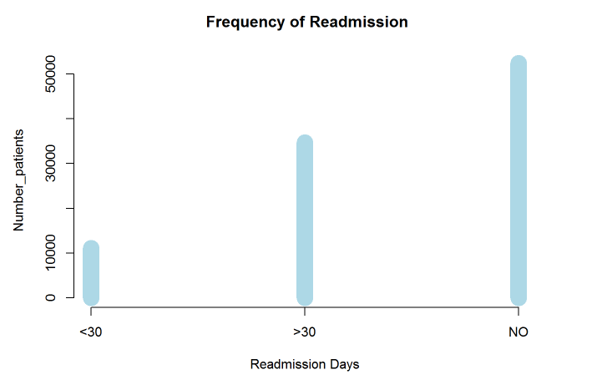
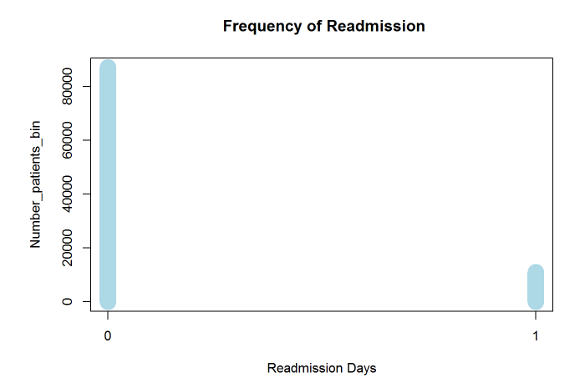
Binary Representation of readmitted within 30 days: “0” represnts No readmisson or readmission after 30 days whereas 1 represents readmission within 30 days. diabetes2$readmittedbin <- ifelse(diabetes2$readmitted == "<30",1,0)

Slide 7
Splitting the data into Training and Test after converting factors of level
diabetes3 <- cbind(diabetes2[c(7:13,17)], lapply(diabetes2[c(1:6,14:16,18:44)],factor))
inTrain <- createDataPartition(diabetes3$readmittedbin, p=.2, list=FALSE)
objTrain <-diabetes3[inTrain,]
objTest <- diabetes3[-inTrain,]
table(objTrain$readmittedbin)
0 : 17398 1: 2214

Slide 8
Rose Data balancing technique:
ROSE(Random Over-Sampling Examples) helps us to generate data synthetically. The data generated using ROSE is considered to provide better estimate of original data.
data.rose <- ROSE(readmittedbin ~ time_in_hospital + num_lab_procedures + num_procedures + num_medications + number_outpatient + number_emergency + number_inpatient + race + age + admission_type_id + discharge_disposition_id + admission_source_id + number_diagnoses + max_glu_serum + A1Cresult + metformin + insulin, data = objTrain,seed=1)$data
table(data.rose$readmittedbin)
0 1
9848 9764

Slide 9
Analyze the data using random forests. Report the mean error rate and the confusion matrix.
library(randomForest)
rf.diabetes_bin <- randomForest(readmittedbin ~ time_in_hospital + num_lab_procedures + num_procedures + num_medications + number_outpatient + number_emergency + number_inpatient + race + age + admission_type_id + discharge_disposition_id + admission_source_id + number_diagnoses + max_glu_serum + A1Cresult + metformin + insulin, data = objTrain,importance=TRUE)
rf.diabetes_bin
rf.predict_bin <- predict(rf.diabetes_bin,newdata =objTest)
rf.cm_bin <- confusionMatrix(rf.predict_bin,objTest$readmittedbin)
rf.cm_bin$table

Slide 10
Reference
## Prediction 0 1
## 0 69483 8759
## 1 106 93
rf.cm_bin$overall[1]
Accuracy
##0.886
mean.error.rate.rf <- (1- rf.cm_bin$overall[1])
mean.error.rate.rf
Model Error
## 0.114

Slide 11
Q & A
Thank You

