Slide 1
DWBI TEAM PROJECT
PROJECT GROUP 3

Slide 2
METHOD
Collected databases from 5 school districts (AL, NE, NW, SE & SW)
School databases contains data regarding Student Absences, Misbehavior & Misbehavior consequences
Integrated all databases from different servers
Created a School DW database on MySQL using Talend
Visualized the data on PowerBI and Tableau to gain insights about the students for instructors and parents

Slide 3
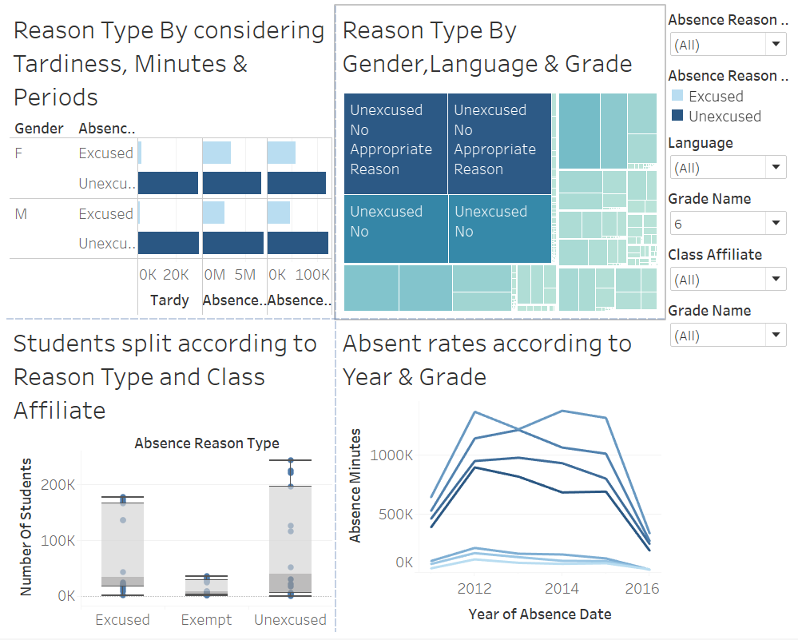
TABLEAU INSIGHTS - ABSENCES
Most used reason and the type according to language, gender and grade.
Absent minutes over the years according to grade.
Number of students in each reason type according to affiliate.

Slide 4
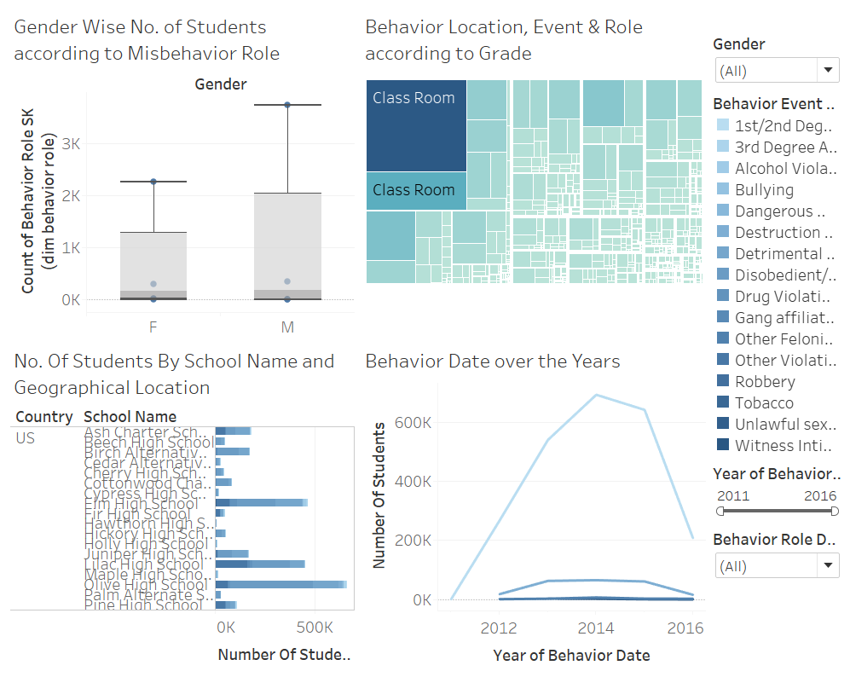
TABLEAU INSIGHTS - BEHAVIOR

Slide 5
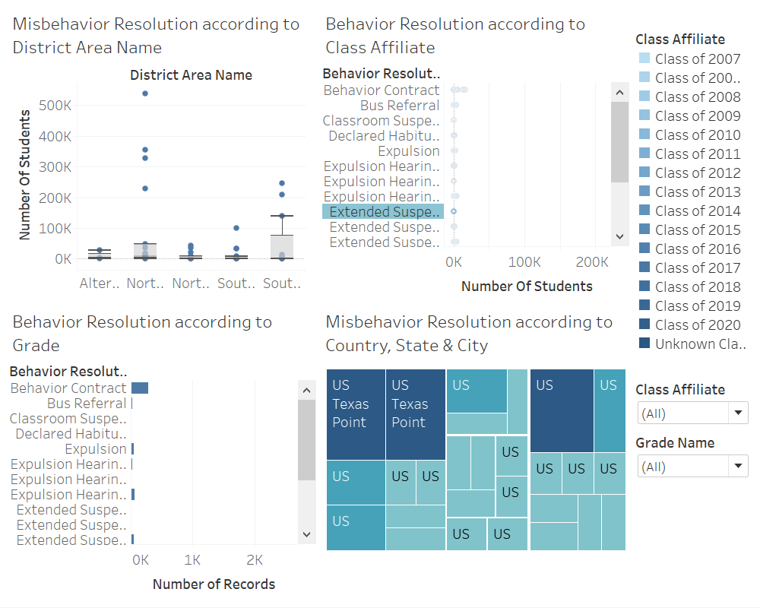
TABLEAU INSIGHTS – BEHAVIOR RESOLUTION

Slide 6
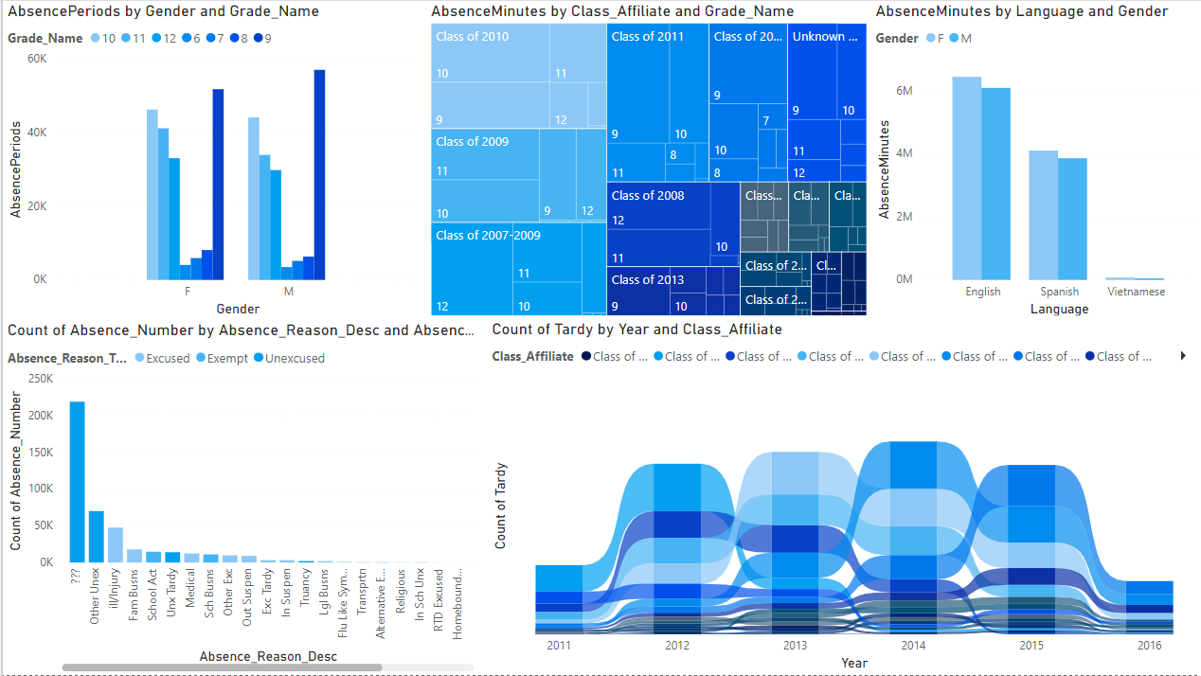
POWER BI INISGHTS - ABSENCE

Slide 7
POWER BI INISGHTS - ABSENCE
Least Absence Periods – Grade 6
Most spoken language - English
Most Tardy Class – 2014
Absence Unexcused for Unknown (???) reasons
Absence Unexempted if students are out because of School associated reasons

Slide 8
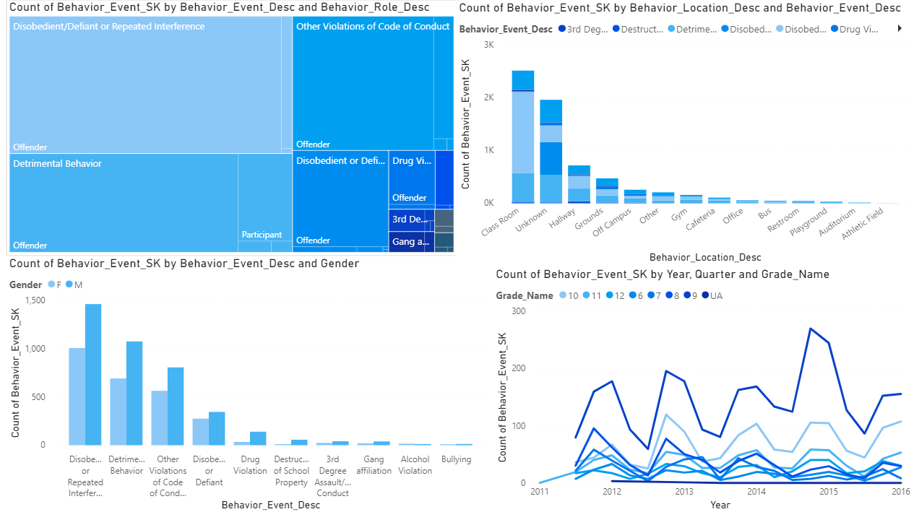
POWER BI INISGHTS - BEHAVIOR
Majority roles in any behavior event – Offender
Most misbehavior cases on-campus occur in Classroom
Majority of misbehavior cases recorded for Males
Only case where Females have a majority is Alcohol Violation
Misbehavior cases spiked during 2014 with maximum cases happening towards the end of the year

Slide 9
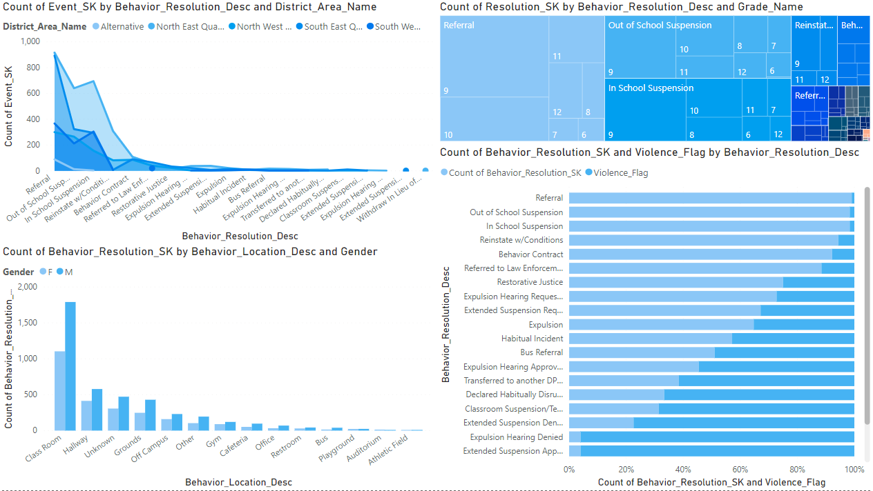
POWER BI INISGHTS – BEHAVIOR RESOLUTION
Most behavior resolution were in Alternative school district.
Greatest occurring behavior resolution – Referral
Most Referrals occurred for Grade 9 students
Most cases of behavior resolutions occur for location – Class, majorly for Males
Severity of resolution highly proportional to violence flag

