Slide 1
Fruit classification Algorithm
22BEC1489 – Kaushal Karthik K M
22BEC1250 – Phani Samhitha K
22BEC1317 – Aman Singhal
BECE301L – DIGITAL SIGNAL PROCESSING SLOT: B1+TB1

Slide 2
Table of contents
Slide 3: Keywords and definitions
Slide 4: Approach
Slide 5: Flow of data/pseudocode
Slide 6: Color histogram
Slide 9: Relevance of Bins
Slide 10: Results
Slide 15: Advantages
Slide 16: Disadvantages
Slide 17: Ways to improve
Slide 18: Reference images
Slide 19: References

Slide 3
Keywords and definitions
Sample/sample image : Images to be classified by the algorithm
reference image: Images to be used as reference in order to classify
HSV: Hue-Saturation-Value color space.
Bins: number of channels (steps between 0 and 255) to be used in Histogram.
Histogram/color histogram: A color histogram is a count of how much of each color occurs in the image.
Normalized histogram: A normalized histogram is a histogram where the net sums is one.
Vector: A vector in MATLAB is a matrix with only one row or only one column.
Distance/Euclidian distance/Euclidian norm: The shortest line distance in Nth dimension between 2 points.

Slide 4
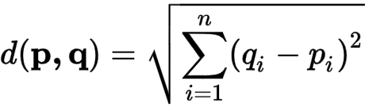
Approach
The algorithm works through normalized histogram color matching, any image to be processed will be converted into a color histogram in the HSV color space and the result there of will be normalized by dividing each value with the net sum to obtain the relative occurrence of every color in the image.
The histogram is represented as a n-point vector in MATLAB, where n is the number of Bins in the histogram. Following normalization we are left with 3n-point vector[slide 8].
Using the generalized Euclidian distance formula, also known as Euclidian norm we can compute the Distance . This is done with the formula
Now we minimize the distance across the 4 categories and the classification is done by examining the result.

Slide 5
Flow of data And pseudo-code
START
Read sample image
Convert to HSV and compute Histogram for H, S and V.
Import the image -> convert to HSV color space -> obtain the color histogram for Hue, Saturation and Value -> concatenate the 3 different histograms into one -> normalize the histogram.
Obtain the Euclidian distance between sample image and pre-defined reference image -> Find the lowest distance -> Display the results and plot the histograms and the image.
H,S,V histograms of reference images
Concatenate the histogram and normalize it
Normalized Histograms for reference images
Calculate the distance (Euclidian norm)
Find the lowest
END
Output the result and plot the graphs

Slide 6
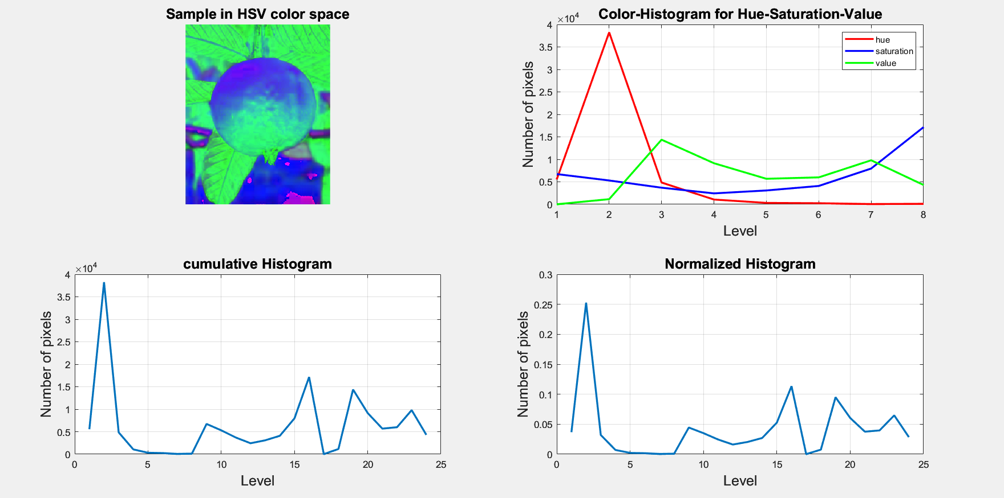
Color-Histogram [histcount()]
For every processed image the following will be computed

Slide 7
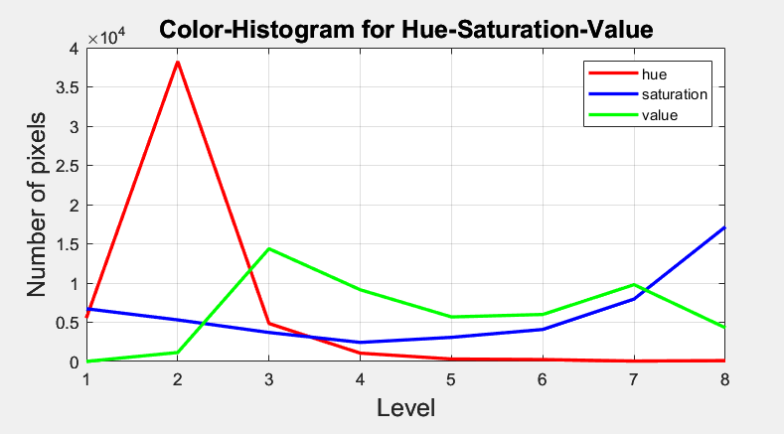
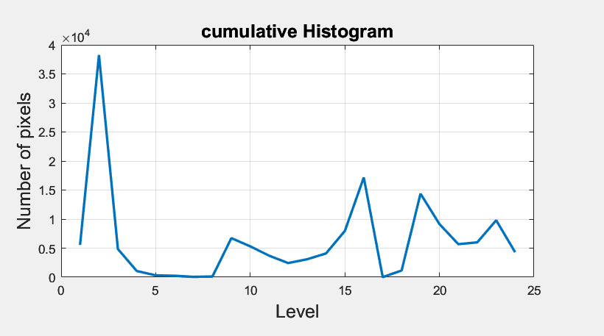
Color histogram is computed for Hue, Saturation and Value separately. To achieve this first the corresponding variable (H,S,V) has to be chosen, this is done with the following command
hsv_sample_image(:,:,1) ;
This value will be passed as argument into histcount() function of MATLAB [this returns a 8 point vector]
hist_H = histcounts(hsv_sample_image(:,:,1), num_bins);
After repeating the similar procedure for saturation and value we obtain graph 1.
Now we will obtain a cumulative histogram by concatenating the 3 individual histograms into a single vector (graph 2) [by doing concatenation we obtain a 24 point vector]
hist_sample_image = [hist_H(:); hist_S(:); hist_V(:)];

Slide 8
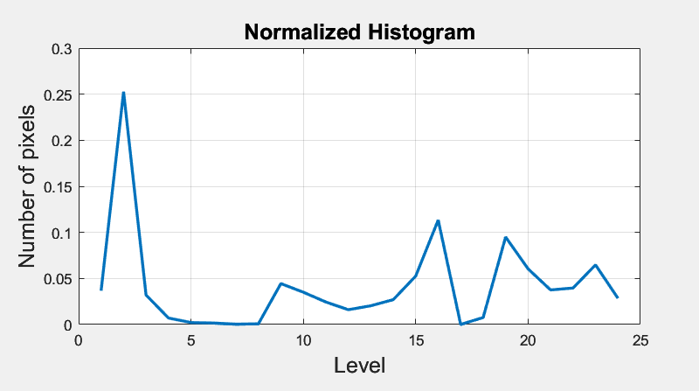
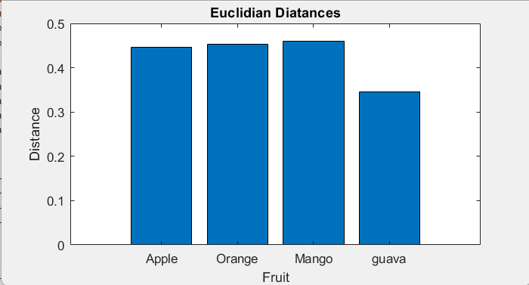
Normalization is done to ensure the sum of all the histogram bins is equal to 1. This is done by dividing every point of the histogram with the total sum (graph 3)
hist_sample_image_norm = hist_sample_image /sum(hist_sample_image);
Euclidian Distance is measured by using the following command [This will compute the Euclidian distance between the given 2 point in 24 dimensions since both are 24 point vectors]
euclidean_distance_apple = norm(hist_sample_image - hist_apple_image);
After calculations we find the minimum value
distances = [euclidean_distance_apple, euclidean_distance_orange, euclidean_distance_mango, euclidean_distance_guava];
[~, classification] = min(distances);

Slide 9
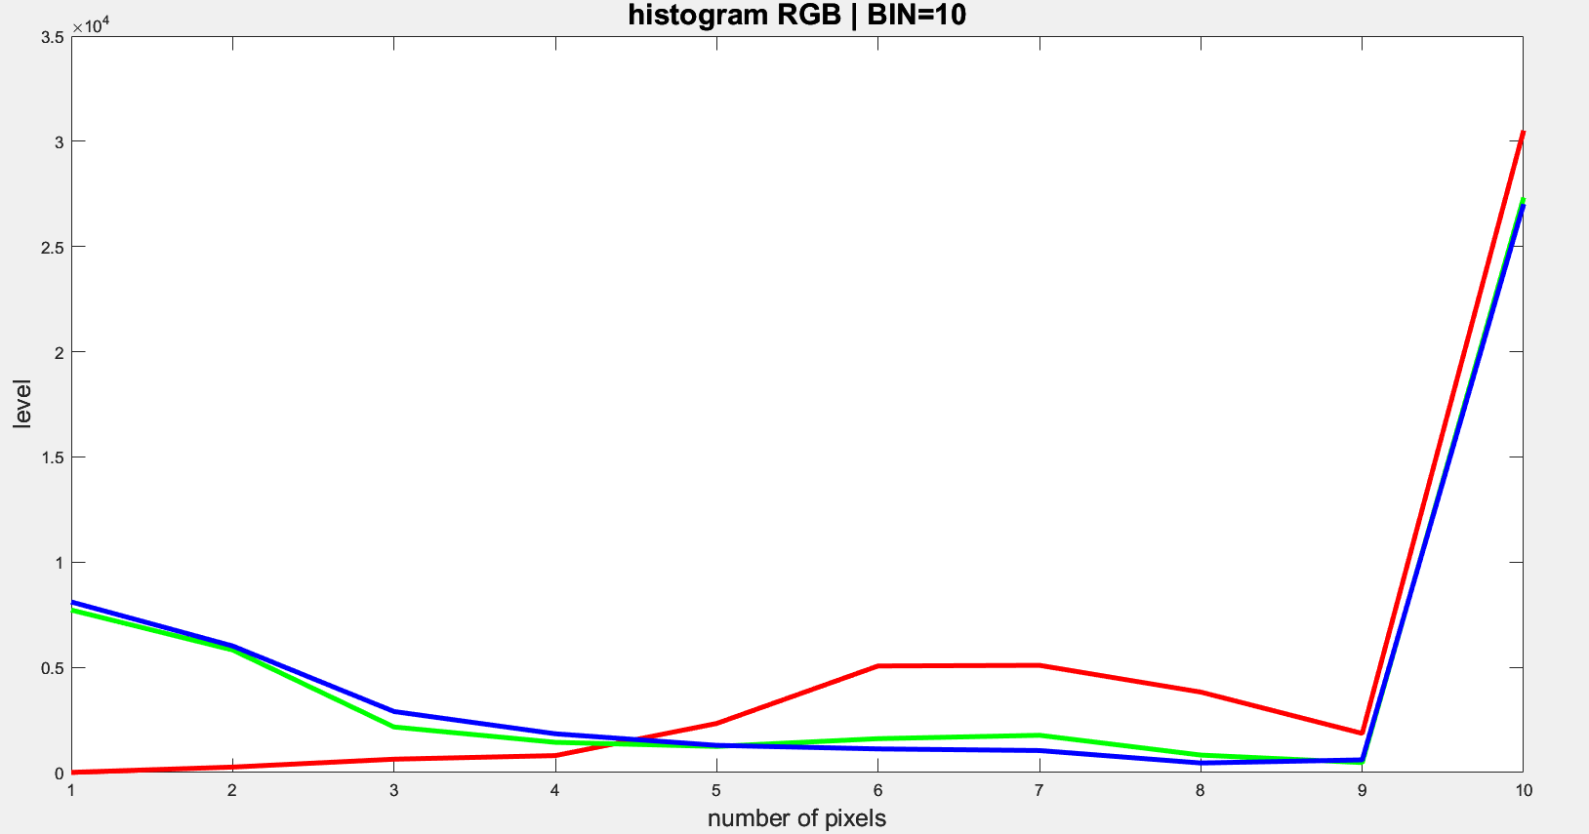
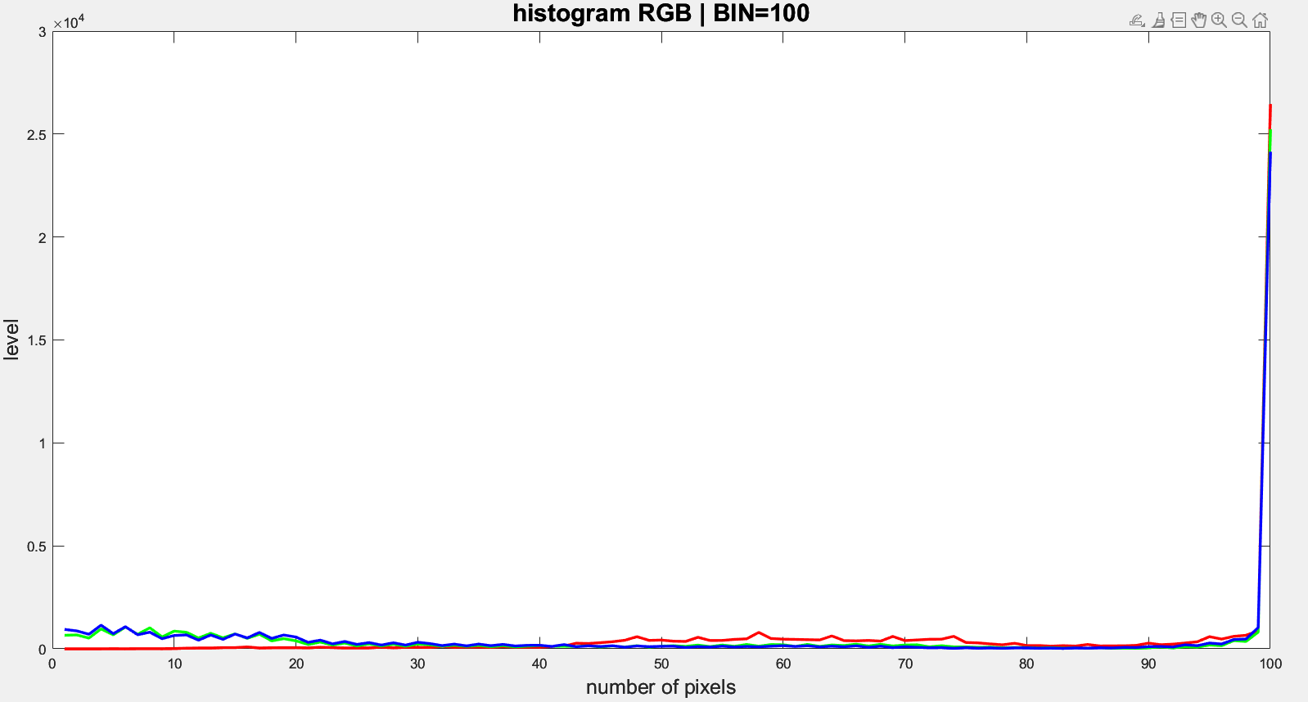
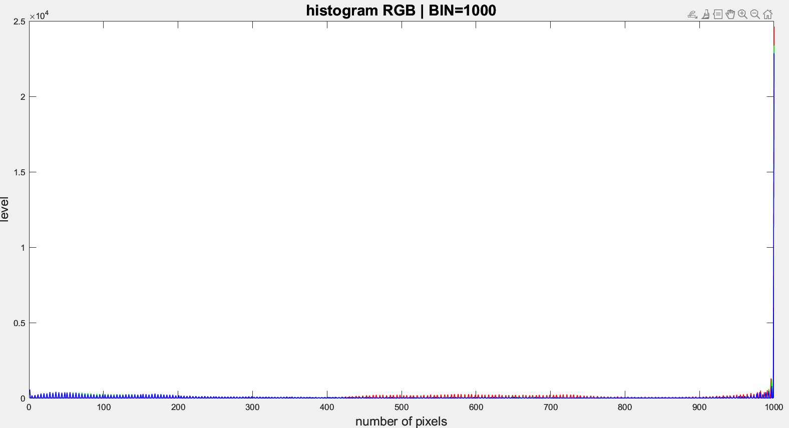
Relevance of Bins in Histogram
A histogram is a mathematical representation of how much of a colour is in an Image. The number of “Bins” is the number of steps in the histograms, that is greater the bins more expansive the right x-axis ( LEVEL ) is.
Increasing the number of bins will result in a finer quantization of color information, providing more detailed histograms.
Decreasing the number of bins with give a sparser quantization and hence we will have loss of information, and this is unreliable.
More detailed histograms will result in higher dimensional Euclidian norm computation, in general we can say (3*bin) dimensions, hence increasing the value of bins will quickly increase the computation complexity.
The figure represents histogram in RGB for same image for bin values 10, 100 , 1000.

Slide 10
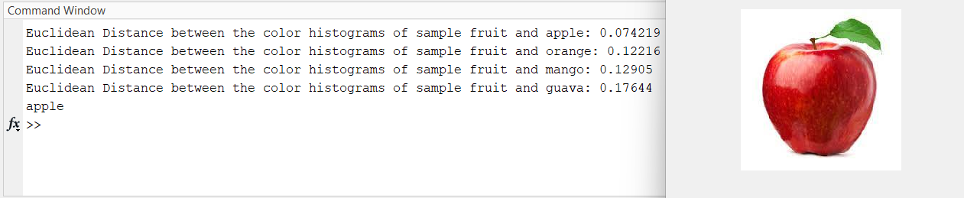
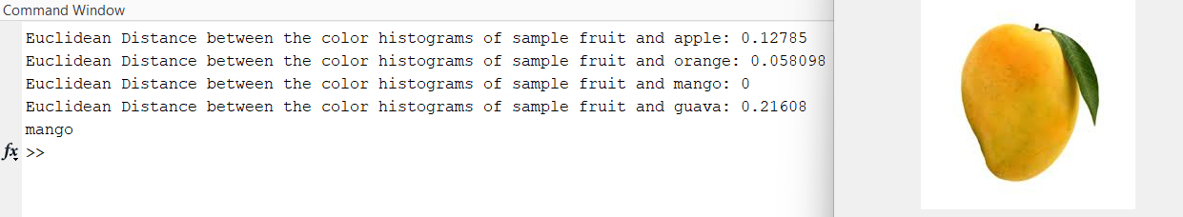
results
The following test runs were conducted with 8 bins per histogram and with only 1 reference image per fruit [ refer slide 12].
First sample:
Second sample:

Slide 11
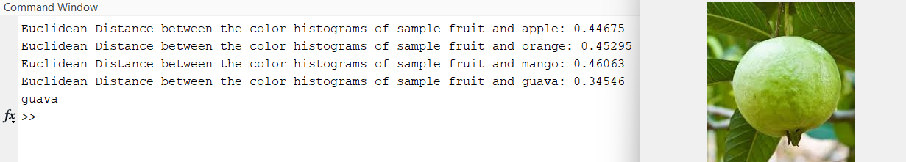
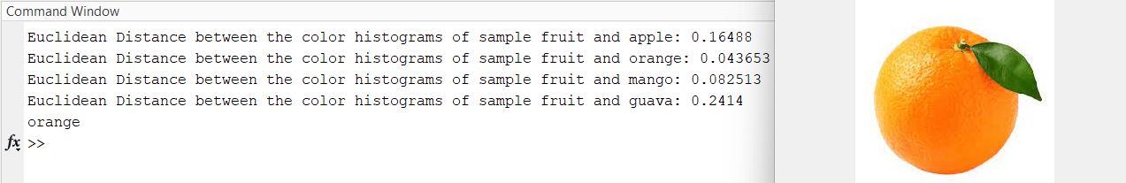
results
Third Sample:
Fourth sample:

Slide 12
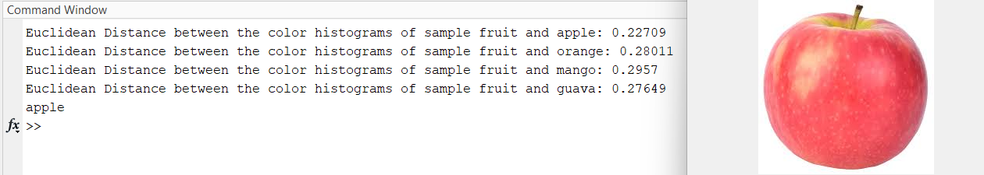
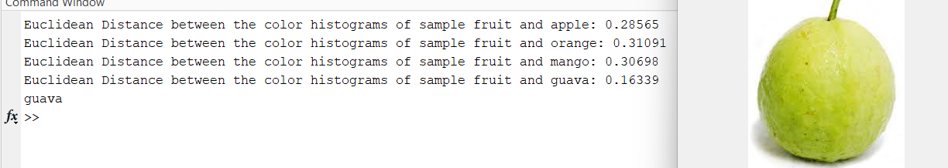
results
Fifth Sample:
Sixth sample:

Slide 13
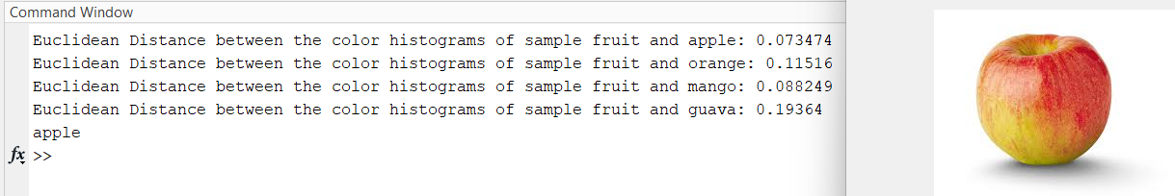
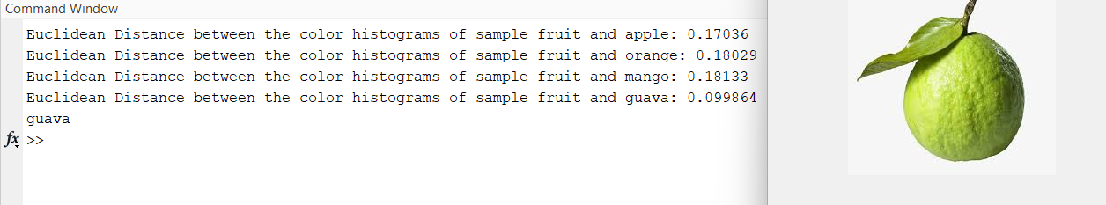
results
Seventh Sample:
Eighth sample:

Slide 14
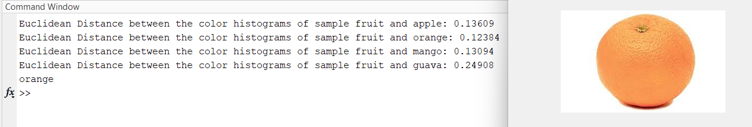
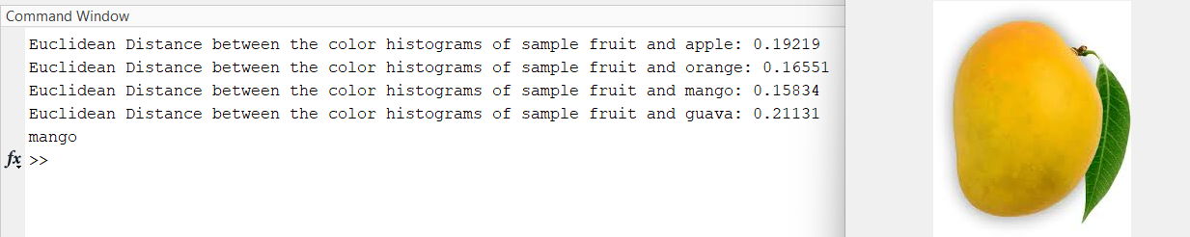
results
Ninth Sample:
Tenth sample:

Slide 15
Advantages
The primary advantage of using color histogram over edge (Shape matching) and Template matching is as follows:
Edge detecting cant effectively sort fruits with similar or close to similar shape, also minor defects on the skin of the fruit, background of the images, brightness and resolution will contribute to inaccurate outputs.
Template matching is a precise procedure where a set template can be matched in another images, as such different images of same fruits will still not be matched due to the precision.
Additionally the computational complexity of such an approach is easier compared to the other 2 method discussed, as part of the computation is pre-defined as the histograms of the references have been computed ahead of time.

Slide 16
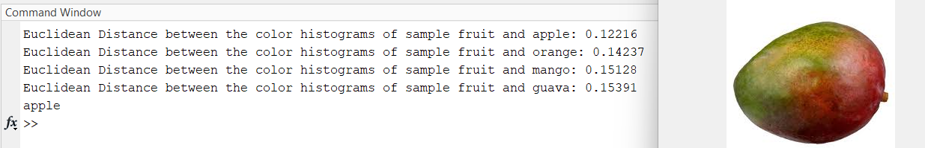
Disadvantages
The main drawback of using color histograms is that multi coloured fruits/unripe fruits will cloud the judgement of the algorithm and this will lead to incorrect results. However this issue can be resolved by expanding the number of reference images [ refer slide 15 ]
Incorrect classification:
As the color of the image is varying it results in incorrect classification, however the distance is varying by 0.01 order of magnitude hence increasing the bin will sort this correctly.

Slide 17
Ways to improve accuracy
Increase the number of bins on histogram: Increasing the number of bins will result in a finer quantization of color information, providing more detailed histograms. However this will increase the computational complexity. The value of 8 was chosen by experimenting with various values to find the optimal value to obtain a balance between accuracy and efficiency
Increase reference images: The runs were done with ONE reference image of each fruit [ refer slide 16 ]. Adding more reference images will increase the accuracy of the algorithm but more time will be taken in order to compute as there are more distance to be measured.

Slide 18
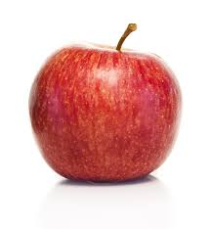
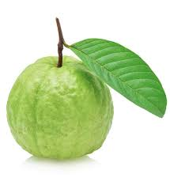
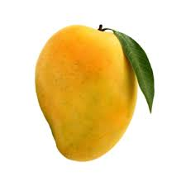
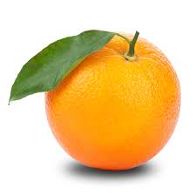
Reference images: apple guava mango orange

Slide 19
References:
https://in.mathworks.com/help/matlab/ref/histcounts.html#buijikm-1-nbins → Histogram documentation
https://www.wikipedia.org/ → Research base for various concepts.
https://www.youtube.com/watch?v=P5FTEryiTl4 → detailed breakdown of template matching.
https://www.youtube.com/watch?v=Fe_z9loJqBU → conceptual breakdown of color spaces, color histogram and equalization.
https://www.youtube.com/watch?v=-9gBpGh6t3o → conceptual breakdown of color spaces, color histogram and equalization.
https://www.youtube.com/watch?v=2kDuYv3ocxU → conceptual breakdown of HSV color space and working with HSV.
https://www.youtube.com/watch?v=_fS43iwDJmk → Color histogram.
https://images.google.com/ → source of sample images and reference images.
https://chat.openai.com → ChatGPT for code optimization and debugging.
https://www.owlnet.rice.edu/~ceng303/manuals/fortran/FOR3_3.html → Pseudocode Flow chart guide.

Slide 20
THANK YOU

