Slide 1








Intro to Open Source – CSCI 2963-01
Group Members:
Adeet Phanse
Alvin Leung
Jacob Arriola
Matt Bu

Slide 2
About Pokémon Snowdown
Pokémon Snowdown is a Pokémon battle simulator where you can fight your opponents, team up and play strategy to take down OP computer bots, and even edit your Pokémon with a fully-functional editor for hours of endless fun!
The game features a single player mode, a two player mode and a no player mode where you can watch the computer battle itself.

Slide 3
Proposal
Our project will be adding to an existing project called Pokémon Snowdown located at https://github.com/maZang/PokeSnowdown
Pokémon Snowdown is a working Pokémon battle simulator however due to time constraints the creators were not able to implement all of content from the actual Pokémon games.
We wish to append some of the information they did not include, such as adding missing moves/items.

Slide 4
Objectives/Learning Outcomes
Add the missing moves/items to the game so that it is more complete
Add new NPCs(trainers) to tournament mode
Learn about OCaml(a new language) in order to work on this project
Learn about working in a group environment and meeting deadlines
Learn how to give and receive code reviews
Get our fork accepted by the main repository so that we contribute back to the source

Slide 5
Division of Work/Community Formation/Sustainability
We will separately work on each category we are adding, ie moves/items/NPC’s
We expect to be able to work with the project’s creators if any problems arise
At the end we will send a pull request to the master branch
This project will be sustainable as we are filling in the missing information and there is always more features to add
They are trying to port this game to windows so our changes will be transferred to that new version

Slide 6
Schedule
Weeks 1 – 3 : Learn Ocaml and get familiar with the environment
Weeks 4-6: Start adding the project and working on the goals we set out to achieve. Add items/npcs/moves to the game
Week 7: Review our code and get ready to submit back to the main repository

Slide 7
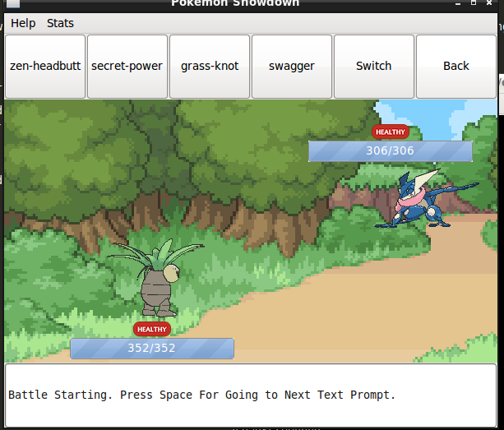

Slide 8
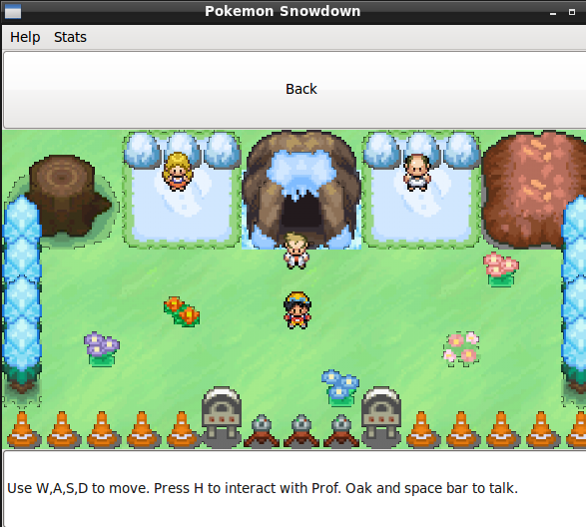

Slide 9
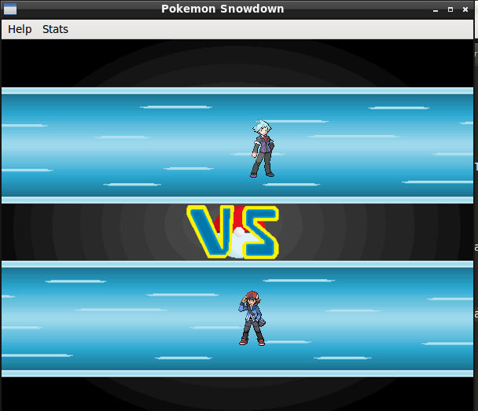

Slide 10
