Slide 1








Intro to Open Source – CSCI 2963-01
Group Members:
Adeet Phanse
Alvin Leung
Jacob Arriola
Matt Bu

Slide 2
Proposal
Our project will be adding to an existing project called Pokémon Snowdown located at https://github.com/maZang/PokeSnowdown
Pokémon Snowdown is a working Pokémon battle simulator however due to time constraints the creators were not able to implement all of content from the actual Pokémon games.
We wish to append some of the information they did not include, such as adding missing moves/items.

Slide 3
Objectives/Learning Outcomes
Add the missing moves/items to the game so that it is more complete
Add new NPCs(trainers) to tournament mode
Learn about OCaml(a new language) in order to work on this project
Learn about working in a group environment and meeting deadlines
Learn how to give and receive code reviews
Get our fork accepted by the main repository so that we contribute back to the source

Slide 4
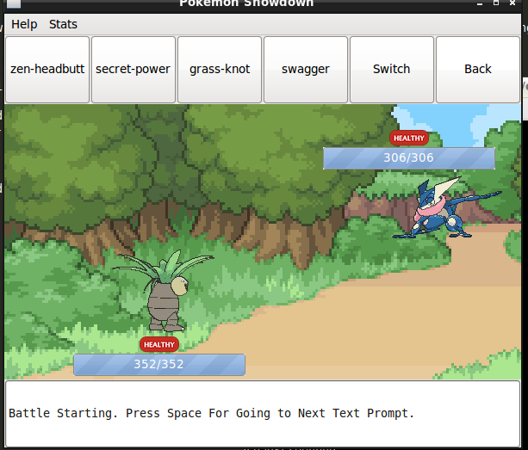

Slide 5
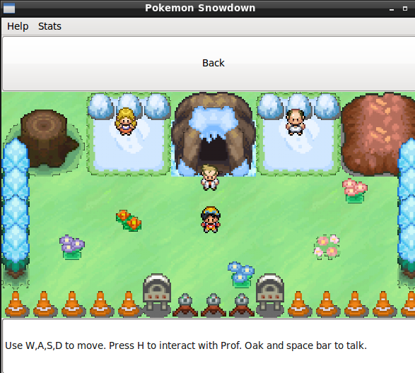

Slide 6
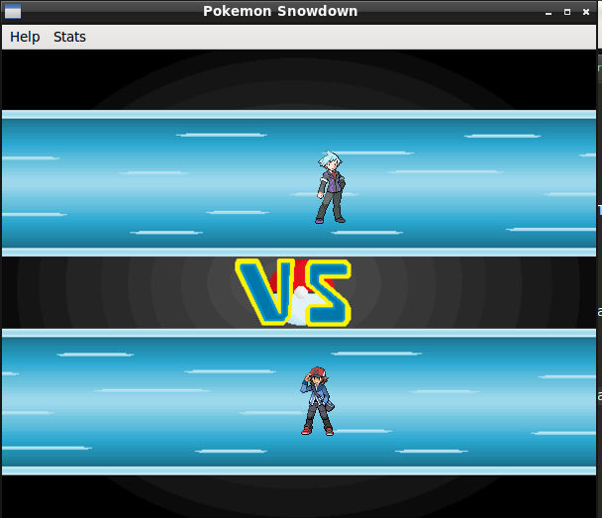

Slide 7
