Slide 1
Project ONE – TEAM Bttv
Belinda – Tawny – trevor – Valerie
Thursday July 28th
Uci bootcamp

Slide 2
Objectives
Introduction - Val
Interesting Questions / Data Used- Val
Data Exploration - Belinda
Cleanup Process - Belinda
Analysis Process - Individual
Conclusions / Summary of Visualizations - Trevor
Implications: What do the findings mean? - Tawny

Slide 3
Introduction - interest and motivation
Challenged to research cancer topics including common lifestyle choices:
Smoking
Alcohol
Obesity
Income/Insurance
Gender
Religion
RESEARCH QUESTION:
What factors or lifestyles attribute to cancer rates throughout the country?

Slide 4
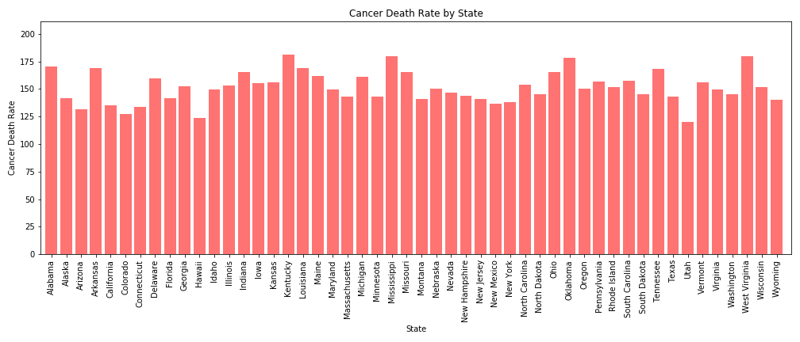
Initial topics of interest 2017 DATA Kentucky (Highest) and Utah (Lowest)

Slide 5



DATA USED and defined
Mostly pulled from Centers Disease Control - 2017
Census Data - 5 year rolling 2013-2017
Death count was adjusted for differences in age distributions
Alcohol binge drinking data - 2015

Slide 6

Data exploration and cleanup process
Finding data by state
Correlating data by year
Merging with state abbreviations
Dropping unwanted columns
Cleaning data wrapped in (“ “)

Slide 7
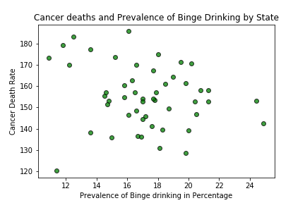
Cancer – alcohol/binge drinking (Belinda)
Wine Consumption
r value: -0.32
r value: -0.2

Slide 8

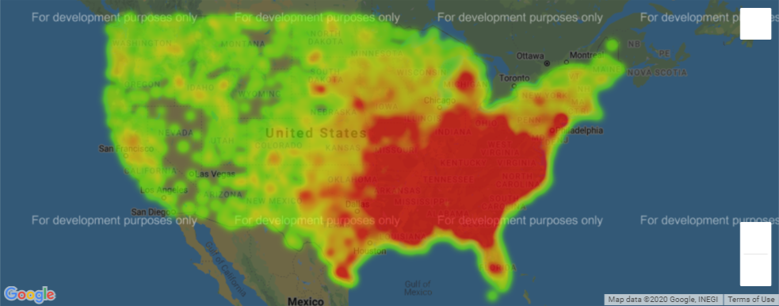
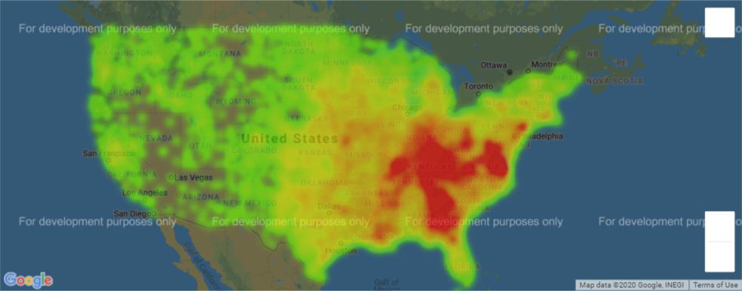
Cancer – census data (tawny)
Deaths from Cancer 2017
Red = High Number of Deaths
Poverty Averages 2014-2017
Census Data (census.gov)
No Insurance -0.07 | xxx
Living Alone 0.07 | -0.20
Population Size 0.14 | 0.21
Health Resources and Services Administration (hrsa.gov/)
Underserviced correlation xxx | -0.07
Red = High Number of Poverty

Slide 9
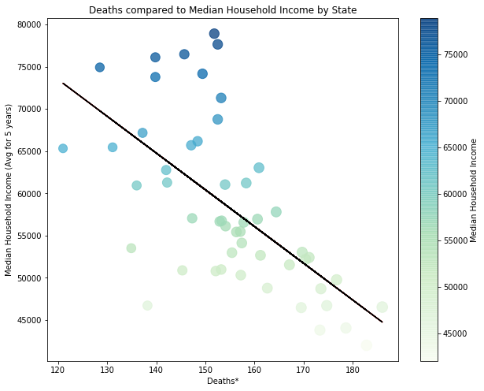
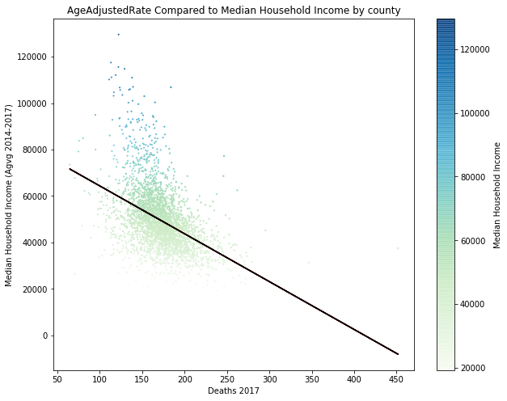
Cancer – census data (tawny)
The Strongest correlation between deaths* and census data was median household income
The correlation between age rate and median household income age is -0.63
The correlation between age rate and median household income age is -0.45
*Death count was adjusted for differences in age distributions

Slide 10
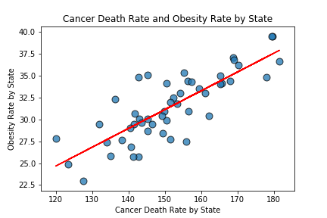
Cancer – obesity (Valerie)
r value: 0.8075564184676005

Slide 11
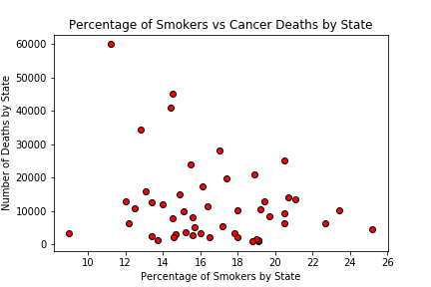
Cancer – smoking (trevor)

Slide 12
Conclusions / Summary
Lower prevalence of alcohol and smoking correlations to cancer than expected
Health insurance has no direct impact (Obamacare)
Higher correlation of obesity in cancer death rate across the nation

Slide 13
What does it all mean?
One of two ways:
Further research into why obesity is prevalent
Further research into how smoking and alcohol are not as prevalent
Look into data before and after state law changes
Requests for further funding to continue research

Slide 14
QUESTIONS OR COMMENTS
Thank you for your feedback!

