Slide 1
Project ONE – TEAM Bttv
Belinda – Tawny – trevor – Valerie
Thursday July 28th
Uci bootcamp

Slide 2
Objectives
Introduction - Val
Interesting Questions / Data Used- Val
Data Exploration - Belinda
Cleanup Process - Belinda
Analysis Process - Individual
Conclusions / Summary of Visualizations - Trevor
Implications: What do the findings mean? - Tawny

Slide 3
Introduction - interest and motivation
Initial interest - highest and lowest cancer rates by state.
Expanded from there:
Smoking
Alcohol
Obesity
Income/Insurance
Gender
Religion
PROJECT QUESTION:
What factors or lifestyles attribute to cancer rates throughout the country?

Slide 4
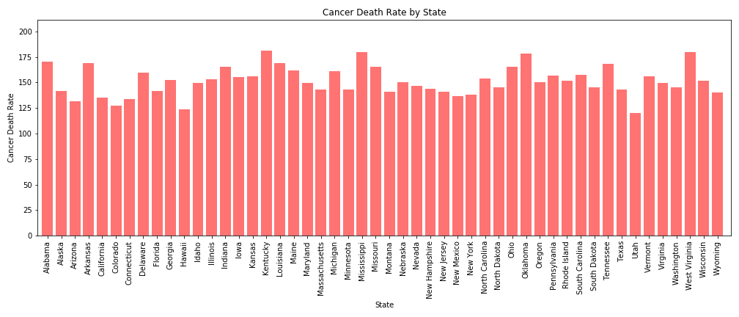
Initial topics of interest Kentucky (Highest) Utah (Lowest

Slide 5
DATA USED and defined
Mostly CDC
Census Data
Age Adjusted Rate
Poverty Line

Slide 6
Data exploration and cleanup process
Finding data by state
Correlating data by year
Merging with state abbreviations
Dropping unwanted columns
Cleaning data wrapped in (“ “)

Slide 7
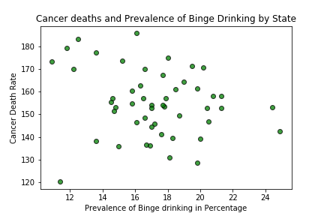
Cancer – alcohol/binge drinking (Belinda)
Wine Consumption
r value: -0.32
r value: -0.2

Slide 8
Cancer – census data (tawny)
Describe correlations
PNG File

Slide 9
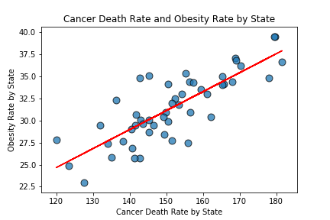
Cancer – obesity (Valerie)
r value: 0.8075564184676005

Slide 10
Cancer – smoking (trevor)
Describe correlations
PNG File

Slide 11
Conclusions / Summary
Overall conclusions-

Slide 12
What does it all mean?

Slide 13
QUESTIONS OR COMMENTS
Thank you for your feedback!

