Slide 1
Project ONE – TEAM Bttv
Belinda – Tawny – trevor – Valerie
Thursday July 28th
Uci bootcamp

Slide 2
Objectives
Introduction - Val
Interesting Questions / Data Used- Val
Data Exploration - Belinda
Cleanup Process - Belinda
Analysis Process - Individual
Conclusions / Summary of Visualizations - Trevor
Implications: What do the findings mean? - Tawny

Slide 3
Introduction - interest and motivation
Initial interest - highest and lowest cancer rates by state.
Expanded from there:
Smoking
Alcohol
Obesity
Income/Insurance
Gender
Religion
PROJECT QUESTION:
What factors or lifestyles attribute to cancer rates throughout the country?

Slide 4
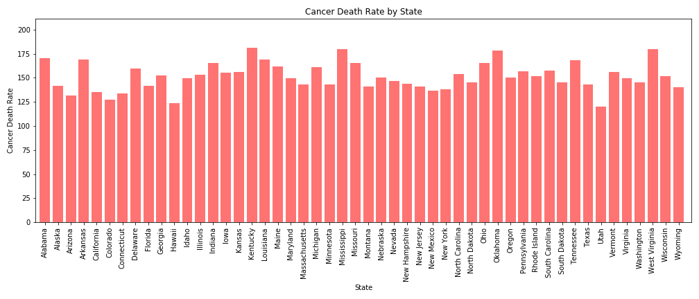
Initial topics of interest Kentucky (Highest) Utah (Lowest

Slide 5
DATA USED and defined
Mostly CDC
Census Data
Age Adjusted Rate
Poverty Line

Slide 6
Data exploration and cleanup process
Finding data by state
Correlating data by year
Merging with state abbreviations
Dropping unwanted columns
Cleaning data wrapped in (“ “)

Slide 7
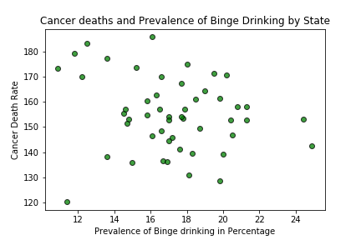
Cancer – alcohol/binge drinking (Belinda)
Wine Consumption
r value: -0.32
r value: -0.2

Slide 8


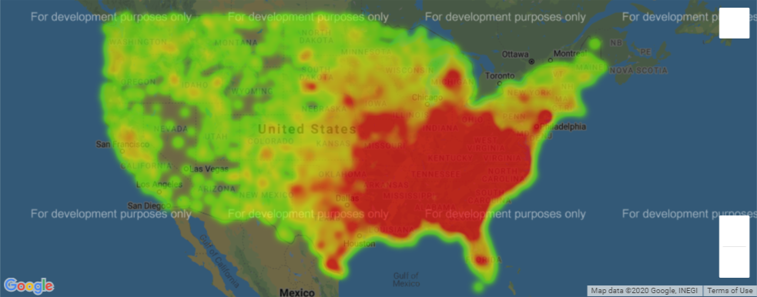
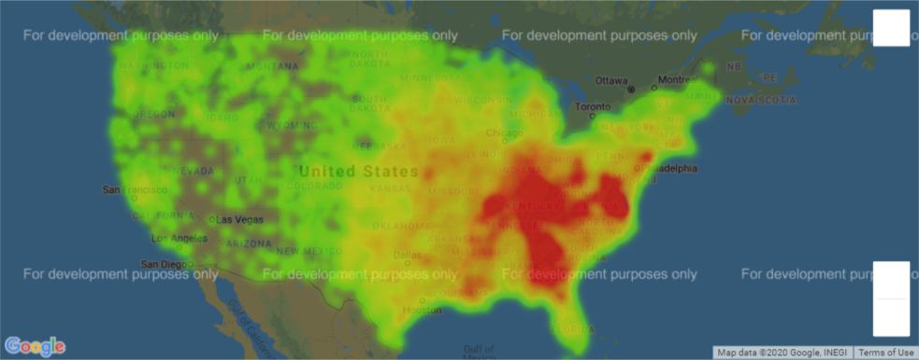
Cancer – census data (tawny)
Deaths from Cancer 2017
Red = High Number of Deaths
Poverty Averages 2014-2017
Census Data (census.gov)
No Insurance -0.07 | xxx
Living Alone 0.07 | -0.20
Population Size 0.14 | 0.21
Health Resources and Services Administration (hrsa.gov/)
Underserviced correlation xxx | -0.07
Red = High Number of Poverty

Slide 9
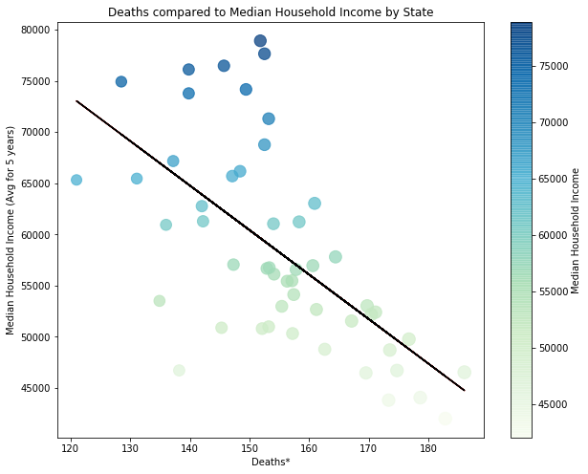
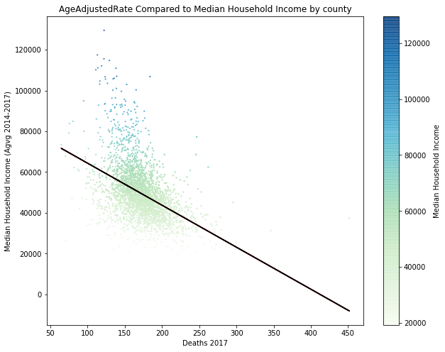
Cancer – census data (tawny)
The Strongest correlation between deaths* and census data was median household income
The correlation between age rate and median household income age is -0.63
The correlation between age rate and median household income age is -0.45
*Death count was adjusted for differences in age distributions

Slide 10
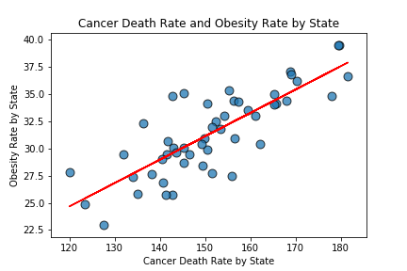
Cancer – obesity (Valerie)
r value: 0.8075564184676005

Slide 11
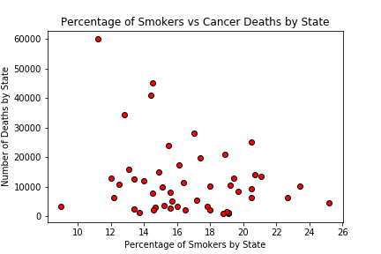
Cancer – smoking (trevor)
No correlation

Slide 12
Conclusions / Summary
Overall conclusions-

Slide 13
What does it all mean?

Slide 14
QUESTIONS OR COMMENTS
Thank you for your feedback!

