Slide 1
Project ONE – TEAM Bttv
Belinda – Tawny – trevor – Valerie
Thursday July 30th
Uci bootcamp

Slide 2
Introduction - interest and motivation
Challenged to research cancer topics including common lifestyle choices:
Smoking
Alcohol
Obesity
Income/Insurance
Gender
Religion
RESEARCH QUESTION:
What factors or lifestyles attribute to cancer rates throughout the country?

Slide 3
Objectives
Interesting Questions / Data Used- Val
Data Exploration - Belinda
Cleanup Process - Belinda
Analysis Process - Individual
Conclusions / Summary of Visualizations - Trevor
Implications: What do the findings mean? - Tawny

Slide 4
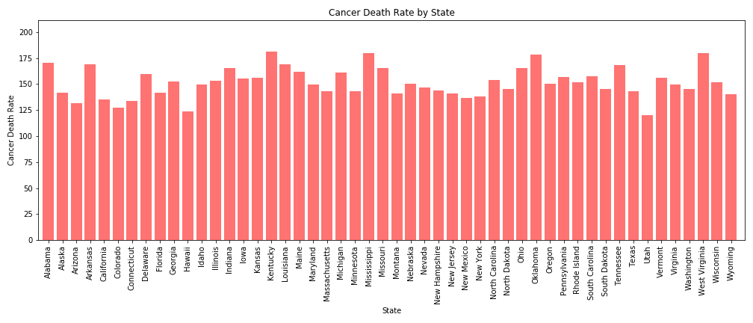
Initial topics of interest 2017 DATA Kentucky (Highest) and Utah (Lowest)

Slide 5



DATA USED and defined
Mostly pulled from Centers Disease Control - 2017
Census Data - 5 year rolling 2013-2017
Death count was adjusted for differences in age distributions and population size
Alcohol binge drinking data - 2015

Slide 6

Data exploration and cleanup process
Finding data by state
Correlating data by year
Merging with state abbreviations
Dropping unwanted columns
Cleaning data wrapped in (“ “)

Slide 7
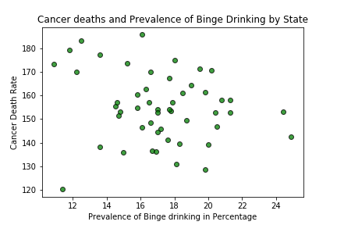
Cancer – alcohol/binge drinking (Belinda)
Wine Consumption
r value: -0.32
r value: -0.2

Slide 8

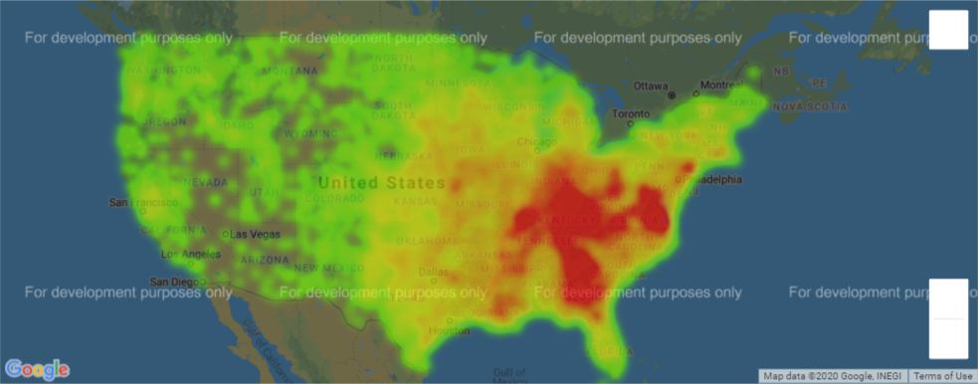
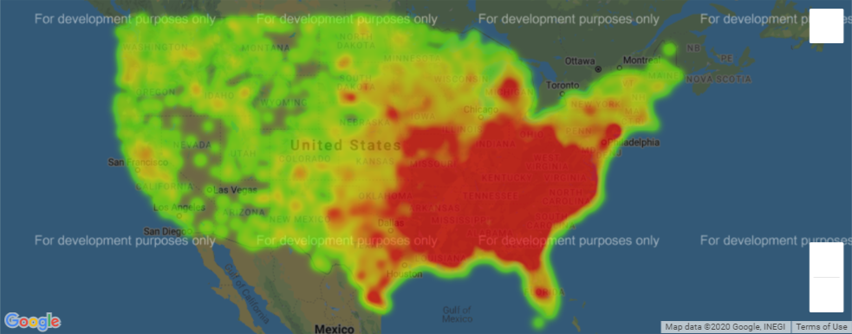
Cancer – census data (tawny)
Death Rates from Cancer 2017
Red = High Number of Deaths (per population)
Pearson correlation County State
Never Married 0.20 0.13
No Insurance -0.05 0.24
Median Age 0.01 0.34
Living Alone 0.07 0.37
Unemployed Below Line 0.34 0.41
Poverty 0.40 0.51
Median Household Income -0.45 -0.63
Medical Underservice Score -0.07 -0.34
Poverty Averages 2013-2017
Red = High Number of Poverty (per population)

Slide 9
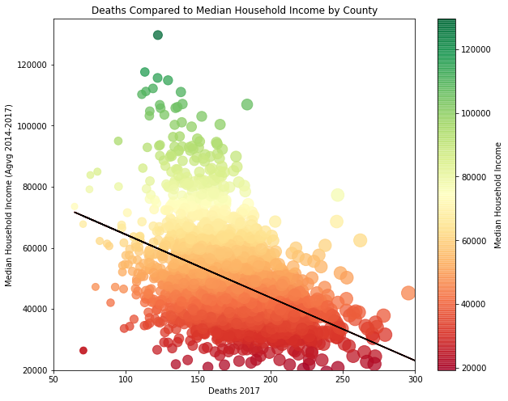
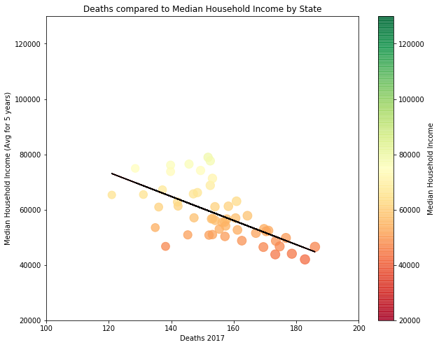
Cancer – census data (tawny)
The correlation between death rate and median household income is -0.45
The correlation between death rate and median household income is -0.63
The Strongest correlation between deaths* and census data was median household income

Slide 10
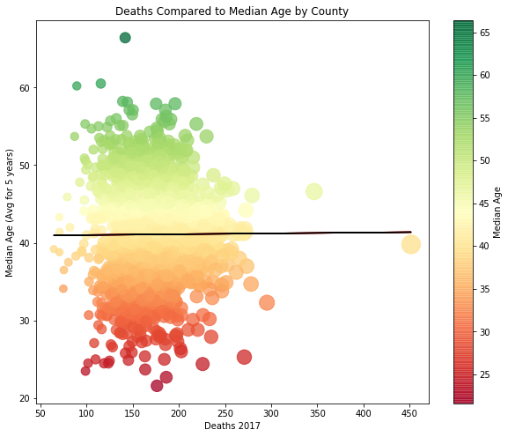
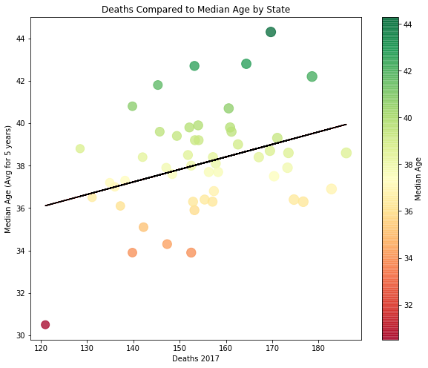
Cancer – census data (tawny)
The correlation between death rate and median age is 0.01
The correlation between death rate and median age is 0.34
By County - The WEAKEST correlation between deaths* and census data was median AGE

Slide 11
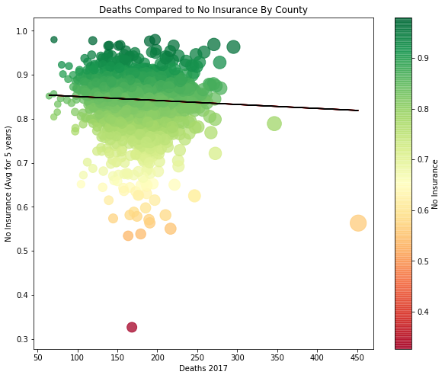
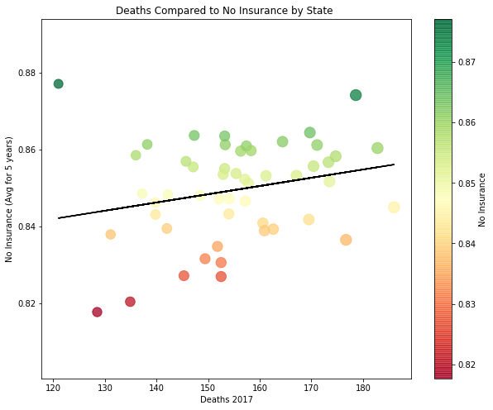
Cancer – census data (tawny)
The correlation between death rate and no insurance is -0.05
The correlation between death rate and no insurance is 0.24
By County - The WEAKEST correlation between deaths* and census data was median AGE

Slide 12
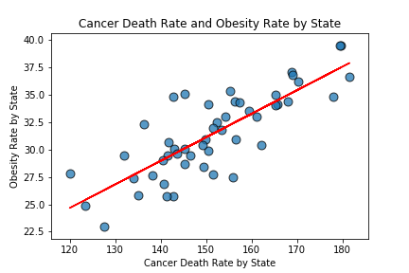
Cancer – obesity (Valerie)
r value: 0.8075564184676005

Slide 13
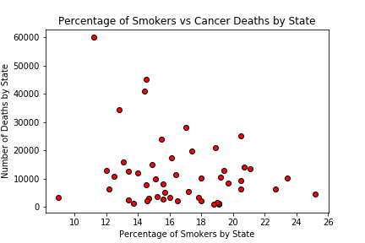
Cancer – smoking (trevor)

Slide 14
Conclusions / Summary
Lower prevalence of alcohol and smoking correlations to cancer than expected
Health insurance has no direct impact (Obamacare)
Higher correlation of obesity in cancer death rate across the nation

Slide 15
What does it all mean?
Look further into why obesity is prevalent
Look into data before and after state law changes (trending)
Requests for further funding to explore difference in local populations

Slide 16
QUESTIONS OR COMMENTS
Thank you for your feedback!

