Slide 1
CMPS 339 PROJECT
Quintinium

Slide 2
TEAM MEMBERS & ROLES
Dustin Branch
Benjamin Henry
Tyler Oalman
Roles: We each took part in a little bit of everything in the project, from developing a schema, generating data, and writing queries.

Slide 3
DESCRIPTION OF BUSINESS
A dance studio that allows students to enroll into one to five courses.
There is also a retail side of the business where students can by dance shoes, costumes, and other accessories.

Slide 4
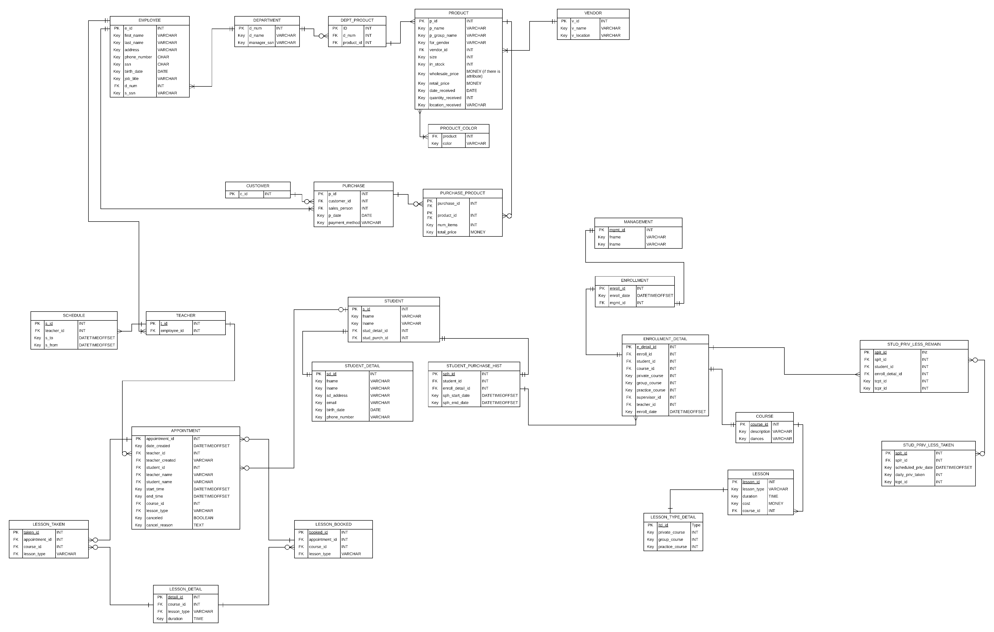

Slide 5
DDL: Query 1- CREATE TABLE
AIM: Create a size table for products
Query:
CREATE TABLE SIZE(
size_id INT NOT NULL IDENTITY(1,1) PRIMARY KEY,
size_num DECIMAL(11,2),
size_char VARCHAR(3) CHECK (size_char = 'XS' OR size_char = 'S' OR size_char = 'M' OR size_char = 'L' OR size_char = 'XL' OR size_char = 'XXL')
);

Slide 6
DDL: Query 2- ALTER TABLE
AIM: Add an attribute called ‘size_index’ to PRODUCT table after removing original ‘size’ attribute.
Query:
ALTER TABLE PRODUCT
ADD size_index INT;

Slide 7
DDL: Query 3- CHECK
AIM: Add a check constraint to the COURSE table for attribute ‘c_name’
Query:
ALTER TABLE COURSE
ADD CONSTRAINT c_name CHECK (c_name = 'Introduction' OR c_name = 'Social Foundation' OR c_name = 'Bronze' OR c_name = 'Silver' OR c_name = 'Gold');

Slide 8
DDL: Query 4- ADD Constraints
AIM: Add a constraint to the PRODUCT table for reference to the SIZE table.
Query:
ALTER TABLE PRODUCT
ADD CONSTRAINT FK_PRODUCT_SIZE
FOREIGN KEY (size_index) REFERENCES SIZE(size_id);

Slide 9
DDL: Query 5- CREATE TRIGGER
AIM: Create a trigger for the COURSE table so new courses are not added.
Query:
CREATE TRIGGER INSTEADOFTriggerCOURSE
ON COURSE
INSTEAD OF INSERT
AS
BEGIN
PRINT('Instead of trigger is Executed!')
END;

Slide 10
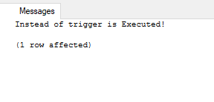
DML: Query 1- Trigger Test
AIM: To test the trigger related to the COURSE table for adding new rows.
Query:
INSERT INTO COURSE (c_name, c_description) VALUES ('Gold', 'testing');

Slide 11
DML: Query 2 – Insert Data
AIM: Insert a new employee to the EMPLOYEE table.
Query:
INSERT INTO EMPLOYEE (e_id, fname, lname, e_email, e_address, e_city, e_state, phone_number, ssn, birth_date, job_title, d_num, mgmt_id)
VALUES (57-1111054,'Newbie','Branch','newbieBranch@patch.com','2200 Morrison Blvd.’,'New Orleans','LA','985-750-8181','439-91-5617','1991-02-16','Telemarketor',5,4);

Slide 12
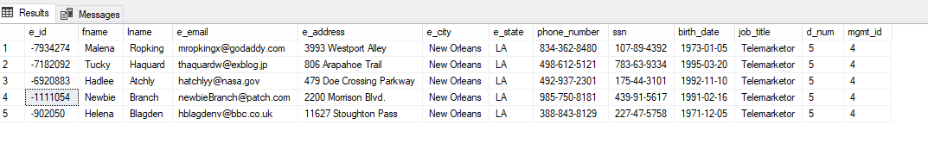
Query 2- Result

Slide 13
DML: Query 3- Update Data
AIM: Add 1 to each “d_num” column in the EMPLOYEE table. Reasoning because we found that in some cases after using the IDENTITY key word, some of the values did not come out as expected.
Therefore, we had to adjust accordingly.
Query:
UPDATE EMPLOYEE SET d_num = d_num + 1;

Slide 14
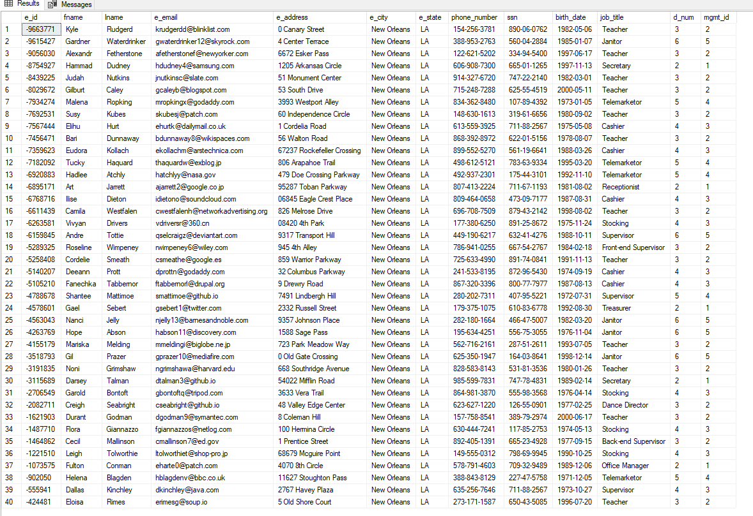
Query 3- Result

Slide 15
DML: Query 4 – Delete Data
AIM: Delete an employee from the EMPLOYEE table.
Query:
DELETE FROM EMPLOYEE WHERE e_id = -1487710;

Slide 16
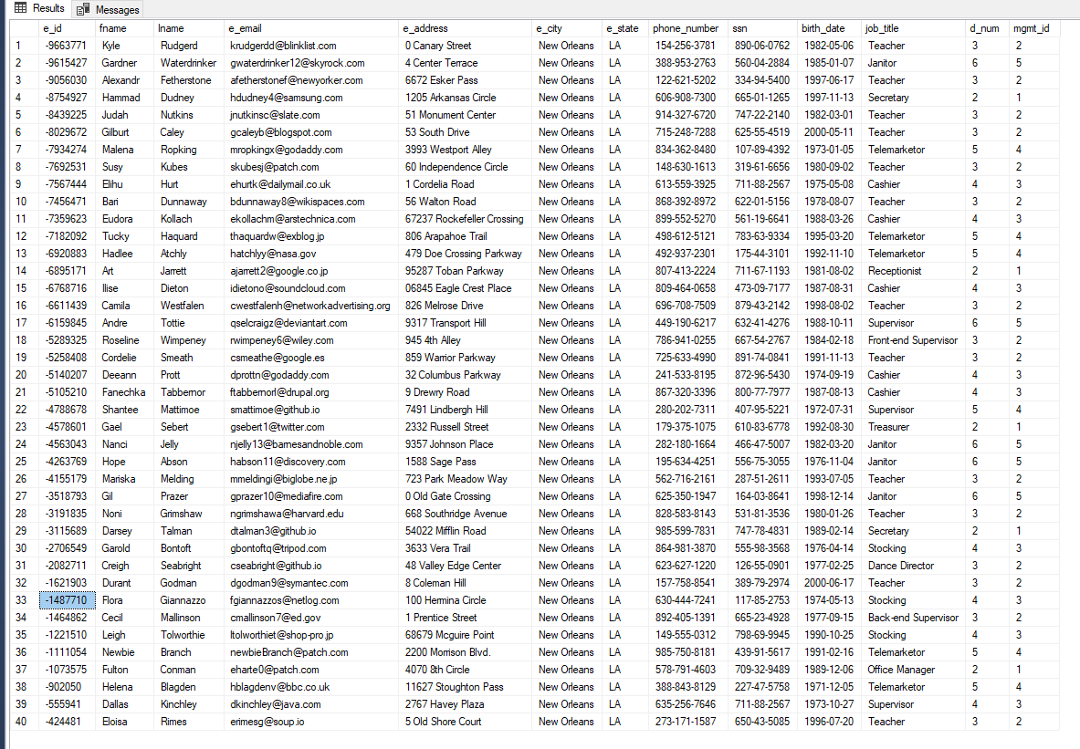
Query 4- Result (BEFORE)

Slide 17
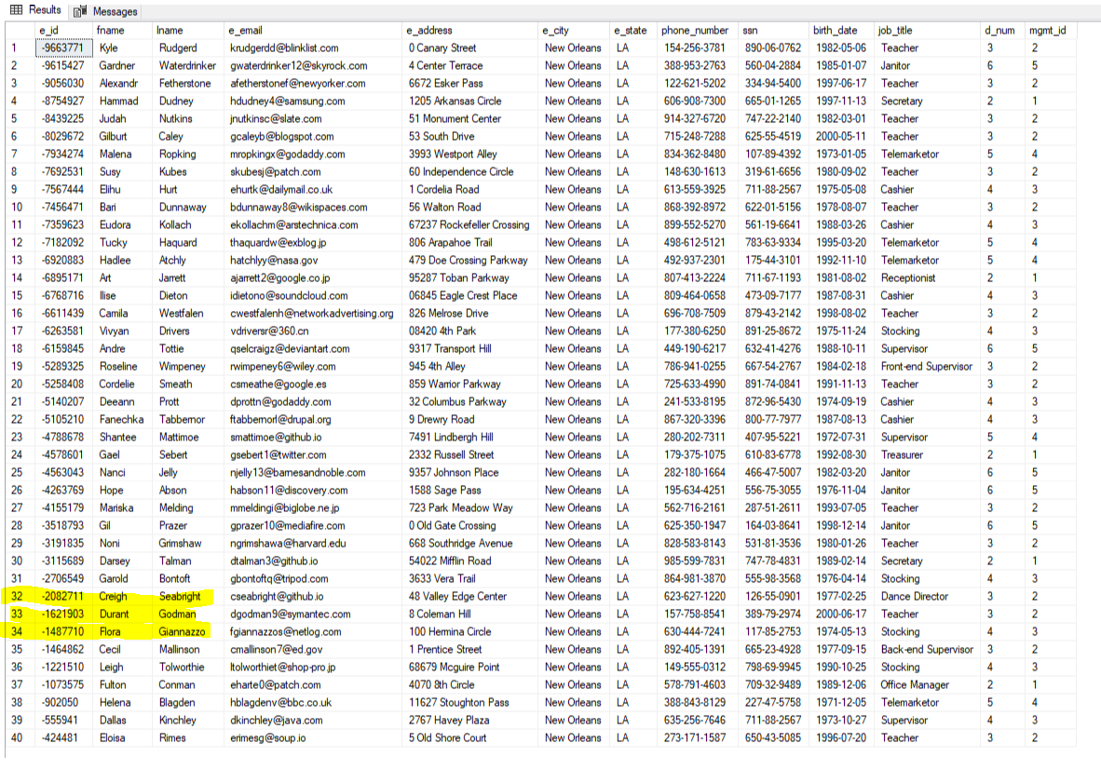
Query 4- Result (AFTER)

Slide 18
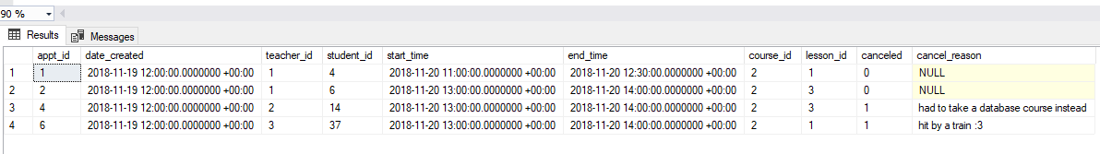
DML: Query 5- Query Data
AIM: Determine how many appointments were made for the Social Foundation course. (course_id = 2)
Query:
SELECT *
FROM APPOINTMENT
WHERE course_id = 2;

Slide 19
DML: Query 6- Sub-query WHERE
AIM: Find products that exist under the group name ‘accessories’
Query:
SELECT P.p_id, P.p_name, P.retail_price, P.sum_in_stock
FROM PRODUCT AS P
WHERE EXISTS (SELECT P.p_group_name, P.sum_in_stock
FROM PRODUCT
WHERE P.p_group_name = 'accessories' AND P.sum_in_stock >= 1
);

Slide 20
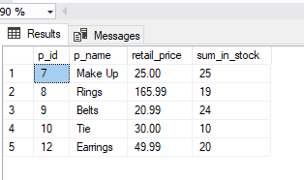
Query 6- Result

Slide 21
DML: Query 7- Sub-query FROM
AIM: Determine number of private lessons taken by the student, ordering them by date.
Query:
SELECT sprvlt_id, tcprvt, scheduled_priv_date
FROM (SELECT sprvlt_id, scheduled_priv_date, tcprvt
FROM STUD_PRIV_LESS_TAKEN
GROUP BY sprvlt_id, sprvlr_id, scheduled_priv_date, tcprvt) AS privTakenSummary
ORDER BY scheduled_priv_date;

Slide 22
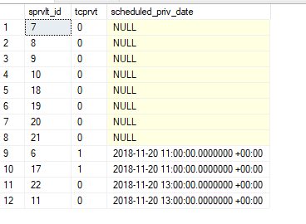
Query 7- Result

Slide 23
DML: Query 8- Sub-query SELECT
AIM: Determine total revenue per day from the store.
Query:
SELECT P.p_date, (SELECT SUM(total_price)
FROM PURCHASE AS PUR
WHERE PUR.p_id = P.p_id) AS RevenuePerDay
FROM PURCHASE AS P;

Slide 24
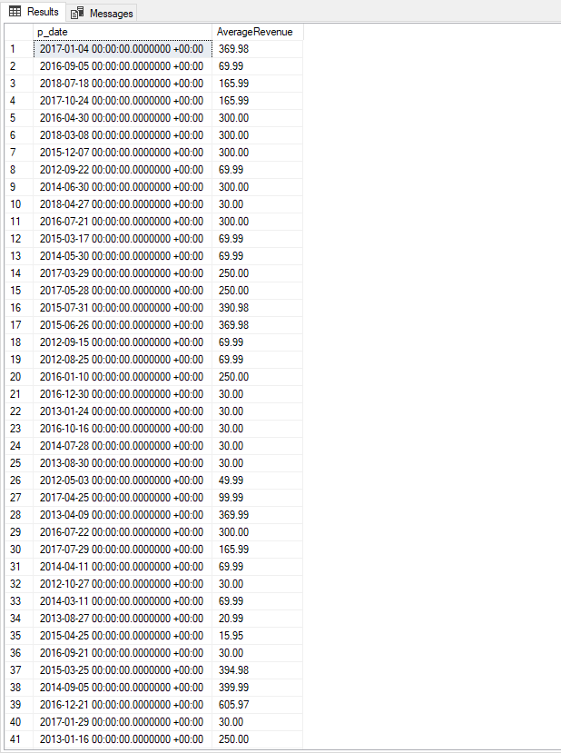
Query 8- Result

Slide 25
DML: Query 9- EXCEPT
AIM: Select all names, job titles, and management IDs in all for all employees except ‘Janitors’
Query:
SELECT E.e_id, E.fname, E.lname, E.job_title, E.d_num, E.mgmt_id
FROM EMPLOYEE AS E
EXCEPT
SELECT E.e_id, E.fname, E.lname, E.job_title, E.d_num, E.mgmt_id
FROM EMPLOYEE AS E
WHERE E.job_title = 'Janitor';

Slide 26
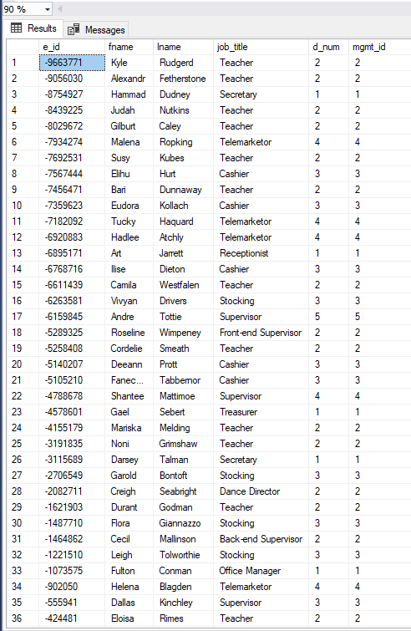
Query 9- Results

Slide 27
DML: Query 10- Query with ANY
AIM: Return rows in PRODUCT table where total number of items in stock is greater than 10
Query:
SELECT p_id, p_name, sum_in_stock
FROM PRODUCT
WHERE p_id = ANY (SELECT p_id FROM PRODUCT WHERE sum_in_stock > 10);

Slide 28
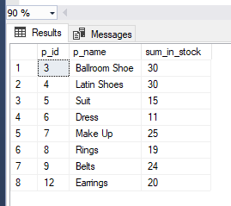
Query 10- Result

Slide 29
DML: Query 11- INNER-JOIN
AIM: Determine which vendors supply each product
Query:
SELECT P.p_id, P.p_name, V.v_id, V.v_name
FROM PRODUCT AS P
INNER JOIN VENDOR AS V ON P.vendor_id = V.v_id;

Slide 30
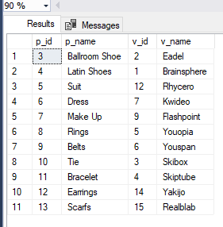
Query 11- Result

Slide 31
DML: Query 12- FULL OUTER JOIN
AIM: See all lessons that were booked and then determine which lessons were taken.
Query:
SELECT B.appt_id, B.course_id, B.lesson_id, T.course_id, T.lesson_id
FROM LESSON_BOOKED AS B
FULL OUTER JOIN LESSON_TAKEN AS T ON B.appt_id = T.appt_id
ORDER BY B.appt_id;

Slide 32
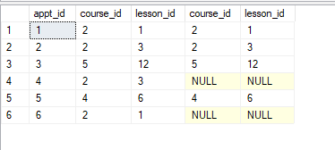
Query 12- Result

Slide 33
DML: Query 13- LEFT JOIN
AIM: See all products bought for a particular purchase
Query:
SELECT *
FROM PURCHASE AS P
LEFT JOIN PURCHASE_PRODUCT AS PP ON P.p_id = PP.purchase_id
ORDER BY P.p_id;

Slide 34
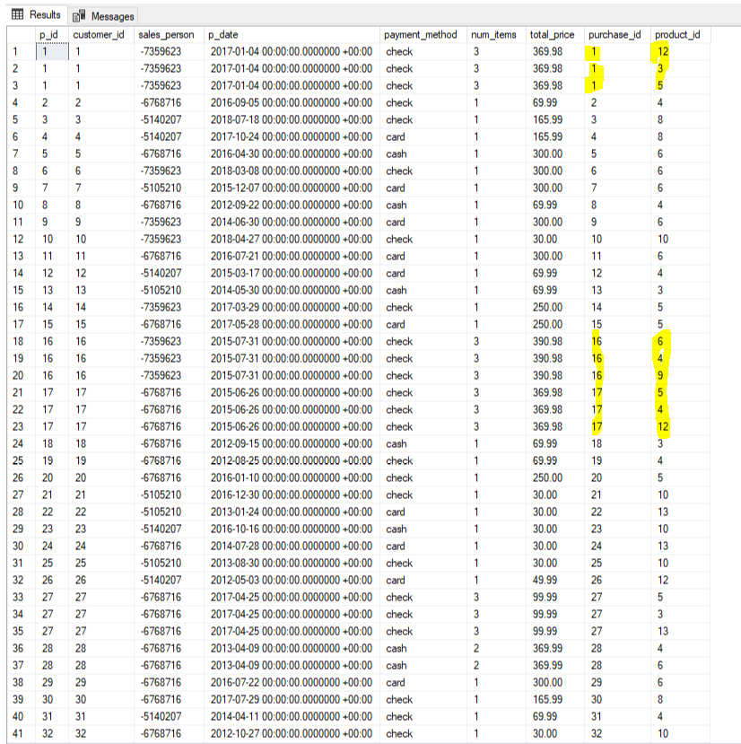
Query 13- Result

Slide 35
DML: Query 14- RIGHT JOIN
AIM: Get the first name, last name, and management ID of employees that are teachers.
Query:
SELECT T.t_id, E.e_id, E.fname, E.lname, E.mgmt_id
FROM EMPLOYEE AS E
RIGHT JOIN TEACHER AS T ON E.e_id = T.employee_id
ORDER BY T.t_id;

Slide 36
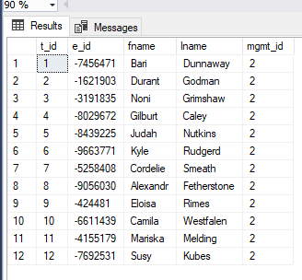
Query 14- Result

Slide 37
DML: Query 15- AGGRE GROUP BY & HAVING
AIM: Determine the total number of sales from each individual cashier
Query:
SELECT E.e_id, E.lname, COUNT(P.sales_person) AS num_of_sales
FROM PRUCHASE AS P
INNER JOIN EMPLOYEE AS E ON P.sales_person = E.e_id
GROUP BY E.e_id
HAVING COUNT(P.sales_person) > 1;

Slide 38
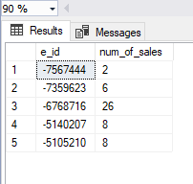
Query 15- Result

Slide 39
DML: Query 16 – AGGRE JOIN SUB
AIM: Determine number of employees in a particular department.
Query:
SELECT D.d_num, COUNT(E.d_num) AS total_employees
FROM DEPARTMENT AS D
FULL OUTER JOIN EMPLOYEE AS E ON D.d_num = E.d_num
WHERE EXISTS (SELECT E.d_num
FROM EMPLOYEE
WHERE E.d_num >= 2
)
GROUP BY D.d_num;

Slide 40
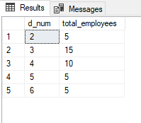
Query 16 - Result

Slide 41
DML: Query 17- WITH
AIM: Use a with query to shorten the employee table and see the department name they work for.
Query:
WITH short_employee
(e_id, lname, job_title, mgmt_id)
AS (SELECT e_id, lname, job_title, mgmt_id
FROM EMPLOYEE)
SELECT *
FROM short_employee AS SE
FULL OUTER JOIN DEPARTMENT AS D ON SE.mgmt_id = D.mgmt_id

Slide 42
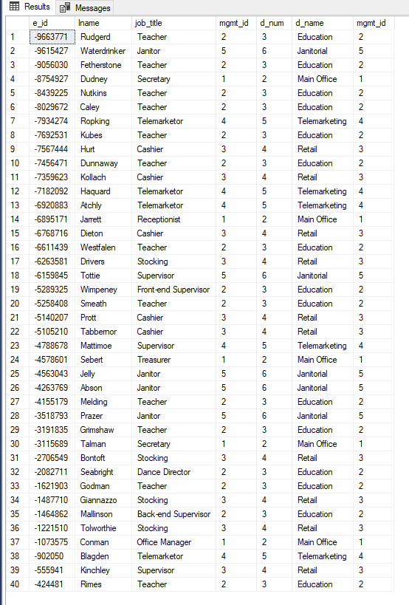
Query 17 - Result

Slide 43
ANALYSIS OF DATA
Upon inserting most of data into the database we found that for some of the attributes declared as PRIMARY KEYS with IDENTITY(1,1) that some row numbers would start counting at 2 or even 3 and on one occasion started at 94.
For example, in our DEPARTMENT table d_num starting at row 2 and went to row 6. However, there are only 5 departments.
Another anomaly found was that the attribute e_id in the EMPLOYEE table chopped off the initial 2 numbers in front of the dash. So, e_id values should have been in this format, “12-3456789”, but instead appear as “-3456789”

Slide 44
ANALYSIS OF DATA
For the IDENTITY anomalies we ended up using a function similar to (UPDATE TABLE SET column = column + x) to re-adjust the data to the appropriate values or modified the values in our data before inserting it in.
In other cases we chose to remove the IDENTITY keyword from the attribute.

