Slide 1
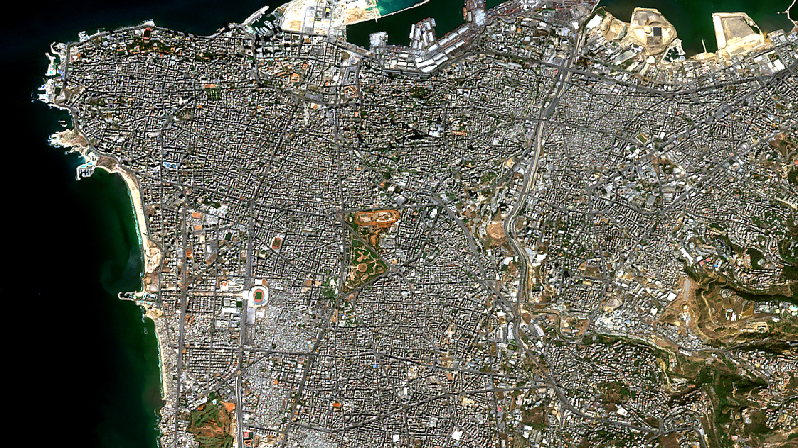
SMART INDIA HACKATHON 2026 · PS: SIH26227 · SPACE TECHNOLOGY · SOFTWARE · MINISTRY OF DEFENCE / INDIAN ARMY — DGIS
TEAM: Quantumcrew | SLIDE 01 / 06
01 — PROBLEM STATEMENT
SEMANTIC RETRIEVAL AND MULTI-TEMPORAL CHANGE ANALYSIS OF SATELLITE IMAGERY
“Finding a changed pixel is easy.
Knowing whether it matters is harder.”
OFFICIAL PROBLEM STATEMENT METADATA
Problem Statement ID: SIH26227
Ministry / Client: Ministry of Defence / Indian Army — DGIS
Theme: Space Technology
Category: Software
Team Name: Quantumcrew (Registered on portal)
Team ID: [Registered Team ID / SIH2026]
AUTHENTIC EARTH OBSERVATION: ESA Sentinel-2A Level-2A BOA Reflectance · 10m GSD · Maritime/Urban Basin
OPERATIONAL DEFENSE MANDATE
Analysts must find relevant satellite scenes and determine whether observed changes are persistent, meaningful, and supported by evidence.
• Real Analyst Intent: “Show me areas with newly built structures near a river corridor.”
• Offline Mandate: Zero cloud APIs, remote tracking, or network egress in defense enclaves.
CURRENT ANALYST WORKFLOW (STATUS QUO BOTTLENECKS)
01
Metadata
→
02
Coordinates
→
03
Scene Search
→
04
Comparison
→
05
Interpretation
CRITICAL DEFENSE FLAW: Naive pixel subtraction triggers severe false-alarm fatigue from seasonal crop phenology, moisture, and sun angle.
TERRAE — Earth Intelligence Satellite Investigation Console | Ministry of Defence / Indian Army — DGIS | SIH 2026 Submission Live Console: https://terrae-geospatial-intelligence.vercel.app

Slide 2
SMART INDIA HACKATHON 2026 · PS: SIH26227 · SPACE TECHNOLOGY · SOFTWARE · MINISTRY OF DEFENCE / INDIAN ARMY — DGIS
TEAM: Quantumcrew | SLIDE 02 / 06
02 — SOLUTION
FROM NATURAL-LANGUAGE QUERY TO EVIDENCE-BACKED INVESTIGATION
REAL-WORLD PROBLEM
Large satellite archives
+ multi-temporal imagery
+ multi-spectral data
SIX-STAGE INVESTIGATION WORKFLOW
PROBLEM ↔ TERRAE RESPONSE
MANUAL SEARCH ➔ SEMANTIC RETRIEVAL
RemoteCLIP embeddings query 50+ satellite tiles across archives
01 ASK
Natural Intent Query
↗
↘
SINGLE BEFORE/AFTER ➔ MULTI-TEMPORAL CONTEXT
T0 / TMID / T1 triplet stack suppresses seasonal phenology
06 DECIDE
Conservative Verdict
02 DISCOVER
RemoteCLIP + FAISS
WHY IT IS HARD
A difference may be caused by:
vegetation, moisture,
shadow, or atmosphere
PIXEL DIFFERENCE ➔ SPECTRAL + SPATIAL
NDVI, NDWI, NDBI indices combined with 8-conn spatial clusters
↑
TERRAE
SATELLITE
INVESTIGATION
↓
OPAQUE RESULT ➔ EVIDENCE CHAIN
Auditable spatial coherence, trajectory, and pixel breakdown
05 CHALLENGE
3-Date Trajectory Check
03 COMPARE
Calibrated Diff (τ=0.15)
FORCED DECISION ➔ SUPPORTED / REVIEW
Conservative decision rules; abstain routing on low confidence
OUR RESPONSE
TERRAE combines:
semantic retrieval + temporal analysis
+ spectral evidence + spatial topology
↖
↙
04 EXPLAIN
Spectral + Spatial Math
VERIFIED CASE 01 TELEMETRY:
• 7,549 px Changed (11.5%) | Spatial Coherence: 99.7%
• Built Support: 97.1% | Trajectory: LATE_ONSET
• System Verdict: ✔ SUPPORTED (High Coherence)
“NOT JUST CHANGE DETECTION. INVESTIGATION.”
Live Console: https://terrae-geospatial-intelligence.vercel.app | GitHub: https://github.com/PhantomCipher13/terrae-geospatial-intelligence | Report: REPORT.md
TERRAE — Earth Intelligence Satellite Investigation Console | Ministry of Defence / Indian Army — DGIS | SIH 2026 Submission Live Console: https://terrae-geospatial-intelligence.vercel.app

Slide 3
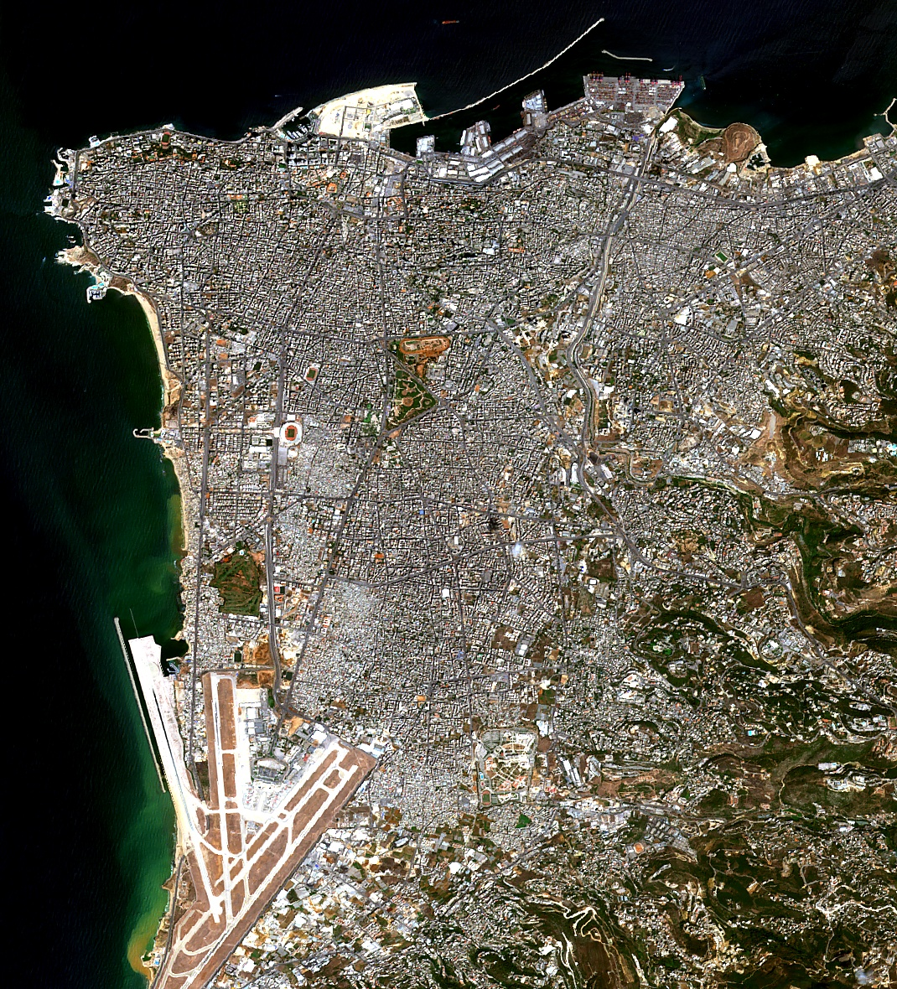
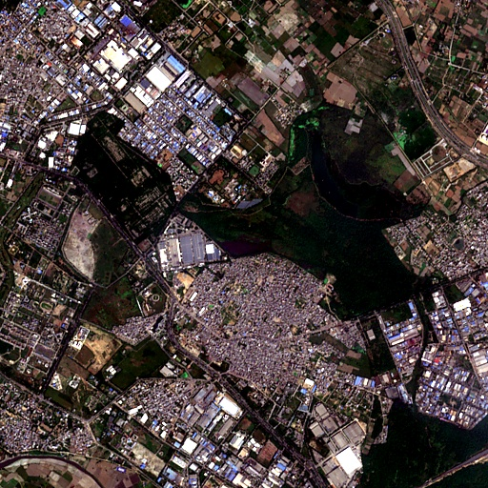
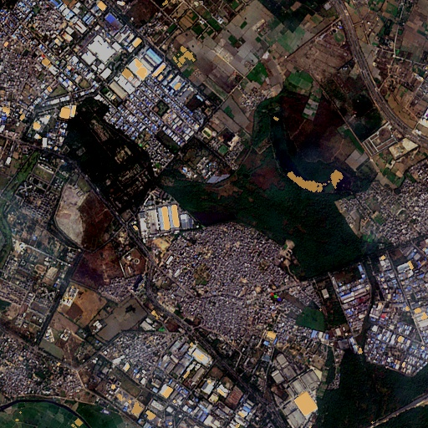
SMART INDIA HACKATHON 2026 · PS: SIH26227 · SPACE TECHNOLOGY · SOFTWARE · MINISTRY OF DEFENCE / INDIAN ARMY — DGIS
TEAM: Quantumcrew | SLIDE 03 / 06
03 — TECHNICAL APPROACH / METHODOLOGY & PROCESS OF IMPLEMENTATION
SYSTEM ARCHITECTURE & MULTI-STREAM EVIDENCE PIPELINE
METHODOLOGY LOOP
CORE SYSTEM PIPELINE (END-TO-END DATAFLOW)
TECHNOLOGIES USED
ASK · Natural Language
Parses operational intent
NATURAL LANGUAGE ➔ “new construction and buildings”
SEMANTIC RETRIEVAL
RemoteCLIP + FAISS
Vision-language cross-modal embeddings + CPU vector indexing
↓
REMOTECLIP ViT-B-32 ➔ 512-dim joint vision-language embedding
DISCOVER · RemoteCLIP + FAISS
512-dim joint cosine retrieval
↓
FAISS FlatIP ➔ Nearest satellite tile cosine scan (2.0 ms)
↓
GEOSPATIAL
Rasterio + NumPy + SciPy
GDAL bindings, surface reflectance math, 8-conn topology
COMPARE · T0 / TMID / T1
Multi-band spectral shift (τ=0.15)
SATELLITE TILE ➔ MGRS 43RGM / EPSG:32643 10m UTM Grid
↓
T0 / TMID / T1 ➔ Multi-date temporal observation stack
EXPLAIN · Spectral + Spatial
NDVI, NDWI & 8-conn topology
↓
TEMPORAL / VALIDATION
Sentinel-2 + OSCD + SQLite
10m BOA reflectance, MGRS grid, MECE trajectory classifier
SPECTRAL CHANGE ➔ B02, B03, B04, B08 differencing (τ = 0.15)
CHALLENGE · Temporal Evidence
MECE trajectory persistence
↓
SPATIAL COHERENCE ➔ 8-connected topology + NDVI / NDWI math
↓
DECIDE · Supported / Review
Auditable conservative verdict
TEMPORAL TRAJECTORY ➔ MECE persistence classification (5 states)
OFFLINE-FIRST
Python + Streamlit + Local Models
Air-gapped operation with zero external runtime calls
↓
CONSERVATIVE VERDICT ➔ SUPPORTED / REVIEW / ABSTAIN
TERRAE — Earth Intelligence Satellite Investigation Console | Ministry of Defence / Indian Army — DGIS | SIH 2026 Submission Live Console: https://terrae-geospatial-intelligence.vercel.app

Slide 4
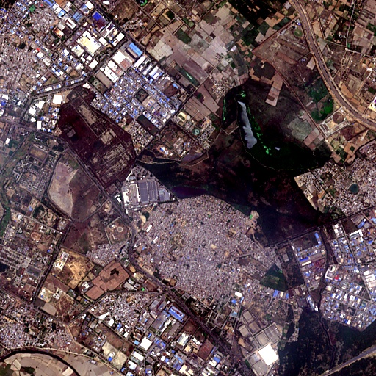
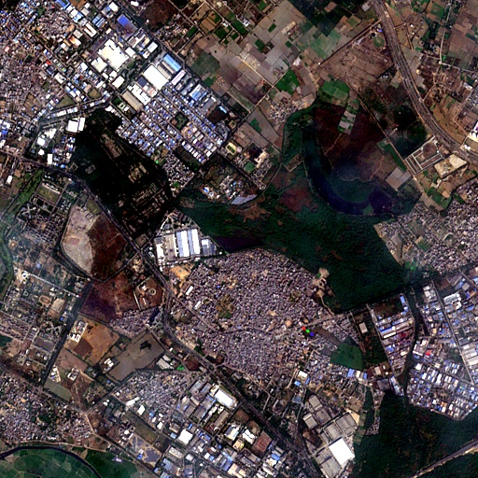
SMART INDIA HACKATHON 2026 · PS: SIH26227 · SPACE TECHNOLOGY · SOFTWARE · MINISTRY OF DEFENCE / INDIAN ARMY — DGIS
TEAM: Quantumcrew | SLIDE 04 / 06
04 — FEASIBILITY & VIABILITY
BUILT TO RUN LOCALLY. VALIDATED ON REAL SENTINEL-2.
FEASIBILITY
REAL SENTINEL-2 MULTI-DATE VALIDATION (MGRS 43RGM · NCR INDIA)
VIABILITY
LOCAL AI
RemoteCLIP + FAISS
Runs on standard CPU
8–16 GB RAM footprint
OFFLINE-FIRST
Air-gapped operation; zero cloud egress
➔
➔
ANALYST-IN-LOOP
Review ambiguous evidence; no black box
REAL DATA
Sentinel-2A · 10m
Level-2A BOA Surface
B02, B03, B04, B08
T0 · 19 MAY 2023
Pre-Monsoon Dry Baseline
TMID · 06 OCT 2023
Post-Monsoon Green Peak
T1 · 05 DEC 2023
Winter Post-Harvest
MODULAR
Decoupled index, sensor & persistence code
EMPIRICAL OBSERVATION METRICS (262,144 VALID PIXELS · 10M GSD)
0.7% (T0 → TMID) | 0.2% (TMID → T1) | 1.0% (T0 → T1)
98.75% STABLE VERDICT: REVIEW (Ambiguous phenology routed to human analyst)
Attribution Support: Built 51.1% | Vegetation 24.7% | Seasonal 19.9% | Unresolved 3.1%
DETERMINISTIC
Threshold τ = 0.15
NDVI & NDWI math
Zero hallucination
EXTENSIBLE
Supports SAR, thermal & dense time series
[135 / 135 TESTS PASSING] [ZERO RUNTIME EXTERNAL CALLS] [262,144 VALID PIXELS] [DETERMINISTIC τ = 0.15]
TERRAE — Earth Intelligence Satellite Investigation Console | Ministry of Defence / Indian Army — DGIS | SIH 2026 Submission Live Console: https://terrae-geospatial-intelligence.vercel.app

Slide 5
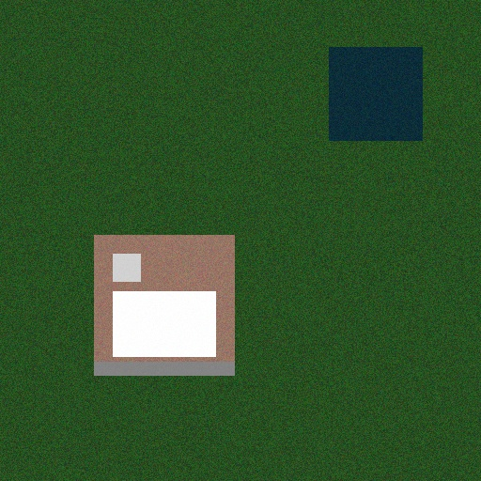
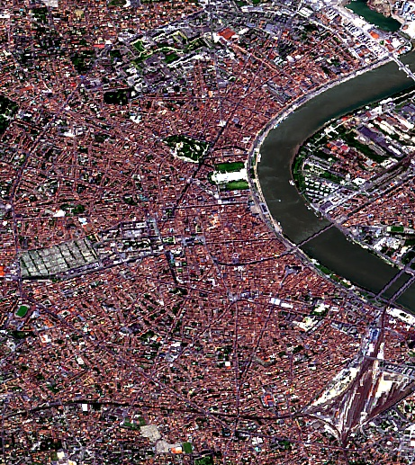
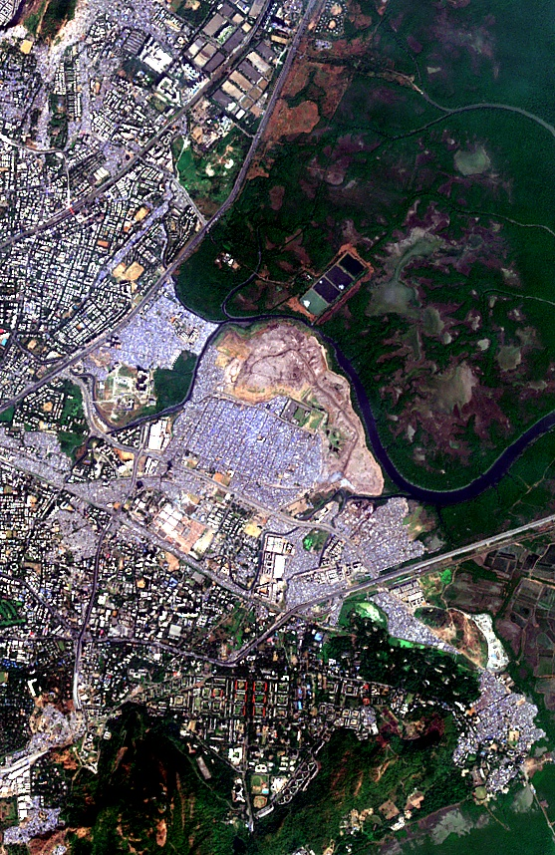
SMART INDIA HACKATHON 2026 · PS: SIH26227 · SPACE TECHNOLOGY · SOFTWARE · MINISTRY OF DEFENCE / INDIAN ARMY — DGIS
TEAM: Quantumcrew | SLIDE 05 / 06
05 — IMPACT & BENEFITS
TURNING SATELLITE ARCHIVES INTO AN INVESTIGATION WORKBENCH
SATELLITE ARCHIVE
Sentinel-2 & SAR tiles
➔
SEMANTIC DISCOVERY
RemoteCLIP prompt
➔
RELEVANT SCENE
Ranked candidates
➔
TEMPORAL COMPARISON
Calibrated change
➔
EVIDENCE REVIEW
Spectral attribution
➔
ANALYST DECISION
Actionable verdict
01 / INFRASTRUCTURE MONITORING
Forward Outpost, Tarmac & Fortified Perimeter Detection
Quickly discovers clandestine military construction, border tarmac paving, and fortified forward compounds. Natural-language intent isolates candidate tiles across thousands of sq km without coordinate guessing.
02 / STRATEGIC SITE DISCOVERY
Cross-Theater Facility Pattern Matching
Query the RemoteCLIP FAISS vector index to discover geographically separated candidate sites sharing identical visual-semantic patterns across the theater, cutting manual catalog triage by hours.
03 / ROAD / TERRAIN CORRIDOR CHANGE
Frontier Logistics Tracks, Earth Clearings & Bridgeheads
Tracks emerging logistics road corridors and supply clearings across rugged terrain. Spatial coherence analysis confirms contiguous linear infrastructure while suppressing single-pixel seasonal slope washouts.
04 / VEGETATION / WATER INTERPRETATION
Defending Against False-Alarm Alert Fatigue
Enforces 3-date MECE persistence trajectories to distinguish agricultural crop cycles (monsoon greening to harvest senescence) from permanent land-cover conversion, protecting command staff from false alarms.
CORE DEFENSE PRINCIPLES: [OFFLINE] [AUDITABLE] [CONSERVATIVE]
“The goal is not to make every result positive. The goal is to make the result explainable.”
TERRAE — Earth Intelligence Satellite Investigation Console | Ministry of Defence / Indian Army — DGIS | SIH 2026 Submission Live Console: https://terrae-geospatial-intelligence.vercel.app

Slide 6
SMART INDIA HACKATHON 2026 · PS: SIH26227 · SPACE TECHNOLOGY · SOFTWARE · MINISTRY OF DEFENCE / INDIAN ARMY — DGIS
TEAM: Quantumcrew | SLIDE 06 / 06
06 — RESEARCH & REFERENCES
EMPIRICAL BENCHMARKS, RESEARCH FOUNDATIONS & PROJECT ACCESS
RESEARCH FOUNDATION FLOW
VALIDATED EMPIRICAL EVIDENCE
PROJECT ACCESS & REFERENCES
REMOTECLIP (Chen et al., IEEE TGRS 2024)
Vision-language foundation model for remote sensing retrieval
1. REAL SENTINEL-2 (MGRS 43RGM · NCR INDIA)
• Analysis Tile: 512×512 (262,144 valid pixels · 10m GSD)
• Observations: T0 (19 May 2023), TMID (06 Oct 2023), T1 (05 Dec 2023)
• Change Fractions: T0→TMID: 0.7% | TMID→T1: 0.2% | T0→T1: 1.0%
• Trajectory Distribution: STABLE = 98.75% (258,869 px)
• Attribution: Built 51.1% | Veg 24.7% | Seasonal 19.9% | Unresolved 3.1%
• System Verdict: REVIEW (Conservative routing on 1.0% change)
PROJECT ACCESS
• Live Console: terrae-geospatial-intelligence.vercel.app
• GitHub Repository: github.com/PhantomCipher13/terrae...
• Technical Report: REPORT.md (6-Part Scientific Dossier)
• Automated Tests: 135 / 135 Tests Passing
• Team: Quantumcrew (SIH26227)
↓
SENTINEL-2 (ESA Copernicus 10m L2A)
Bottom-Of-Atmosphere calibrated multispectral surface reflectance
↓
OSCD BENCHMARK (Daudt et al., IEEE IGARSS 2018)
Onera Satellite Change Detection standardized ground truth
2. OSCD BENCHMARK — 5-PAIR VALIDATION SUBSET
• Pairs: Aguas Claras, Beirut, Bordeaux, Cupertino, Mumbai
• Valid Pixels Evaluated: 3,025,938 valid pixels | Fixed τ = 0.15
QUANTITATIVE BENCHMARK METRICS:
• Micro Aggregate: Precision 57.55% | Recall 9.72% | F1 0.1663 | IoU 0.0907
• Macro Average: Precision 52.22% | Recall 7.84% | F1 0.1267 | IoU 0.0692
Class Imbalance Note: Accuracy (97.90%) is dominated by 97.64% unchanged ground truth. Low recall reflects conservative noise suppression.
COMPACT REFERENCES
[1] RemoteCLIP: Chen et al., IEEE TGRS 2024.
[2] Sentinel-2: ESA Level-2A ATBD (10m BOA).
[3] OSCD: Daudt et al., IEEE IGARSS 2018.
[4] NDVI: Rouse et al., NASA SP-351, 1974.
[5] NDWI: McFeeters, Int. J. Remote Sens., 1996.
↓
NDVI / NDWI (Rouse et al. / McFeeters)
Biophysical normalized difference band ratio indices
↓
TERRAE CONSOLE (Quantumcrew SIH26227)
Evidence-based satellite investigation workstation
“INVESTIGATE THE CHANGE. FOLLOW THE EVIDENCE. KNOW WHEN TO REVIEW.”
TERRAE — Earth Intelligence Satellite Investigation Console | Ministry of Defence / Indian Army — DGIS | SIH 2026 Submission Live Console: https://terrae-geospatial-intelligence.vercel.app

