Slide 1

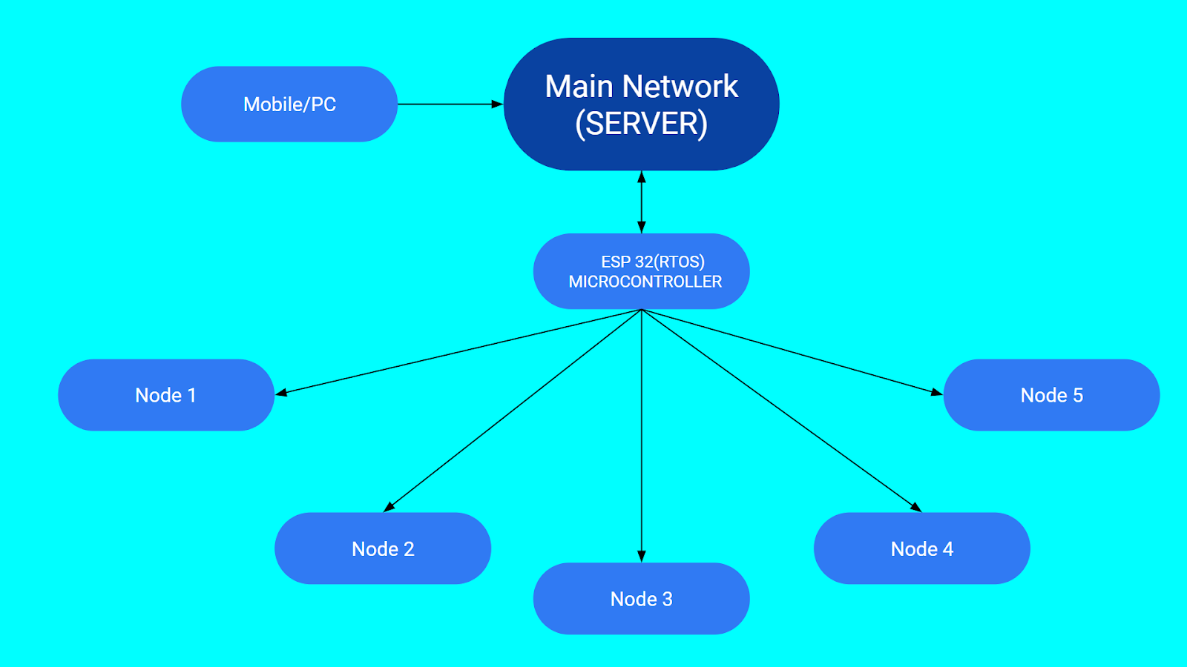
RV College of Engineering
Home Automation Using RTOS.
Rishabh Kumar Lal(1RV22CS159), Sankalpa BR
(1RV22CS178), Risheek S(1RV22CS160).
Go, change the world
Department of Computer Science and Engineering
RV College of Engineering, Bangalore – 560059, INDIA
Problem Definition
The rising demand for smart home solutions drives the development of home automation systems, requiring efficient management of tasks, resources, and communication. Real-Time Operating Systems (RTOS) like Free RTOS offer precise timing control for seamless operation.
Relevance to operating system
Real-time scheduling: The project requires real-time scheduling to ensure that the node and the main server communicate efficiently and that the devices are controlled in a timely manner. This aligns with the real-time scheduling concepts learned in the OS course, such as priority-based scheduling and time-slicing.
Resource management: The project requires efficient resource management to ensure that the system operates smoothly and that the devices are controlled without consuming excessive resources. This aligns with the resource management concepts learned in the OS course, such as memory management and process management.
Inter-task communication: The project requires inter-task communication to ensure that the nodes and the main server can exchange data and control commands. This aligns with the inter-task communication concepts learned in the OS course, such as message passing and shared memory.
IoT and smart home devices: The project involves the development of a complex embedded system that interacts with IoT devices and smart home appliances. This aligns with the IoT and smart home devices concepts learned in the OS course, such as network communication and device integration.
System calls used
Free RTOS: A real-time operating system kernel for microcontrollers, providing task scheduling, inter-task communication, and synchronization primitives, enabling developers to create responsive and efficient embedded applications.
Arduino IDE: An integrated development environment tailored for Arduino-compatible boards, simplifying the process of writing, compiling, and uploading code to microcontroller-based projects, fostering rapid prototyping and development.
MQTT Protocol: A lightweight publish-subscribe messaging protocol widely used in IoT applications, facilitating communication between devices and servers with minimal overhead, ensuring efficient data exchange and scalable network architectures.
ESP32: A versatile microcontroller chip offering Wi-Fi and Bluetooth connectivity, alongside a rich set of peripherals and processing power, making it suitable for a wide range of IoT and embedded projects.
Applications
•Energy efficiency: The home automation system can be designed to optimize energy usage by controlling the lighting, heating, and cooling systems based on occupancy, time of day, and weather conditions.
•Security: The home automation system can be integrated with security cameras, motion sensors, and door locks to provide enhanced security and surveillance
•Convenience: The home automation system can provide users with a seamless and intuitive experience by allowing them to control their devices through voice assistants, mobile applications, and web services.
Conclusion:
The implementation of a home automation system with an RTOS marks a significant advancement, efficiently managing tasks, resources, and communication. Utilizing FreeRTOS enables seamless interaction between nodes and a central server, enhancing user experience and comfort. Scalability and modularity ensure adaptability to evolving needs, paving the way for further advancements in smart home technology.
Reference:
1.Aniket R. Yeole, Sapana M. Bramhankar, Arjun Gaikwad, Abhijeet Bansod, Atul Borade, “RTOS Based Home Automation System UsingATMEGA”, International Journal of Innovative Research in Computer and Communication Engineering (Research and Reviews)-Vol. 3, Iss: 2, pp 910-915.
2.Syed Anwaarullah, S. V. Altaf, “RTOS based Home Automation System using Android” , 01 Jan 2013.
3."FreeRTOS Tutorials" on Udemy.
Guide Information: Ms. Jyoti Shetty, Dept of Computer Science and Engineering, RV College of Engineering.
Presented by: Rishabh Kumar Lal(1RV22CS159),
Sankalpa BR (1RV22CS178),
Risheek S(1RV22CS160).

