Slide 1


http://www.briansimulator.org
Bertrand Fontaine
Albert Einstein college of medicine, NY
Bertrand.fontaine@einstein.yu.edu
Notes:
* Brian is a simulator for spiking neural networks in Python
1

Slide 2
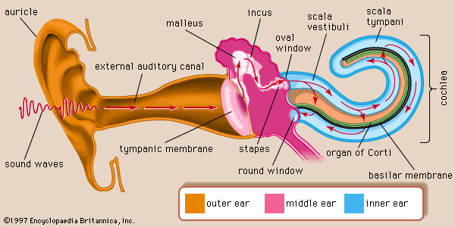
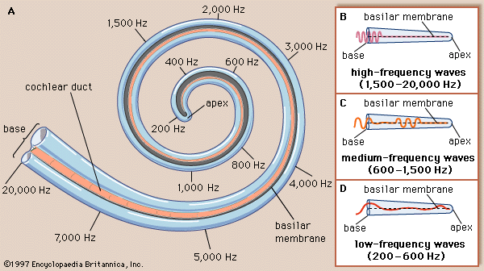
Peripheral auditory system
Sound makes the tympanic membrane vibrate
Middle ear matches impedance between air and fluid in cochlea
Different frequencies make the basilar membrane vibrate at different positions -> frequency analyzer
Hair cell vibrate with the basilar membrane and auditory nerve discharge
Source: http://www.ifd.mavt.ethz.ch/education/student_projects/edom_Hopf

Slide 3
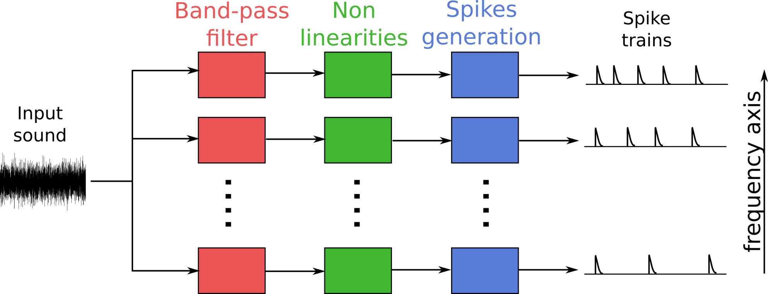
Simple cochlear model
Band-pass filter at different frequencies
Non-linearities (compression, halve-wave rectification…)
Spike generation (Poisson process, LIF neuron…)

Slide 4
Brian hears
Vectorization of frequency channels
Buffering
Python, C, or GPU
Library of complex cochlear and auditory nerve models
Head related transfer function
Modular approach: easy to build new complex model
Easy to interface with Brian

Slide 5
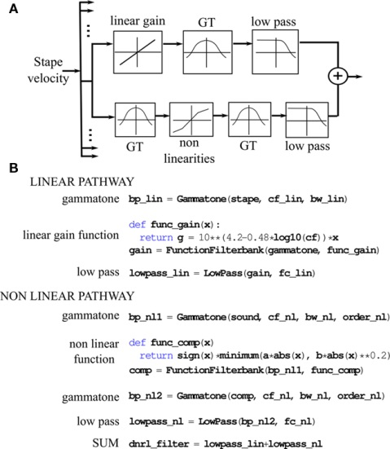
Complex model

Slide 6
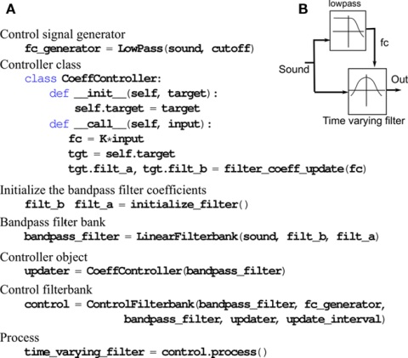
Control filterbank

Slide 7
References
Fontaine B, Goodman DFM, Benichoux V and Brette R (2011) Brian hears: online auditory processing using vectorization over channels. Front. Neuroinform. 5:9. doi: 10.3389/fninf.2011.00009
http://www.briansimulator.org/docs/hears.html
Brian/examples/hears

