Slide 1


Compartmental modeling
http://www.briansimulator.org
Romain Brette
Ecole Normale Supérieure, Paris
romain.brette@ens.fr
Notes:
* Brian is a simulator for spiking neural networks in Python
1

Slide 2

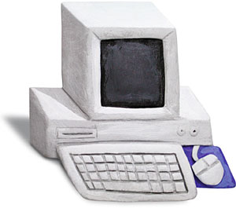
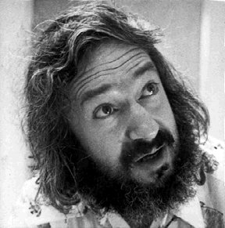
Why for compartmental modeling?
“A simulator should not only save the time of processors, but also the time of scientists”
scientist
computer
Drawbacks of current options:
1) Writing the code takes time
2) Not very flexible (or, writing something new is complicated)
3) Code is often difficult to read and split over many files in different languages

Slide 3
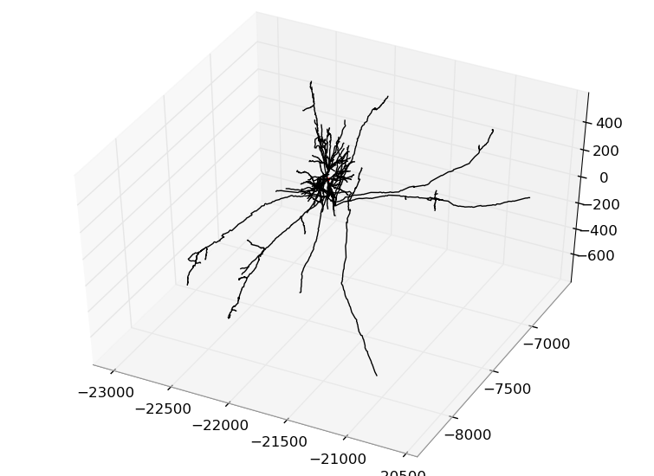
Compartmental modeling in
This is experimental and unfinished!
from brian.experimental.morphology import *
mymorph=Morphology('pyramidalL5.swc')
eqs='''
Im=gl*(El-v)+gNa*m**3*h*(ENa-v) : amp/cm**2 # transmembrane current
gNa : siemens/cm**2 # spatially distributed conductance
dm/dt=(minf-m)/tauinf : 1 # etc
''‘
neuron=SpatialNeuron(model=eqs,morphology=mymorph,
cm=0.9*uF/cm**2,Ri=150*ohm/cm)
initial_segment=neuron.axon[0*um:100*um]
initial_segment.gNa=linspace(0*nS/cm**2,3000*nS/cm**2,len(initial_segment))

Slide 4
Morphology
morpho=Soma(30*um)
morpho.dendrite=Cylinder(diameter=2*um,length=3*um,n=10)
morpho.dendrite.L=Cylinder(diameter=1*um,length=3*um,n=10)
morpho.dendrite.R=Cylinder(diameter=1*um,length=3*um,n=10)
morpho.dendrite.LL=Cylinder(diameter=1*um,length=3*um,n=10)
morpho=Morphology('pyramidalL5.swc')
morpho.plot()

Slide 5
Initialization
eqs=’’’Im=gL*(EL-v)+I+gNa*m*(ENa-v) : amp/cm**2
I : amp/cm**2
gNa : siemens/cm**2
...’’’
neuron=SpatialNeuron(model=eqs,morphology=morpho,
cm=0.9*uF/cm**2,Ri=150*ohm/cm)
neuron.I=0*amp/cm**2
neuron.dendrite.gNa[20:]=100*gL
neuron.dendrite[0*um:50*um].gNa=1e-3*siemens/cm**2
neuron.I[0]=0,05*nA/neuron.area[0]

Slide 6
Future work
Point currents and synapses
Better monitoring
Speed! (code generation)
Movies?
What else?

Slide 7
Interactive session!
Possibilities:
The Hodgkin-Huxley model
A passive cable
A bipolar neuron

